Slide 1
Conservation of Current is Universal and Exact
in three slides
Bob Eisenberg
January 11, 2018
Department of Applied Mathematics
Illinois Institute of Technology Chicago
and
Department of Physiology and Biophysics
Rush University, Chicago

Slide 2

Conservation of Current is Exact and Universal
$$div \left( J\left(x,t\right)+ε_{0}\frac{∂E\left(x,t\right)}{∂t} \right)=0$$
Current
even though
Physics of Charge Flow
Varies Profoundly
How can that possibly be?

Slide 3
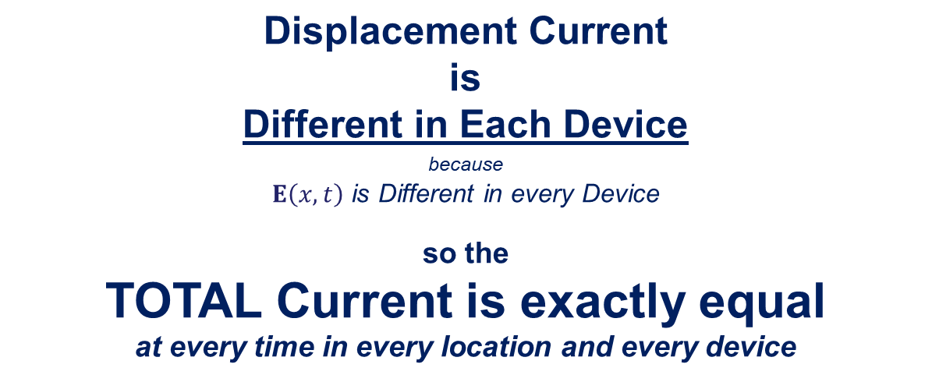

$$div \left(J\left(x,t\right)+ε_{0}\frac{∂E\left(x,t\right)}{∂t}\right)=0$$
Current
Device 1
Device 2
$$\text{Displacement} \text{Current}$$
is
Different in Each Device
because
$E\left(x,t\right)$ is Different in every Device
so the
TOTAL Current is exactly equal
at every time in every location and every device
Total Current = Displacement Current + Device Current

Slide 4
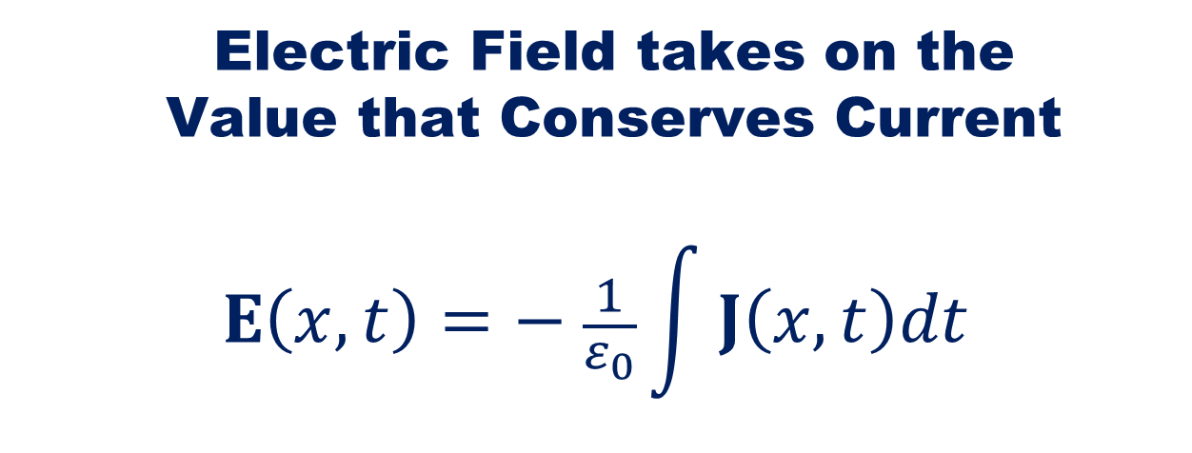
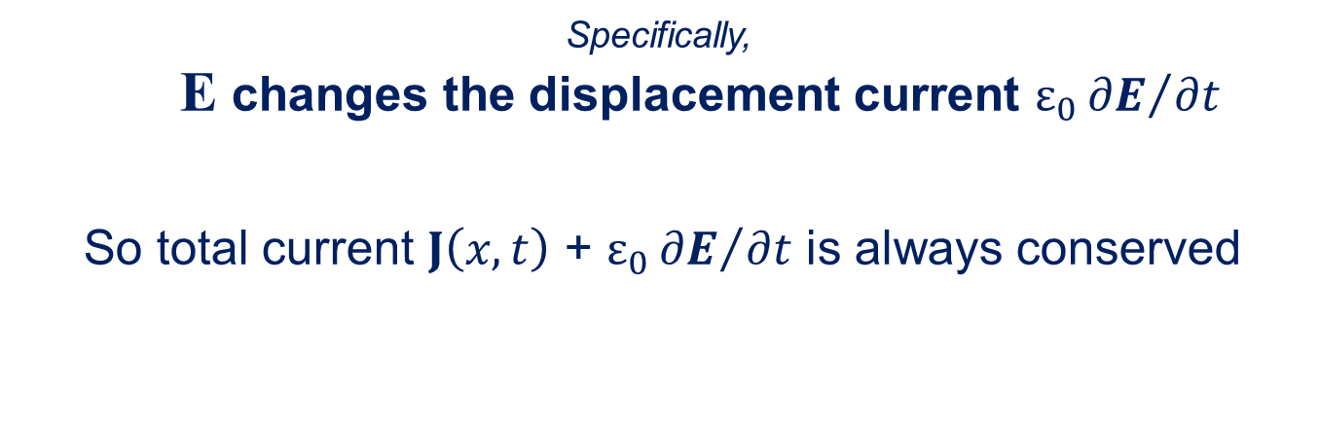
Electric Field takes on the
Value that Conserves Current
$$E\left(x,t\right)=− \frac{1}{ε_{0}}\int{J\left(x,t\right)dt}$$
Specifically,
E changes the displacement current ${\text{ε}}_{0}{∂E}/{∂t}$
So total current $J\left(x,t\right)$ + ${\text{ε}}_{0}{∂E}/{∂t}$ is always conserved
(that Maxwell called the polarization of the vacuum)
Details and PROOF
including quantum mechanics at
https://arxiv.org/abs/1609.09175

