Slide 1
Bob Eisenberg
Penn State August 2016
Electricity is Different
‘Charge’ is an Abstraction
with
VERY different Physics
in different systems

Slide 2
Maxwell Equations
as written by Heaviside, using Gibbs notation
Displacement Current
Everywhere!

Slide 3
The Electric Field is Strong
If you were standing at arm’s length from someone and each of you had
One percent more electrons than protons,
the force
would lift the
Entire Earth!
slight paraphrase of third paragraph, p. 1-1 of
Feynman, R. P., R. B. Leighton, and M. Sands. 1963. The Feynman: Lectures on Physics, Mainly Electromagnetism and Matter. New York: Addison-Wesley Publishing Co.,
also at http://www.feynmanlectures.caltech.edu/II_toc.html.

Slide 4
Continuity of Current is Exact no matter what carries the current
Electricity is Different
even though
Physics of Charge Flow
Varies Profoundly
even Creating Plasmas!
‘Charge’ is an Abstraction
with
VERY different Physics
in different systems

Slide 5
Density and Concentration Fields
are
Weak
One percent change in density does almost nothing
The Electric Field is Strong
One percent change in charge
lifts the Earth,

Slide 6
Generalized Current
is
Conserved
Maxwell Equation
Displacement Current
Everywhere!
Vector Identity
Conservation law
Generalized Current

Slide 7
Continuity of Current is Exact no matter what carries the current
Maxwell Equations are Special
even though
Physics of Charge Flow
Varies Profoundly
even Creating Plasmas!
‘Charge’ is an Abstraction
with
VERY different Physics
in different systems

Slide 8
Mathematics of Continuity
in Maxwell equations can
Create New Kind of Physics,
New Kind of Charge
When we unplug a computer power supply,
we often
CREATE
SPARKS,
i.e., a PLASMA,
a NEW KIND
of current flow
Pop!

Slide 9
Physics of Charge Flow
Varies Profoundly
But conservation of current is exact

Slide 10

Parameterization is not Possible
under more than one condition
because
Electric Field is Global
SPARKS
Pop!
*speaking loosely

Slide 11
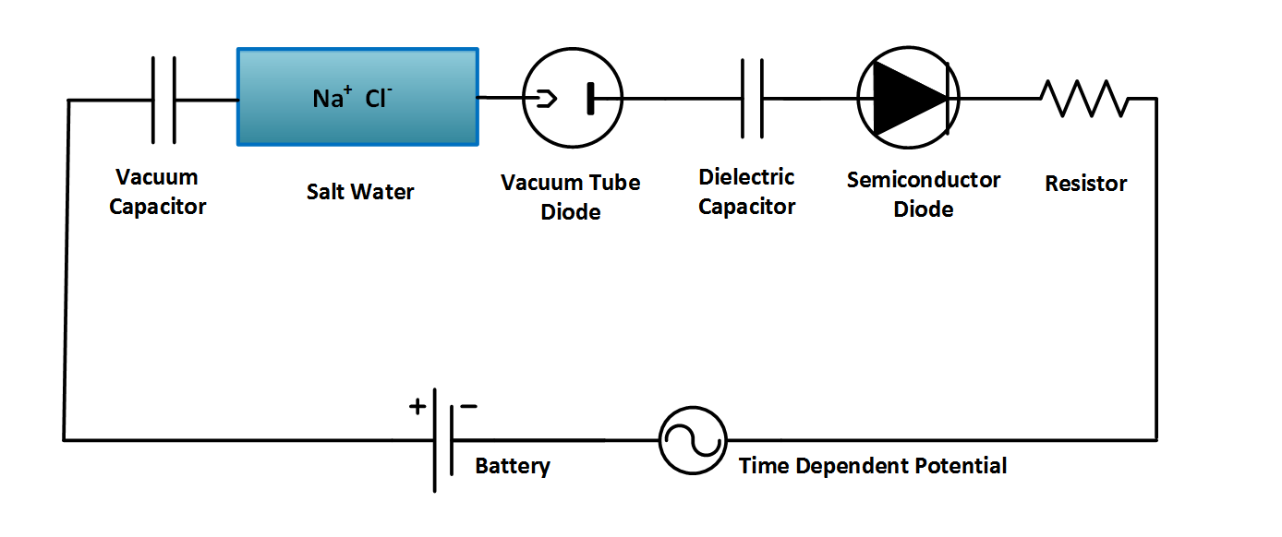
but Continuity of Current is Exact
No matter what carries the current!
‘Charge’ is an Abstraction
with different Physics
in different systems
Ag AgCl
Ag AgCl
D = permittivity × E

Slide 13
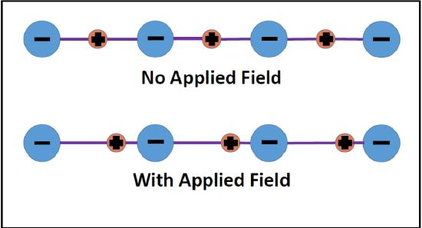
Electrodynamics and
Ions in Chemistry
Applied Electric Field ZERO
Applied Electric Field
NOT ZERO

Slide 14
How can this be?
Chemistry
is about
Chemicals
not signals

Slide 15
Law of Mass Action
is how chemists have described chemicals,
not flows
k is constant
[ A] means the activity or approximately the concentration of species A, i.e., the number density of A

Slide 16
‘Current-in’
does not equal
‘Current-out’
in Rate Models
if rate constants are independent
and
Currents are Uncorrelated

Slide 17
Correlation
between currents
is in fact
ALWAYS
0.999 999 999 999 999 999
because
Continuity of Current is Exact
Kirchoff Continuity of Current Law
including displacement current
is another form of Maxwell’s Equations
Heras, J.A.: Am J Phys 75: 652 (2007); Eur J Phys 30: 845 (2009); Am J Ph79: 409 (2011)

Slide 18
More specifically
In general
The discussion assumes the reactants A, B, …. are at different spatial locations.
The discussion assumes reactants are charged,
as they almost always are with fixed and/or permanent dipole charges

Slide 19
Engineering
is about
Signal Flow
not chemicals

Slide 20
Maxwell’s Equations
Kirchoff’s Current Law
compute
Signals
from Conservation of Charge
and
Continuity of Current,
including displacement current

Slide 21
Law of Mass Action
is about
Conservation of Mass and Matter
It is not about conservation of charge
[X] means the concentration, really activity of species Z, i.e., concentration is the number density

Slide 22
[X] means the concentration, really activity of species Z, i.e., concentration is the number density

Slide 23
Kirchoff Current Law
and
Maxwell Equations
are nearly the same thing
Bhat & Osting (2011). IEEE Trans Antennas and Propagation 59: 3772-3778
Heras (2007) American Journal of Physics 75: 652-657
Heras (2011) American Journal of Physics 79: 409
Itzykson & Zuber Quantum Field Theory (1990) p. 10

Slide 24
Parameterization is not Possible
under more than one condition
Rate constants chosen at one boundary charge or one potential
cannot work for different charges or potentials
Currents in Rate Models
are
Independent of Charge and Potential
but
in the real world
Currents depend on Charge and Potential

Slide 26
Physical Chemists are Frustrated by Real Solutions

Slide 27
All of Biology occurs in Salt Solutions
of definite composition and concentration
and that matters!
Salt Water is the Liquid of Life
Pure H₂O is toxic to cells and molecules!
Salt Water is a Complex Fluid
Main Ions are Hard Spheres, close enough
Sodium Na⁺ Potassium K⁺ Calcium Ca²⁺ Chloride Cl⁻
K⁺
Na⁺
Ca⁺⁺
Cl⁻
3 Å

Slide 28
Central Result of Physical Chemistry
Ions
in a solution are a
Highly Compressible Plasma
although the
Solution is Incompressible
Free energy of an ionic solution is mostly determined by the
Number density of the ions.
Density varies from 10⁻¹¹ to 10¹M
in typical biological system of proteins, nucleic acids, and channels.
Learned from Doug Henderson, J.-P. Hansen, Stuart Rice, among others…Thanks!

Slide 29
Electrolytes are Complex Fluids
Treating a
Complex Fluid
as if it were a
Simple Fluid
will produce
Elusive Results

Slide 30
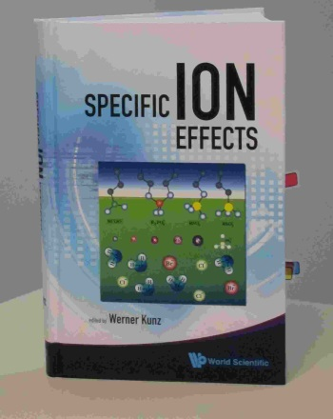
It is not surprising that
Inconsistent Treatments
of ionic solutions
have been so
Unsuccessful
despite more than a century of work by fine scientists and mathematicians
Werner Kunz:
“It is still a fact that over the last decades,
it was easier to fly to the moon
than to describe the
free energy of even the simplest salt solutions
beyond a concentration of 0.1M or so.”
Kunz, W. "Specific Ion Effects"
World Scientific Singapore, 2009; p 11.

Slide 31

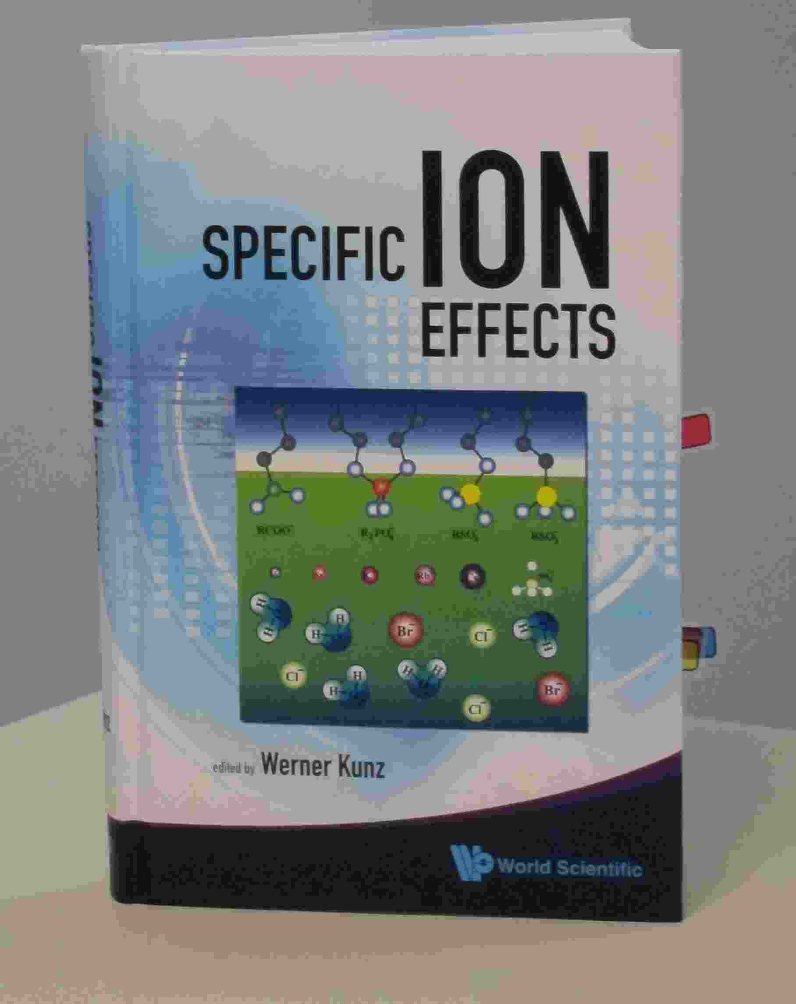
Werner Kunz
“It is still a fact that over the last decades,
it was easier to fly to the moon
than to describe the
free energy
of even the simplest salt solutions
beyond a concentration of 0.1M or so.”
Kunz, W. "Specific Ion Effects"
World Scientific Singapore, 2009; p 11.

Slide 32
The classical text of Robinson and Stokes
(not otherwise noted for its emotional content) gives a glimpse of these feelings when it says
“In regard to concentrated solutions, many workers adopt a counsel of despair, confining their interest to concentrations below about 0.02 M, ... ” p. 302 Electrolyte Solutions (1959) Butterworths , also Dover (2002)

Slide 33
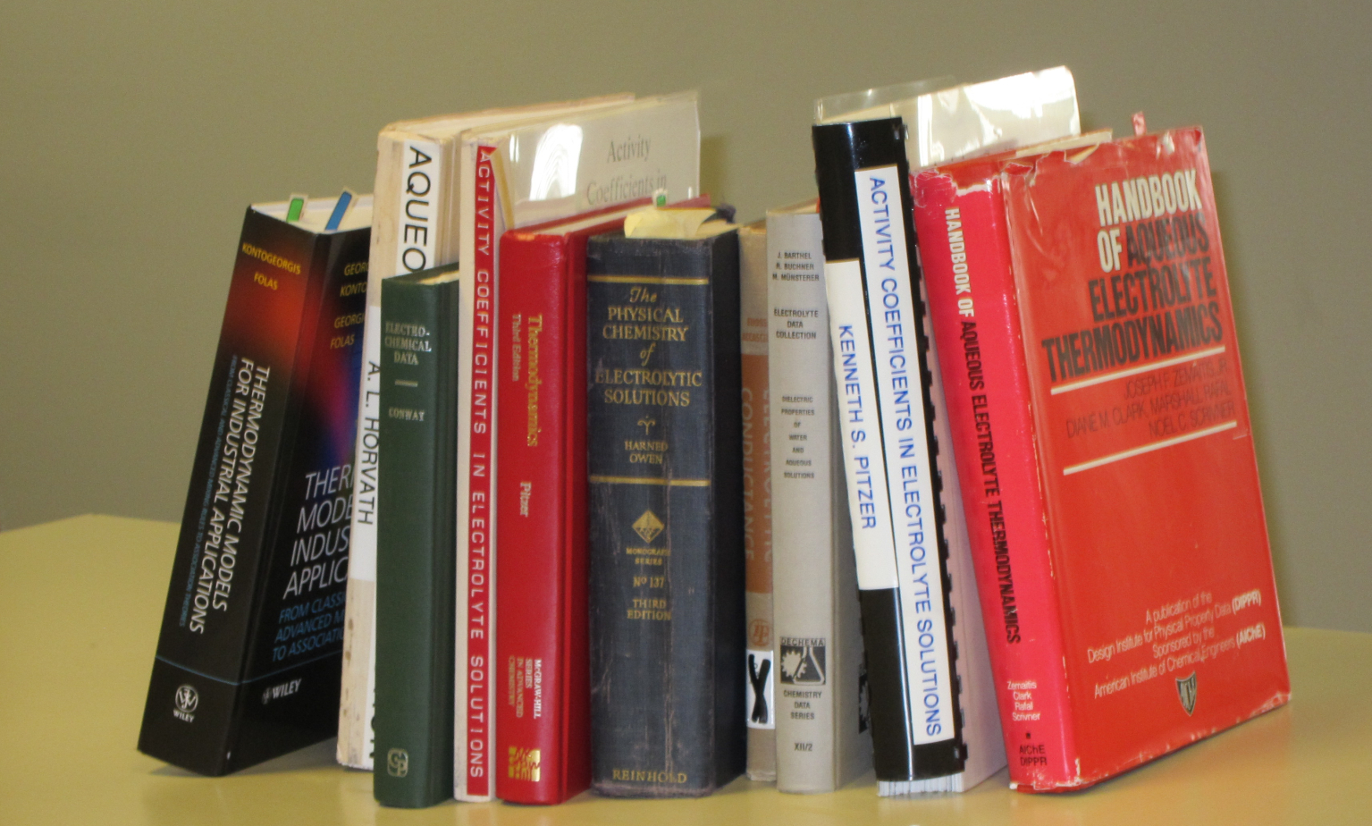
Good Data

Slide 34
It is difficult to even define
in a unique way
Properties of One Ion
when
Everything
Interacts
with
Everything
Tremendous Opportunity for Applied Mathematics

Slide 35

Electrolytes are Complex Fluids
After 690 pages and 2604 references, properties of
SINGLE Ions
are
Elusive*
because
Every Ion
Interacts
with
Everything
*’elusive’ is in the authors’ choice in the title
but emphasis is added
Hünenberger & Reif (2011)
“Single-Ion Solvation
… Approaches to Elusive* Thermodynamic Quantities”

Slide 36
Ions in Water are the Liquid of Life
They are not ideal solutions
Everything
Interacts
with
Everything
For Modelers and Mathematicians
Tremendous Opportunity for Applied Mathematics
because
‘law’ of mass action assumes nothing interacts
Chun Liu’s Energetic Variational Principle
EnVarA

Slide 37
Good Data
Compilations of Specific Ion Effect
>139,175 Data Points [Sept 2011] on-line
IVC-SEP Tech Univ of Denmark
http://www.cere.dtu.dk/Expertise/Data_Bank.aspx
2. Kontogeorgis, G. and G. Folas, 2009:
Models for Electrolyte Systems. Thermodynamic
John Wiley & Sons, Ltd. 461-523.
3. Zemaitis, J.F., Jr., D.M. Clark, M. Rafal, and N.C. Scrivner, 1986,
Handbook of Aqueous Electrolyte Thermodynamics.
American Institute of Chemical Engineers
4. Pytkowicz, R.M., 1979,
Activity Coefficients in Electrolyte Solutions. Vol. 1.
Boca Raton FL USA: CRC. 288.

Slide 38
Everything Interacts
Mathematics of Chemistry
must deal
Naturally
with
Interactions
‘Law of Mass Action’ assumes nothing interacts
So this is a great opportunity for new mathematics and applications!

Slide 39

Mathematics of
Interactions
in
Complex Fluids
‘Law’ of Mass Action
including
Interactions
Variational Approach
EnVarA
Conservative
Dissipative
From Bob Eisenberg p. 1-6, in this issue

Slide 40
Shielding
is a defining property of
Complex Fluids
It is VERY hard to Simulate at Equilibrium
and (in my opinion)
IMPOSSIBLE to Simulate in nonequilibrium
Like Batteries or Nerve Fibers
because flows involve
Far Field (macroscopic) boundaries

Slide 41
Main Qualitative Result
Shielding Dominates
Electric Properties of Channels, Proteins, as it does Ionic Solutions
Shielding is ignored in traditional treatments
of Ion Channels and of Active Sites of proteins
Rate Constants Depend on Shielding
and so
Rate Constants Depend on Concentration and Charge

Slide 42
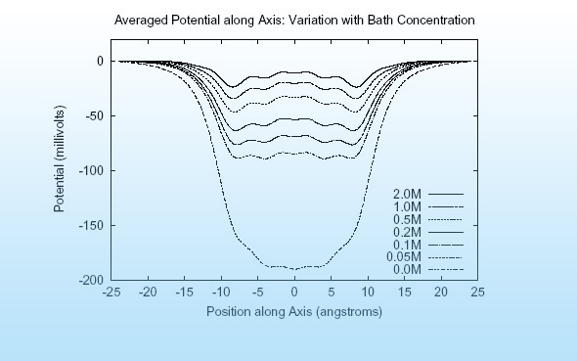
Main Qualitative Result
Shielding in Gramicidin
Hollerbach & Eisenberg

Slide 43
Reconciling
Mass Action
and
Maxwell/Kirchoff
will no doubt be a
Long Journey

Slide 44
“ … incomplete truths learned on the way
may become ingrained
and taken as the whole truth….…
what is true
and what is only sometimes true
will become confused.”
Richard Feynman
from p.15-61 “The Feynman: Lectures on Physics, Mainly Electromagnetism and Matter. Vol. 2” 1963, New York: Addison-Wesley Publishing Co., also at available on line

Slide 45
History of Derivations of Law of Mass Action
“Sometimes it is necessary
to put a veil
on the past,
For the Sake of the Future”
Henry Clay, the Essential American
p. 375 D.S. & J.T. Heidler

Slide 46
“Journey of a thousand miles starts with a single step”
in the right direction,
I beg to add to this Chinese saying

Slide 47
As a Chicago Surgeon put it
You better head in the right direction,
if you want to get anywhere

Slide 48
That direction needs to include the electric field, calculated and calibrated, global and local if the journey is ever to end, in my view.

Slide 49
Replacement of
“Law of Mass Action”
is
Feasible for
Ionic Solutions
using the
All Spheres
(primitive = implicit solvent model of ionic solutions)
and
Theory of Complex Fluids

Slide 50
Variational Approach
EnVarA
‘Law’ of Mass Action
including
Interactions
Conservative
Dissipative
From Bob Eisenberg p. 1-6, in this issue

Slide 51
Energetic Variational Approach
allows
accurate computation of
Flow and Interactions
in Complex Fluids like Liquid Crystals
Classical theories and Molecular Dynamics
have difficulties with flow, interactions,
and complex fluids
Engineering needs Calibrated Theories and Simulations
Engineering Devices almost always use flow

Slide 52
Energetic Variational Approach
EnVarA
Chun Liu, Rolf Ryham, and Yunkyong Hyon
Mathematicians and Modelers: two different ‘partial’ variations
written in one framework, using a ‘pullback’ of the action integral
Shorthand for Euler Lagrange process
with respect to
Shorthand for Euler Lagrange process
with respect to
Action Integral, after pullback
Rayleigh Dissipation Function
Composite
Variational Principle
Euler Lagrange Equations
Field Theory of Ionic Solutions: Liu, Ryham, Hyon, Eisenberg
Allows boundary conditions and flow
Deals Consistently with Interactions of Components

Slide 53
Dissipation Principle
Conservative Energy dissipates into Friction
Number Density
time
Permanent Charge of protein
Hard Sphere Terms
Thermal Energy
valence
proton charge
c_{i} number density; thermal energy; D_{i} diffusion coefficient; n negative; p positive; z_{i} valence; ε dielectric constant
Note that
with suitable boundary conditions

Slide 54
Energetic Variational Approach
EnVarA
is defined by the Euler Lagrange Process,
as I understand the pure math from Craig Evans
which gives
Equations like PNP
BUT
I leave it to you (all)
to argue/discuss with Craig
about the purity of the process
when two variations are involved

Slide 55
PNP (Poisson Nernst Planck) for Spheres
Non-equilibrium variational field theory EnVarA
Nernst Planck Diffusion Equation
for number density c_{n} of negative n ions; positive ions are analogous
Diffusion Coefficient
Thermal Energy
Coupling Parameters
Ion Radii
Number Densities
Poisson Equation
Dielectric Coefficient
valence
proton charge
Eisenberg, Hyon, and Liu
Permanent Charge of Protein

Slide 56
Semiconductor PNP Equations
For Point Charges
Dielectric Coefficient
Poisson’s Equation
Permanent Charge of Protein
Valence
Proton charge
Cross sectional Area
Drift-diffusion & Continuity Equation
Number Densities
Flux
Diffusion Coefficient
Chemical Potential
Not in Semiconductor
valence
proton charge
Thermal Energy

Slide 57
All we have to do is
Solve them! with Boundary Conditions defining
Charge Carriers ions, holes, quasi-electrons
Geometry

Slide 58
Solution* of PNP Equation
*MATHEMATICS
This solution was actually DERIVED by computing many conditional probability measures explicitly by repeated analytical integrations
Eisenberg, Klosek, & Schuss (1995) J. Chem. Phys. 102, 1767-1780
Eisenberg, B. (2000) in Biophysics Textbook On Line "Channels, Receptors, and Transporters"
Eisenberg, B. (2011). Chemical Physics Letters 511: 1-6

Slide 59
Please do not be deceived
by the eventual simplicity of Results.
This took >2 years!
Solution
was actually
DERIVED
with explicit formulae
for probability measures
from a
Doubly Conditioned Stochastic Process
involving
Analytical Evaluation
of
Multidimensional Convolution Integrals
Eisenberg, Klosek, & Schuss (1995) J. Chem. Phys. 102, 1767-1780
Eisenberg, B. (2000) in Biophysics Textbook On Line "Channels, Receptors, Transporters"
Eisenberg, B. (2011). Chemical Physics Letters 511: 1-6

Slide 60
All we have to do is
Solve them!
Don’t Despair
Semiconductor Technology has
Already Done That!

Slide 61
Semiconductor Devices
PNP equations describe many robust input output relations
Amplifier
Limiter
Switch
Multiplier
Logarithmic convertor
Exponential convertor
These are SOLUTIONS of PNP for different boundary conditions
with ONE SET of CONSTITUTIVE PARAMETERS
PNP of POINTS is TRANSFERRABLE
Analytical should be attempted using techniques of
Weishi Liu University of Kansas
Tai-Chia Lin National Taiwan University & Chun Liu PSU

Slide 62
The End
Any Questions?

