Slide 1
Mathematics
describes only a tiny part of life,
But
Mathematics* Creates
our
Standard of Living
*e.g., Electricity, Computers, Fluid Dynamics, Optics, Structural Mechanics, ….

Slide 2
How can we use mathematics to describe biological systems?
I believe some biology is
Physics ‘as usual’
‘Guess and Check’
But you have to know which biology!

Slide 3
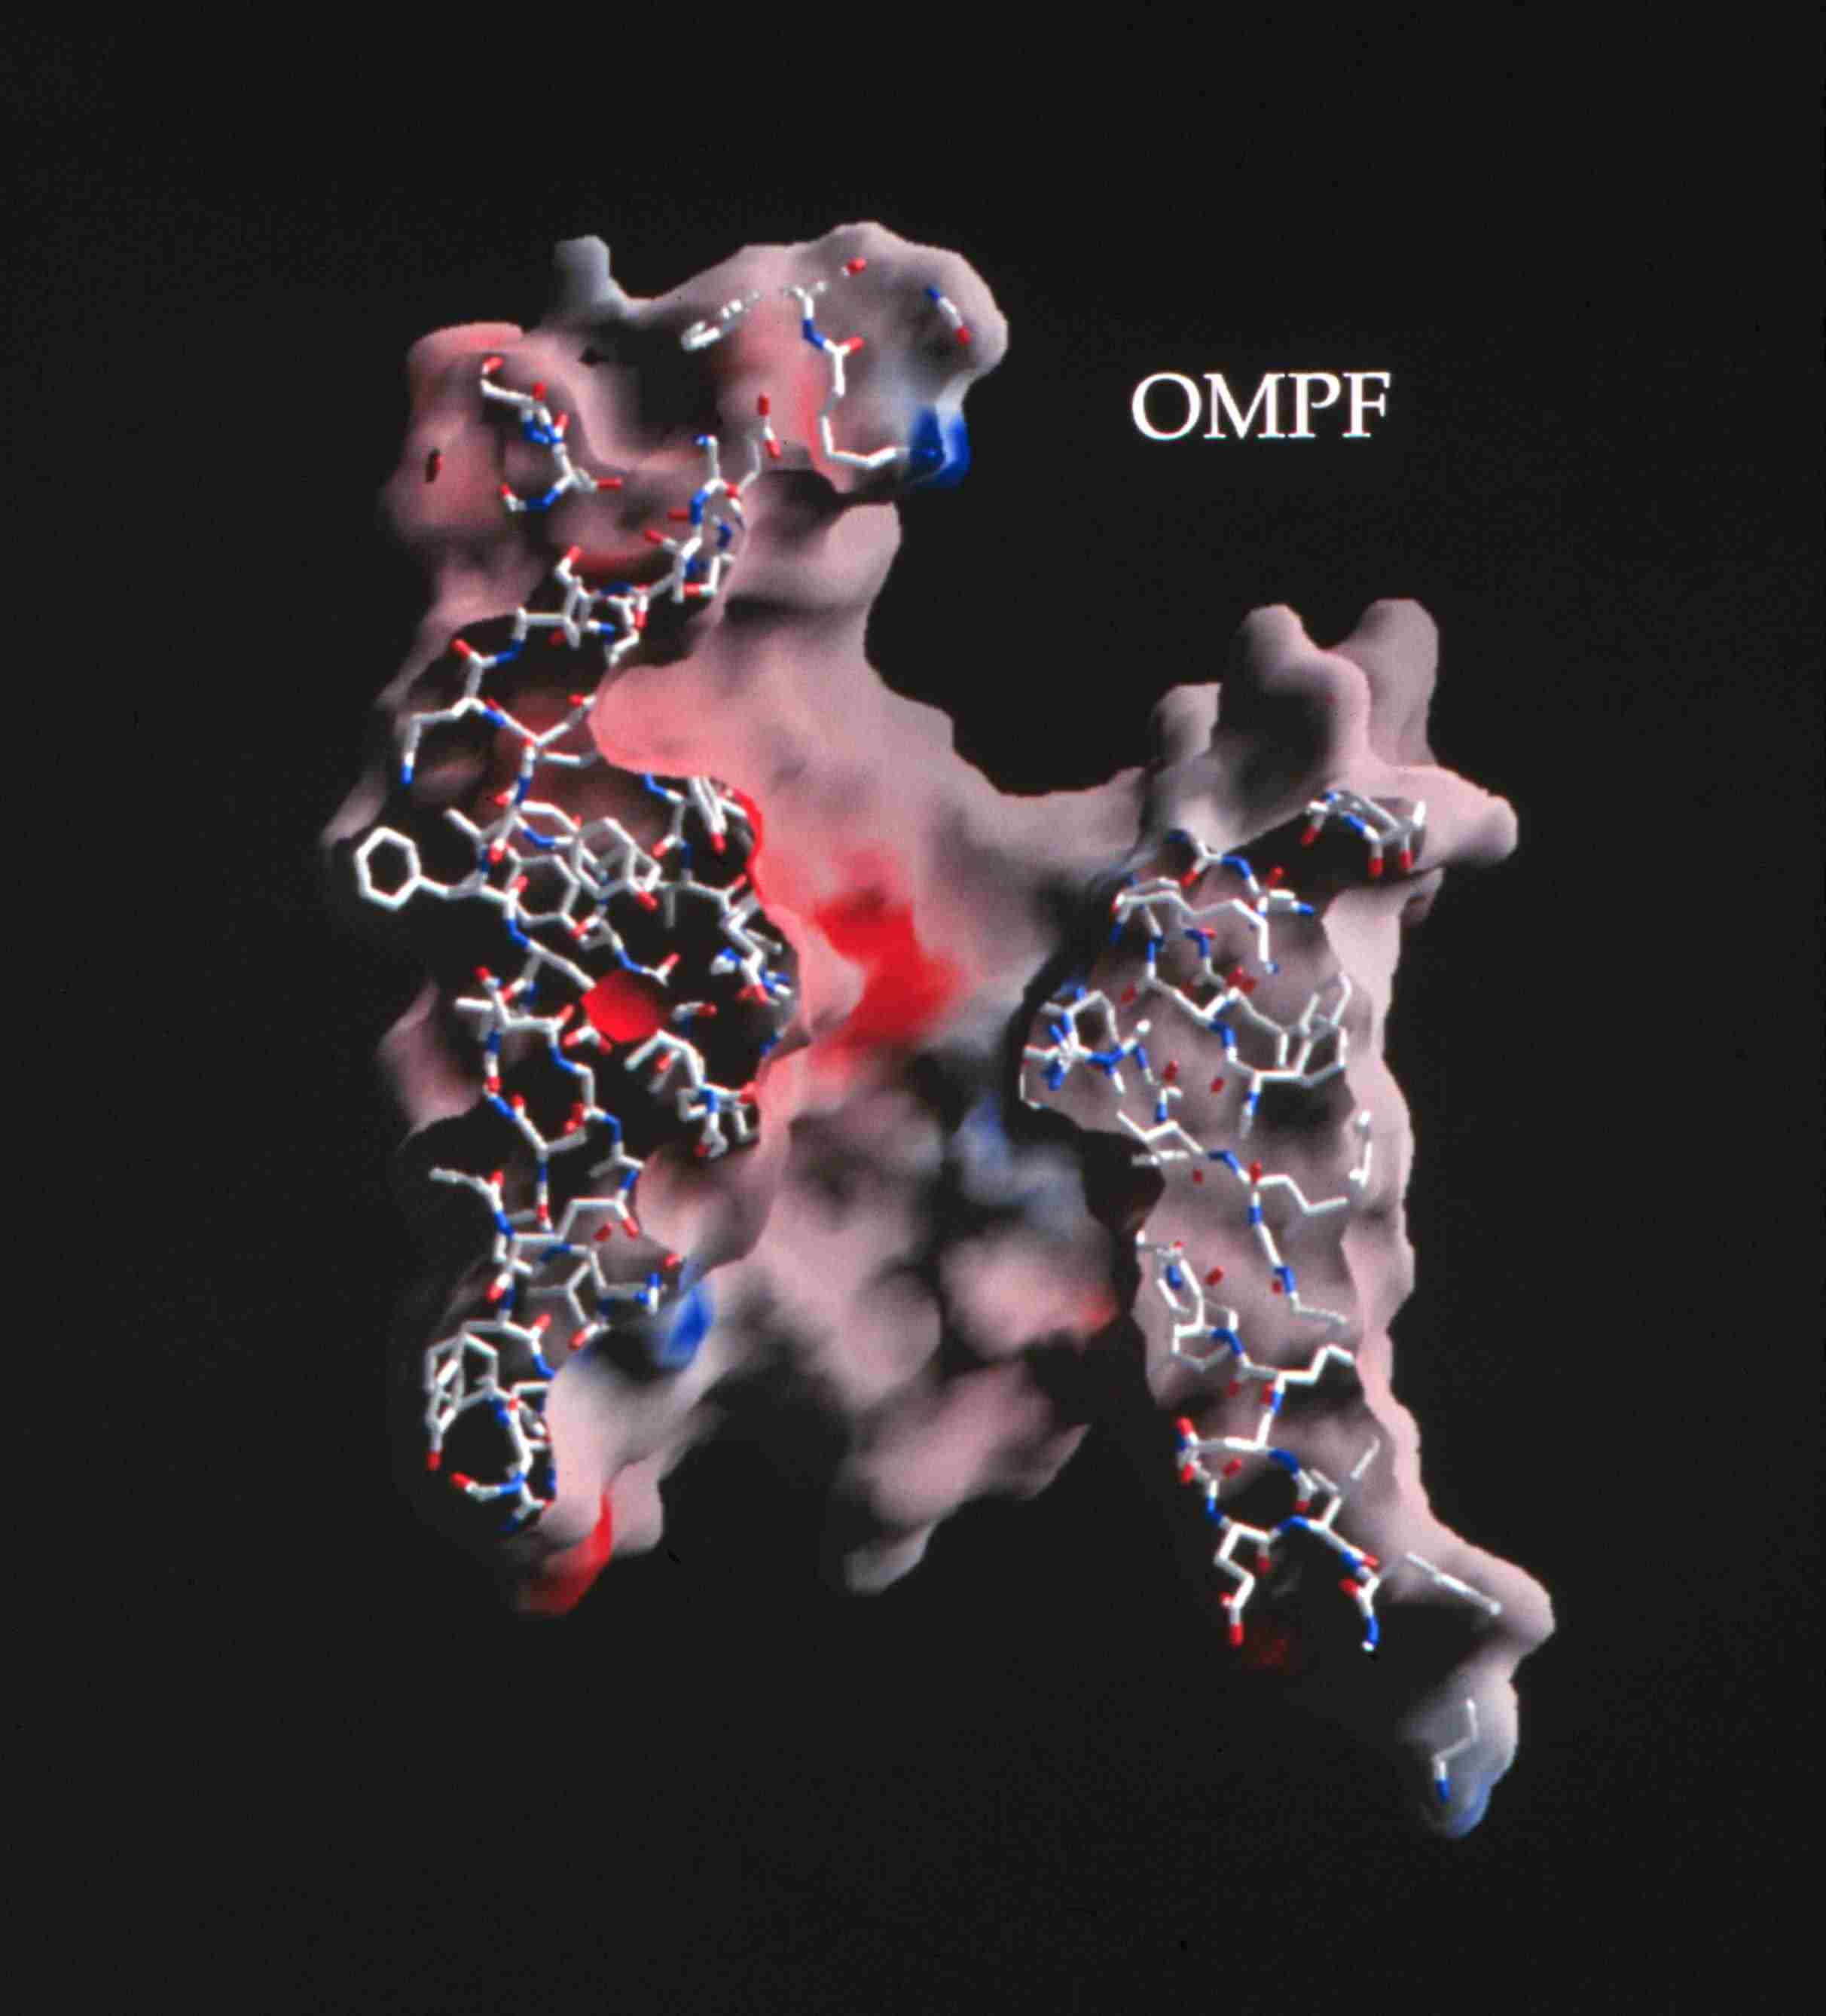
Ion Channels are the Valves of Cells
Ion Channels are the Main Controllers of Biological Function
Selectivity
Different Ions
carry
Different Signals
Ions in Water
are the
Liquid of Life
Hard Spheres
Na⁺
Chemical Bonds are lines
Surface is Electrical Potential
Red is negative (acid)
Blue is positive (basic)
Ca⁺⁺
+
K⁺
0.7 nm = Channel Diameter
~30 Å
Figure of ompF porin by Raimund Dutzler
3 Å
Notes:
MD scales are very different

Slide 4
Natural nano-valves* for atomic control of biological function
Ion Channels are Biological Devices
Ion channels coordinate contraction of cardiac muscle, allowing the heart to function as a pump
Ion channels coordinate contraction in skeletal muscle
Ion channels control all electrical activity in cells
Ion channels produce signals of the nervous system
Ion channels are involved in secretion and absorption in all cells: kidney, intestine, liver, adrenal glands, etc.
Ion channels are involved in thousands of diseases and many drugs act on channels
Ion channels are proteins whose genes (blueprints) can be manipulated by molecular genetics
Ion channels have structures shown by x-ray crystallography in favorable cases
K⁺
~30 Å
*nearly pico-valves: diameter is 400 – 900 picometers
Notes:
Ion channels are a class of Proteins that reside in the cell membrane of all biological cells. Each channel protein consists of a chain of amino acids folded in such a way that it forms a nanoscopic water-filled tunnel through which ions can flow to cross the otherwise impermeable membrane.
Every ion channel carries a strong and steeply varying distribution of permanent charge, which depends on the particular combination of channel and prevalent physiological conditions. This permanent charge has an important role in determining the current-voltage characteristics of the open channel.
Many channels are designed by nature to selectively transmit or block a particular ion species. This allows only one type of ion to cross the membrane even though other ions may be present in much higher concentrations. Many channels can also open and close by mechanical or other means, switching on and off like electronic devices.
From a physiological point of view ion channels are essential for maintaining the correct internal ion composition necessary for cell survival and function. They directly control electrical signaling in the nervous system, muscle contraction, and the delivery of many clinical drugs. Malfunctioning channels cause or are associated with many diseases.
From a device point of view, ion channels can be thought of as elements in an electrical circuit, behaving like resistors, diodes or batteries depending on the specific channel and environmental factors. By replacing or deleting one or more of the amino acids many channels can be mutated, altering the charge distribution along the channel. Designing and engineering channels with specific conductances and selectivities, and incorporating them into bio-devices, is a real possibility.

Slide 5

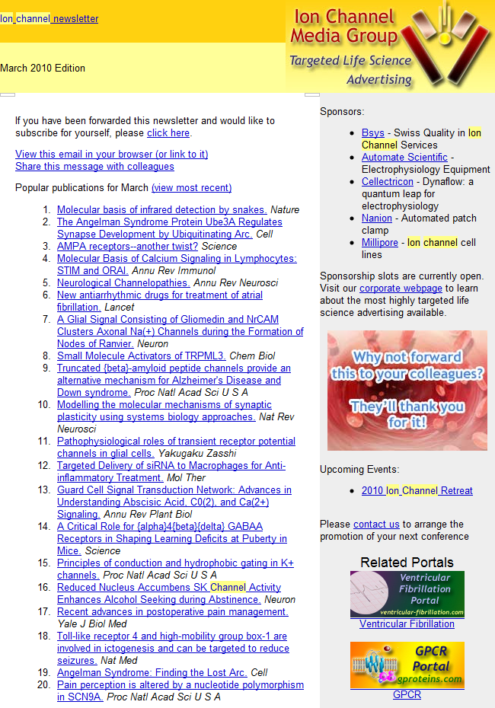
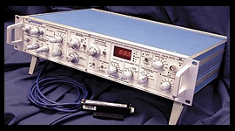
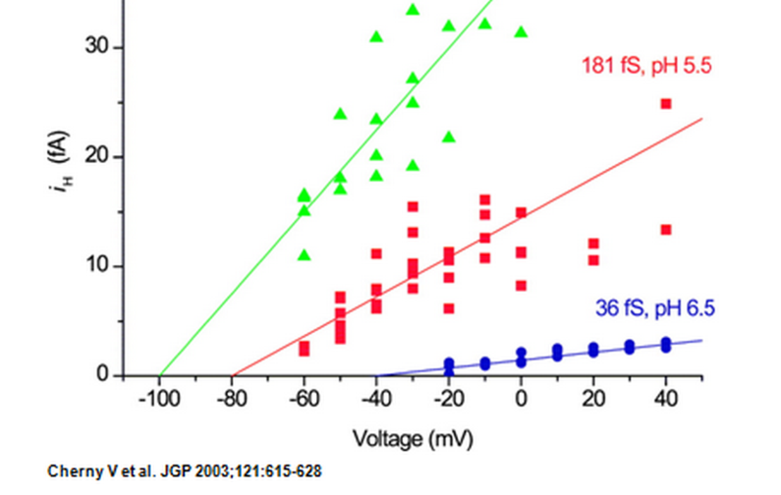
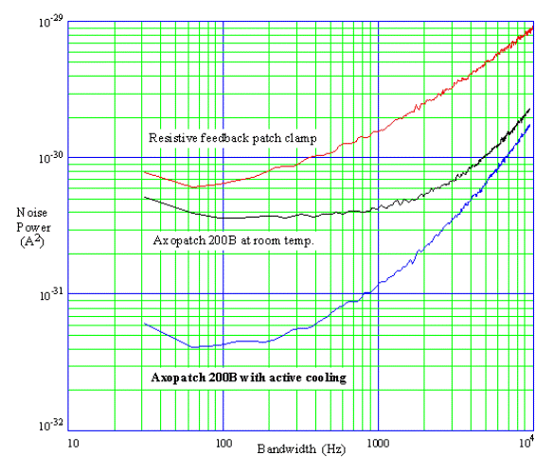
Thousands of
Molecular Biologists
Study Channels every day,
One protein molecule at a time
This number is not an exaggeration.
We have sold >10,000 AxoPatch amplifiers
Ion Channel Monthly
AxoPatch 200B
Femto-amps
(10⁻¹⁵ A)

Slide 6
Channel Structure Does Not Change
once the channel is open
Current vs. time
Amplitude vs. Duration
Open
Closed
Open Amplitude, pA
5 pA
100 ms
Open Duration /ms
Lowpass Filter = 1 kHz Sample Rate = 20 kHz
Typical Raw Single Channel Records
Ca²⁺ Release Channel of Inositol Trisphosphate Receptor: slide and data from Josefina Ramos-Franco. Thanks!

Slide 7
Channels are only Holes
Why can’t we understand and build them?
Where to start?
Why not compute all the atoms?

Slide 8
Multiscale Issues
more later
Computational Scale | Biological Scale | Ratio
Time 10⁻¹⁵ sec | 10⁻⁴ sec | 10¹¹
Space 10⁻¹¹ m | 10⁻⁵ m | 10⁶
Spatial Resolution |  | 10¹⁸
Solute Concentration |  | 10¹¹
Three Dimensional (10⁶)³
Biological Scales Occur Together
so must be
Computed Together
This may be impossible in simulations
Physicists and Engineers rarely try

Slide 9
Multiscale Issues
It may not be possible to deal accurately
with
Ratios of Scales
of
10¹¹ 10⁶ 10¹⁸ 10¹²
All at Once
Physicists and Engineers rarely try!
Computational Biology is
NOT doing ‘Physics as Usual’

Slide 10
Why can’t we understand and build channels?
Uncalibrated Simulations
will not make devices that actually work
Unpopular view because
Calibration is Hard Work
particularly for Non-Ideal systems
with
Correlations, Finite Size effects, and Flows

Slide 11
Where do we start?
Physics ‘As Usual’
‘Guess and Check’
Stochastic ‘Derivation’
Later
will include biological adaptation
of Correlations and Crowded Charge

Slide 12
We start with Langevin equations of charged particles
Opportunity and Need
Simplest stochastic trajectories
are
Brownian Motion of Charged Particles
Einstein, Smoluchowski, and Langevin ignored charge
and therefore
do not describe Brownian motion of ions in solutions
We use
Theory of Stochastic Processes
to go
from Trajectories to Probabilities
Once we learn to count Trajectories of Brownian Motion of Charge,
we can count trajectories of Molecular Dynamics
Schuss, Nadler, Singer, Eisenberg

Slide 13
Langevin Equations
Positive cat ion, e.g., p = Na⁺
Negative an ion, e.g., n = Cl¯
Electric Force
from all charges including
Permanent charge of Protein,
Dielectric Boundary charges,
Boundary condition charge
Schuss, Nadler, Singer, Eisenberg

Slide 14
Electric Force from Poisson Equation
Electric Force
from all charges including
Permanent charge of Protein,
Dielectric Boundary charges,
Boundary condition charge
Excess ‘Chemical’ Force
Implicit Solvent
‘Primitive’ Model
or
Primitive Solvent Model
Schuss, Nadler, Singer, Eisenberg

Slide 15
Equilibrium
Thermodynamics
Nonequilibrium
Schuss, Nadler, Singer & Eisenberg
Configurations
Trajectories
Boltzmann Distribution
Fokker Planck Equation
Finite OPEN System
Statistical
Mechanics
Theory of Stochastic Processes
Thermodynamics
Device Equation

Slide 16
From Trajectories to Probabilities
Main Result of Theory of Stochastic Processes
Joint probability density of position and velocity
satisfies a Fokker Planck equation
with Fokker Planck Operator
Coordinates are positions and velocities of N particles in 12N dimensional phase space
Schuss, Nadler, Singer, Eisenberg

Slide 17
Conditional PNP
Electric Force depends on Conditional Density of Charge
Closures or Approximations
Needed
Permittivity, Dielectric Coefficient,
Charge on Electron
Channel
Protein
Nernst-Planck gives UNconditional Density of Charge
Mass
Friction
Schuss, Nadler, Singer, Eisenberg

Slide 18

Poisson-Nernst-Planck (PNP)
Poisson’s Equation
Proton charge Valence
Dielectric Coefficient
Permittivity
Channel Protein
Number Densities
Drift-diffusion & Continuity Equation
Flux
Diffusion Coefficient
Chemical Potential
Thermal Energy
Thermal Energy
Valence
Proton charge
Chemical Correlations

Slide 19
Semiconductor Equations:
One Dimensional PNP
Dielectric Coefficient
Poisson’s Equation
Permanent Charge of Protein
Valence
Proton charge
Cross sectional Area
Drift-diffusion & Continuity Equation
Number Densities
Flux
Diffusion Coefficient
Chemical Potential
valence
proton charge
Thermal Energy

Slide 20
Counting at low resolution gives
‘Semiconductor Equations’
Poisson-Nernst-Planck (PNP)
Ions are Points in PNP
contains only the
Correlations of Means
Gouy-Chapman, (nonlinear) Poisson-Boltzmann, Debye-Hückel,
are siblings with similar resolution
but at equilibrium, without current or flux of any species
Devices do not exist at equilibrium

Slide 21
How do we check the theory?
Compare with Biological Function!
Our task is to
Discover & Understand, Control & Improve
Biological Function
Inverse Problem
That means Selectivity
Ions are not Ideal
/
Potassium K⁺ = Na⁺ Sodium
Heinz Engl, Martin Burger

Slide 22
Channels are Selective
Different Ions Carry Different Signals through Different Channels
ompF porin
Ca⁺⁺
Na⁺
K⁺
3 Å
+
0.7 nm = Channel Diameter
Diameter matters
Diameter is the Only Difference between K⁺ and Na⁺
In ideal solutions K⁺ = Na⁺
~30 Å
Flow time scale is 0.1 msec to 1 min
Figure of ompF porin by Raimund Dutzler

Slide 23
Channels are Selective
because
Ions are NOT Ideal
Potassium K⁺ = Na⁺ Sodium
/
K⁺
Na⁺
3 Å
Ideal Electrolytes are Identical
if they have the same charge

Slide 24
Modelers and Mathematicians, Bioengineers: this is reverse engineering
How does the
Channel control Selectivity?
Inverse Problems
Many answers are possible
Central Issue
Which answer is right?
Core Math Problem has actually been solved
using methods for the
Inverse Problem of a Blast Furnace
Burger, Eisenberg and Engl (2007) SIAM J Applied Math 67: 960-989

Slide 25
How does the
Channel control Selectivity?
Inverse Problems: many answers possible
Central Issue
Which answer is right?
Key is
ALWAYS
Large Amount of Data
from
Many Different Conditions
Burger, Eisenberg and Engl (2007) SIAM J Applied Math 67: 960-989

Slide 26
Goal:
Understand Selectivity
well enough to
Fit Large Amounts of Data
from many solutions and concentrations
and to
Make a Calcium Channel
Macro Scale
Atomic Scale

Slide 27
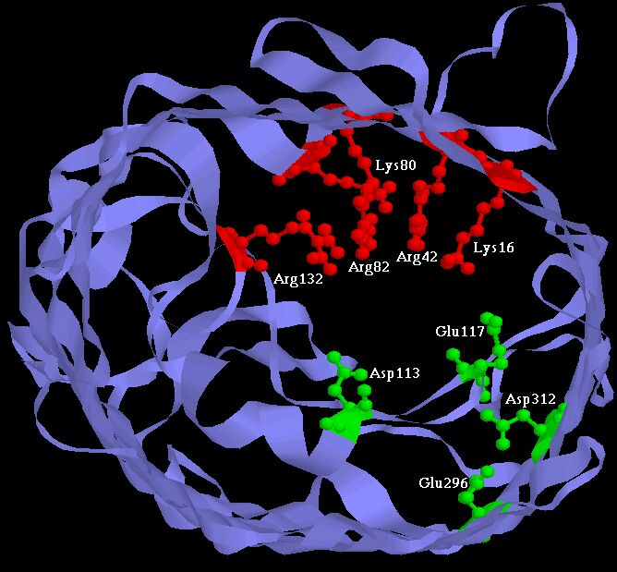
Experiments have built
Two Synthetic Calcium Channels
Atomic Scale
Mutants of ompF Porin
Designed by Theory
Glutathione derivatives
MUTANT ─ Compound
Calcium selective
Unselective
Wild Type
As density of permanent charge increases, channel becomes calcium selective
E_{rev} → E_{Ca} in 0.1M 1.0 M CaCl₂
Macro Scale
||
built by Henk Miedema, Wim Meijberg of BioMade Corp.,Groningen, Netherlands
Miedema et al, Biophys J 87: 3137–3147 (2004)

Slide 28
Comparison with Experiments shows
Potassium K⁺ Sodium Na⁺
Must include Biological Adaptation!
Working Hypothesis
Biological Adaptation is
Crowded Ions and Side Chains

Slide 29
Physical basis of function
Active Sites of Proteins are Very Charged
7 charges ~ 20 M net charge
= 1.2×10²² cm⁻³
liquid Water is 55 M
solid NaCl is 37 M
OmpF Porin
Ions are Crowded
Hard Spheres
Na⁺
+
+
+
+
+
K⁺
Ca²⁺
Na⁺
-
-
-
K⁺
-
Induced Fit
of
Side Chains
4 Å
Selectivity Filters and Gates of Ion Channels
are
Active Sites
Figure adapted from Tilman Schirmer

Slide 30
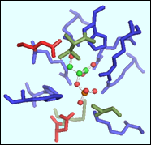
Charge Density
22 M
 |  | #AA | MS_A^3 | CD_MS+ | CD_MS- | CD_MSt
EC1:Oxidoreductases | Average | 47.2 | 1,664.74 | 7.58 | 2.82 | 10.41
 | Median | 45.0 | 1,445.26 | 6.12 | 2.49 | 8.70
EC2:Transferases | Average | 33.8 | 990.42 | 13.20 | 6.63 | 19.83
 | Median | 32.0 | 842.43 | 8.18 | 6.71 | 14.91
EC3:Hydrolases | Average | 24.3 | 682.88 | 13.14 | 13.48 | 26.62
 | Median | 20.0 | 404.48 | 11.59 | 12.78 | 23.64
EC4:Lyases | Average | 38.2 | 1,301.89 | 13.16 | 6.60 | 19.76
 | Median | 28.0 | 822.73 | 10.81 | 4.88 | 16.56
EC5:Isomerases | Average | 31.6 | 1,027.15 | 24.03 | 11.30 | 35.33
 | Median | 34.0 | 989.98 | 9.05 | 7.76 | 16.82
EC6:Ligases | Average | 44.4 | 1,310.03 | 9.25 | 9.93 | 19.18
 | Median | 49.0 | 1,637.98 | 8.32 | 7.95 | 17.89
 |  | #AA | MS_A^3 | CD_MS+ | CD_MS- | CD_MSt
Total n= 150 | Average | 36.6 | 1,162.85 | 13.39 | 8.46 | 21.86
 | Median | 33.0 | 916.21 | 8.69 | 7.23 | 16.69
EC#: Enzyme Commission Number based on chemical reaction catalyzed
#AA: Number of residues in the functional pocket
MS_A^3: Molecular Surface Area of the Functional Pocket (Units Angstrom^3)
CD_MS+: Charge Density (positive)
CD_MS-: Charge Density (negative)
CD_MSt: Total Charge density
Jimenez-Morales,
Liang,
Eisenberg

Slide 31
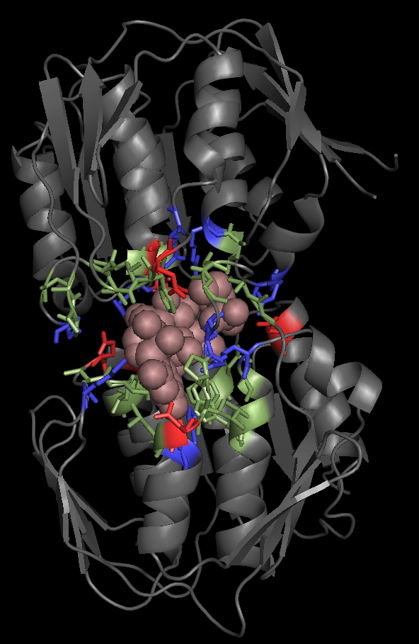
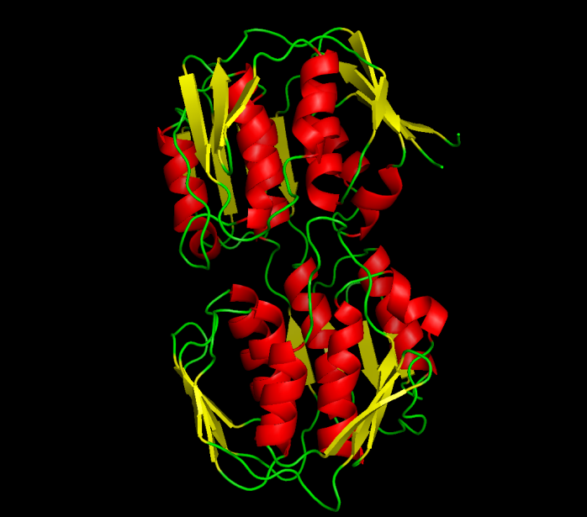
Example:
UDP-N-ACETYLGLUCOSAMINE ENOLPYRUVYL TRANSFERASE (PDB:1UAE)
Functional Pocket Molecular Surface Volume: 1462.40 A³
Density Charge: 19.3 Molar (11.3 M+. 8 M-)
EC2: TRANSFERASES
Average Charged Density: 19.8 Molar
Green: Functional pocket residues
Blue: Basic = Positive charged = R+K+H
Red: Acid = Negative charged = E + Q
Brown URIDINE-DIPHOSPHATE-N-
ACETYLGLUCOSAMINE
Jimenez-Morales, Liang, Eisenberg

Slide 32
Working Hypothesis
Biological Adaptation is
Crowded Ions and Side Chains
Everything interacts

Slide 33
Working Hypothesis
Interactions in Channels
come mostly from
Finite Size Effects
Chemically Specific Properties
come from
Diameter and Charge
learned from Doug Henderson, J.-P. Hansen, Stuart Rice, among others…
Thanks!

Slide 34
Bulk Solutions:
Interactions come mostly from
Finite Size Effects
Chemically Specific Properties
of ions (e.g. activity = free energy per mole)
are known to come from interactions of their
Diameter and Charge
and dielectric ‘constant’ of ionic solution
Atomic Detail
‘Primitive Implicit Solvent Model’
learned from Doug Henderson, J.-P. Hansen, Stuart Rice, among others…
Thanks!

Slide 35
Ions in Water are the Liquid of Life
They are not ideal solutions
Everything
Interacts
with
Everything
For Modelers and Mathematicians
Tremendous Opportunity for Applied Mathematics
Chun Liu’s Energetic Variational Principle
EnVarA

Slide 36
Variational Principles Deal with Interactions
Consistently and Automatically
Chun Liu,
with Yunkyong Hyon, and Bob Eisenberg
EnVarA
New Component (or Scale)
implies
New Field Equations (Euler Lagrange)
by
Algebra Alone
No new Assumptions

Slide 37
Energetic Variational Approach
EnVarA
Chun Liu, Rolf Ryham, Yunkyong Hyon, and Bob Eisenberg
Mathematicians and Modelers: two different ‘partial’ variations
written in one framework, using a ‘pullback’ of the action integral
Action Integral, after pullback
Rayleigh Dissipation Function
Composite
Variational Principle
Euler Lagrange Equations
Field Theory of Ionic Solutions
that allows boundary conditions and flow and deals with Interactions of Components self-consistently

Slide 38
Variational Analysis of Ionic Solution
EnVarA
Generalization of Chemical Free Energy
Dielectric Coefficient
from
Poisson Eq.
Number Densities
Lagrange
Multiplier
Eisenberg, Hyon, and Liu

Slide 39
EnVarA
Dissipation Principle for Ions
Number Density
time
Permanent Charge of protein
Hard Sphere Terms
Thermal Energy
valence
proton charge
c_{i} number density; thermal energy; D_{i} diffusion coefficient; n negative; p positive; z_{i} valence
Eisenberg, Hyon, and Liu

Slide 40
Field Equations with Lennard Jones Spheres
Non-equilibriium variational field theory EnVarA
Nernst Planck Diffusion Equation
for number density c_{n} of negative n ions; positive ions are analogous
Diffusion Coefficient
Thermal Energy
Coupling Parameters
Ion Radii
Number Densities
Poisson Equation
Dielectric Coefficient
valence
proton charge
Eisenberg, Hyon, and Liu
Permanent Charge of Protein

Slide 41
Energetic Variational Approach
EnVarA across biological scales: molecules, cells, tissues
developed by Chun Liu
with
(1) Hyon, Eisenberg Ions in Channels
(2) Bezanilla, Hyon, Eisenberg Conformation Change of Voltage Sensor
(3) Ryham, Eisenberg, Cohen Virus fusion to Cells
(4) Mori, Eisenberg Water flow in Tissues
Multiple
Scales
creates a new
Multiscale Field Theory of Interacting Components
that allows boundary conditions and flow
and deals with
Ions in solutions self-consistently

Slide 42
Energetic Variational Approach
developed by Chun Liu
Preliminary Results
and
Provocations

Slide 43
Eisenberg, Hyon, and Liu

Slide 44
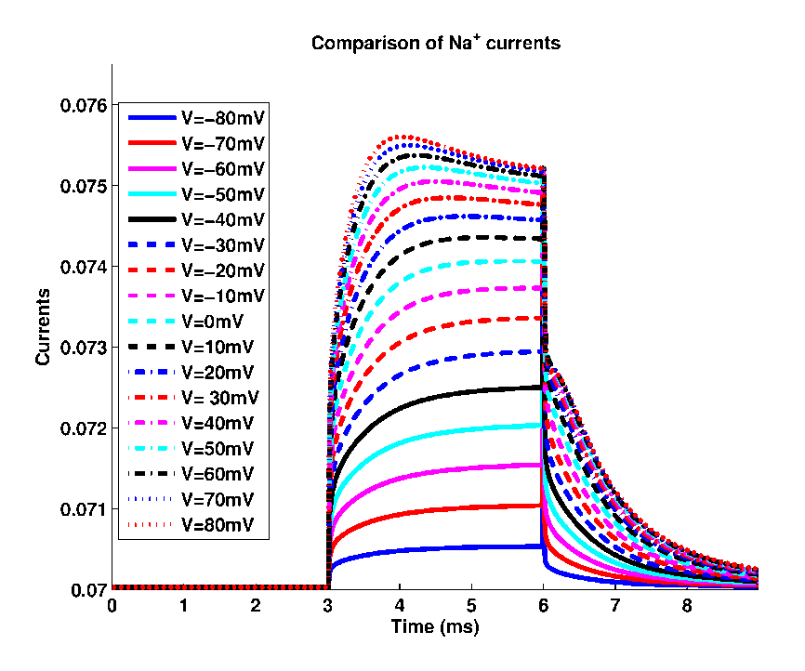
Nonequilibrium Computations
with Variational Field Theory
EnVarA
Binding Curves
Current Voltage Time Curves

Slide 45
Energetic Variational
Approach
EnVarA
New mechanisms*
(e.g., active transport)
can be added
*if they define an energy and its variation
Energy defined by simulations or theories or experiments is OK
Full micro/macro treatment is needed for an Atomic Model, with closure, as in liquid crystals
Eisenberg, Hyon, and Liu

Slide 46
Back to the Calcium Channel
Then, the Sodium Channel

Slide 47
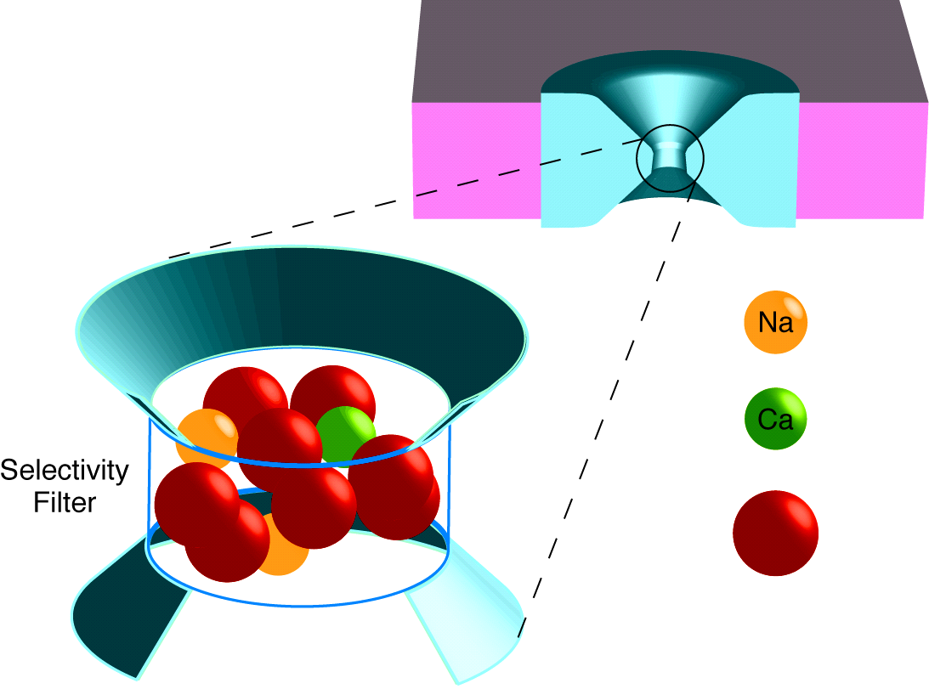
Selectivity Filter Crowded with Charge
L type Ca Channel
+
++
Selectivity
Filter
^{“Side Chains”}
O^{−½}
Wolfgang Nonner

Slide 48
large mechanical forces

Slide 49
Multiscale Analysis at Equilibrium
Solved with Metropolis Monte Carlo
MMC Simulates Location of Ions
both the mean and the variance
Produces Equilibrium Distribution
of location
of Ions and ‘Side Chains’
MMC yields Boltzmann Distribution with correct Energy, Entropy and Free Energy
Other methods
give nearly identical results:
Equilibrium Multiscale
MSA (mean spherical approximation
SPM (primitive solvent model)
DFT (density functional theory of fluids),
Non-equilibrium Multiscale
DFT-PNP (Poisson Nernst Planck)
EnVarA…. (Energy Variational Approach)
etc

Slide 50
Metropolis Monte Carlo
Simulates Location of Ions
both the mean and the variance
Details:
Start with Configuration A, with computed energy E_{A}
Move an ion to location B, with computed energy E_{B}
If spheres overlap, E_{B} → ∞ and configuration is rejected
If spheres do not overlap, E_{B} → 0 and configuration is accepted
If E_{B} < E_{A} : accept new configuration.
If E_{B} > E_{A} : accept new configuration with probability
Key idea
MMC chooses configurations with a Boltzmann probability and weights them evenly
instead of
choosing them from uniform distribution and then weighting them with exp(−E/k _{B}T)

Slide 51
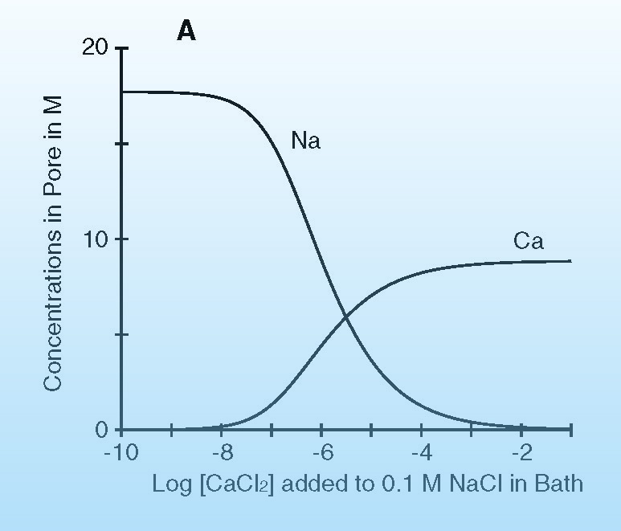
Selective Binding Curve
L type Ca channel
Wolfgang Nonner

Slide 52
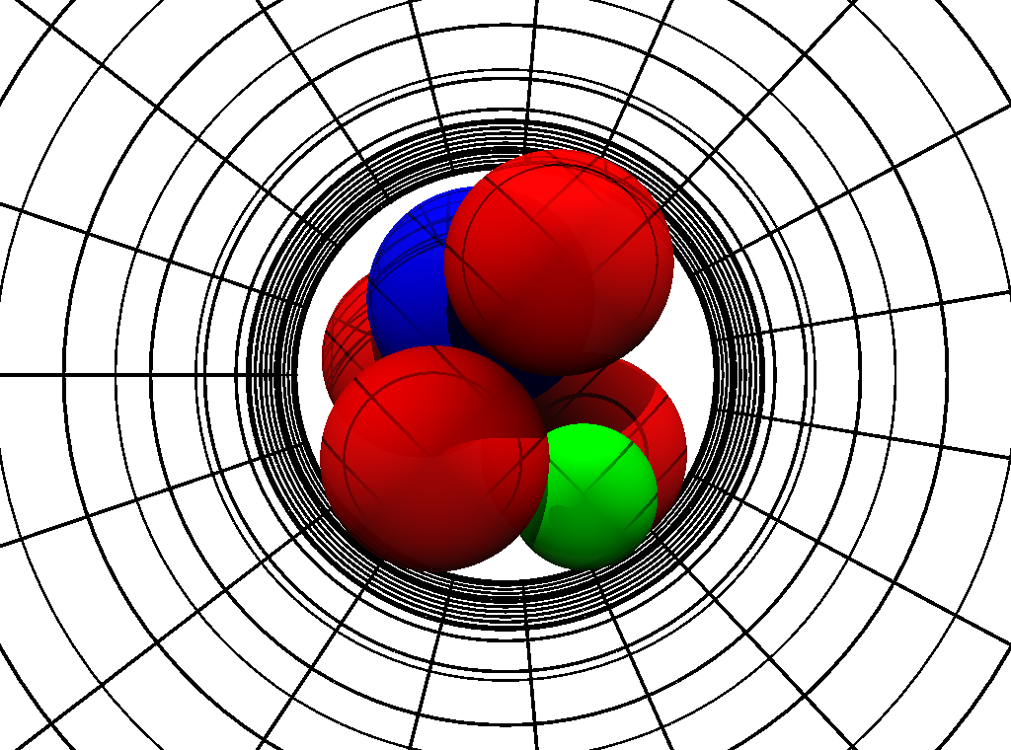
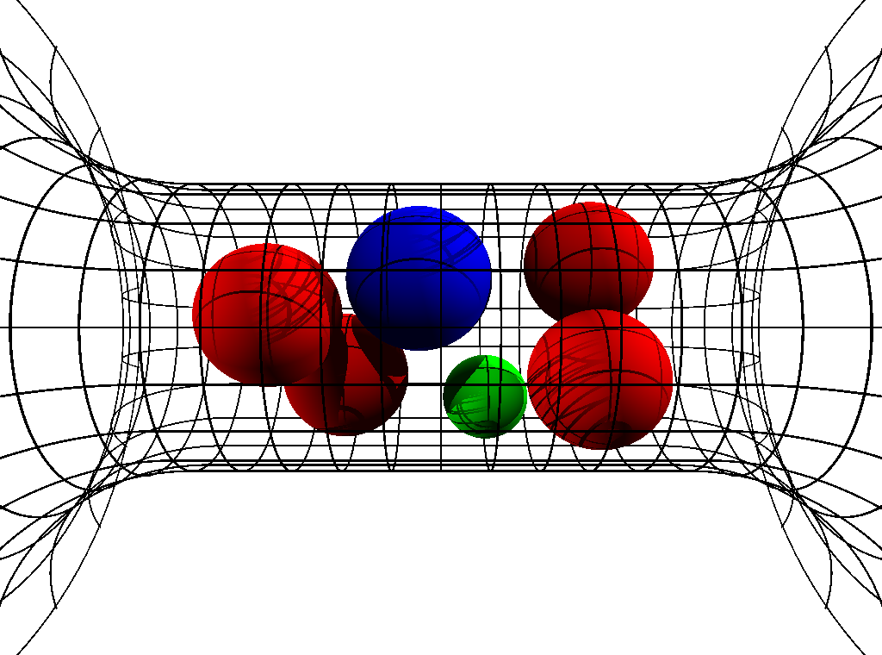
Crowded Ions
Radial Crowding is Severe
Ion Diameters ‘Pauling’ Diameters
Ca⁺⁺ | 1.98 Å
Na⁺ | 2.00 Å
K⁺ | 2.66 Å
‘Side Chain’ Diameter
Lysine K | 3.00 Å
D or E | 2.80 Å
Channel Diameter 6 Å
6Å
Snap Shots of Contents
Parameters are Fixed in all calculations
in all solutions for all mutants
‘Side Chains’ are Spheres
Free to move inside channel
Experiments and Calculations done at pH 8
Boda, Nonner, Valisko, Henderson, Eisenberg & Gillespie

Slide 53
Mutation
  Na Channel
  Ca Channel
Same Parameters
  E
  E
  E
  A
  D
  E
  K
  A
Charge -3e
Charge -1e
1
0.004
Na⁺
Ca²⁺
Na⁺
Occupancy (number)
0.002
0.5
Ca²⁺
0
0
-6
-4
-2
0
0.05
0.1
log (Concentration/M)
Concentration/M
EEEE has full biological selectivity
^{in similar simulations}
Boda, et al

Slide 54
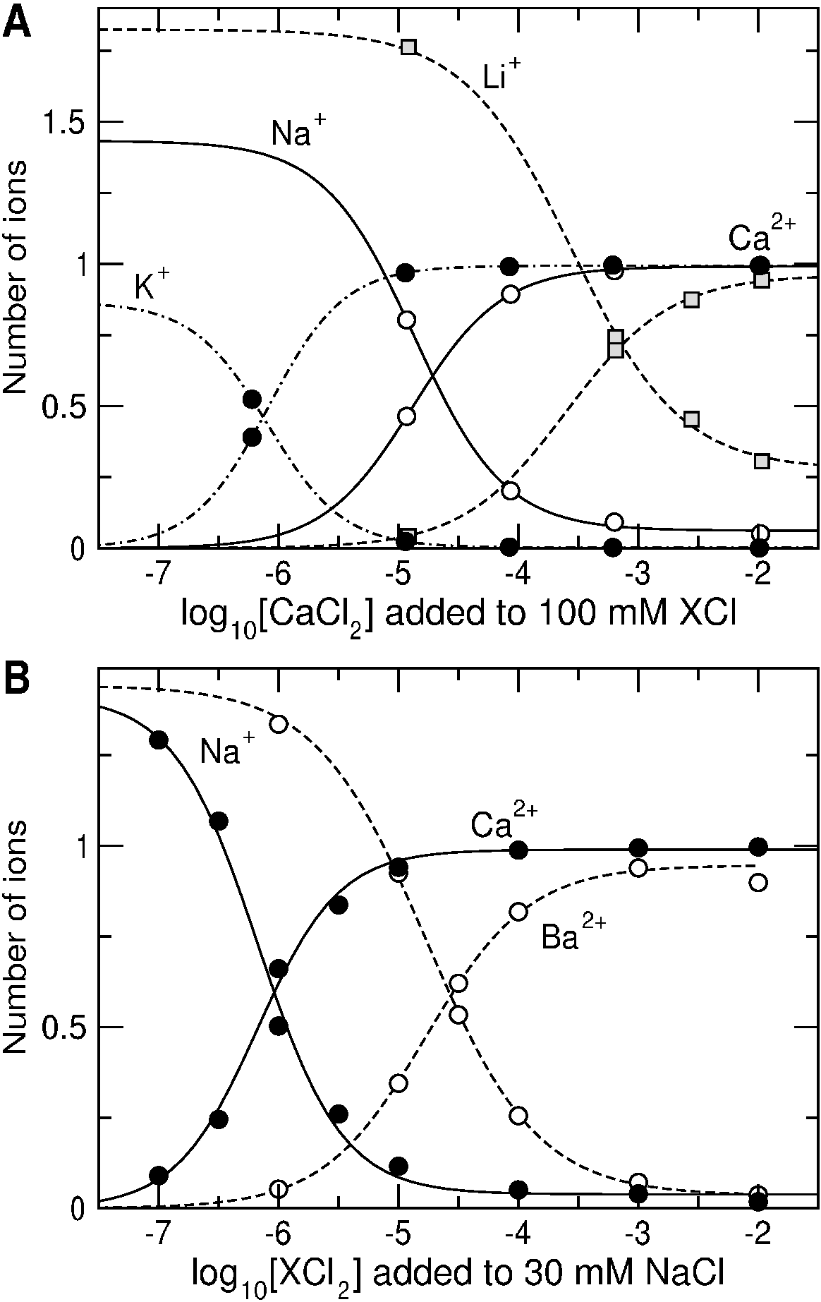
Na, K, Li, Ca, Ba Binding in Calcium Channel

Slide 55
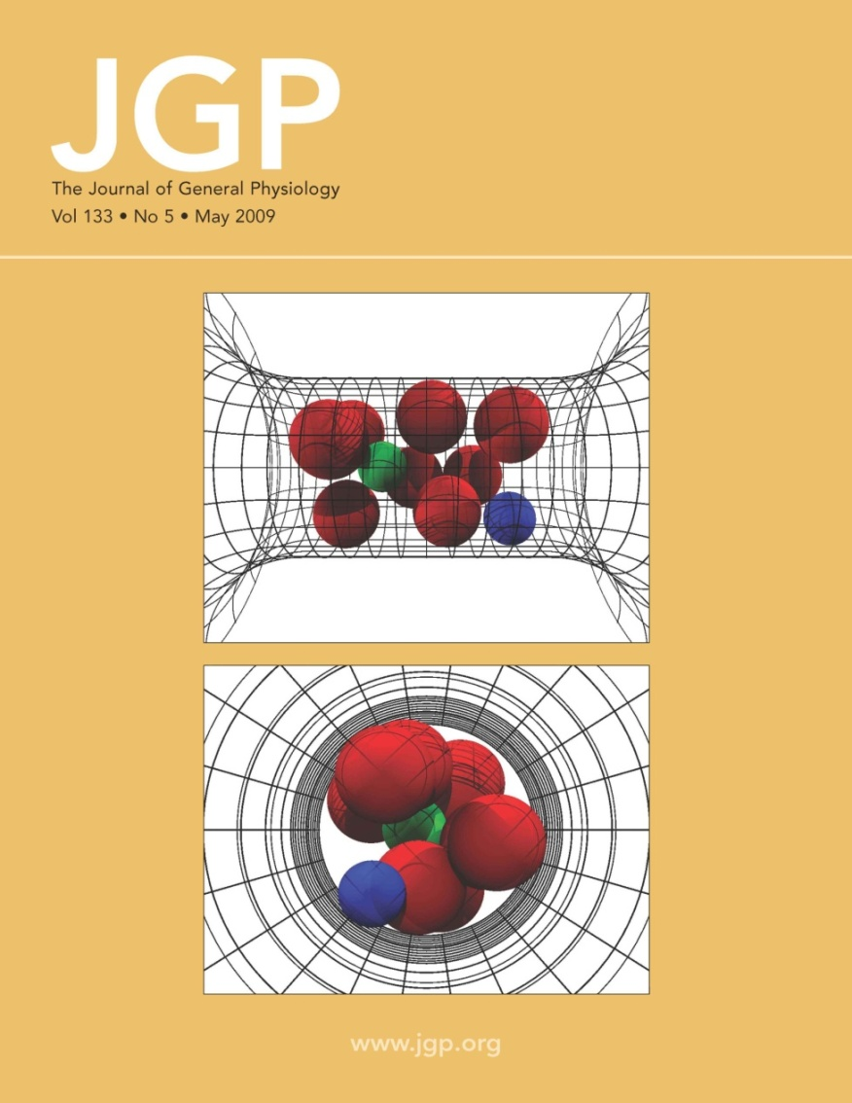
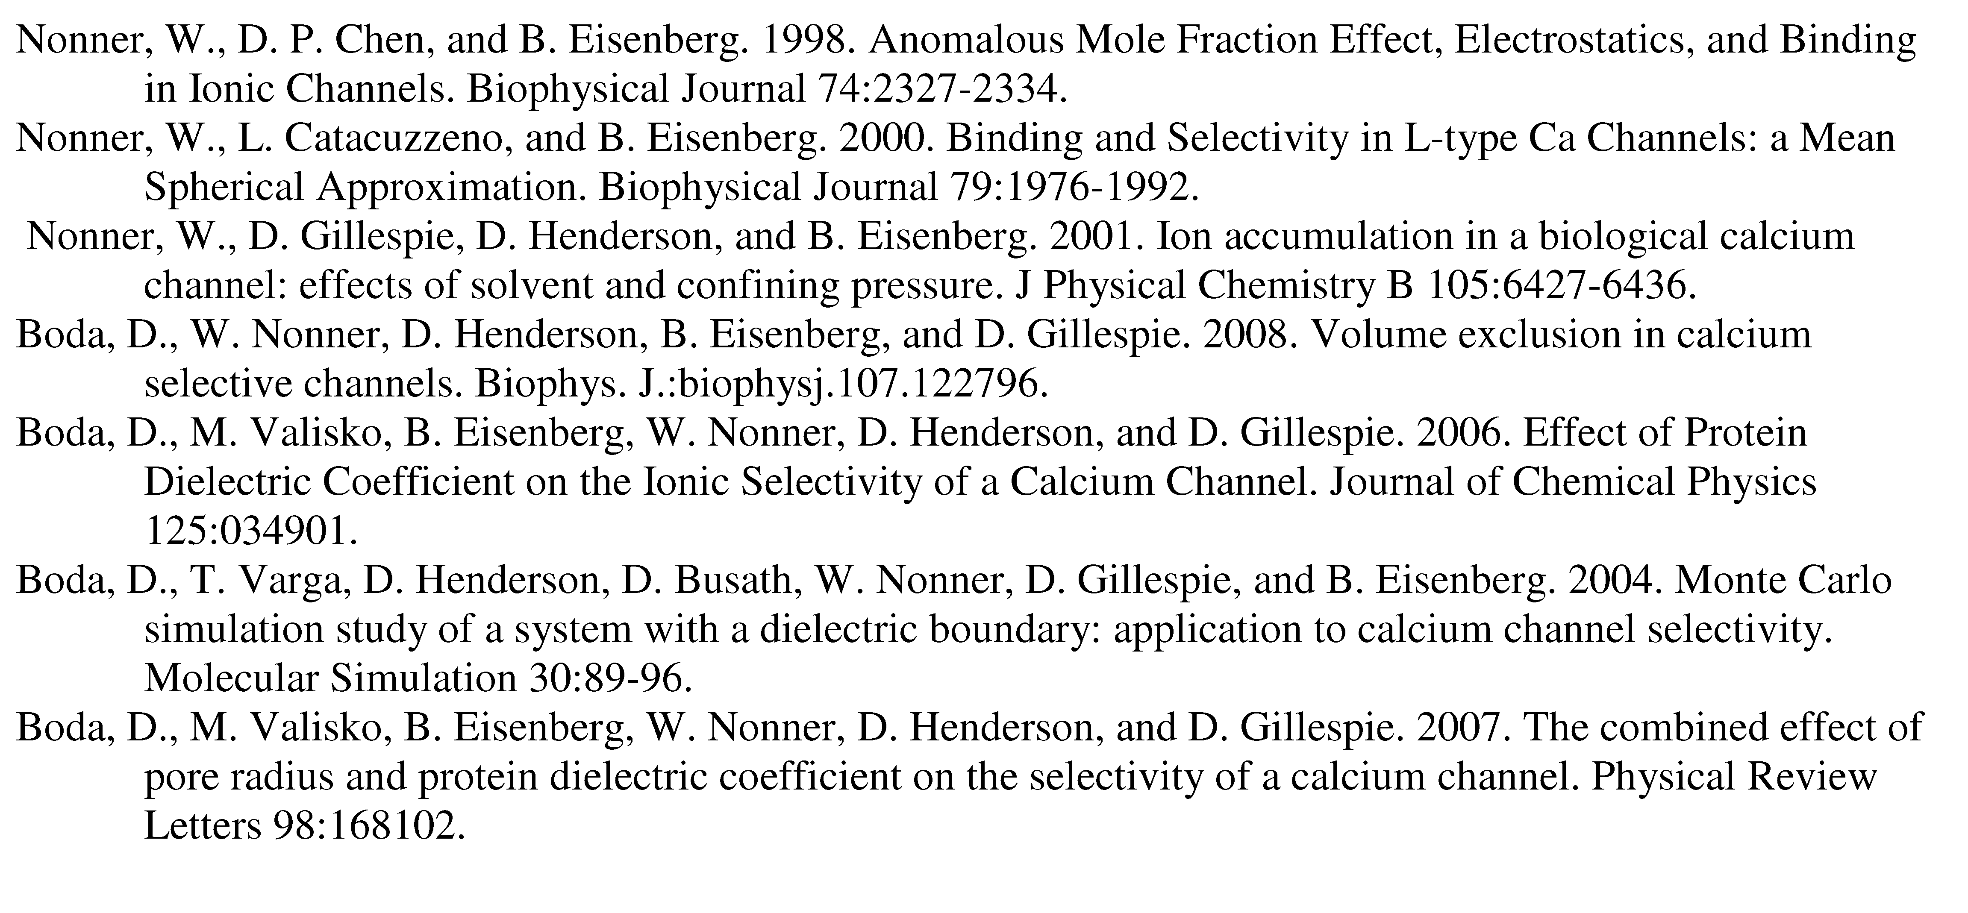
Calcium Channel has been examined in ~35 papers, e.g.,
Most of the papers are available at
ftp://ftp.rush.edu/users/molebio/Bob_Eisenberg/Reprints
http://www.phys.rush.edu/RSEisenberg/physioeis.html

Slide 56
Selectivity
comes from
Electrostatic Interaction
and
Steric Competition for Space
Repulsion
Location and Strength of Binding Sites Depend on Ionic Concentration and Temperature, etc
Rate Constants are Variables

Slide 57

for
Biologists:
a Word Picture
How does Calcium Selectivity Work?
qualitatively
Nonner and Eisenberg

Slide 58
How does it work qualitatively?
(for biologists)
2 Ca⁺⁺
are
LESS CROWDED
than 4 Na⁺
Nonner and Eisenberg

Slide 59
Selectivity from Crowded Charges
2 Ca⁺⁺ are less crowded than 4 Na⁺
Ca Channel
Filled with Na⁺
(not to scale)
Ca Channel
Filled with Ca⁺⁺
(not to scale)
−½
−½
Na⁺
−½
−½
−½
−½
−½
Ca⁺⁺
−½
−½
Na⁺
−½
−½
−½
Na⁺
Na⁺
−½
Ca⁺⁺
−½
−½
−½
Channel Protein
Glutamate Oxygens = 4e
8 of –½ charge each
Volume 0.38 nm³
Dielectric Constant 64
Outside the Filter
Bulk Solution
NaCl and CaCl₂

Slide 60
Ionic Selectivity in Protein Channels
Crowded Charge Mechanism
4 Negative Charges
of glutamates of protein
DEMAND
4 Positive Charges
nearby
either 4 Na⁺ or 2 Ca⁺⁺
Nonner and Eisenberg

Slide 61
Ionic Selectivity in Protein Channels
Crowded Charge Mechanism
Simplest Version: MSA
2 Ca⁺⁺ are LESS CROWDED than 4 Na⁺,
Ca⁺⁺ SHIELDS BETTER than Na⁺, so
Protein Prefers Ca⁺⁺
because
Ca⁺⁺ is less crowded
Nonner and Eisenberg

Slide 62
What does the protein do?
Channel and Contents
form a
Self-Organized Structure
with Side Chains at position of
Minimum Free Energy
Protein Fits the Substrate
“Induced Fit Model of Selectivity”

Slide 63
What does the protein do?
(for biologists)
Certain MEASURES of structure are
Powerful DETERMINANTS of Function
e.g., Volume, Dielectric Coefficient, etc.
Induced Fit Model of Selectivity
Atomic Structure is not pre-formed
Atomic Structure is an important output of the simulation
Nonner and Eisenberg

Slide 64
What does the protein do?
Protein maintains
Mechanical Forces*
Volume of Pore
Dielectric Coefficient/Boundary
Permanent Charge
* Driving force for conformation changes ??
Nonner and Eisenberg

Slide 65
Binding Sites* are outputs of our Calculations
Induced Fit Model of Selectivity
Our model has no preformed
structural binding sites
but
Selectivity is very Specific
*Selectivity is in the Depletion Zone,
NOT IN THE BINDING SITE
of the DEKA Na Channel

Slide 66
Challenge
from leading biophysicists
Walter Stühmer and Stefan Heinemann
Max Planck Institutes, Göttingen, Leipzig
Can a physical theory explain the mutation
Calcium Channel into Sodium Channel?
DEEA DEKA
Calcium Channel
Sodium Channel

Slide 67
DEKA Sodium Channel has very different properties from Ca channel, e.g., ‘binding’ curve,
Na⁺ vs Ca⁺⁺ selectivity
Na⁺ vs K⁺ selectivity

Slide 68
DEKA Sodium Channel 6 Å
Sodium Channel
specifically, the
Aspartate D Acid Negative
Glutamate E Acid Negative
Lysine K Basic Positive
Alanine A Aliphatic Neutral
QUALITATIVELY DIFFERENT Properties from the Calcium Channel

Slide 69
Mutation
  Na Channel
  Ca Channel
Same Parameters
  E
  E
  E
  A
  D
  E
  K
  A
Charge -3e
Charge -1e
1
0.004
Na⁺
Ca²⁺
Mutation
Na⁺
Occupancy (number)
0.002
0.5
Same Parameters
Ca²⁺
0
0
-6
-4
-2
0
0.05
0.1
log (Concentration/M)
Concentration/M
EEEE has full biological selectivity
^{in similar simulations}
Boda, et al

Slide 70
Nothing was changed from the
EEEA Ca channel except the amino acids
Calculated DEKA Na Channel
Selects
Ca ²⁺ vs. Na ⁺ and also K⁺ vs. Na⁺
Calculations and experiments done at pH 8

Slide 71
Selectivity
comes from
Electrostatic Interaction
and
Steric Competition for Space
Repulsion
Location and Strength of Binding Sites Depend on Ionic Concentration and Temperature, etc
Rate Constants are Variables

Slide 72
Miracle
We can actually compute the
Structures that determine Selectivity

Slide 73
New Miracle??
Can EnVarA actually compute the
Function of these systems?

Slide 75
How?
How does the DEKA Na Channel Select Na⁺ vs. K⁺ ?
Calculations and experiments done at pH 8

Slide 76
Size Selectivity is in the Depletion Zone
Na⁺ vs. K⁺ Occupancy
Binding Sites
NOT SELECTIVE
Channel Protein
Na⁺
[NaCl] = 50 mM
[KCl] = 50 mM
pH 8
K⁺
Concentration [Molar]
Selectivity Filter
K⁺
Na⁺
Na Selectivity
because 0 K⁺
in Depletion Zone
Depletion Zone
of the DEKA Na Channel, 6 Å
Boda, et al

Slide 77
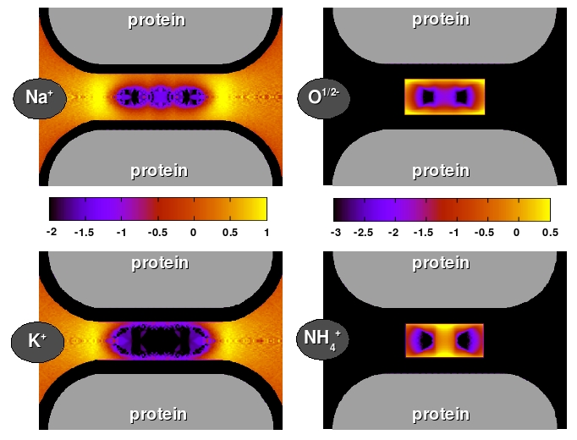
Binding Sites
Size Selectivity
*Binding Sites are outputs of our INDUCED FIT
Model of Selectivity,
not structural inputs
NOT selective
Selectivity Filter
Selectivity Filter
[NaCl] = [KCl] = 50 mM
Ion Diameter
Ca⁺⁺ | 1.98 Å
Na⁺ | 2.00 Å
K⁺ | 2.66 Å
‘Side Chain’ Diameter
 | 3.00 Å pH 8
 | 2.80 Å pH 8
Na Channel DEKA 6 Å
Selectivity Filter
Selectivity Filter
log C/C_{ref}
Selectivity Filter
Selectivity Filter
Lys or K
Selectivity Filter
Selectivity Filter
D or E
Na vs K Size Selectivity is in Depletion Zone
Boda, et al
BLACK = Depletion=0

Slide 78
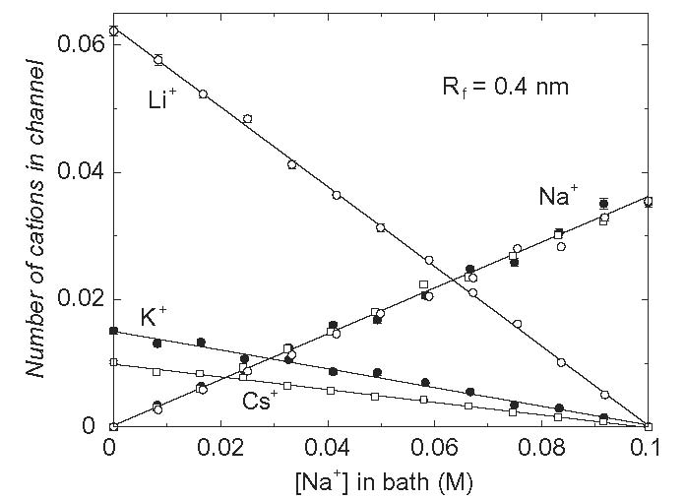
Na, K, Li, Cs Binding in Sodium channel

Slide 79
What do the Variables do?
What happens if we
Vary Diameter and
Vary Dielectric Coefficient?
Sensitivity Analysis

Slide 80
Inverse Problem
We discover
Orthogonal Control Variables* in simulations of the Na channel, but not the Ca channel.
*These emerge as outputs. They are not inputs.

Slide 81
Control Variables
Selectivity Na⁺ vs K⁺
Selectivity Depends on Structure
Depends STEEPLY on channel diameter
Depends only on channel diameter

Slide 82
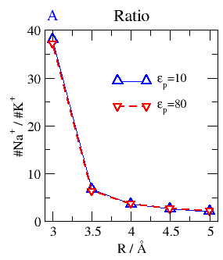
Na⁺ vs K⁺ (size) Selectivity (ratio)
Depends on Channel Size, not Protein Dielectric Coefficient*
Selectivity
for small ion
Na⁺
2.00 Å
K⁺
Na⁺
K⁺
2.66 Å
6 8 10
Small Channel Diameter Large
in Å
Boda, et al
*in DEKA Na Channel

Slide 83
Control Variables
Conductance of DEKA Na⁺ channel
Conductance Depends Steeply on Dielectric
Contents of Channel depend only on dielectric
but
Selectivity does not depend on Dielectric
Selectivity depends only on Structure

Slide 84
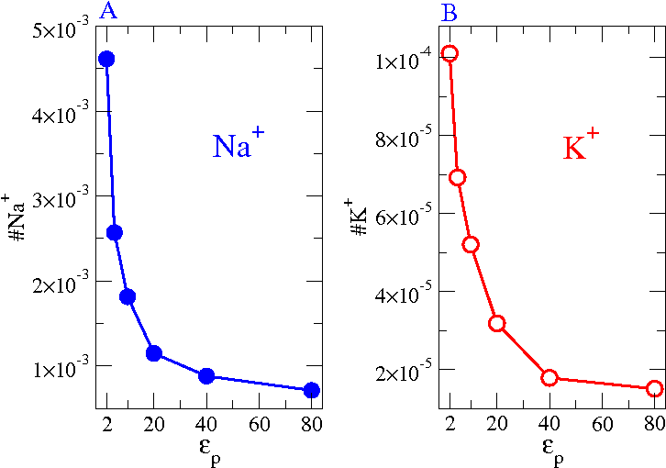
Control Variable
Channel Contents (occupancy)
depends on
Protein Polarization (dielectric)
DEKA Na Channel, 6 Å
Na⁺
Occupancy
2.0 Å
K⁺
2.66 Å
Channel Contents
occupancy
Boda, et al

Slide 85
Channel Diameter and
Dielectric Coefficient emerge as
Orthogonal Control Variables* in simulations of the Na channel, but not the Ca channel.
*These emerge as outputs. They are not inputs.
Static Structure
Dynamic Structure

Slide 86
Supplementary Material
RyR Channel:
Current Voltage Curves

Slide 87
Best Evidence is from the
RyR Receptor
Gillespie, Meissner, Le Xu, et al,
not Bob Eisenberg
● More than 120 combinations of solutions & mutants
● 7 mutants with significant effects fit successfully

Slide 88
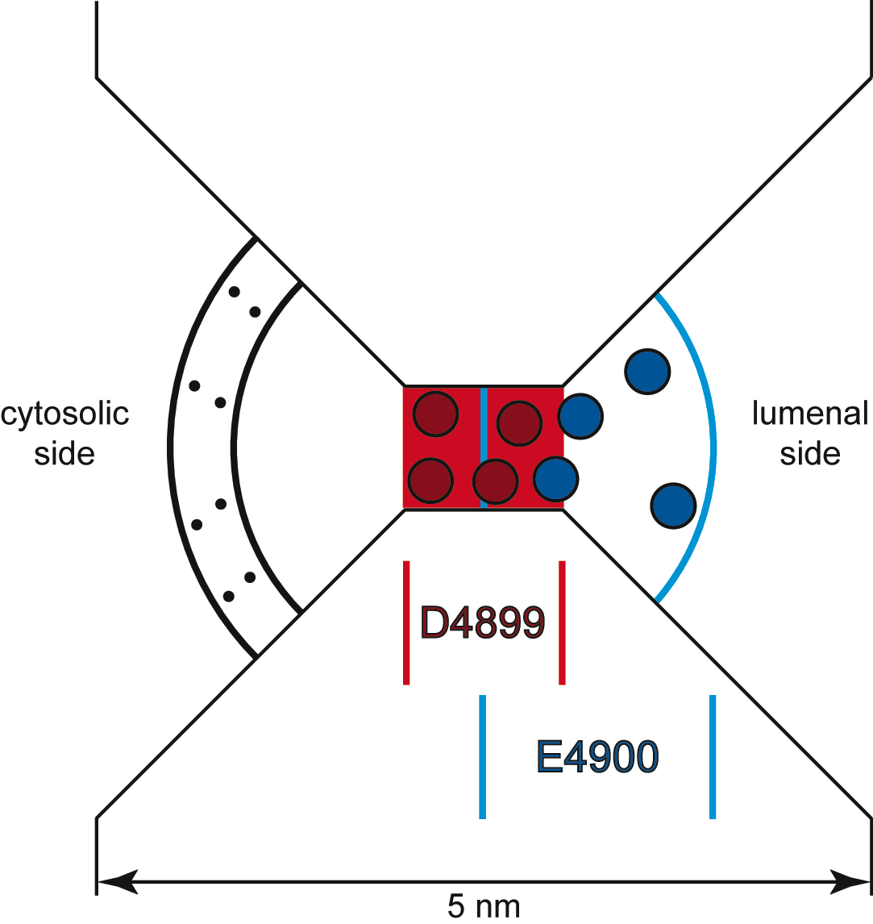
The Geometry
Selectivity Filter
is 10 Å long and 8 Å in diameter
confines four D4899
negative amino acids.
Four E4900 positive amino acids are on lumenal side, overlapping D4899.
Cytosolic distributed charge
Protein
Cytoplasm
Lumen
Protein
D. Gillespie et al., J. Phys. Chem. 109, 15598 (2005).

Slide 89
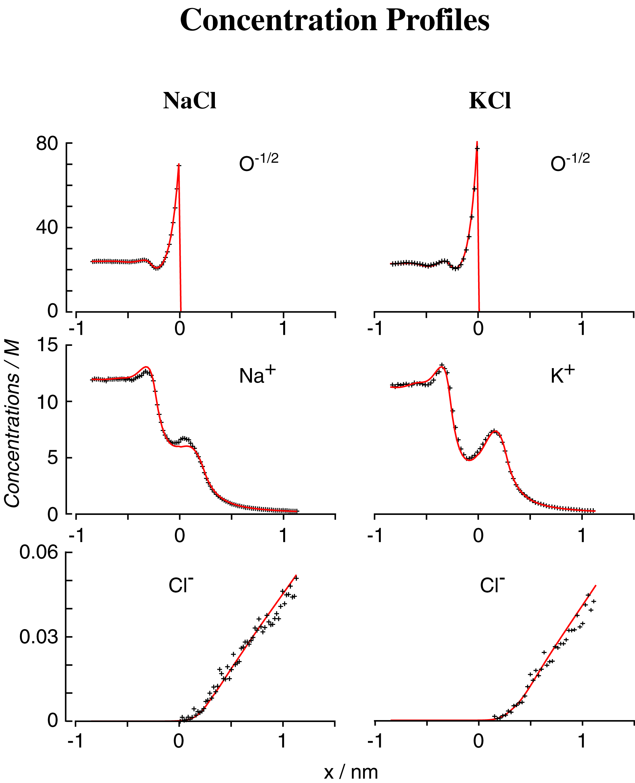
DFT/PNP vs Monte Carlo Simulations
Concentration Profiles
Misfit
Nonner, Gillespie, Eisenberg

Slide 90
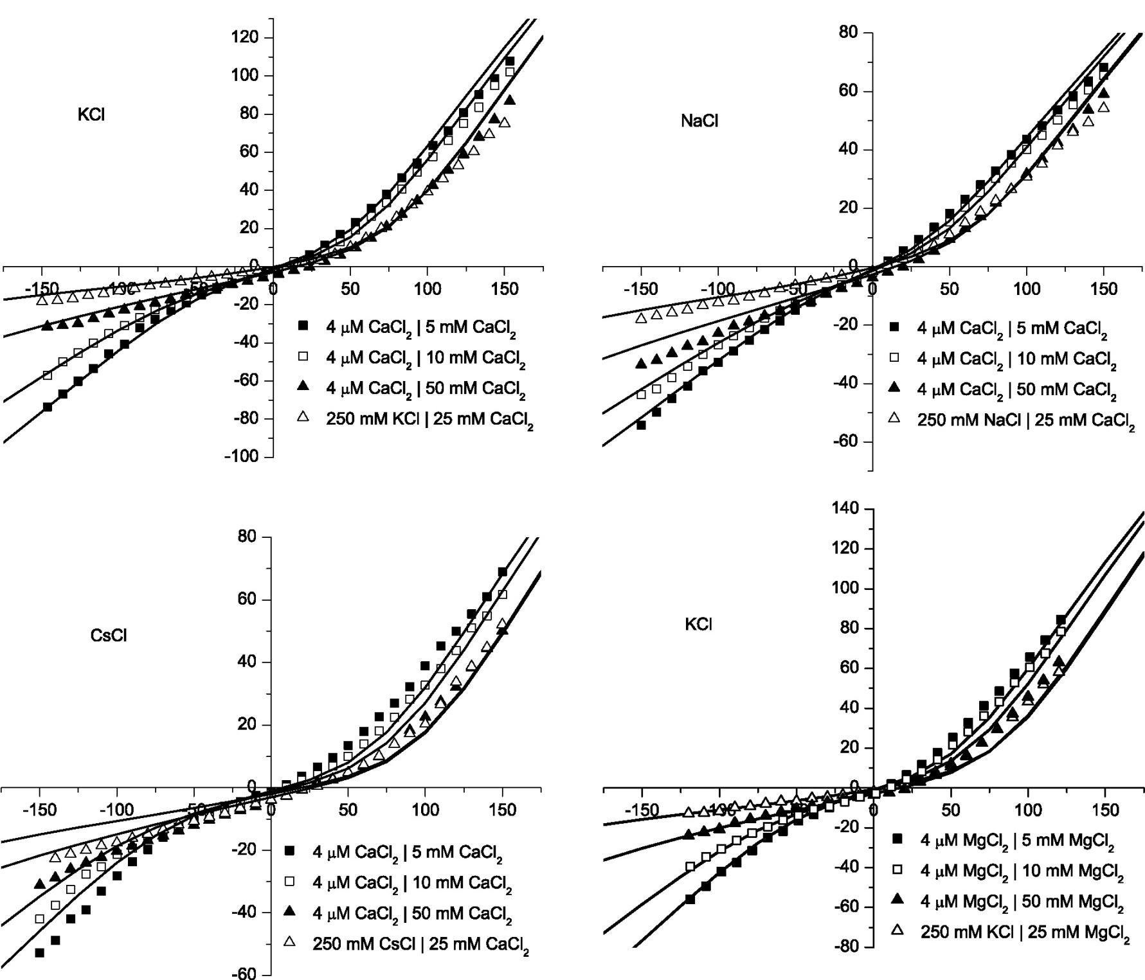
Divalents
Gillespie, Meissner, Le Xu, et al
KCl
CaCl₂
NaCl
CaCl₂
Error < 0.1 kT/e
Misfit
2 kT/e
CsCl
CaCl₂
KCl
MgCl₂
Misfit

Slide 91
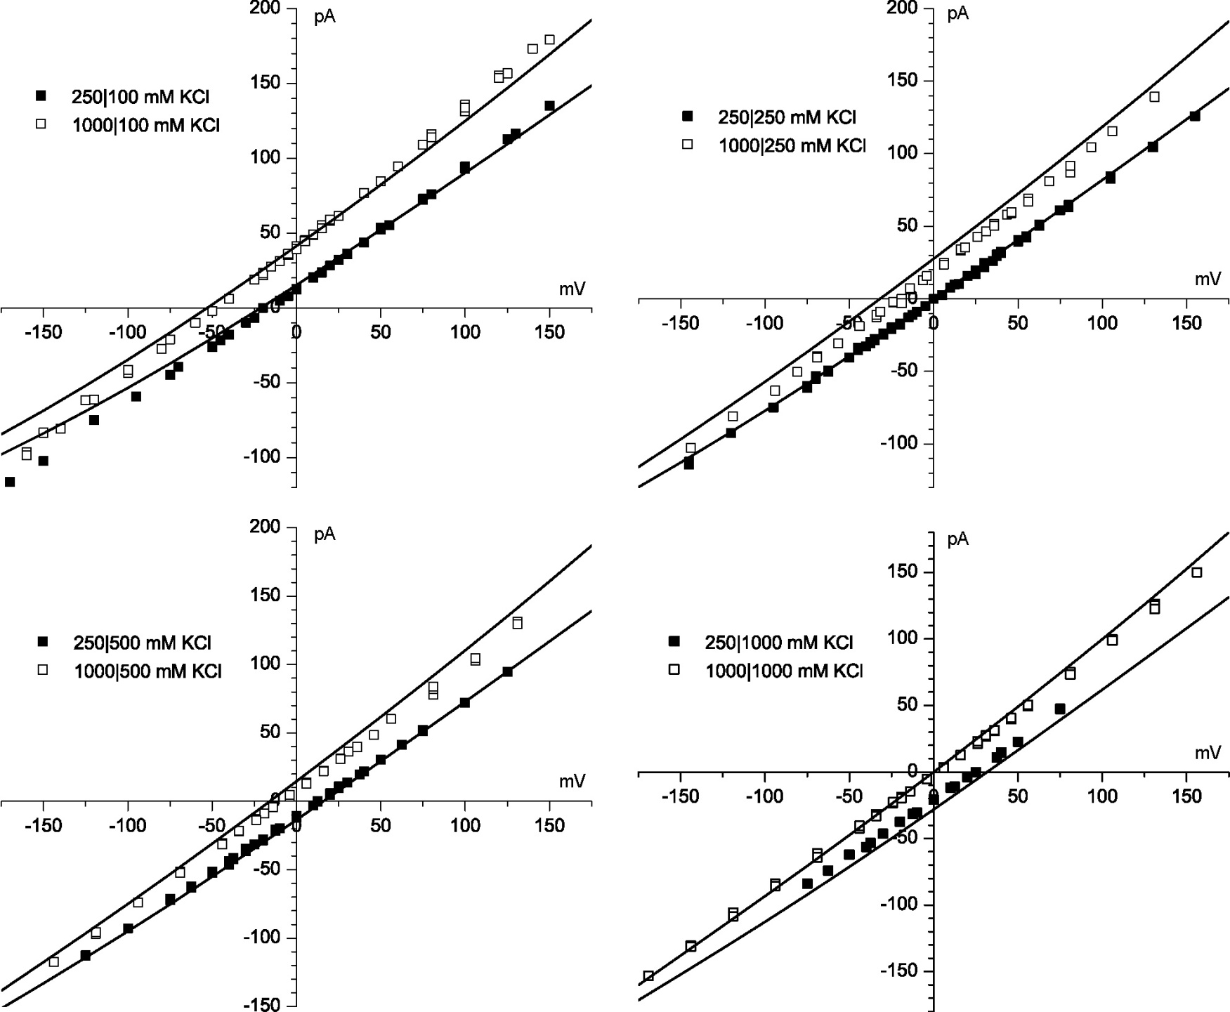
KCl
Gillespie, Meissner, Le Xu, et al
4 kT/e
Error < 0.1 kT/e
Misfit

Slide 92
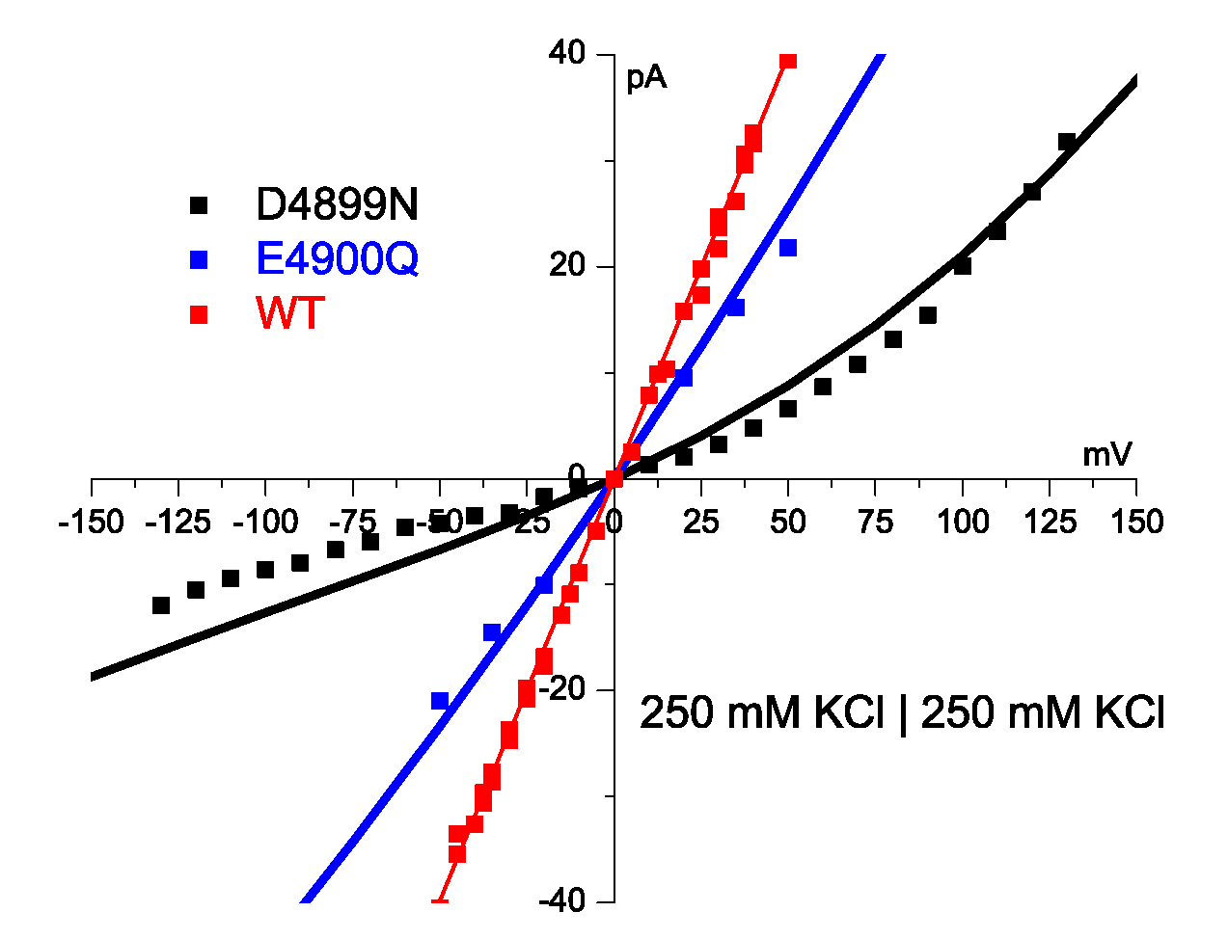
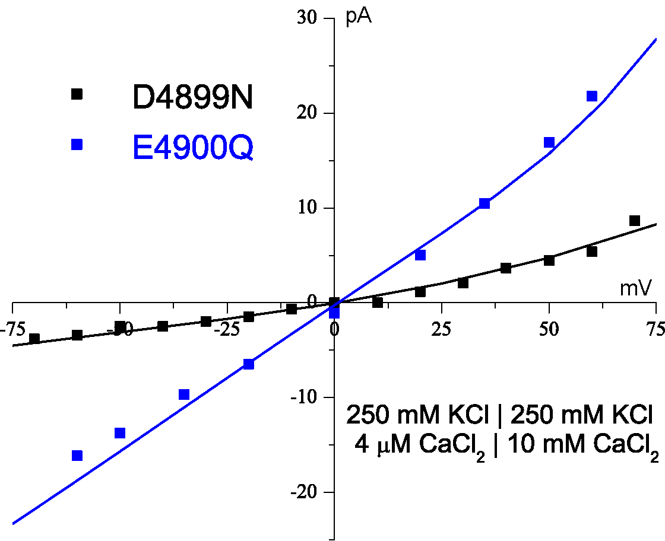
Theory fits Mutation with Zero Charge
No parameters adjusted
Theory Fits Mutant in K
Theory Fits Mutant
in K + Ca
Error < 0.1 kT/e
1 kT/e
Protein charge density
wild type* 13 M
Water is 55 M
*some wild type curves not shown, ‘off the graph’
⇨
0 M in D4899
1 kT/e
Gillespie et al
J Phys Chem 109 15598 (2005)

Slide 94
Vaccination
against
Traditional Models

Slide 95
Traditional Biochemistry
and
Traditional Molecular Dynamics
Assume
Ideal Solutions
Ions in Water and Life are NOT ideal
Life Occurs in ~130 mM salt solutions
Ions in Water are the Liquid of Life

Slide 96
No gas phase models of
traditional channel biochemistry
Liquids are not Gases
Rate Constants are Variables
No discussions of individual trajectories of Structural Biologists
Counting and Statistics are essential

Slide 97
Computation Starts
From Crystal Structure
when available
but
Crystal Structures cannot determine Selectivity
because
1) Crystal Structures are measured in only one unphysiological solution
2) Crystal Structures are not accurate enough
3) Crystal Structures do not give entropy

Slide 98
Selectivity
Depends Sensitively on Self-organized Structure and their Flexibility
Induced Structure is Different in Different Solutions
so
Structure must be Computed!
Rate constants are variables that change dramatically with conditions

Slide 100
Supplementary Material

Slide 101
Ions in Water are the Liquid of Life. They are not ideal solutions
Chemically Specific Properties
of Ionic Solutions come from
Interactions
Molecular Dynamics Force Fields are Calibrated
assuming no interactions with concentrations
Force Fields must be REcalibrated
in each Biological Solution

Slide 102
Ca²⁺ and Na⁺ Binding Curves
DEEA Calcium Channel
Eisenberg, Hyon, and Liu
Eisenberg, Hyon, and Liu

Slide 103
Eisenberg, Hyon, and Liu

Slide 104
Nonequilibrium Computations
with Variational Field Theory
EnVarA
Binding Curves
Current Voltage Time Curves

Slide 105
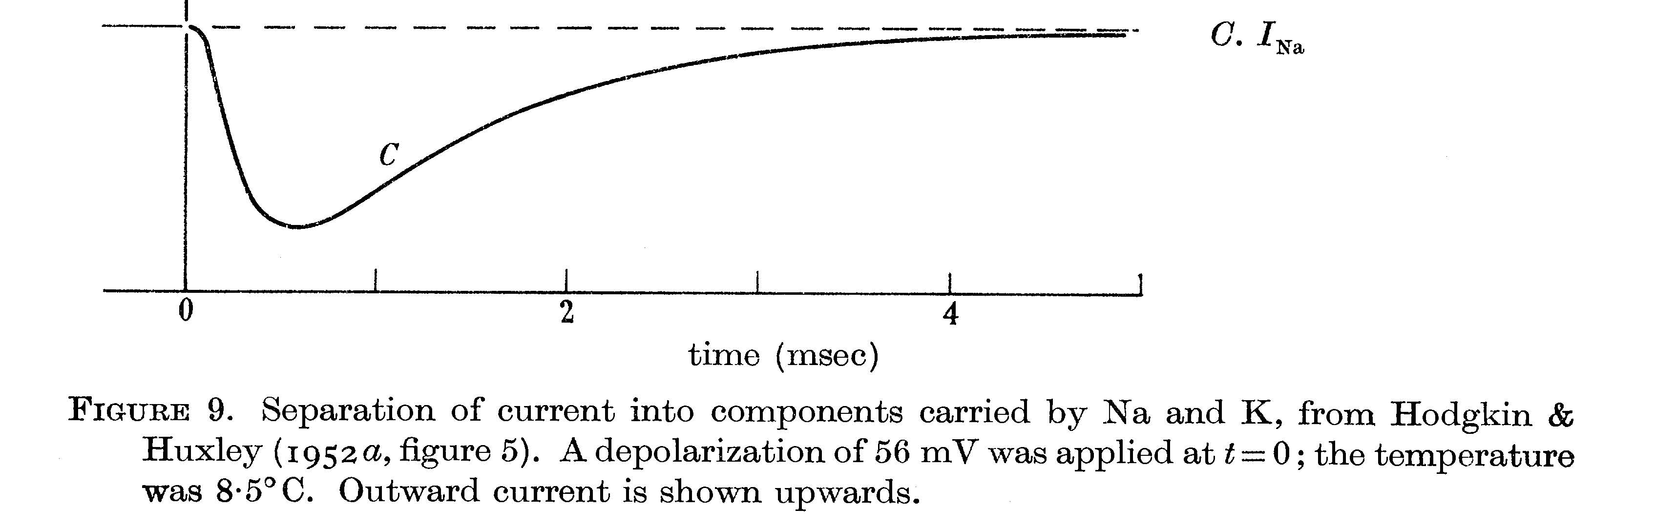
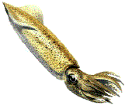
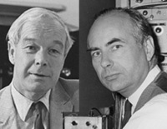
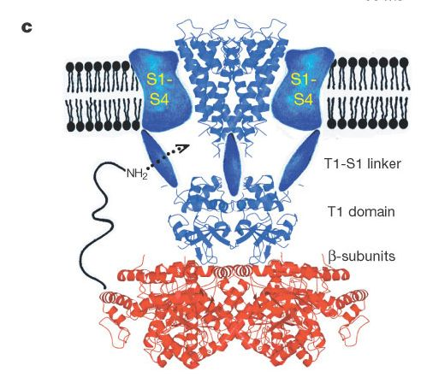
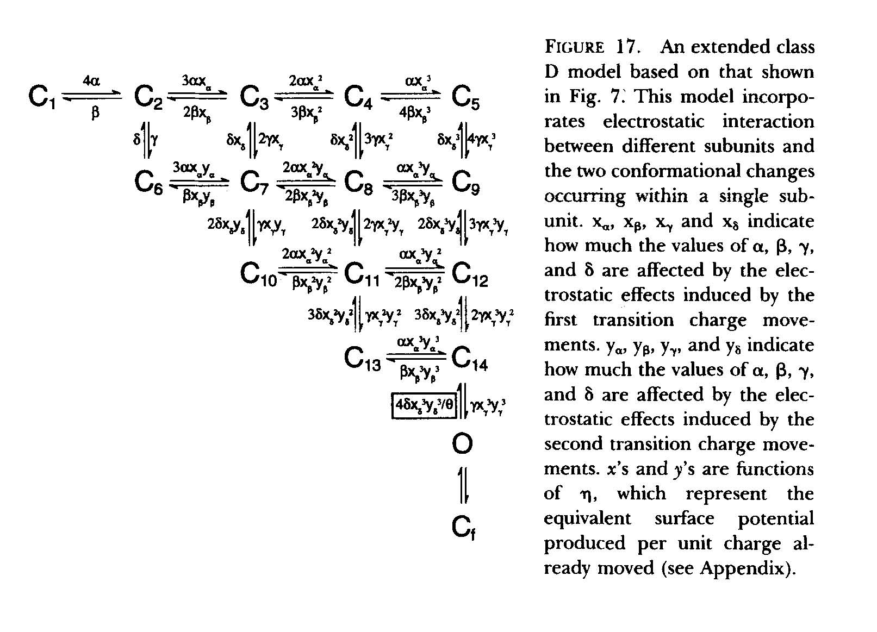
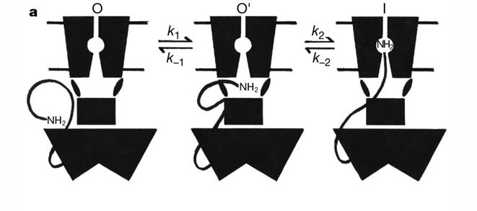
Sodium Conductance and Inactivation
in Squid Axon (nerve fiber)
Hodgkin Huxley
J. Physiol (1952) 116:497
Conventional Explanation: Elaborate Structural Change

Slide 106
Inactivation is Important
Many diseases produced by changes in details of inactivation.
Energetics of Brain determined by details of inactivation*
Energetics determined by time overlap of Na and K currents
*Alle, Roth, and Geiger. Science (2009) 325:1405-8.

Slide 107
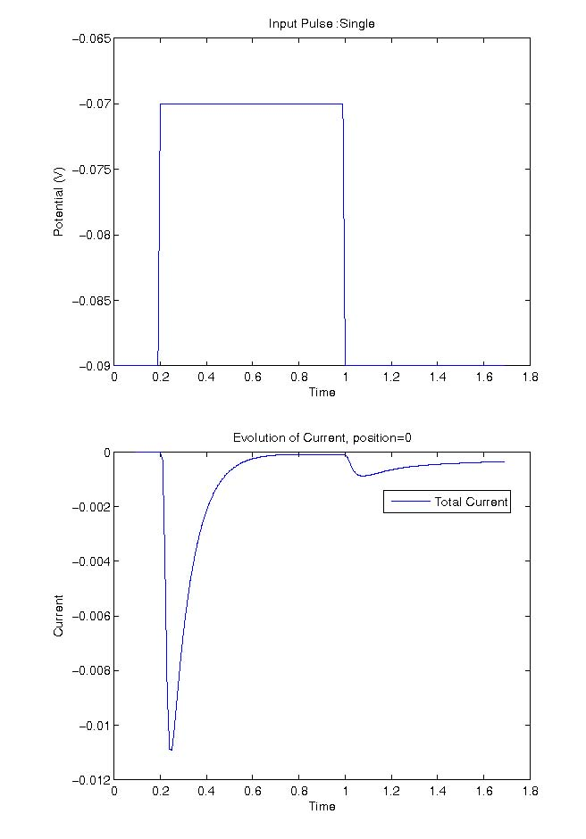
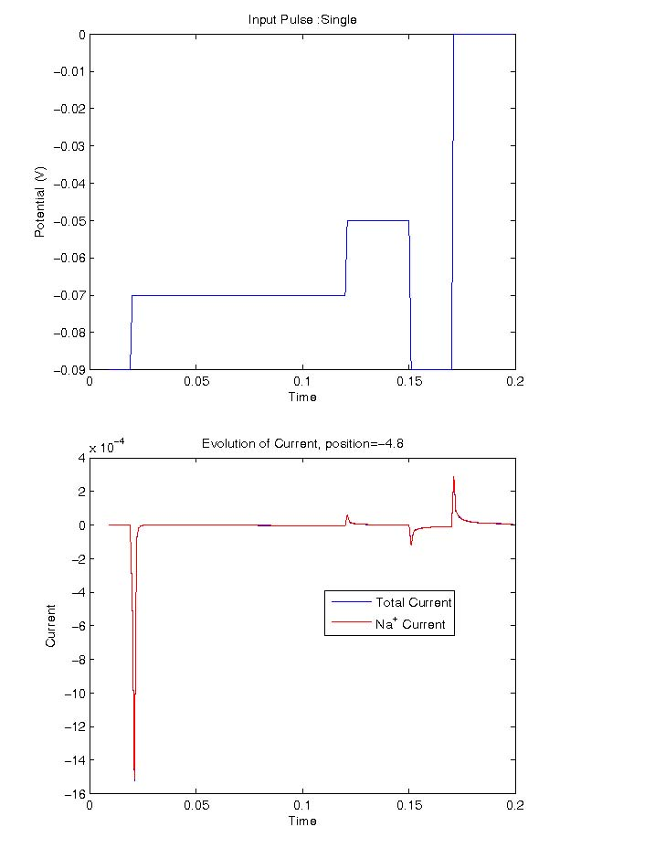
Sodium Conductance and Inactivation
Variational Computation in Fixed Structure
Eisenberg, Hyon, and Liu

Slide 108
Energetic Variational Analysis
EnVarA
Chun Liu, Yunkyong Hyon and Bob Eisenberg
New Interpretations
likely to be
Controversial
but
Quantitative and Testable

Slide 109
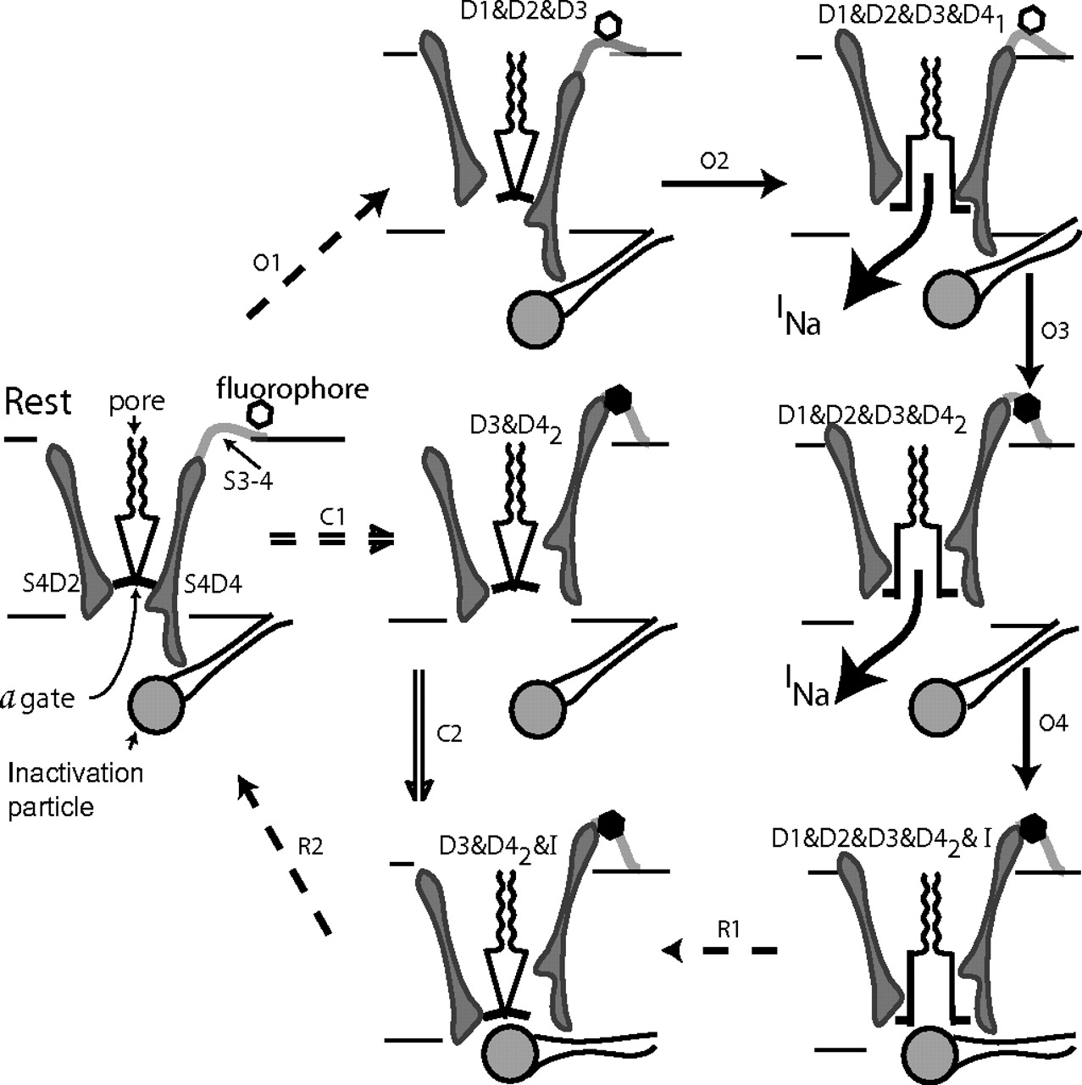
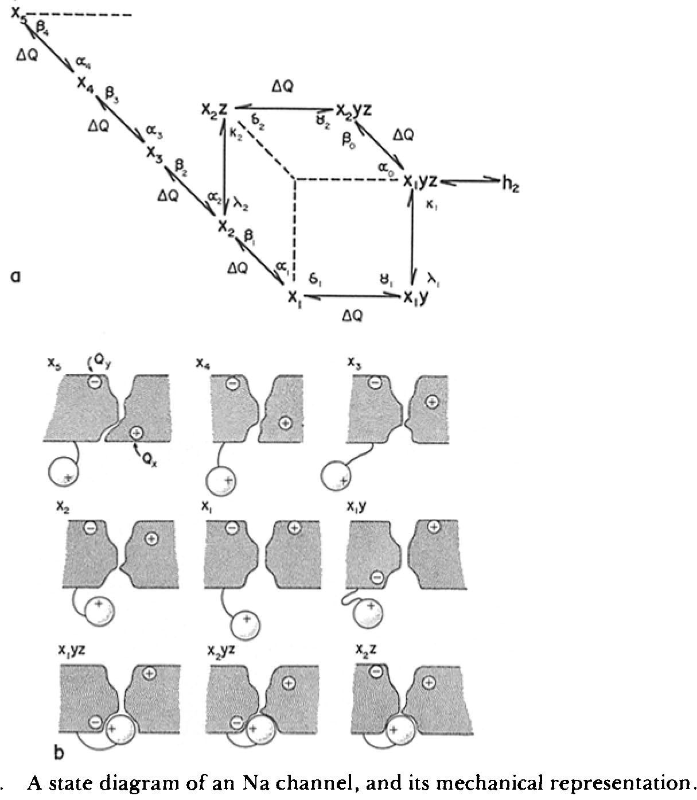
Channel Activation and Inactivation
‘Ball and Chain’ Model
Armstrong PNAS 2006 103:17991
Armstrong & Bezanilla J Gen Physiol 1977 70:567
Existing Models are Structural and Mechanical
with no quantitative results
Notes:
Channel activation and inactivation. At rest, the S4s of all domains are fully deactivated, forced inward by negative Vm. This pinches closed the a gate at the inner end of the pore. The scallops represent the selectivity filter. Path O: On depolarizing to 0 mV, the most likely path is shown by arrows O1–O4, with dashed arrows indicating multiple steps. Conduction begins when all four domains are activated, with D4 activated to stage 1. Stage 2 activation of D4 removes the steric hindrance that prevents closing of the inactivation gate and quenches fluorescence of the tag attached to the S3–4 linker of D4. Path C: At −30 mV, paths C and O are equally probable. After step C1, the a gate is held closed by D1 and D2, which are not activated, but inactivation is possible because D3 and D4 are activated, the latter to stage 2. The inactivation gate closes in step C2. Recovery: Steps R1 close the a gate as D1 and D2 deactivate, generating the inactivation resistant component of Ig. During step R2, negative Vm drives the S4s of D3 and D4 inward, the latter forcing the inactivation particle out of blocking position.

Slide 110
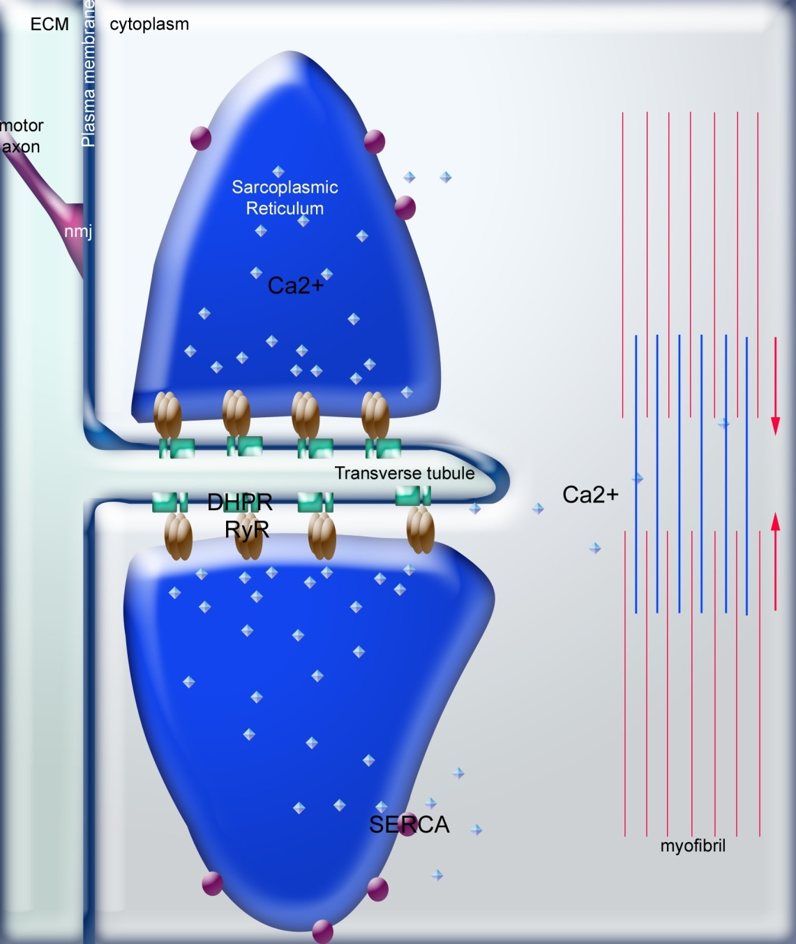
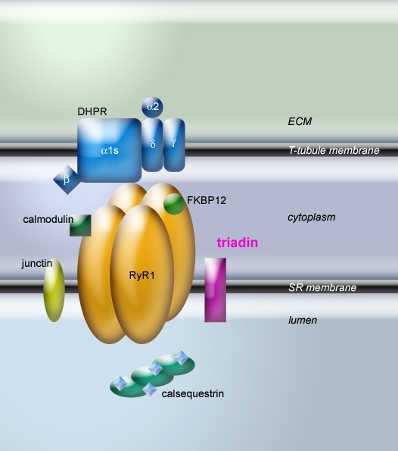
Channels are parts of Machines, e.g., Excitation-Contraction Coupling
L type Ca Channel RyR ryanodine receptor
L-type Ca Channel
RyR
Thanks for the figure to
László Csernoch, Debrecen, Hungary
Isabelle Marty, Grenoble, France
Notes:
Composed of two proteins associated: the RyR and the DHPR.

Slide 111
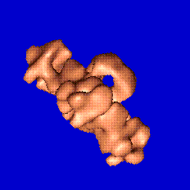
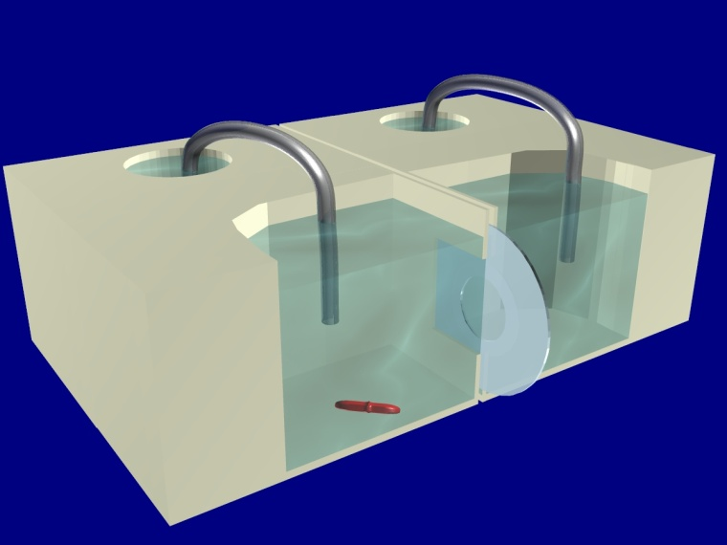
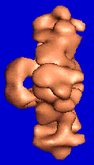
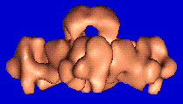
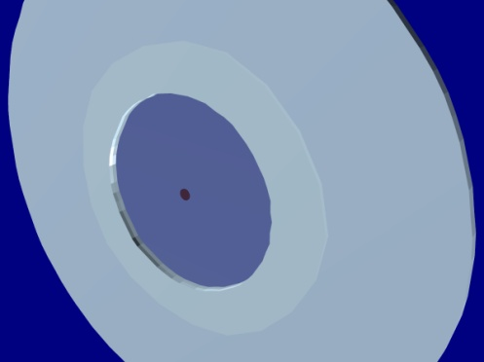
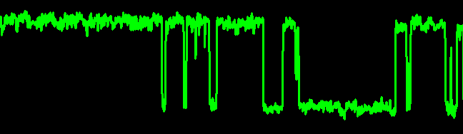
Function of SINGLE isolated RyR Channels
in Artificial Planar Lipid Bilayers
AxoPatch
Patch-Clamp
Amplifier
Designed
at Rush
Planar
Bilayer
Ca
Fused
Vesicle
Single Channel Current
Experimental
Chamber
open
closed
Teflon
Septa
Slide from
Mike Fill
Thanks!
80-100 µM
Diameter

Slide 112
Gating and Permeation
Selectivity,
Permeation
are
Amplitude
Gating is Time Behavior
Notes:
The patch clamp allows one to record the tiny currents flowing through a single ion channel. They look like rectangles - what could be simpler? The height of the rectangle is the current, the width is the open duration. Counting rectangles gives you the opening frequency.
The rest of this lecture deals with Gating (width of the rectangle) and permeation (height of the rectangle). Note that the widths show a wide variation (exponential distribution) but the heights are relatively constant and are normally distributed.

Slide 113
For Modelers and Mathematicians: This is reverse engineering!
Central Problem
How does the channel control Selectivity?
Inverse Problem for Selectivity
Badly posed, many answers are possible,
simultaneously over and under determined
with noise and systematic error
Core Math Problem has actually been solved
using methods for the
Inverse Problem of a Blast Furnace
Burger, Eisenberg and Engl (2007) SIAM J Applied Math 67: 960-989

Slide 114
Channels are Selective
Different Types of Channels
use
Different Types of Ions
for
Different Information

Slide 115
Energetic Variational Analysis
EnVarA
Chun Liu, Yunkyong Hyon and Bob Eisenberg
New Interpretations
likely to be
Controversial
but
Quantitative and Testable

Slide 116
Time Dependence
is
Important
Many diseases produced by inactivation
Energetics of Brain
determined by inactivation*
*Energetics determined by time overlap of Na and K currents
Alle, Roth, and Geiger. Science (2009) 325:1405-8.

Slide 117
Time Dependent Sodium Conductance
Inactivation in Squid Axon (nerve fiber)
Hodgkin Huxley
J. Physiol (1952) 116:497
Conventional Explanation: Elaborate Structural Change

Slide 118
Sodium Conductance and Inactivation in Fixed Structure
Variational Computation
Eisenberg, Hyon, and Liu

Slide 119
Multiscale Issues
are the key
if we want to actually build channels that work
Computational Scale | Biological Scale | Ratio
Time 10⁻¹⁵ sec | 10⁻⁴ sec Action Potential | 10¹¹
Space 10⁻¹¹ m | 10⁻⁵ m Side Chains of Proteins | 10⁶
Spatial Resolution |  | 10¹⁸
Solute Concentration | 10⁻¹¹ to 20 Molar | 10¹²
Three Dimensional (10⁶)³

