Slide 1
Crowded Channels and Active Sites

Slide 2
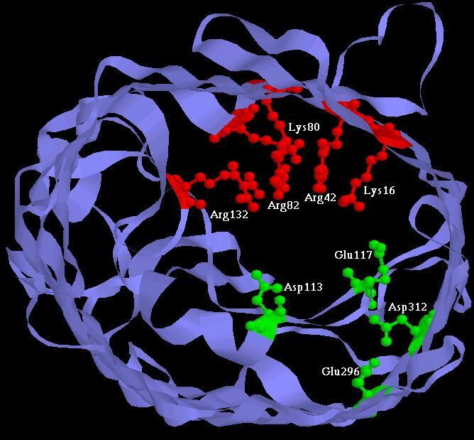
Physical basis of function
Active Sites of Proteins are Very Charged
7 charges ~ 20 M net charge
= 1.2×10²² cm⁻³
liquid Water is 55 M solid NaCl is 37 M
OmpF Porin
Ions are Crowded
Hard Spheres
Na⁺
+
+
+
+
+
K⁺
Ca²⁺
Na⁺
-
-
-
K⁺
-
Induced Fit of Side Chains
4 Å
Selectivity Filters and Gates of Ion Channels
are
Active Sites
Figure adapted from Tilman Schirmer

Slide 3
Crowded Active Sites in 573 Enzymes
Enzyme Type |  | Catalytic Active Site Density (Molar) |  |  | Protein
 |  | Acid (positive) | Basic (negative) | | Total | | Elsewhere
 | Total (n = 573) | 10.6 | 8.3 | 18.9 | 2.8
EC1 | Oxidoreductases (n = 98) | 7.5 | 4.6 | 12.1 | 2.8
EC2 | Transferases (n = 126) | 9.5 | 7.2 | 16.6 | 3.1
EC3 | Hydrolases (n = 214) | 12.1 | 10.7 | 22.8 | 2.7
EC4 | Lyases (n = 72) | 11.2 | 7.3 | 18.5 | 2.8
EC5 | Isomerases (n = 43) | 12.6 | 9.5 | 22.1 | 2.9
EC6 | Ligases (n = 20) | 9.7 | 8.3 | 18.0 | 3.0
Jimenez-Morales, Liang, Eisenberg

Slide 4
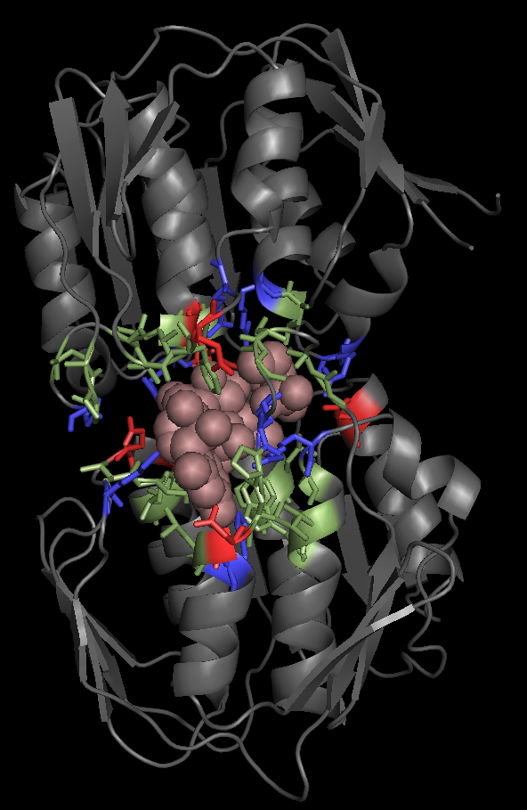
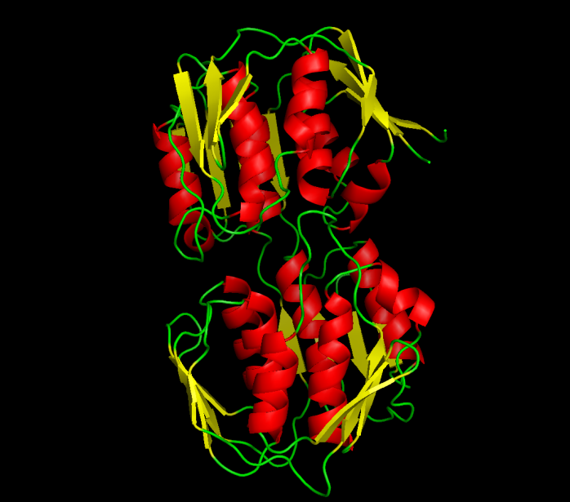
Example:
UDP-N-ACETYLGLUCOSAMINE ENOLPYRUVYL TRANSFERASE (PDB:1UAE)
Functional Pocket Molecular Surface Volume: 1462.40 A³
Density : 19.3 Molar (11.3 M+. 8 M-)
EC2: TRANSFERASES Average Ionizable Density: 19.8 Molar
Crowded
Green: Functional pocket residues
Blue: Basic = Probably Positive = R+K+H
Red: Acid = Probably Negative = E + Q
Brown URIDINE-DIPHOSPHATE-N-
ACETYLGLUCOSAMINE
Jimenez-Morales, Liang, Eisenberg

