Slide 1
3 Replace Law of Mass Action

Slide 2
Traditional Chemical Models depend historically and logically on The Law of Mass Action

Slide 3
Law of Mass Action
Differential equation is almost always solved assuming and are constants.
[ A] means the concentration of species A, i.e., the number density of A

Slide 4
Everything is hidden in K_{eq}, k_{f} and k_{b}
Interactions mean
k’s and K are functions
not constants

Slide 5
Great Opportunity for New Mathematics and Its Applications
‘Law’ of Mass Action including Interactions
Variational Approach
EnVarA
Conservative
Dissipative
From Bob Eisenberg p. 1-6, in this issue

Slide 6
Where to start?
‘Law of Mass Action’
must be Replaced by a
Variational Field Theory
throughout Chemistry and Biology!!

Slide 7
Variational Principles Deal with Interactions Consistently and Automatically
Chun Liu, with YunKyong Hyon, and Bob Eisenberg
EnVarA
New Component (or Scale) implies
New Field Equations (Euler Lagrange)
by
Algebra Alone
No new Assumptions

Slide 8
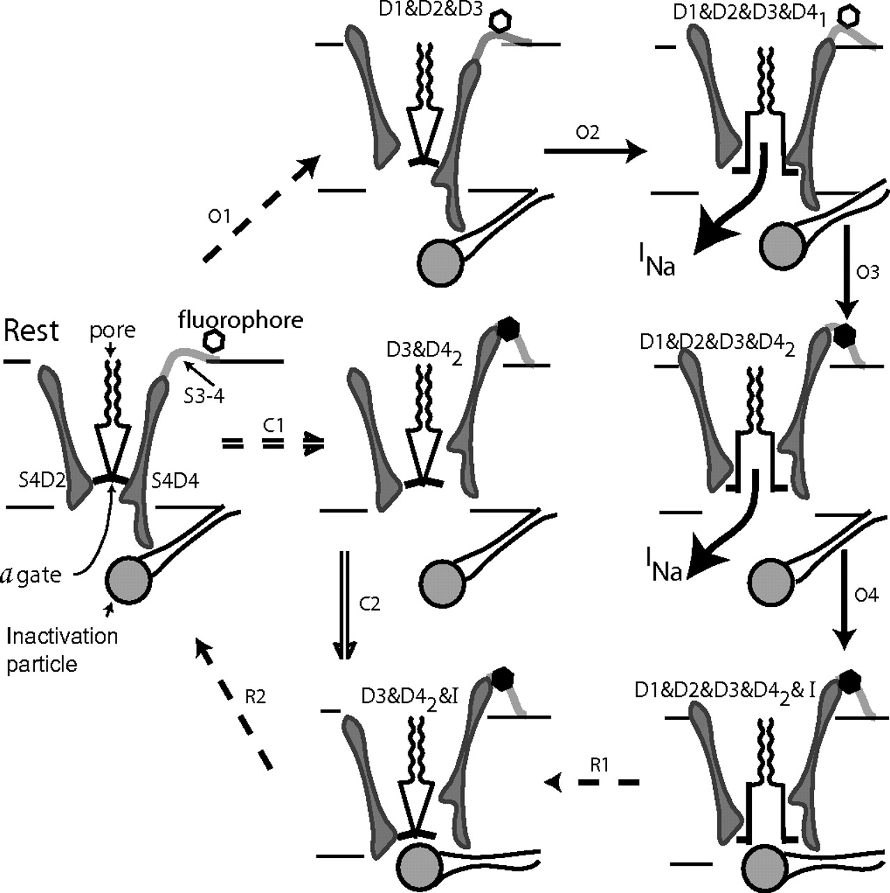
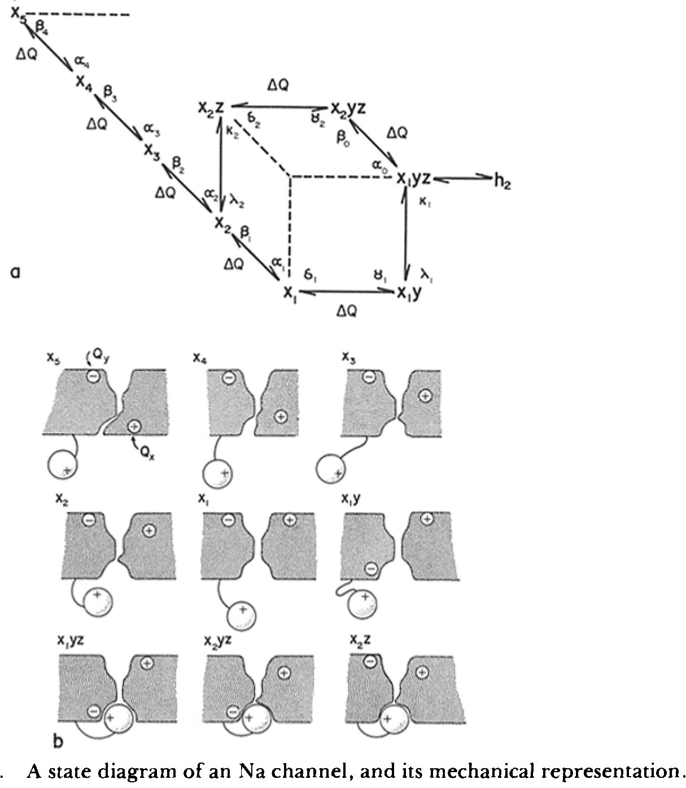
Variational Approach is needed to Add Components and Mechanisms with Minimal Confusion
in my opinion

Slide 9
Replacement of “Law of Mass Action” is Feasible for Electrolyte Solutions
the ‘liquid of life’

