Slide 1
Electric Field is Strong
The Electric Field is Special

Slide 2
The Electric Field is Strong
“If you were standing at arm’s length from someone and each of you had
One percent more electrons than protons,
the force
would lift the
Entire Earth!”
slight paraphrase of third paragraph, p. 1-1 of
Feynman, R. P., R. B. Leighton, and M. Sands 1963
Feynman Lectures on Physics, Mainly Electromagnetism and Matter.
also at http://www.feynmanlectures.caltech.edu/II_toc.html.

Slide 3
The Electric Field is Strong
Electrons are points < 10⁻²² m
Maxwell Equations are Universal, true on all known time scales and distances, with quantum interpretations, e.g., Casmir effect
The Electric Field is Special

Slide 4
Electrostatics and Chemistry
“… all forces
on atomic nuclei in a molecule
can be considered as
purely classical attractions
involving
Coulomb’s law”
“The electron cloud distribution is prevented from collapsing by obeying Schrödinger’s equation.”
R.P. Feynman (1939)
Forces in Molecules.
Physical Review 56: 340.

Slide 5
Continuity of Current is Exact no matter what carries the current
Maxwell Equations are Special
even though
Physics of Charge Flow
Varies Profoundly
even Creating Plasmas!
‘Charge’ is an Abstraction
with
VERY different Physics
in different systems

Slide 6
Maxwell’s Equations
are about
Conservation of Charge
and continuity of current, including displacement current

Slide 7
‘Charge’ is an Abstraction
with different Physics
in different systems

Slide 8
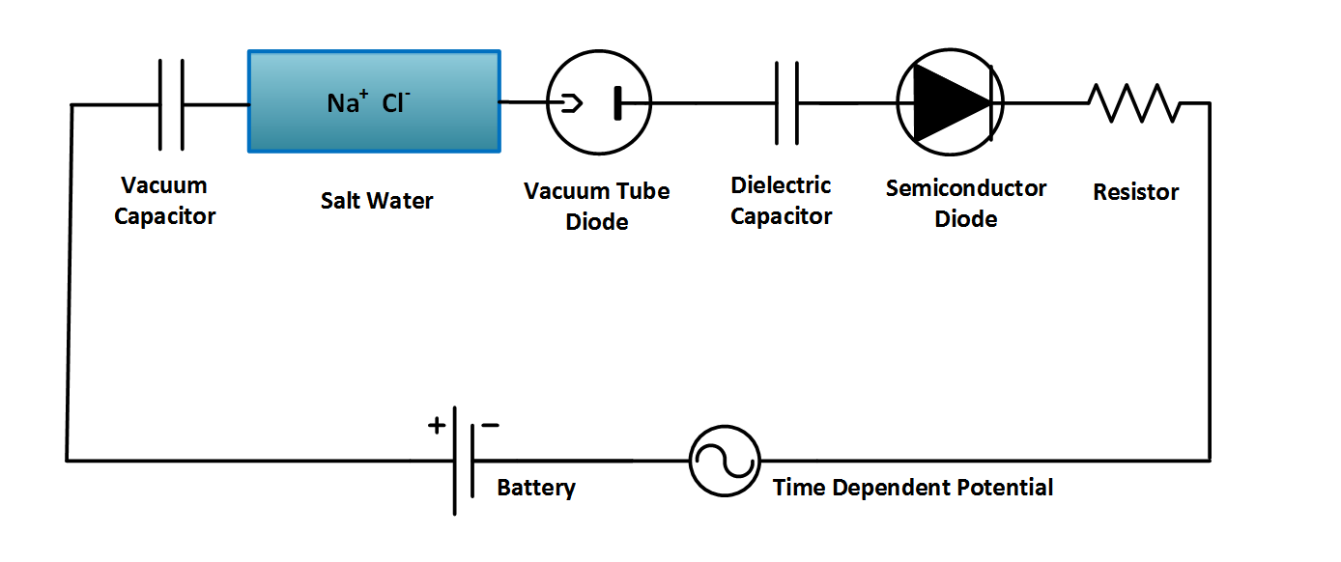
but Continuity of Current is Exact
No matter what carries the current!
‘Charge’ is an Abstraction
with different Physics
in different systems
Ag AgCl
Ag AgCl
D = permittivity × E

Slide 9
What does GLOBAL mean?
NON-equilibrium so very different
from equilibrium?
equilibrium analysis cannot approximate
or
be extended to nonequilibrium devices
Next two slides are for fun
and GENERAL education
They are not part of the logical argument

Slide 10
Continuity of Current is Exact
even though
Physics of Charge Flow
Varies Profoundly
even
Creating Plasmas in air
SPARKS
Pop!
*speaking loosely

Slide 11
Mathematics of Continuity
in Maxwell equations can
Create New Kind of Physics,
New Kind of Charge
When we unplug a computer power supply,
we often
CREATE
SPARKS,
i.e., a PLASMA,
a NEW KIND
of current flow
Pop!

Slide 12
Back to the main discussion

Slide 13
Maxwell’s Equations
are about
Conservation of Charge
and continuity of current, including displacement current

Slide 14
Rate Models Fail
because
‘Current-in’
does not equal
‘Current-out’
if rate constants are independent of potential

Slide 15
Kirchoff Current Law
and
Maxwell Equations
are nearly the same thing
Bhat & Osting (2011). IEEE Trans Antennas and Propagation 59: 3772-3778
Heras (2007) American Journal of Physics 75: 652-657
Heras (2011) American Journal of Physics 79: 409
Itzykson & Zuber Quantum Field Theory (1990) p. 10

Slide 16
Rate Models Fail
because
Current-in does not equal Current-out!!
(if rate constants are independent of potential)

Slide 17
Kirchoff’s Current Law
= Maxwell’s Equations
Correlation coefficient
0.999 999 999 999 999 999
EVERYTHING
INTERACTS
WITH
EVERYTHING ELSE
including the boundaries ‘at infinity’

Slide 18
Artifactual Charge is Produced by I_{XY} − I_{YZ}
The Electric Field is Strong
If you were standing at arm’s length from someone and each of you had
One percent more electrons than protons,
the force
would lift the
Entire Earth!

Slide 19
Estimates of
Violation of Continuity of Current
Set all concentrations and rate constants to one
Set all concentrations and valences to one
Effects are Huge
much more than 1%

Slide 20
Artifactual Charge is Produced by I_{XY} − I_{YZ}
The Electric Field is Strong
Artifactual Charge can create Artifactual Results
Artifactual Charge
can
inactivate channels
denature enzymes
breakdown membranes
protonate weak bases
even strip electrons off atoms, destroying compounds

Slide 21
How improve law of mass action?
Rate Constants
must depend on
Electrical Potential
EVERYWHERE

Slide 22
Everything is hidden
in K_{eq}, k_{f} and k_{b}
Interactions exist:
k’s and K are function(al)s
not constants

Slide 23
Parameterization is not Possible
under more than one condition
Rate constants chosen at one boundary charge or one potential
cannot work for different charges or potentials.
Different Boundary Charges or Potentials
Change Currents
in the real world
but
Currents in Rate Models
are
Independent of Charge and Potential

Slide 24
How improve law of mass action?
Rate Constants
must be determined
from Differential Equations or
a Variational Principle

Slide 25
Physical Chemists are Frustrated by Real Solutions

Slide 26
It is not surprising that
Inconsistent Treatments
of ionic solutions
have been so
Unsuccessful
despite more than a century of work by fine scientists and mathematicians
There are no successful theories of ionic conductance, and no successful theories of properties of ionic mixtures even at equilibrium.
No simulations even address the properties of ionic mixtures or ionic conductance.

Slide 27
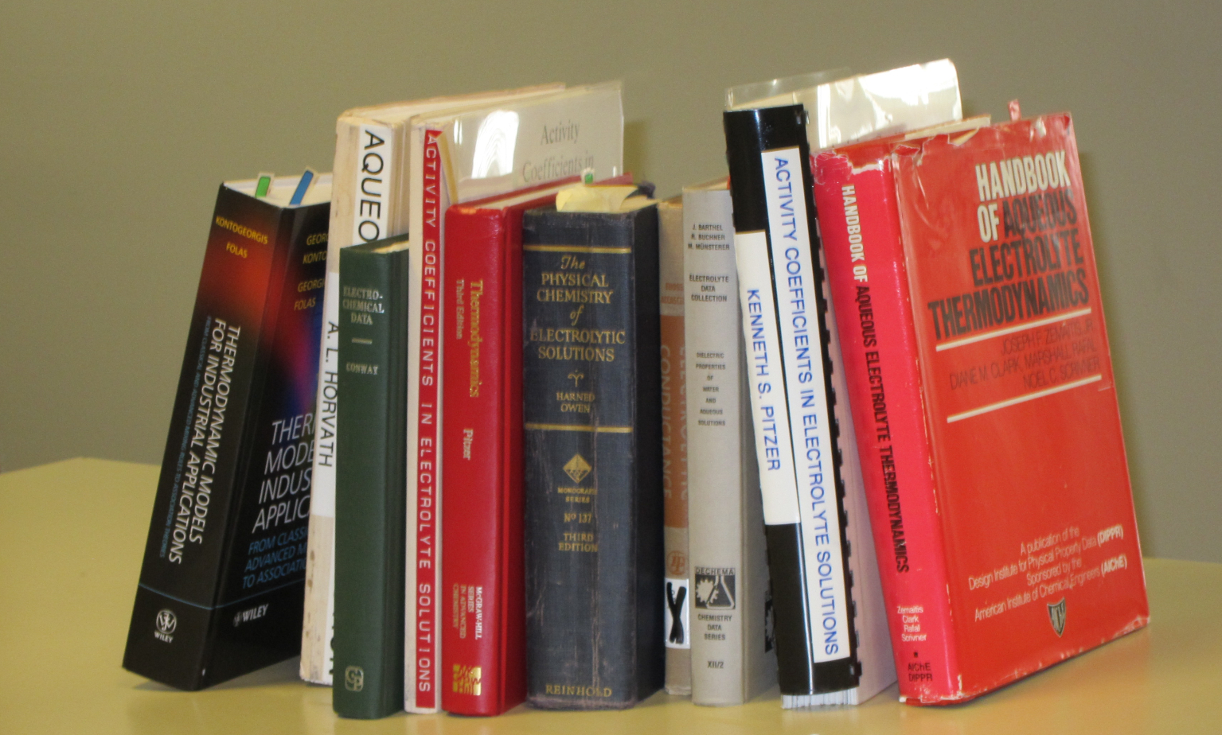
Good Data

Slide 28
Good Data
Compilations of Specific Ion Effect
>152,076 Data Points [Oct 2014] on-line
IVC-SEP Tech Univ of Denmark
http://www.cere.dtu.dk/Expertise/Data_Bank.aspx
2. Kontogeorgis, G. and G. Folas, 2009:
Models for Electrolyte Systems. Thermodynamic
John Wiley & Sons, Ltd. 461-523.
3. Zemaitis, J.F., Jr., D.M. Clark, M. Rafal, and N.C. Scrivner, 1986,
Handbook of Aqueous Electrolyte Thermodynamics.
American Institute of Chemical Engineers
4. Pytkowicz, R.M., 1979,
Activity Coefficients in Electrolyte Solutions. Vol. 1.
Boca Raton FL USA: CRC. 288.

Slide 29
The classical text of Robinson and Stokes
(not otherwise noted for its emotional content) gives a glimpse of these feelings when it says
“In regard to concentrated solutions, many workers adopt a counsel of despair, confining their interest to concentrations below about 0.02 M, ... ” p. 302 Electrolyte Solutions (1959) Butterworths , also Dover (2002)

Slide 30

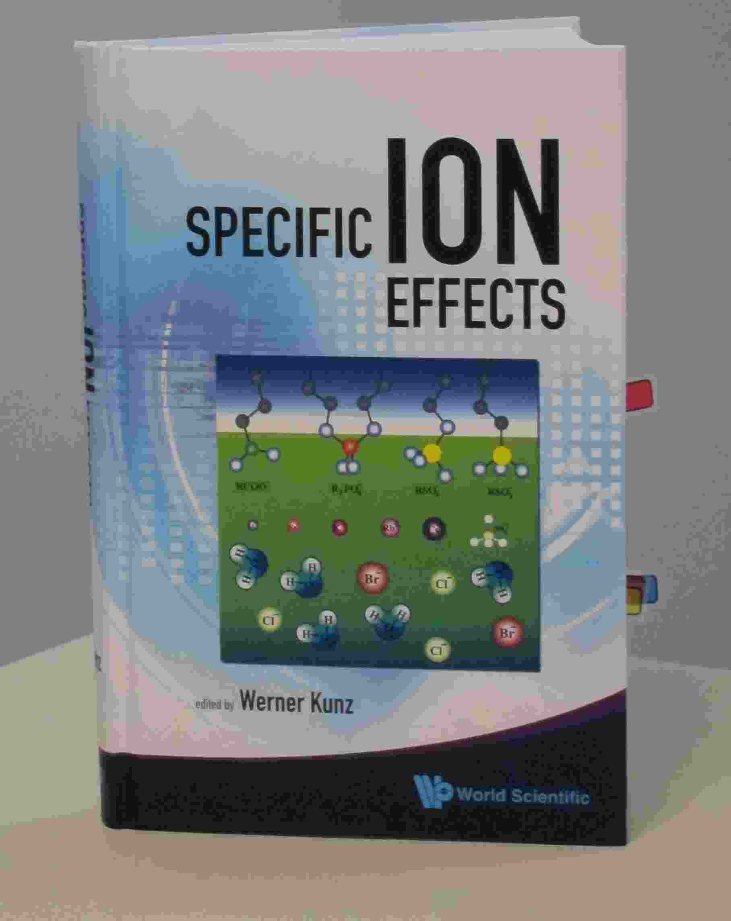
Werner Kunz
“It is still a fact that over the last decades,
it was easier to fly to the moon
than to describe the
free energy
of even the simplest salt solutions
beyond a concentration of 0.1M or so.”
Kunz, W. "Specific Ion Effects"
World Scientific Singapore, 2009; p 11

Slide 31
Physical Chemists will be Frustrated by Real Solutions until
Everything Interacts with Everything Else in their theories and simulations including the
Special Role of the Electric Field
Strong, Global, true on all scales

Slide 32

A poet hopes we will never learn the difference between dreams and realities
“Ah, but a man's reach should exceed his grasp,
Or what's a heaven for?”
  Robert Browning
  "Andrea del Sarto", line 98.
Scientists must Grasp
and not just reach
That is why calibrations are necessary
Otherwise,
progress is slow and machines and devices do not work

Slide 33
Reconciling
Mass Action
and
Maxwell-Kirchoff
will no doubt be a
Long Journey

Slide 34
“Journey of a thousand miles starts with a single step”
in the right direction,
I beg to add to this Chinese saying

Slide 35
That direction needs to include the electric field, calculated and calibrated, global and local, if the journey is ever to end, in my view

Slide 36
Only Variational Methods Guarantee Consistency among all fields including electric field although, apparently,
Poisson is enough to ensure
Conservation of charge and
Continuity of current

Slide 37
When the journey is done consistently,
with honest calibrated simulations and theory,
it can end in
Moore’s Law
Semiconductor Technology
BILLIONS* of times more powerful than 50 years ago
Nothing remotely like it in all of human history

