Slide 1
Thank You!
Thanks to the MBI
to Guo-wei for Mathematical Molecular Biology
and
to Benoit Roux & Marie-Therese Wolfram for inviting me!

Slide 2
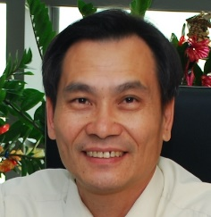
Saturation of Ions in Channels and Solutions: a Fermi-Poisson Treatment
Bob Eisenberg
Jinn Liang Liu
劉晉良
Jinn-Liang is first author on our papers

Slide 3
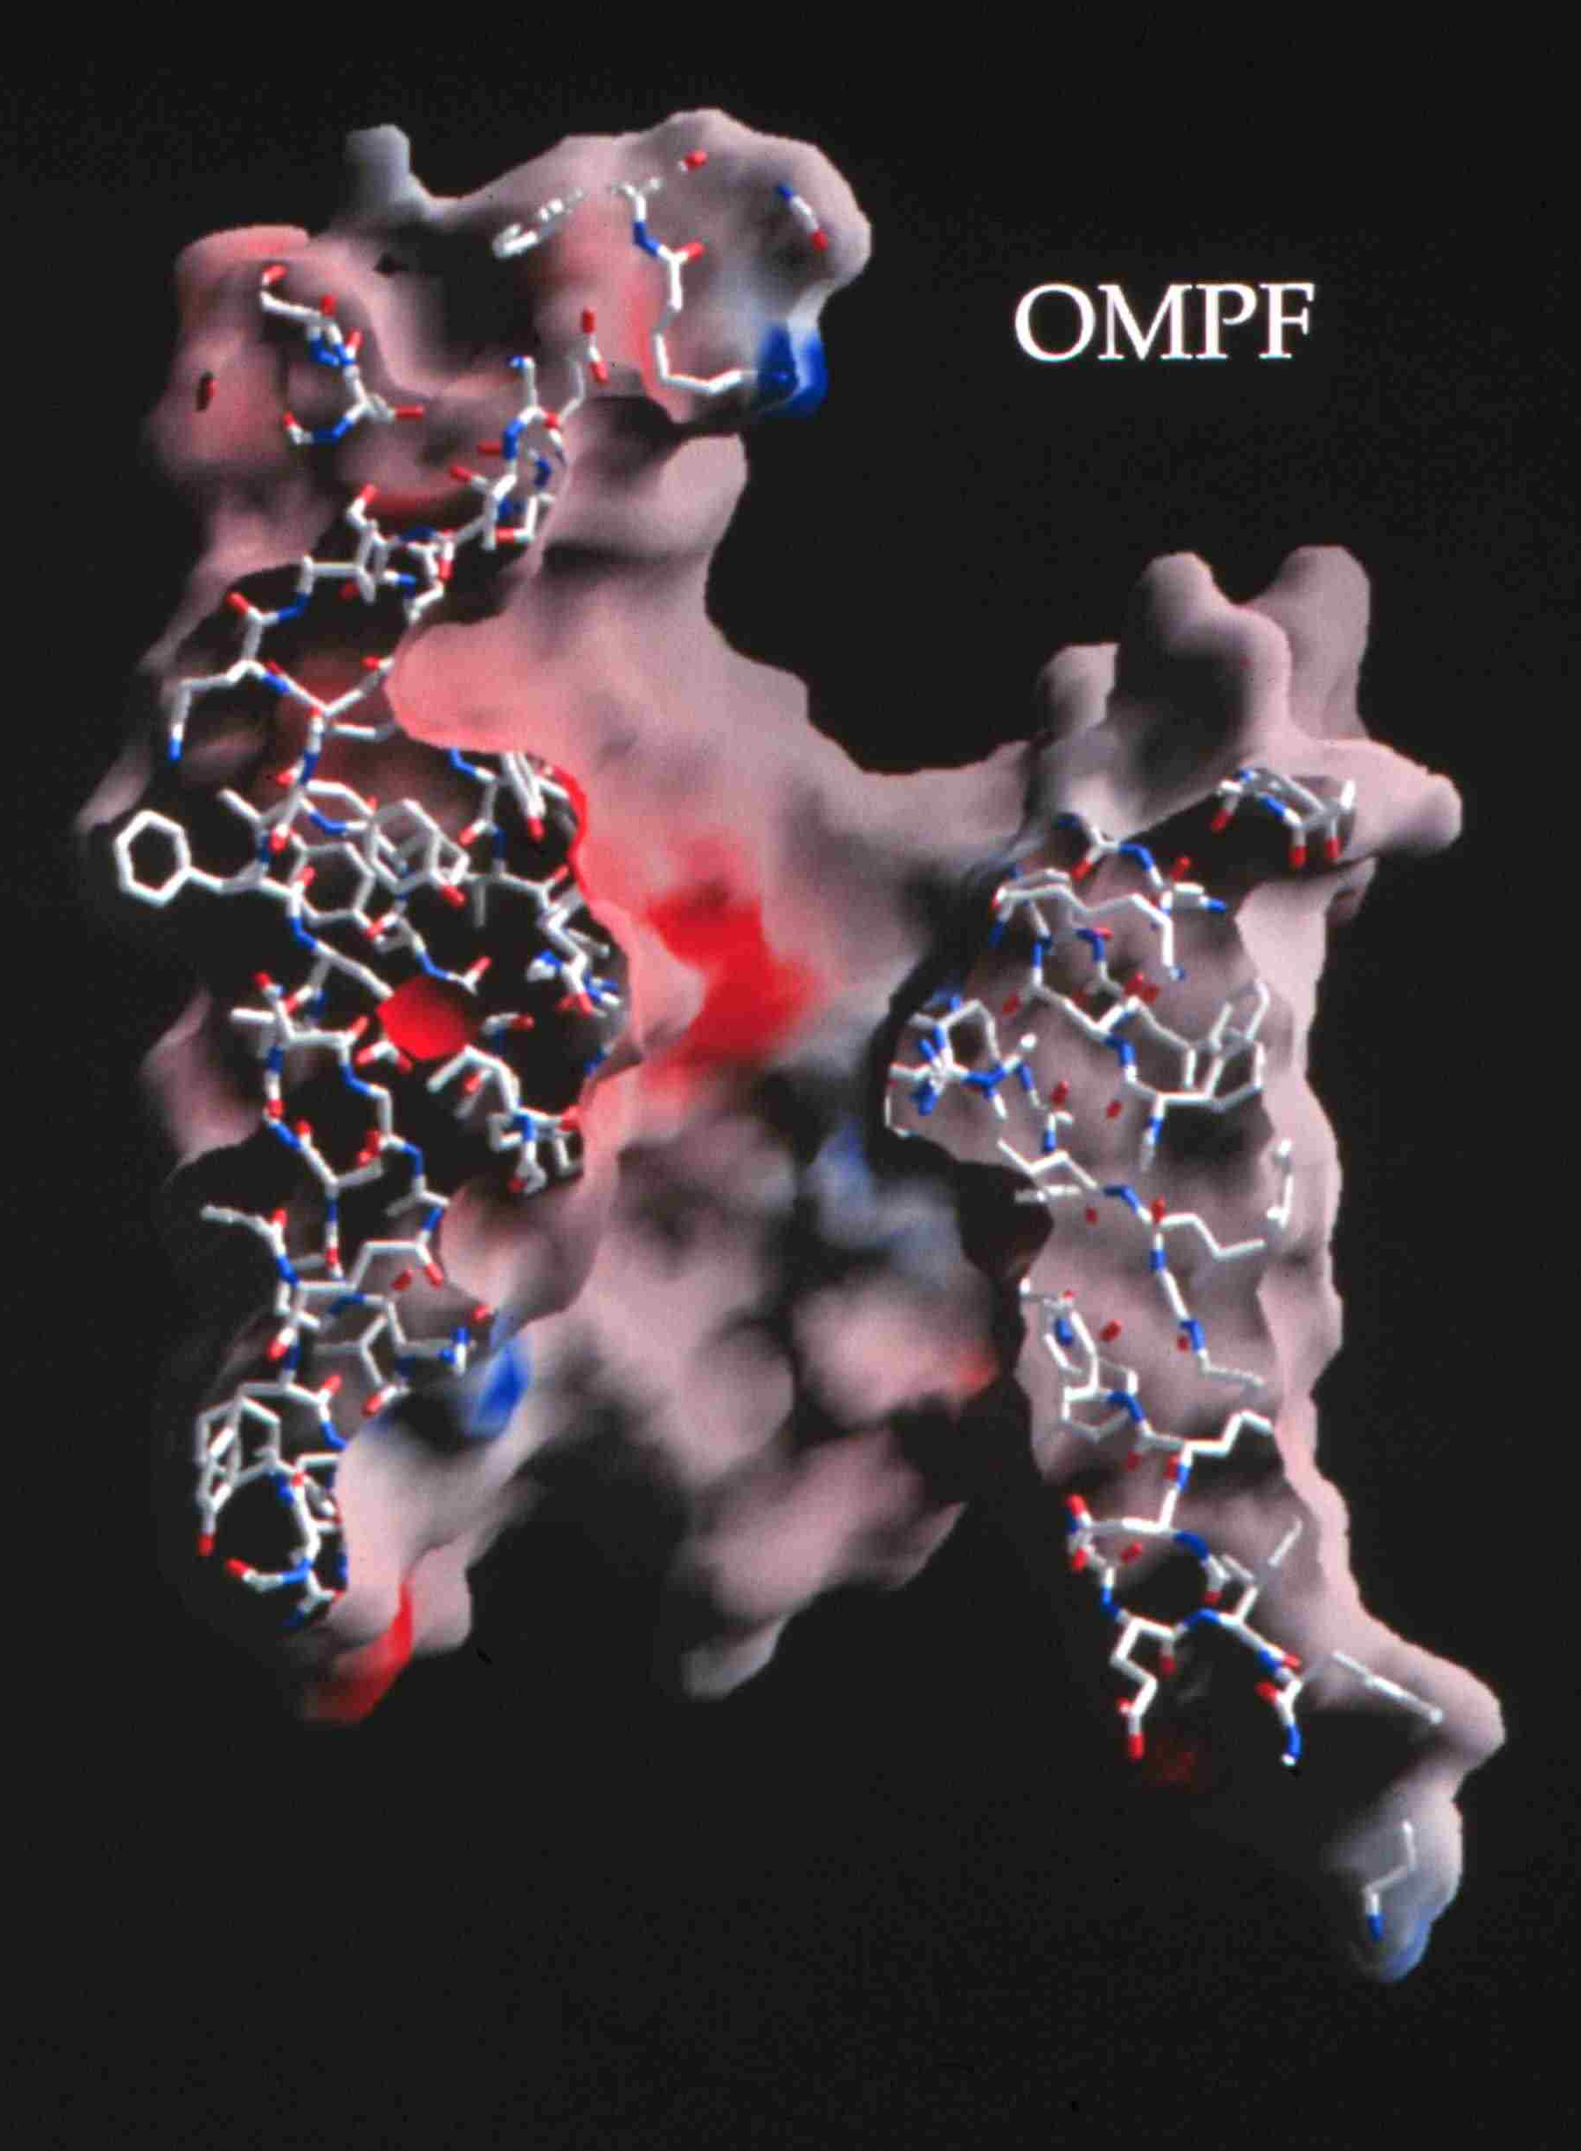
Channels are Devices Valves and Diodes Different Ions Carry Different Signals through Different Channels
ompF porin
Ca⁺⁺
Na⁺
K⁺
300 x 10⁻¹² meter
+
Diameter matters Ionic solutions are NOT ideal
Classical Biochemistry assumes ideal solutions.
K⁺ & Na⁺ are identical only in Ideal Solutions.
0.7 × 10⁻⁹ meter = Channel Diameter
~3 x 10⁻⁹ meters
Flow time scale is 10⁻⁴ sec to 1 min
Figure of ompF porin by Raimund Dutzler

Slide 4
Valves Control Flow
Channels are (nano) valves
Classical Theory & Simulations NOT designed for flow
Thermodynamics, Statistical Mechanics do not allow flow
Rate and Markov Models do not Conserve Current

Slide 5
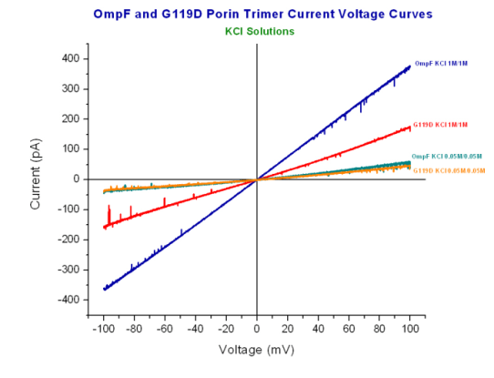
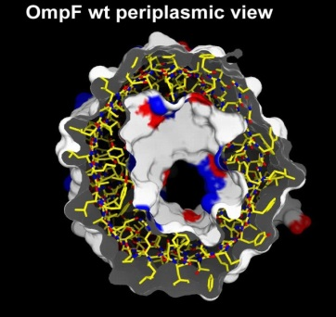
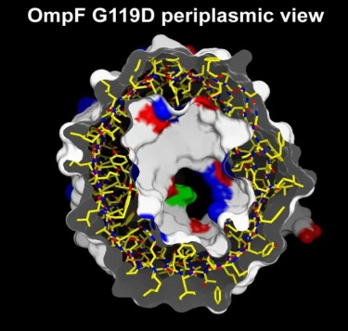
A few atoms make a BIG Difference
Glycine G replaced by Aspartate D
Ompf
OmpF 1M/1M
G119D 1M/1M
OmpF 0.05M/0.05M
G119D 0.05M/0.05M
G119D
Current Voltage relation determined by John Tang in Bob Eisenberg’s Lab
Structure determined by Raimund Dutzler in Tilman Schirmer’s lab

Slide 6
Mathematics must be accurate
There is no engineering without accurate numbers
Details matter in devices!
Think of the clearances as a piston moves in a cylinder of an automobile motor

Slide 7
Mathematical Issues
are fascinating and nontrivial
(1) Multi-scale in their essence
(2) Non-equilibrium in their essence but of a special simple type, power supplies = spatially non-uniform potentials

Slide 8
Mathematical Issues
are fascinating and nontrivial
Flows driven by Spatial Variation of macroscopic boundary conditions
usually inhomogeneous Dirichlet in electrical and chemical potentials

Slide 9
Mathematical Issues
are fascinating and nontrivial
(4) Everything involves
non-ideal ionic mixtures, divalents
Ionic Solutions are the ‘Liquid of Life’
Pure water is lethal

Slide 10
Where to start?
Why not compute all the atoms?
Calibrated
all-atom simulations are
not on the horizon
if they must accurately include Power Supplies i.e., inhomogeneous Dirichlet Boundary Conditions,
Flows,
Non-ideal mixtures including Ca²⁺

Slide 11
Scientists
must Grasp and not just reach
Calibrations are necessary
or nothing works
Poets
hope we will never learn the difference between dreams and realities
“Ah, … a man's reach should exceed his grasp, Or what's a heaven for?”
Robert Browning
"Andrea del Sarto", line 98

Slide 12
Uncalibrated Simulations will make devices that do not work
Details matter in devices

Slide 13
Where to start?
Biological Adaptation
Crowded Charge

Slide 14
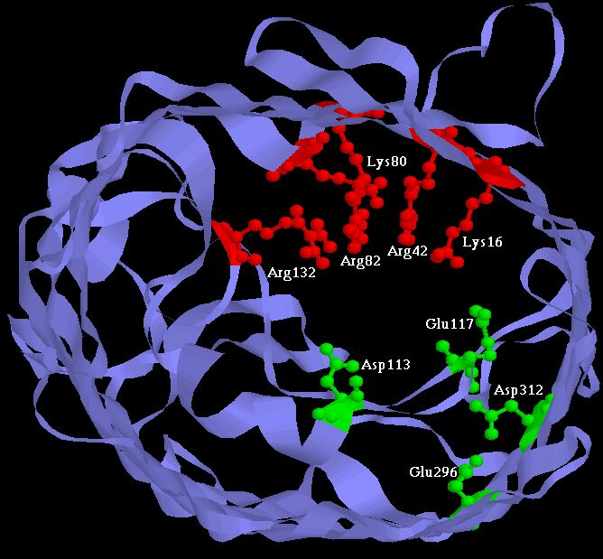
Physical basis of function
Active Sites of Proteins are Very Charged
7 charges ~ 20 M net charge
= 1.2×10²² cm⁻³
liquid Water is 55 M solid NaCl is 37 M
OmpF Porin
Ions are Crowded
Hard Spheres
Na⁺
+
+
+
+
+
K⁺
Ca²⁺
Na⁺
-
-
-
K⁺
-
Induced Fit of Side Chains
4 Å
Selectivity Filters and Gates of Ion Channels
are
Active Sites
Figure adapted from Tilman Schirmer

Slide 15
Working Hypothesis
bio-speak:
Crucial Biological Adaptation is
Crowded Ions and Side Chains
Biology occurs in concentrated >0.3 M mixtures of spherical charges
NOT IDEAL AT ALL Solutions are extraordinarily concentrated >10M where they are most important, near DNA, enzyme active sites, and channels and electrodes of batteries and electrochemical cells. (Solid NaCl is 37M)
Poisson Boltzmann does NOT fit data!!

Slide 16
Crowded Active Sites in 573 Enzymes
Enzyme Type |  | Catalytic Active Site Density (Molar) |  |  | Protein
 |  | Acid (positive) | Basic (negative) | | Total | | Elsewhere
 | Total (n = 573) | 10.6 | 8.3 | 18.9 | 2.8
EC1 | Oxidoreductases (n = 98) | 7.5 | 4.6 | 12.1 | 2.8
EC2 | Transferases (n = 126) | 9.5 | 7.2 | 16.6 | 3.1
EC3 | Hydrolases (n = 214) | 12.1 | 10.7 | 22.8 | 2.7
EC4 | Lyases (n = 72) | 11.2 | 7.3 | 18.5 | 2.8
EC5 | Isomerases (n = 43) | 12.6 | 9.5 | 22.1 | 2.9
EC6 | Ligases (n = 20) | 9.7 | 8.3 | 18.0 | 3.0
Jimenez-Morales, Liang, Eisenberg

Slide 17
Electrolytes are Complex Fluids
Treating a Complex Fluid as if it were a Simple Fluid will produce Elusive Results

Slide 18
Idealized Theories like Debye Hückel and Poisson Boltzmann Do not fit data at all in any biological solution I do not exaggerate as quotations will show Biological solutions are always mixtures with total concentrations >100 mM and involve Ca²⁺ and other multi-valent ions Debye Hückel and Poisson Boltzmann are usable ONLY for pure NaCl <50 mM

Slide 19
Robinson and Stokes Classic text (not otherwise noted for its emotional content) gives a glimpse of frustration of physical chemists “In regard to concentrated solutions, many workers adopt a counsel of despair, confining their interest to concentrations below about 0.02 M, ... ” p. 302 Electrolyte Solutions (1959) Butterworths , also Dover (2002), emphasis added

Slide 20
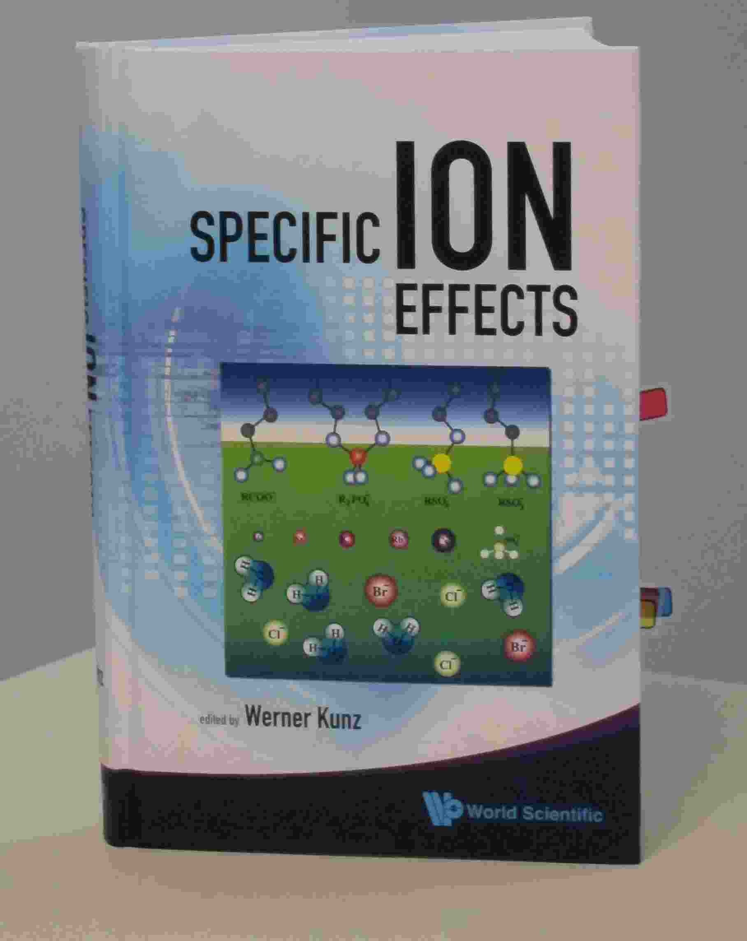
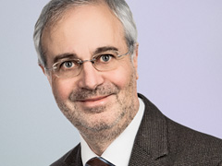
Werner Kunz
“It is still a fact that over the last decades, it was easier to fly to the moon than to describe the free energy of even the simplest salt solutions beyond a concentration of 0.1M or so.”
Kunz, W. "Specific Ion Effects"
World Scientific Singapore, 2009; p 11.

Slide 21
“Poisson Boltzmann theories are restricted to such low concentrations that the solutions cannot be studied in the laboratory”
slight paraphrase of p. 125 of Barthel, Krienke, and Kunz , Springer, 1998
Original text “… experimental verification often proves to be an unsolvable task”

Slide 22
“ …. it is almost never valid to use Debye-Hückel theory
… it is important to take proper account of ion size”
Stell, G. and C.G. Joslin Biophys J, 1986. 50(5): p. 855-859.

Slide 23
Don’t worry!
Crowded Charge
is GOOD for mathematicians
It enables
SIMPLIFICATION
by exploiting a biological fact
(an adaptation)
Charges are Crowded where they are important!

Slide 24
Working Hypothesis
in language of mathematics
Crowded Charge
enables
Dimensional Reduction
to a
Device Equation

Slide 25
Working Hypothesis in language of Engineering and Biology
Device Equation
is How it Works!

Slide 26
Motivation
Natural Description of Crowded Charge
is a
Fermi Distribution because it describes saturation in a simple way and is used throughout physics
Simulating saturation by interatomic repulsion (Lennard Jones) is a significant mathematical challenge to be side-stepped if possible Eisenberg, Hyon and Liu (2010). JChemPhys 133: 104104

Slide 27
Motivation
Largest Effect of Crowded Charge is Saturation
Saturation cannot be described at all by classical Poisson Boltzmann
approach and is described in a uncalibrated way
by present day Molecular Dynamics when Mixtures and Divalents are Biologically Important in Concentrations of 10⁻⁸ to 10¹ M

Slide 28
Motivation
Fermi Description
is designed to deal with
Saturation of Concentration
Simulating saturation by interatomic repulsion (Lennard Jones) is a significant mathematical challenge to be side-stepped if possible Eisenberg, Hyon and Liu (2010). JChemPhys 133: 104104

Slide 29
Fermi Description of Saturation of Volume by Spherical Ions
Fermi (like) Distribution
J.-L. Liu J Comp Phys (2013) 247:88

Slide 30
Fermi (like) Distribution
depends on Steric Factor of System
Algebraic Model of Calcium Channel
works surprisingly well despite crudeness of molecular model
J Comp Phys (2013) 247:88
Algebraic Model of Bulk Solution, e.g. Calcium Chloride

Slide 31
Fermi Description of
Crowded Charge and Saturation
4) We adopt the simplest treatment so we can deal with 3D structures
many chemical complexities are known to us and have been left out purposely for this reason
5) We require exact consistency with electrodynamics of flow because
Key to successful modelling of ions
Electric forces are so large that deviations from consistency do not allow transferrable models
and can easily wreck models all together
Flow is Essential Death is the only Equilibrium of Life

Slide 32
Exact consistency with electrodynamics of flow is
THE key to successful modelling of ions
in my opinion
Electric forces are so large that deviations from consistency do not allow transferrable models
and can easily wreck models all together
Flow is Essential
Death is the only Equilibrium of Life

Slide 33
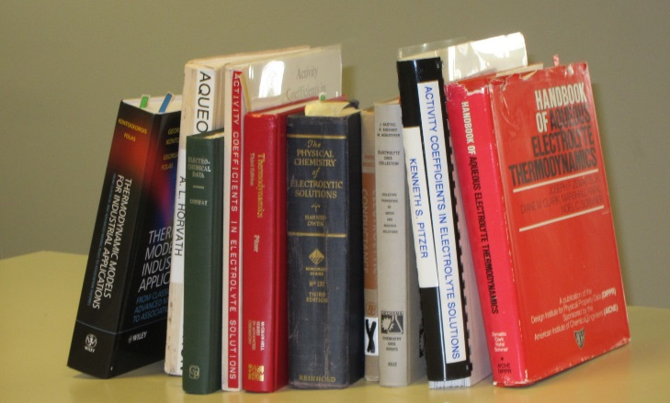
Challenge Can Simplest Fermi Approach
Describe ion channel selectivity and permeation?
Describe non-ideal properties of bulk solutions?
There are no shortage of chemical complexities to include, if needed!
Classical Treatments of Chemical Complexities

Slide 34
Fermi Description uses Entropy of Mixture of Spheres from Combinatoric Analysis
W is the mixing entropy of UNEQUAL spheres with N available NON-UNIFORM sites
Connection to volumes of spheres and voids, and other details are published in 5 papers
J Comp Phys (2013) 247:88 J Phys Chem B (2013) 117:12051 J Chem Phys (2014) 141: 075102 J Chem Phys, (2014) 141: 22D532 Physical Review E (2015) 92:012711
Expressions in other literature are not consistent with this entropy

Slide 35
Electro-Chemical Potential and Void Volume
Voids are Needed
It is impossible to treat all ions and water molecules as
hard spheres and at the same time have
Zero Volume of interstitial Voids between all particles.

Slide 36
Consistent Fermi Approach is Novel Consistent Fermi approach has not been previously applied to ionic solutions as far as we, colleagues, referees, and editors know
Previous treatments* have inconsistent treatment of particle size
They do not reduce to Boltzmann functionals in the appropriate limit
Previous treatments often do not include non-uniform particle size
Previous treatments* are inconsistent with electrodynamics and
nonequilibrium flows including convection
Details
Previous treatments do not include discrete water or voids.
They cannot deal with volume changes of channels, or pressure/volume in general
Previous treatments do not include polarizable water with polarization as an output
*Previous treatments
Bazant, Storey & Kornyshev,. Physical Review Letters, 2011. 106(4): p. 046102.
Borukhov, Andelman & Orland, Physical Review Letters, 1997. 79(3): p. 435.
Li, B. SIAM Journal on Mathematical Analysis, 2009. 40(6): p. 2536-2566.
Liu, J.-L., Journal of Computational Physics 2013. 247(0): p. 88-99.
Lu & Zhou, Biophysical Journal, 2011. 100(10): p. 2475-2485.
Qiao, Tu & Lu, J Chem Phys, 2014. 140(17):174102
Silalahi, Boschitsch, Harris & Fenley, JCCT 2010. 6(12): p. 3631-3639.
Zhou, Wang & Li Physical Review E, 2011. 84(2): p. 021901.

Slide 37
Fermi (like) Distribution
Fermi (like) Distribution
is a general Quantitative Statement of
Charge-Space Competition
Simulated and compared to experiments in > 35 papers of Boda, Henderson, et al,
and >10 papers of Gillespie, et al,
also gives Gibbs Fermi Functional J Comp Phys, 2013 247:88; J Phys Chem B, 2013 117:12051 so the Fermi approach
Can be embedded in the Energy Variational Formulation
EnVarA developed by Chun Liu, more than anyone Eisenberg, Hyon and Liu (2010). JChemPhys 133: 104104

Slide 38
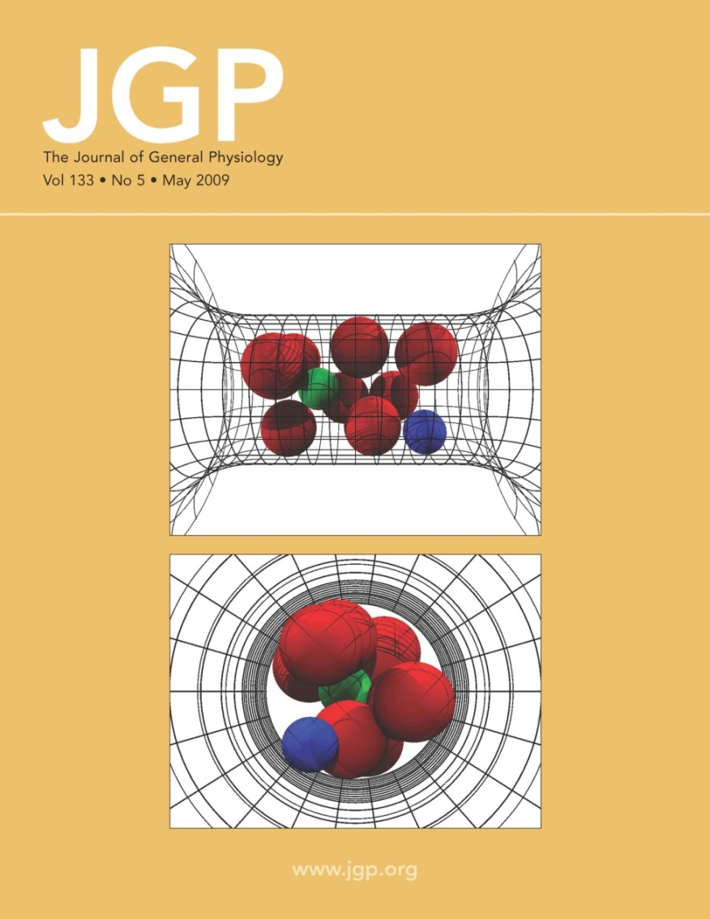
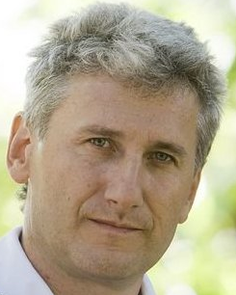
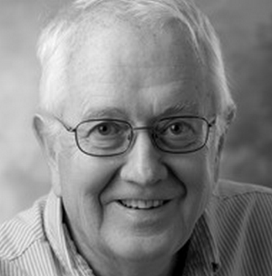
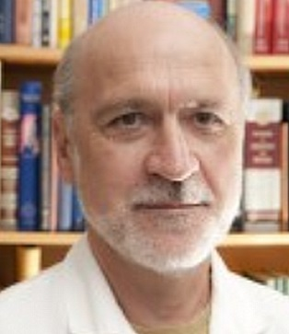
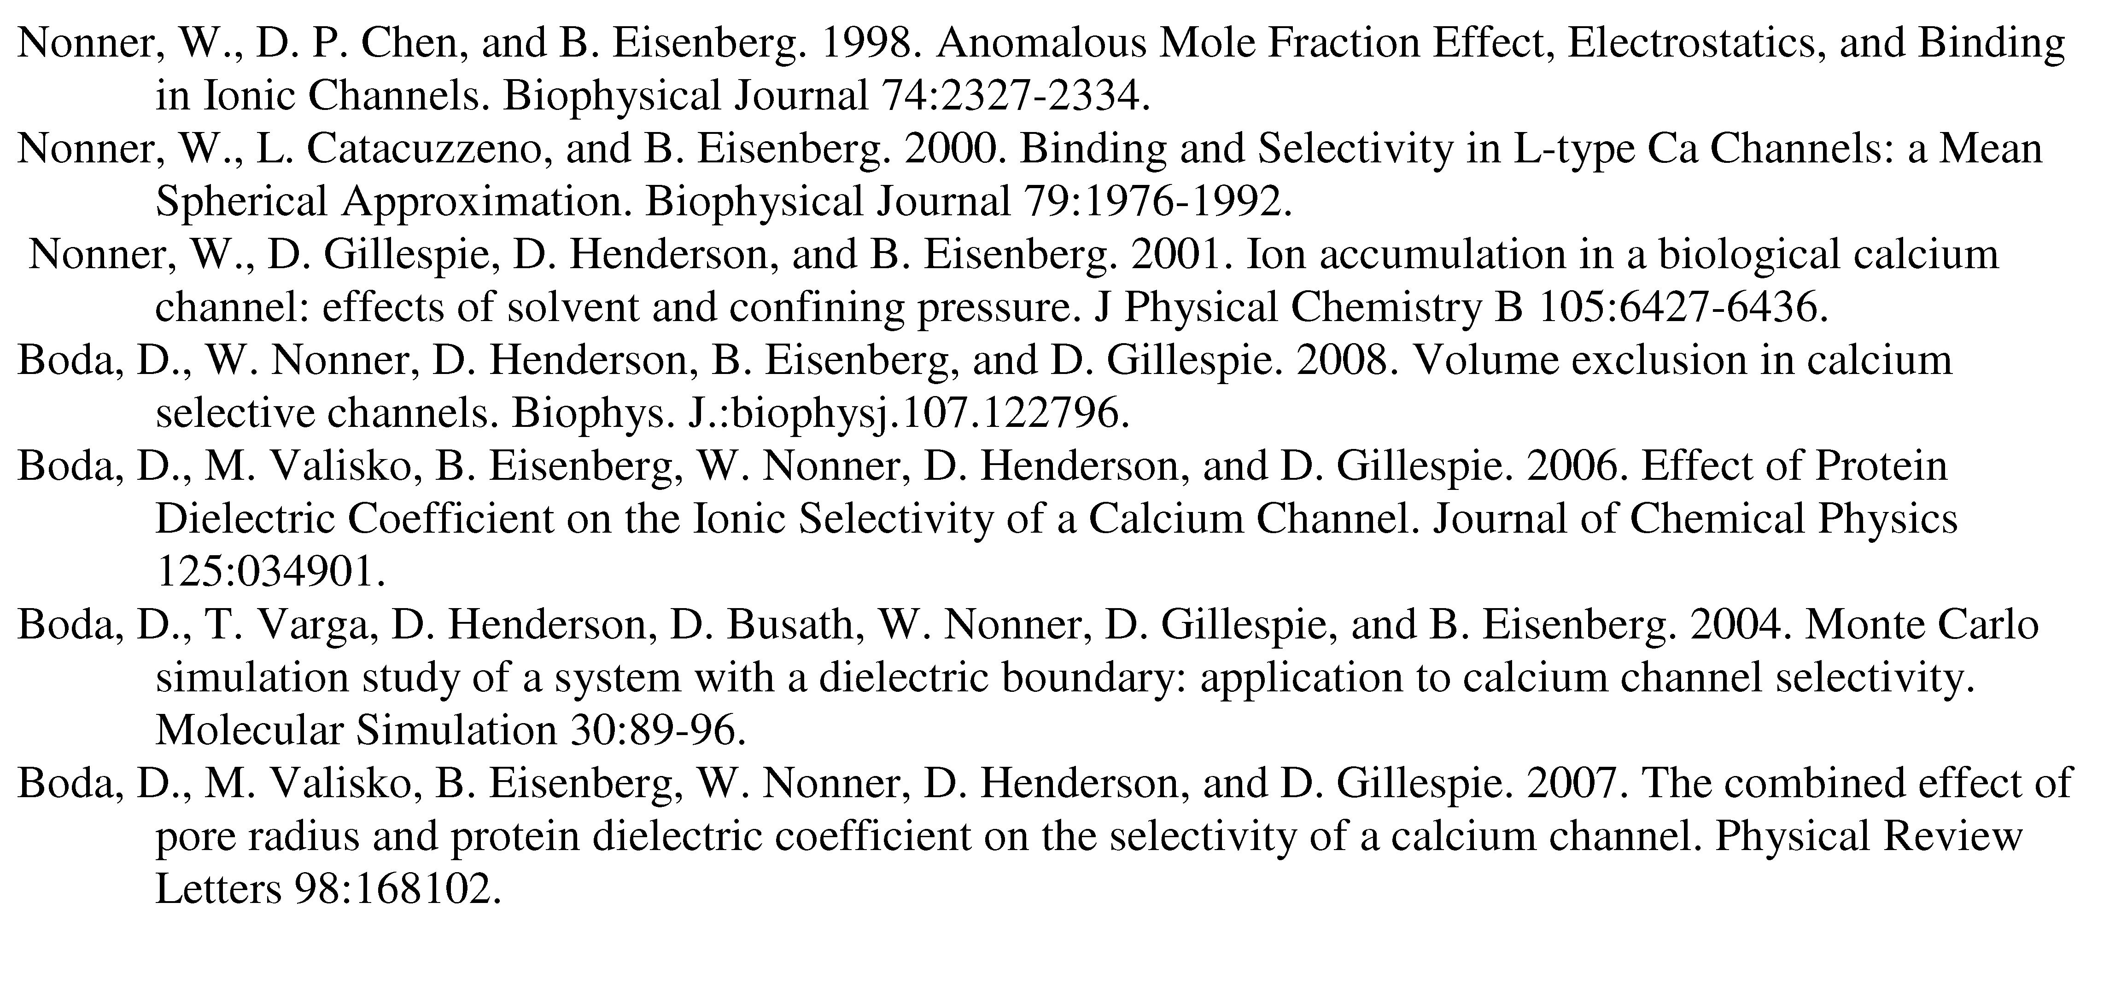
Charge-Space Competition
Monte Carlo Methods
Dezső Boda
Doug Henderson
Wolfgang Nonner
More than 35 papers are available at
ftp://ftp.rush.edu/users/molebio/Bob_Eisenberg/reprints

Slide 39
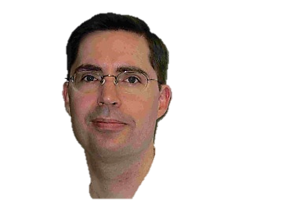
Best Evidence for All Spheres Charge Space Competition is from the
RyR Receptor
Dirk Gillespie Dirk_Gillespie@rush.edu
Gerhard Meissner, Le Xu, et al, not Bob Eisenberg
● More than 120 combinations of solutions & mutants
● 7 mutants with significant effects fit successfully

Slide 40
Poisson-Fermi Analysis is NON-Equilibrium
Flows are Essential in Devices & Biology
Structure is Essential in Devices & Biology
Implemented fully in 3D Code to accommodate 3D Protein Structures
Flows cease only at death
PNPF uses treatment by Santangelo 2006¹ used by Kornyshev 2011² of near/far fields crudely separated by fixed correlation length
PNPF introduces steric potential^{3,4} so unequal spheres are dealt with consistently
PNPF force equation reduces^{3,4} to pair of 2nd order PDE’s and Appropriate boundary conditions that are consistent and allow Robust and Efficient Numerical Evaluation
4) PNPF combines force equation and Nernst-Planck Description of Flow
¹PhysRev E (2006) 73:041512 ²PhysRev Ltrs (2011) 106:046102 ³JCompPhys (2013) 247:88 ⁴J PhysChem B (2013) 117:12051

Slide 41
PNPF
Poisson-Nernst-Planck-Fermi
Implemented fully in 3D Code to accommodate 3D Protein Structures
Flow
Force
approximates dielectric of entire bulk solution including correlated motions of ions, following Santangelo 2006¹ used by Kornyshev 2011² with Liu’s corrected and consistent Fermi treatment of spheres
We introduce^{3,4} two second order equations and boundary conditions
That give the polarization charge density
$ε_{water}\left(l_{c}∇^{2}−1\right)$
3D computation is facilitated by using 2nd order equations
¹PhysRev E (2006) 73:041512 ²PhysRev Ltrs (2011) 106:046102 ³JCompPhys (2013) 247:88 ⁴J PhysChem B (2013) 117:12051

Slide 42
Nonequilibrium Force Equation
Implemented fully in 3D Code to accommodate 3D Protein Structures
Fourth Order Santangelo¹ PDE
is introduced as a crude correlation length to separate near and far fields
approximates dielectric properties of entire bulk solution including correlated motions of ions, Santangelo (2006)¹ followed by Kornyshev (2011)²
using J.-L. Liu’s³ (2013) consistent Fermi treatment of spheres that corrects previous oversimplifications²
We introduce^{3,4} two second order equations and boundary conditions
That give the polarization charge density
$ε_{water}\left(l_{c}∇^{2}−1\right)$
3D computation is facilitated by using 2nd order equations
¹PhysRev E (2006) 73:041512 ²J Chem Phys 141: 22D532; Phys Rev Ltrs (2011) 106:046102 ³JCompPhys (2013) 247:88 ⁴J Phys Chem B (2013) 117:12051

Slide 43
Gibbs-Fermi ‘Grand’ Free Energy Functional*
voids
*Liu & Eisenberg, JChemPhys (2014) 141:22D532). N.B. Dissipation to be determined

Slide 44
Computational Problems Abound
and are Limiting if goal is to fit real data
It is very easy to get results that only seem to converge, and are in fact Not Adequate approximations to the converged solutions
Jerome, J. (1995) Analysis of Charge Transport. Mathematical Theory and Approximation of Semiconductor Models. New York, Springer-Verlag.
Markowich, P. A., C. A. Ringhofer and C. Schmeiser (1990). Semiconductor Equations. New York, Springer-Verlag.
Bank, R. E., D. J. Rose and W. Fichtner (1983). Numerical Methods for Semiconductor Device Simulation IEEE Trans. on Electron Devices ED-30(9): 1031-1041.
Bank, R, J Burgler, W Coughran, Jr., W Fichtner, R Smith (1990) Recent Progress Algorithms for Semiconductor Device Simulation
Intl Ser Num Math 93: 125-140.
Kerkhoven, T. (1988) On the effectiveness of Gummel's method SIAM J. Sci. & Stat. Comp. 9: 48-60.
Kerkhoven, T and J Jerome (1990). "L(infinity) stability of finite element approximations to elliptic gradient equations." Numer. Math. 57: 561-575.

Slide 45
Computing Flows is Difficult in Electric Field Problems
because the electric field is so strong
1% error in concentrations does little
1% error in charge “lifts the earth”
One percent more electrons than protons would
Lift the Entire Earth!
paraphrase of third paragraph, p. 1-1 of
Feynman, R. P., R. B. Leighton, and M. Sands. 1963. The Feynman: Lectures on Physics, Mainly Electromagnetism and Matter. New York: Addison-Wesley Publishing Co.,
also at http://www.feynmanlectures.caltech.edu/II_toc.html.

Slide 46
Computational Electronics has solved these problems over the last 40 years in thousands of papers used to design our digital devices
Vasileska, D, S Goodnick, G Klimeck (2010) Computational Electronics: Semiclassical and Quantum Device Modeling and Simulation. NY, CRC Press.
Selberherr, S. (1984). Analysis and Simulation of Semiconductor Devices. New York, Springer-Verlag.
Jacoboni, C. and P. Lugli (1989). The Monte Carlo Method for Semiconductor Device Simulation. New York, Springer Verlag.
Hess, K. (1991). Monte Carlo Device Simulation: Full Band and Beyond. Boston, MA USA, Kluwer.
Hess, K., J. Leburton, U.Ravaioli (1991). Computational Electronics: Semiconductor Transport and Device Simulation. Boston, Kluwer.
Ferry, D. K. (2000). Semiconductor Transport. New York, Taylor and Francis.
Hess, K. (2000). Advanced Theory of Semiconductor Devices. New York, IEEE Press.
Ferry, D. K., S. M. Goodnick and J. Bird (2009). Transport in Nanostructures. New York, Cambridge University Press.
It is very easy to get results that only seem to converge, and are in fact not adequate approximations to the converged solutions.
Jerome, J. W. (1995). Analysis of Charge Transport. Mathematical Theory and Approximation of Semiconductor Models. New York, Springer-Verlag.

Slide 47
Keys to Successful Computation
Avoid errors by checking against analytical solutions of Guowei and collaborators
Avoid singularities on boundaries of protein (that wreck convergence)
Use a simplified Matched Interface Boundary sMIB method of Guowei and collaborators modified to embed Scharfetter Gummel SG criteria of computational electronics (extended to include steric effects).
SG is REQUIRED TO ENSURE CONTINUITY OF CURRENT
Charge Conservation is not enough
Scharfetter and Gummel, IEEE Trans. Elec. Dev.16, 64 (1969)
P. Markowich, et al, IEEE Trans. Elec. Dev. 30, 1165 (1983).
Zheng, Chen, and G.-W. Wei, J. Comp. Phys. 230, 5239 (2011).
Geng, S. Yu, and G.-W. Wei, J. Chem. Phys. 127, 114106 (2007).
S. M. Hou and X.-D. Liu, J. Comput. Phys. 202, 411 (2005).
J.-L. Liu, J. Comp. Phys. 247, 88 (2013).
Modified Successive Over-relaxation SOR for fourth order PNPF

Slide 48
Poisson Fermi Analysis Status Report
Nonequilibrium implemented fully in 3D Code to accommodate 3D Protein Structures
But only partially compared to experiments
In Bulk or Channels, so far.
Gramicidin (tested with real three dimensional structure, including flow) Physical Review E, 2015. 92:012711
Ca_{V}1.n EEEE, i.e., L-type Calcium Channel, tested with homology model
J Phys Chem B, 2013 117:12051 (nonequilibrium data is scarce)
PNPF Poisson-Nernst-Planck-Fermi for systems with volume saturation
General PDE, Cahn-Hilliard Type, Four Order, Pair of 2nd order PDE’s
Not yet tested by comparison to bulk data
J Chem Phys, 2014. 141:075102; J Chem Phys,141:22D532
Numerical Procedures tailored to PNPF have been implemented (tested) J Comp Phys, 2013 247:88; Phys Rev E, 2015. 92:012711
NCX Cardiac Ca²⁺/Na⁺ exchanger branched Y shape KNOWN structure.
Physical analysis of a transporter using consistent mathematics
using crystallographic structure Liu & Eisenberg, Neurosciences 2015 :450.09

Slide 49
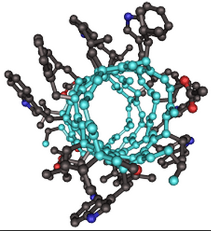
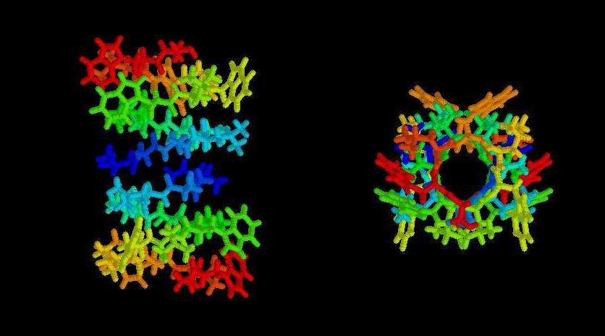
Gramicidin A
Unusual SMALL Bacterial Channel
often simulated and studied
Margaret Thatcher,
student of Nobelist Dorothy Hodgkin
Bonnie Wallace leading worker
Validation of PNP Solvers with Exact Solution
following the lead of Zheng, Chen & Wei J. Comp. Phys. (2011) 230: 5239
.

Slide 50
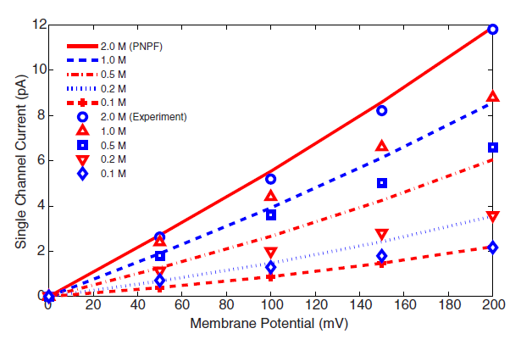
Three Dimensional Theory Comparison with Experiments
Gramicidin A

Slide 51
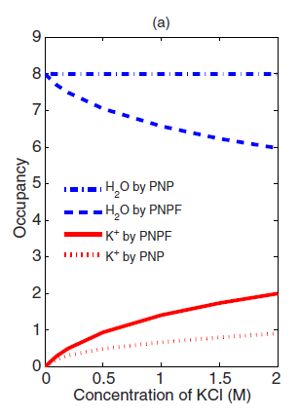
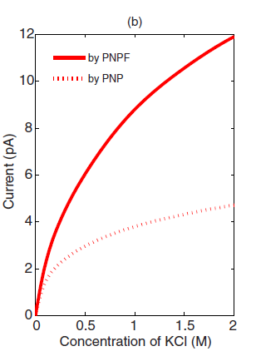
Steric Effect is Large in (crowded) Gramicidin
PNPF vs PNP
Water Occupancy
Current
vs Voltage
K⁺ Occupancy

Slide 52
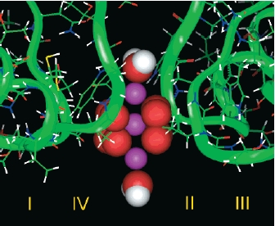
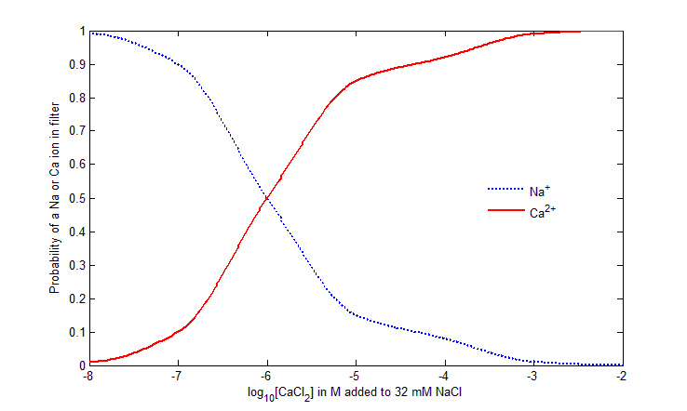
Cardiac Calcium Channel Ca_{V}.n
_{Lipkind-Fozzard Model}
_{Binding Curve}
Liu & Eisenberg J Chem Phys 141(22): 22D532

Slide 53
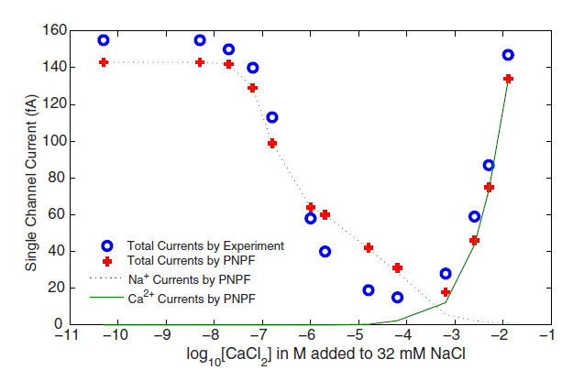
Cardiac Calcium Channel Ca_{V}1.n
Experimental Signature Anomalous* Mole Fraction
Non-equilibrium
Na Channel
Ca Channel
*Anomalous because CALCIUM CHANNEL IS A SODIUM CHANNEL at [CaCl₂] ≅ 10^{-3.4}
Ca²⁺ is conducted for [Ca²⁺] > 10^{-3.4}, but Na⁺ is conducted for [Ca²⁺] <10^{-3.}
Liu & Eisenberg (2015) Physical Review E 92: 012711

Slide 54
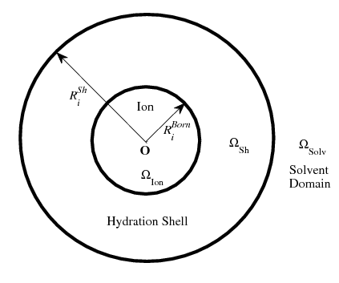
Poisson Fermi Approach to Bulk Solutions
Same equations, different model of nearby atoms

Slide 55
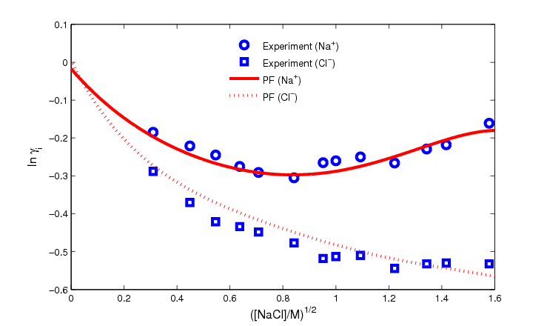
Activity Coefficients Na⁺ Cl⁻ ‘normalized’ free energy per mole

Slide 56
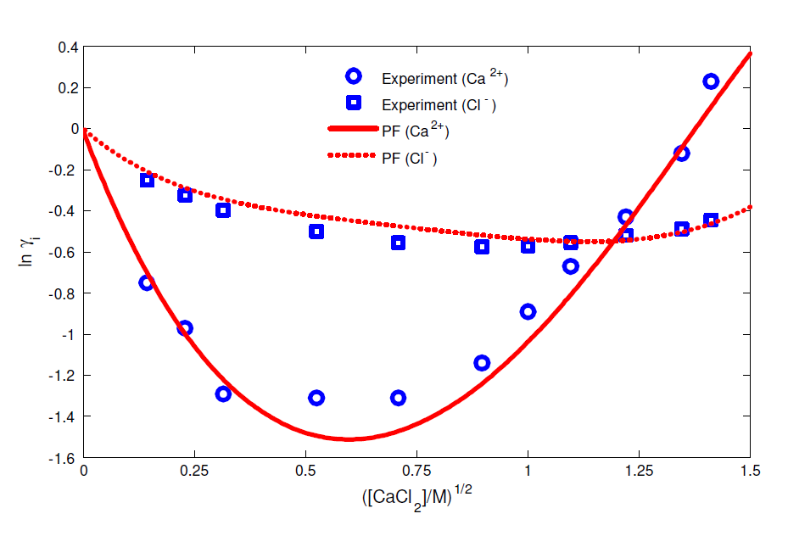
Activity Coefficients Ca²⁺Cl₂¯ ‘normalized’ free energy per mole

Slide 57
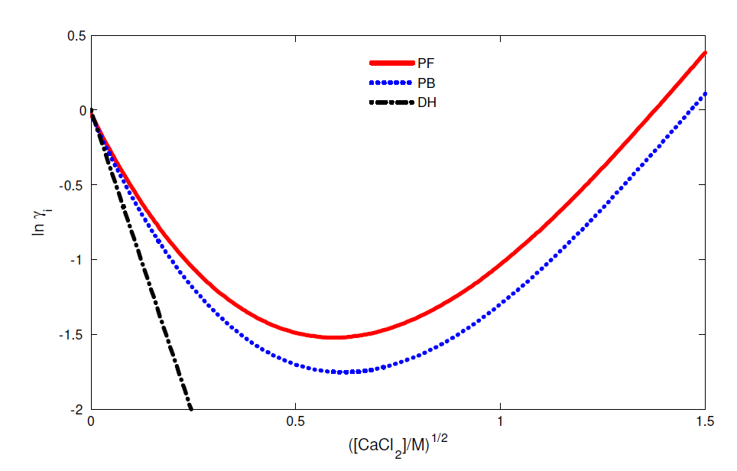
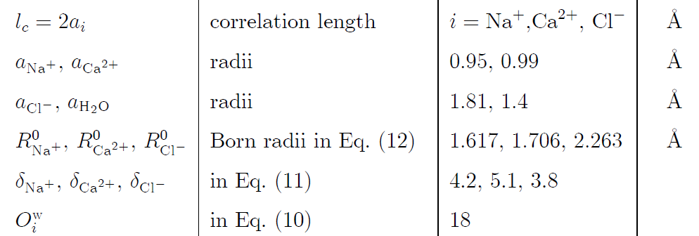
Debye-Hückel Fails Disastrously
Poisson Boltzmann is quite inaccurate
Poisson Fermi does Surprisingly Well
Parameters, NOT further adjusted

Slide 58
Bulk Solution
How well does the Poisson Fermi Approach for Bulk Solutions?
Same equations, different model of nearby atoms
Occupancy is 6+12 Waters* held Constant in Model of Bulk Solution
in this oversimplified Poisson Fermi Model Liu & Eisenberg (2015) Chem Phys Ltr 10.1016/j.cplett.2015.06.079
*in two shells: experimental Data on Occupancy Rudolph & Irmer, Dalton Trans. (2013) 42, 3919
Mähler & Persson, Inorg. Chem. (2011) 51, 425

Slide 59
More Detail
INSIDE CHANNELS

Slide 60
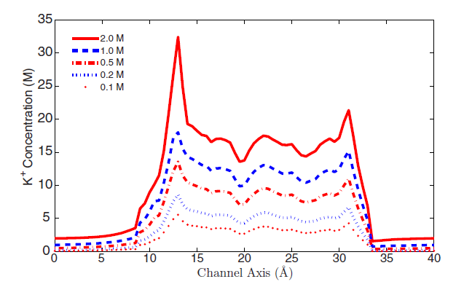
Gramicidin Two K⁺ Binding Sites
OUTPUTS of our calculations
Binding sites are prominent in NMR measurements & MD calculations
BUT they VARY
with conditions in any consistent model and so
cannot be assumed to be of fixed size or location

Slide 61
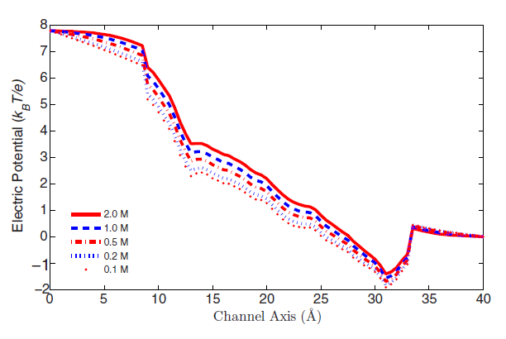
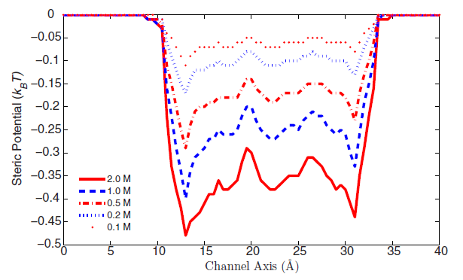
Steric Effect is Significant
Gramicidin is Crowded
Shielding is Substantial
Electric Potential
Steric Potential
Shielding
Shielding has been ignored in many papers
Results are often at one concentration or unspecified concentration, as in most molecular dynamics
Channel is often described as a potential profile This is inconsistent with electrodynamics as in classical rate models
Shielding

Slide 62
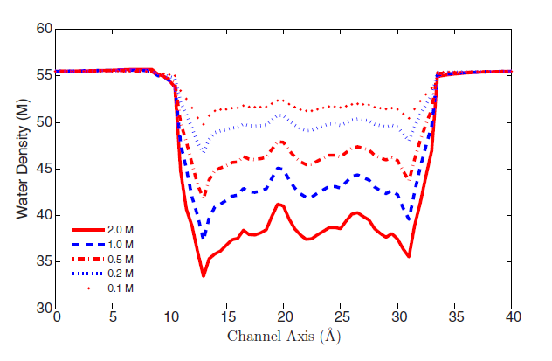
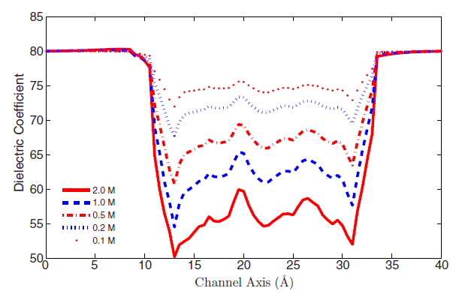
Inside Gramicidin
Water Density
Dielectric Function
an OUTPUT of model
Liu & Eisenberg J Chem Phys 141: 22D532

Slide 63
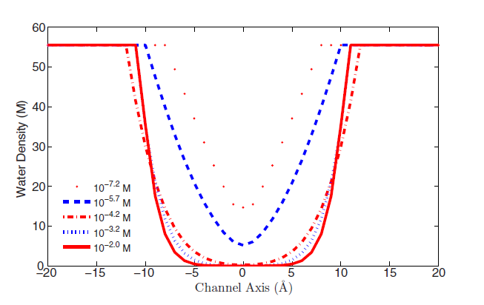
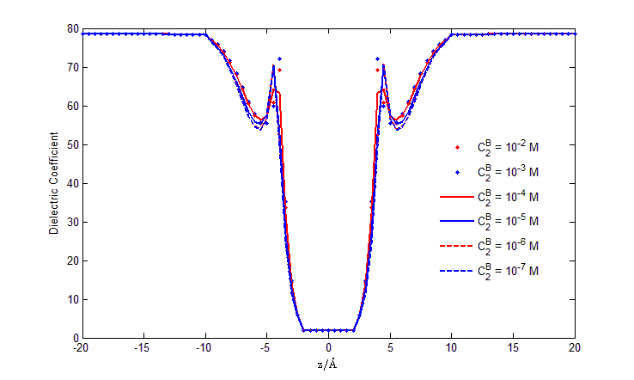
Inside the Cardiac Calcium Channel Ca_{V}1.n
Dielectric Function
An Output of this Model
Water Density
Liu & Eisenberg (2015) Phys Rev E 92: 012711
Liu & Eisenberg J Chem Phys 141(22): 22D532

Slide 64
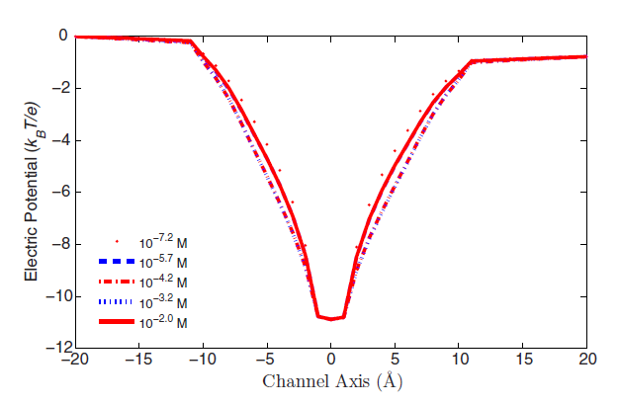
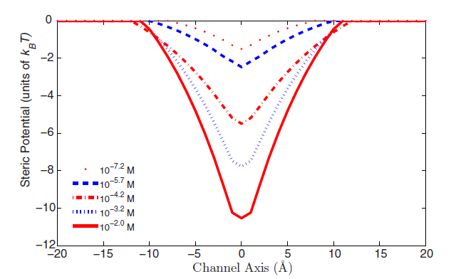
Inside the Cardiac Calcium Channel Ca_{V}1.n
Electric Potential
Steric Potential
Estimator of Crowding

Slide 65
The End
Any Questions?

Slide 66
Engineering and Physiology:
Essence of Engineering
is knowing
What Variables to Ignore!
WC Randels
quoted in Warner IEEE Trans CT 48:2457 (2001)

Slide 67
Take Home Lesson
Devices in Engineering are Defined
by their
Reduced Model

Slide 68
Physiology and Medicine
are all about
Reduced Models
in which SOME atomic details Control Function

