Slide 1
H-bonds in Crambin: Coherence in an α‑helix
Stanley Nicholson David Minh
Preprint Nicholson, Stanley Minh, David Eisenberg, Robert. (2022) doi:10.48550/ arXiv.2211.16372.
Presentation at Journal Club
Rush: Physiology and Biophysics
Illinois Institute of Technology Chicago IL USA
Bob Eisenberg Applied Math, Illinois Institute of Technology Chicago IL USA
Physiology and Biophysics, Rush Medical College Chicago IL USA
December 2, 2022

Slide 2
Abstract
We applied coherence analysis to molecular dynamics simulations of the plant protein crambin, a thionin storage protein found in Abyssinian cabbage. Coherence analysis was developed by engineers to identify linear interactions, without statistical assumptions. Coherence is greater than 0.9 between the displacement of oxygen and nitrogen atoms of H‑bonds in α‑helices for frequencies between 0.391 GHz and 5.08 GHz (corresponding reciprocally to times of 2.56 ns and 0.197 ns). These H‑bonds act much like a linear system. Unrelated atoms have uncorrelated motions and much smaller coherence, say 0.02. Groups of atoms (that form a layer of an α‑helix) were averaged and the coherence function of two groups was evaluated. Layers of the α‑helix form a linear system, suggesting that the harmonic analysis of classical molecular dynamics can successfully describe the allosteric interactions of the layers of an α‑helix.
doi:10.48550/arXiv.2211.16372

Slide 3
Structural Biology and Molecular Dynamics have overwhelmed us with data
Molecular Biology has yielded so much atomic scale information that we do not know what to do with it

Slide 4
We tried something simple, reliable, without assumptions
Unlikely to succeed
We checked to see if atomic motions
in chemical bonds
Can be described by linear systems,
Really rigid structures
(as it turned out)
‘Linear systems’ are defined in Circuit Theory. They are usually described
by causal, constant coefficient ordinary differential equations.
Examples are resistors, amplifiers, springs, damped harmonic oscillator

Slide 5
We tried something that is simple, reliable, without assumptions
BUT unlikely to succeed
RISK: If it does not work, we know nothing
RISK: waste of time; difficult project
Literature, Theory, Numerics, and Programming are hard and exhausting to learn
REWARD
If it works, the results are reliable without assumptions
Stanley Nicholson
Undergraduate
Eager to try risky idea
of an old timer
David Minh showed us how to do it
with molecular dynamics

Slide 6
Structural Biology and Molecular Dynamics have overwhelmed us with data
Molecular Biology has yielded so much atomic scale information that we do not know what to do with it

Slide 7
Structural Biology and Molecular Dynamics have overwhelmed us with data.
198,747 structures; 1,000,361 computed models in Protein Data Bank (Dec 1, 2022)
Molecular Biology has yielded so much atomic scale information that we do not know what to do with it
Trajectories of all atoms (except hydrogen) are easily computed at resolution of 10⁻¹⁵ sec for < 1 μsec
10⁹ data points for each atom for just 1 μsec of function
~10¹⁴ data points per protein

Slide 8
Successful Physiological and Biochemical Models have many fewer variables
Evolution is unlikely to need that much resolution
to maximize the reproduction of organisms

Slide 9
How do we see the FOREST for§ the trees,
really
for the LEAVES?
§ Non-native speakers: ‘for’ is older poetical English. Modern plain English/American would say ‘because of’

Slide 10
How do we see the FOREST for the trees,
really
for the LEAVES?
Detail
obscures
Meaning

Slide 11
Hundreds of research groups
are trying to solve these problems
in many disciplines of mathematics
Coarse graining Homogenization
Statistical Inference
Cluster Analysis Model Building
Deep Data Emergent Theories
Dimensional Reduction

Slide 12
Reliability of the Results
Difficult to evaluate by theory or computation
Because of
Strong Assumptions
Without theory, or simulations, one needs innumerable difficult experiments
that are often ambiguous

Slide 13
We tried something simple, reliable, without assumptions
Unlikely to succeed

Slide 14
We tried something simple, reliable, without assumptions
Unlikely to succeed
In fact They turn out to be Rigid Structures
Are atomic motions
in chemical bonds
linear systems?
‘Linear systems’ are defined in Circuit Theory. They are usually described
by causal, constant coefficient ordinary differential equations.
Examples are resistors, amplifiers, springs, damped harmonic oscillator

Slide 15
It turns out that many things in a protein are rigid structures
H-bonds, Salt Bridges, Layers of $α$ Helix (secondary structure), and of course Covalent Bonds of the protein Crambin are linear systems that are nearly rigid

Slide 16
Details fully explained in tutorial style H-bonds in Crambin
Coherence in an $α$-helix
Nicholson, Stanley Minh, David Eisenberg, Robert doi:10.48550/arXiv.2211.16372 (2022)

Slide 17
Crambin PDB 1CRN
Seed Storage Protein from Abyssinian kale
Crambe abyssinica
Gluten free Vegetable Oil
https://www.youtube.com/watch?v=M4DWFfkVmU4

Slide 18
Coherence Function allows analysis without ANY assumptions
No assumptions about distributions are made
It is OK if distributions do not even exist as robust descriptions of random trajectories

Slide 19
Only assumption is that Fourier Analysis is Possible
Mathematics (without physics) shows that Fourier Analysis of
Thermal motion is always possible
(it might not be useful, but it is possible with a robust definition)

Slide 20
Methods worked out by Engineers in 1960-1970
to detect weak signals
from Soviet Bomber Sukhoi S24 ‘Fencer’
Rick Mathias and I developed these methods to measure
Electrical Properties of Skeletal Muscle
Cardiac Muscle Lens of the eye

Slide 21
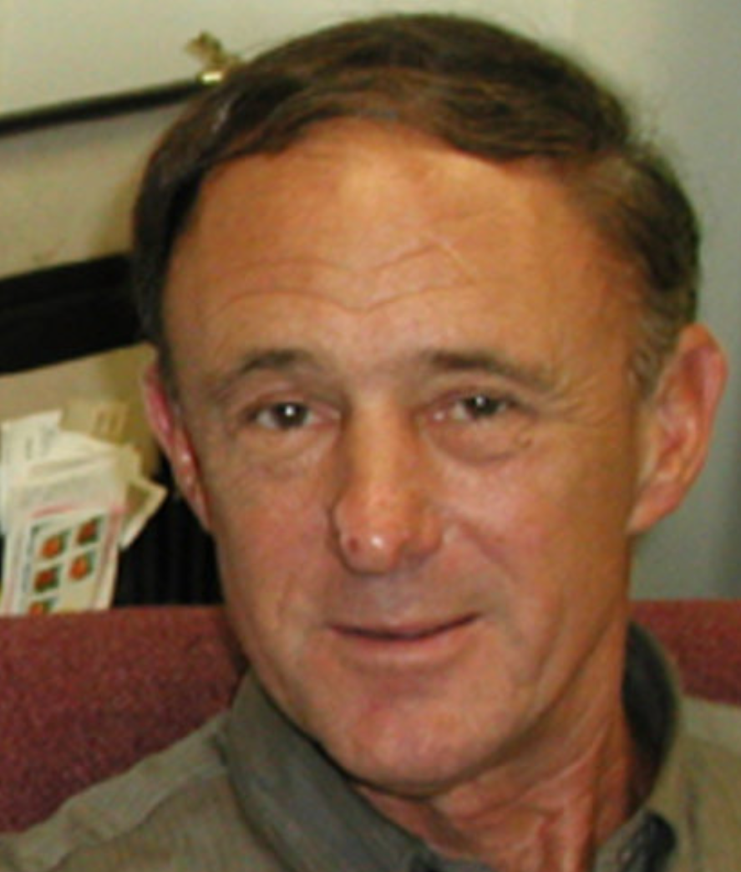
Mathias, R.T. Analysis of Membrane Properties Using Extrinsic Noise. In Membranes, Channels, and Noise, Eisenberg, R., Frank, M., Stevens, C., Eds.; Springer US: 1984; pp. 49-116.
Rae, J.L.; Mathias, R.T.; Eisenberg, R.S. Physiological role of the membranes and extracellular space with the ocular lens. Exp Eye Res 1982, 35, 471-489, doi:10.1016/0014-4835(82)90044-6.
Mathias, R.T.; Eisenberg, R.S.; Valdiosera, R. Electrical properties of frog skeletal muscle fibers interpreted with a mesh model of the tubular system. Biophys J 1977, 17, 57-93.
Eisenberg, R.S.; Mathias, R.T.; Rae, J.S. Measurement, modeling, and analysis of the linear electrical properties of cells. Annals of the New York Academy of Sciences 1977, 303, 342-354.
Mathias, R.T.; Rae, J.L.; Eisenberg, R.S. Electrical properties of structural components of the crystalline lens. Biophys J 1979, 25, 181-201.
Eisenberg, R.S.; Mathias, R.T. Structural analysis of electrical properties of cells and tissues. CRC Crit Rev Bioeng 1980, 4, 203-232.
Mathias, R.T.; Rae, J.L.; Eisenberg, R.S. The lens as a nonuniform spherical syncytium. Biophys J 1981, 34, 61-83.
Levis, R.A.; Mathias, R.T.; Eisenberg, R.S. Electrical properties of sheep Purkinje strands. Electrical and chemical potentials in the clefts. Biophys J 1983, 44, 225-248.
Milton, R.L.; Mathias, R.T.; Eisenberg, R.S. Electrical properties of the myotendon region of frog twitch muscle fibers measured in the frequency domain. Biophys J 1985, 48, 253-267.
Reviewed in
Eisenberg Robert, S. Impedance Measurement of the Electrical Structure of Skeletal Muscle. In Comprehensive Physiology, Republished by the American Physiological Society.
Eisenberg, R. Electrical Structure of Biological Cells and Tissues. In Impedance spectroscopy: theory, experiment, and applications, Barsoukov, E., Macdonald, J.R., Eds.; John Wiley: 2018.
Eisenberg, R. Structural Analysis of Fluid Flow in Complex Biological Systems. Modeling and Artificial Intelligence in Ophthalmology. Preprints 2022, 2022050365 (doi: 10.20944/preprints202205.0365.v1).

Slide 22
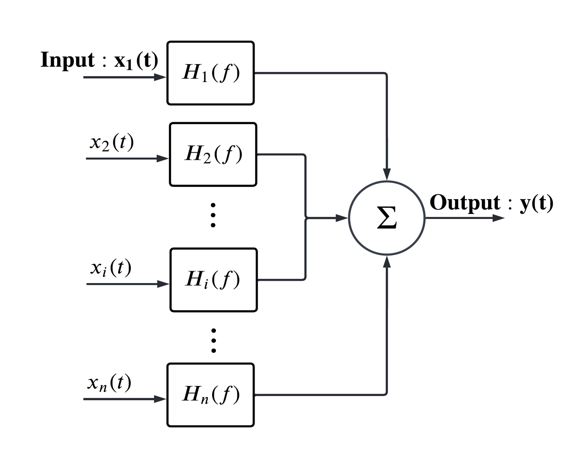
Input Position$⇔$Output Position is Chemical Bond or Atomic Interaction in Protein
Input Current$⇔$ Output voltage is equivalent circuit of muscle

Slide 23
Coherence Definition
Other definitions do not work. Definition must involve powers $G_{xx}\left(f\right){,G}_{yy}\left(f\right)$, $G_{xy}\left(f\right)$ not the signals $x\left(t\right) and y(t)$
$$C_{xy}\left(f\right)=\frac{{\left|G_{xy}\left(f\right)\right|}^{2}}{G_{xx}\left(f\right)G_{yy}\left(f\right)}$$
$Coherence=$ $\frac{Cross Power}{Self {power}_{x} × Self {power}_{y}}$
Classical Reference: Bendat, J.S.; Piersol, A.G. Measurement and analysis of random data; John Wiley: 1966.

Slide 24
System is linear when $H\left(f\right)={G_{xy}(f)}/{G_{xx}\left(f\right)}$ then $G_{yy}\left(f\right)={\left|H\left(f\right)\right|}^{2}G_{xx}\left(f\right)$
$G_{xy}\left(f\right)=H\left(f\right)G_{xx}\left(f\right)$
Proof of Coherence Theorem
$$C_{xy}\left(f\right)=\frac{{\left|H\left(f\right)G_{yy}\right|}^{2}}{G_{xx}\left(f\right){\left|H\left(f\right)\right|}^{2}G_{xx}} =\frac{{\left|H\left(f\right)\right|}^{2}}{{\left|H\left(f\right)\right|}^{2}}= 1$$

Slide 25
Coherence Theorem
Coherence is one, if and only if the system is linear
$Coherence=$ $\frac{{\left|Cross Power\right|}^{2}}{Self {power}_{x} × Self {power}_{y}}$

Slide 26
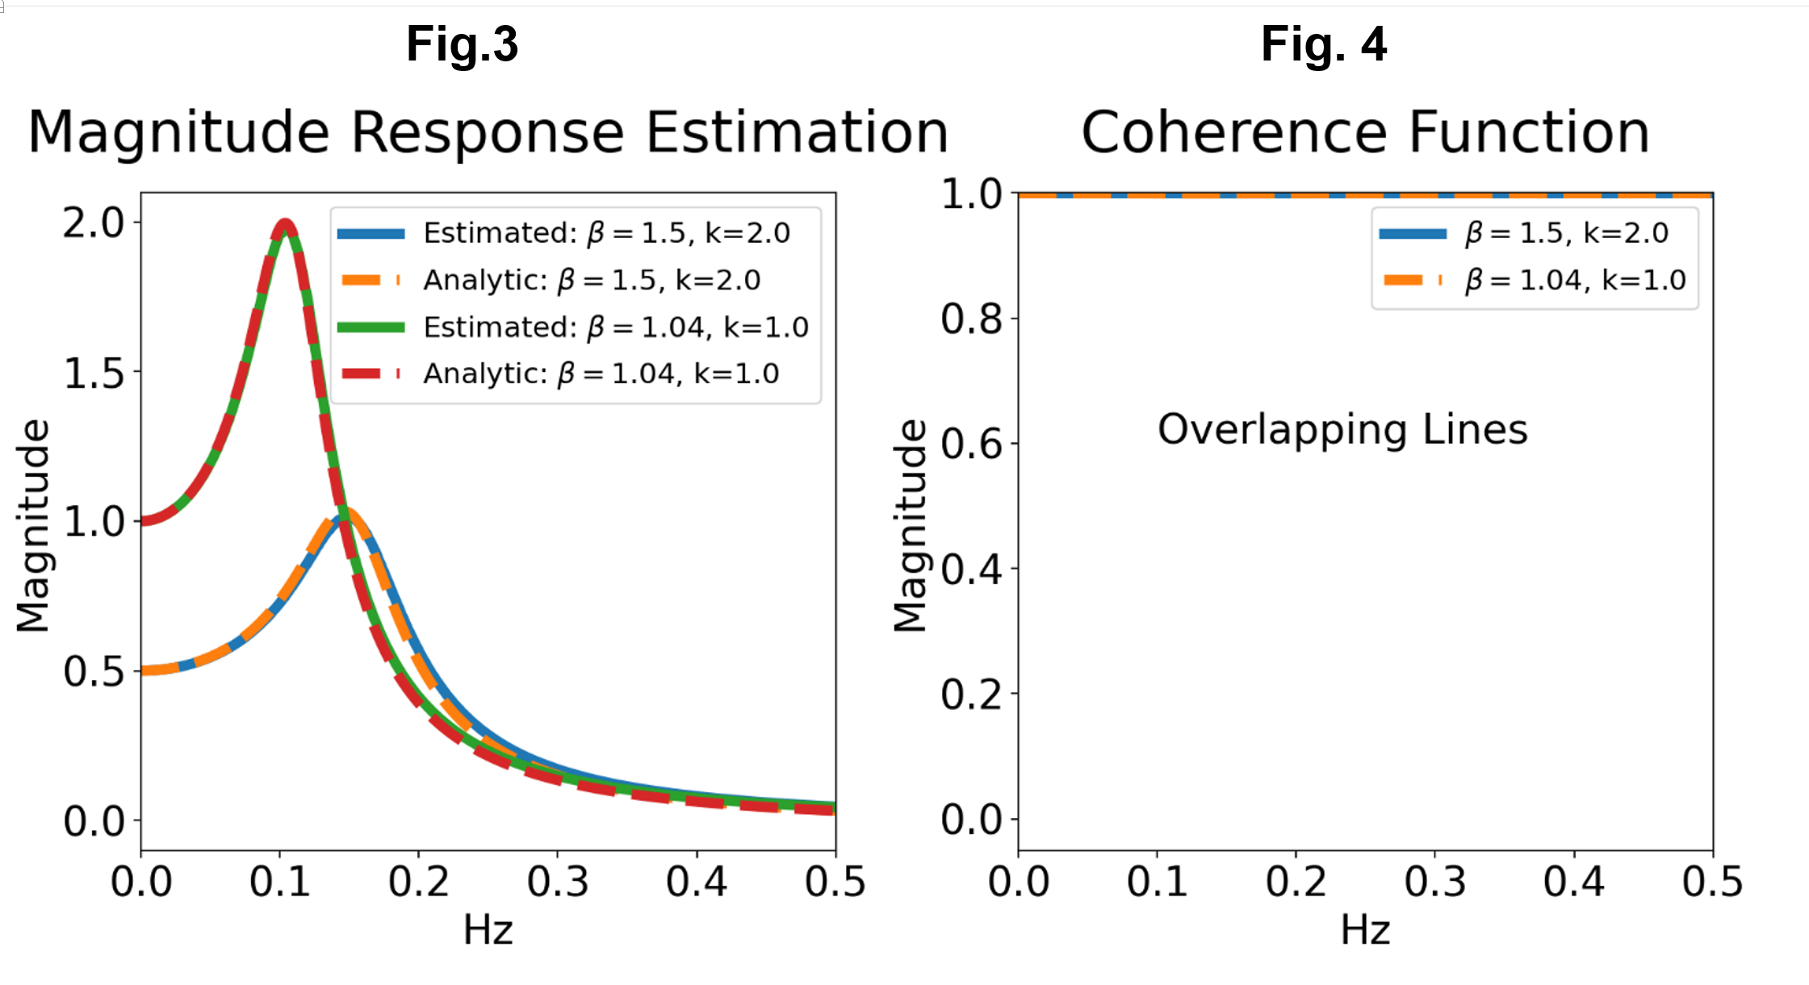
Validation Analytical vs. Numerical of damped mass and spring
In Figure 3 and 4 simulation was done for 0.5 seconds using the ‘lsim’ command cited in the text. Sampling rate was 2 Hz for a total of 65536 samples. 256 frequency points were used in the estimated curves. The auto power spectra are calculated using Welch’s method implemented in MATLAB as ‘pwelch’ cited in the text, and the Signal Processing Toolbox, with a Hanning window size of 16 points, and 50% overlap between windows. Cross power is computed using ‘cpsd’ with same parameters. Choices for the number of DFT points depends on the desired frequency resolution: [number of DFT points] equals [sampling rate] multiplied by [frequency resolution].

Slide 27
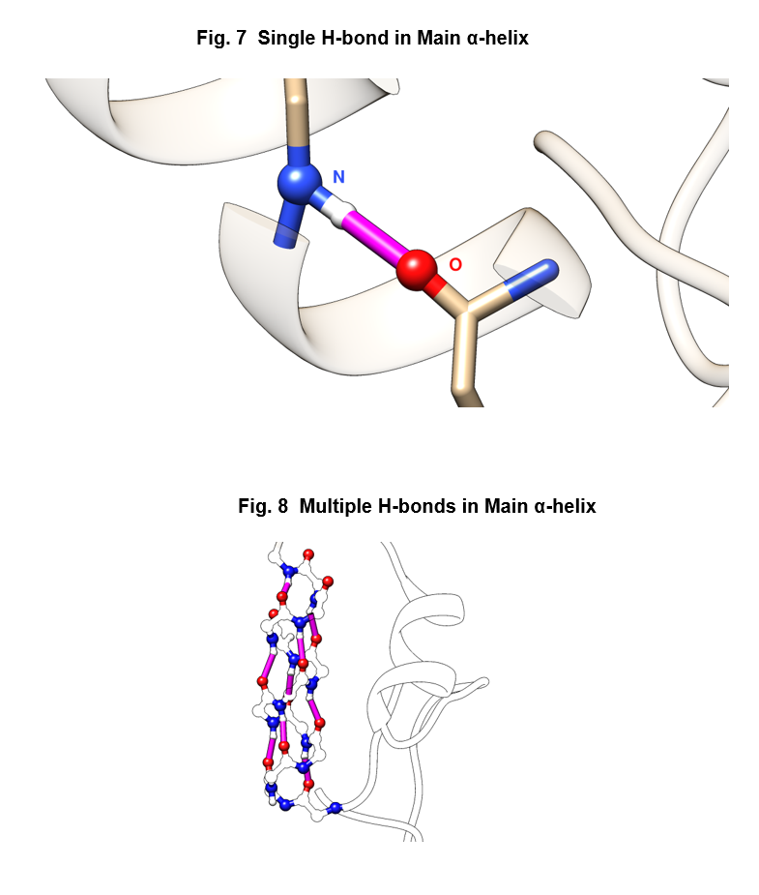

Slide 28
Crambin PDB 1CRN
Seed Storage Protein from Abyssinian kale
Crambe abyssinica
Gluten free Vegetable Oil
https://www.etsy.com/listing/631019762/
100-pure-abyssinian-oil-cold-pressed
https://www.youtube.com/watch?v=M4DWFfkVmU4

Slide 29
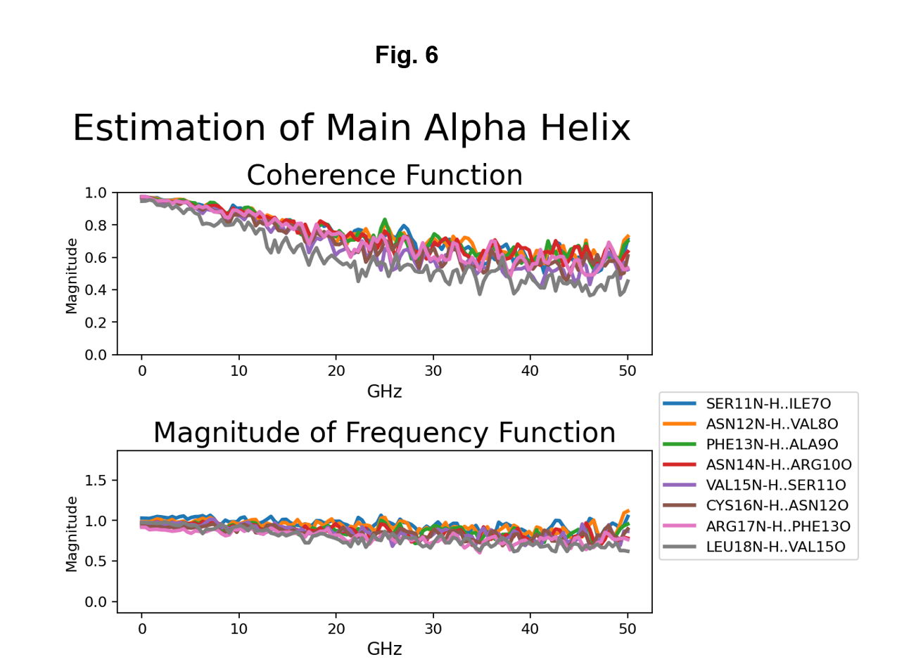
Non-interacting atoms

Slide 30
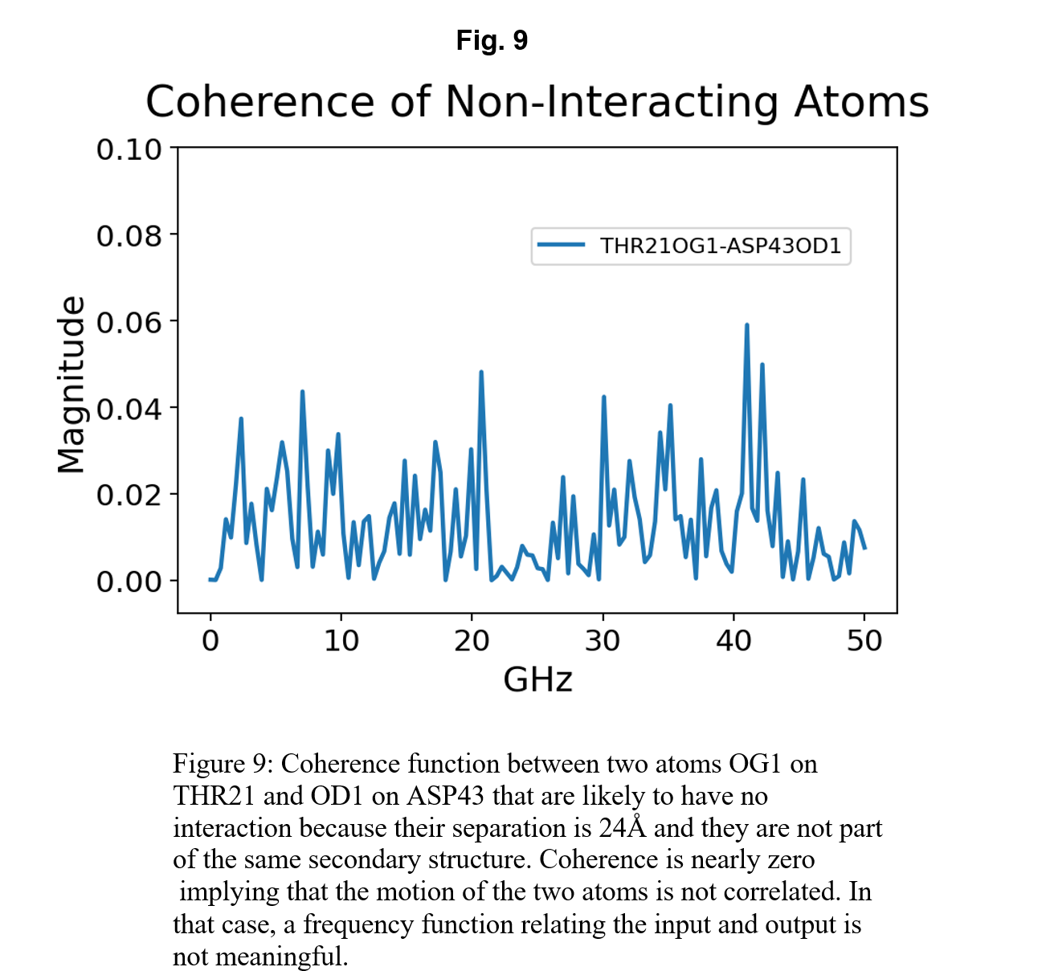
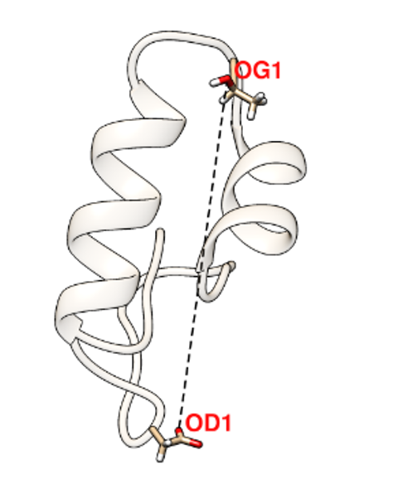
Please Notice
Vertical Scale
Mean

Slide 31
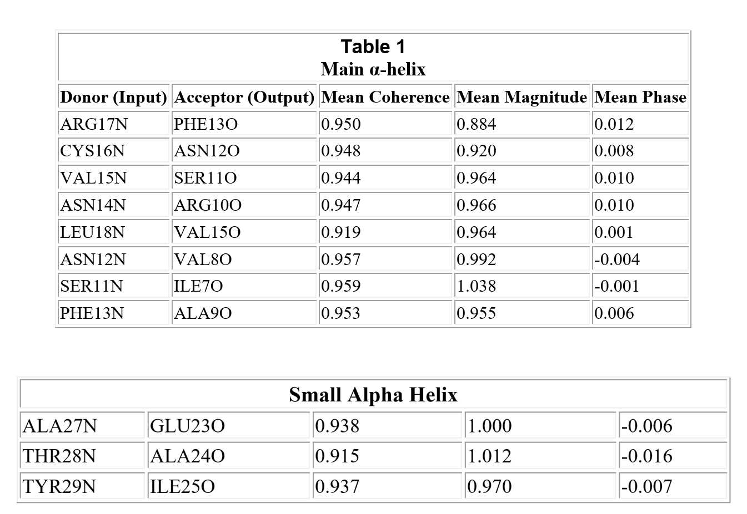
Detailed Results (some of many more)

Slide 32
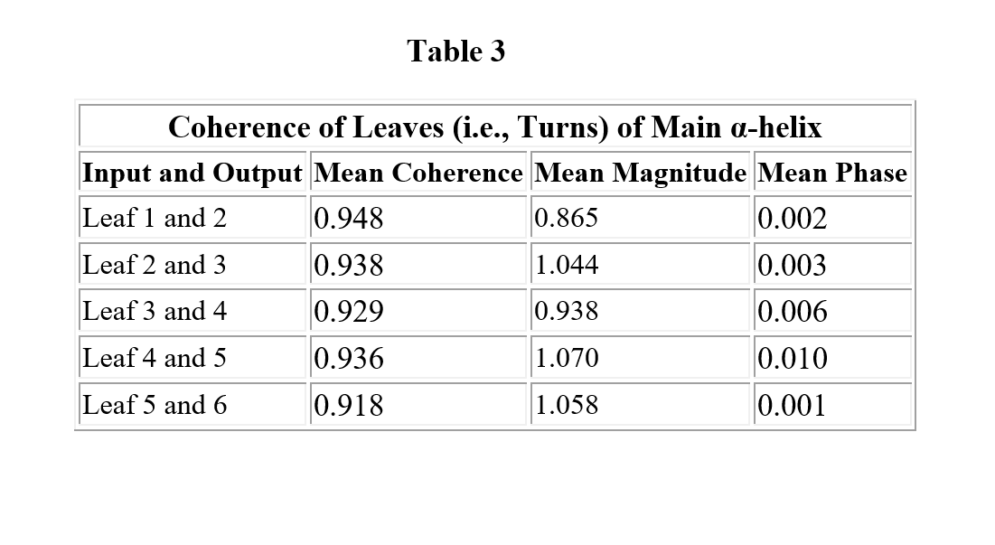
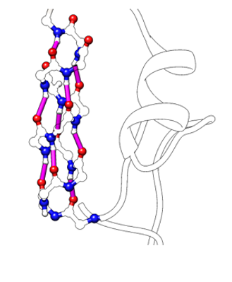
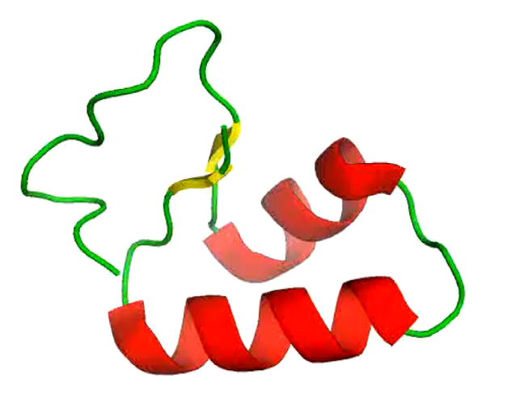
Large Structures are Rigidly Connected They Cohere ‘better’ than H-bonds
Leaf 1
Leaf 2
Leaf 1
Leaf 2

Slide 33
Questions, please

Slide 34
End

