Slide 1
From Maxwell to Mitochondria, a Kirchhoff Computation
Bob Eisenberg bob.Eisenberg@gmail.com
May 5, 2023
Current flow in circuits is the physical basis of computation in computers and the nervous system. We show how the Maxwell equations in circuits imply Kirchhoff's current law, but only when current includes the universal displacement current $ε_{0}∂E/∂t$.
Mitochondria house the respiratory chain of proteins that make ATP, that stores the chemical energy of life. Kirchhoff's current law makes possible computations of the ${>10}^{18}$atoms of the mitochondrion, as it made possible the computation of the Atlantic cable (Kelvin Heaviside), the nerve axon (Hodgkin Huxley), the lens of the eye (Mathias, Huaxiong Huang et a;), and the glia of the optic nerve bundle (Huaxiong Huang, Shixin Xu et al).

Slide 2
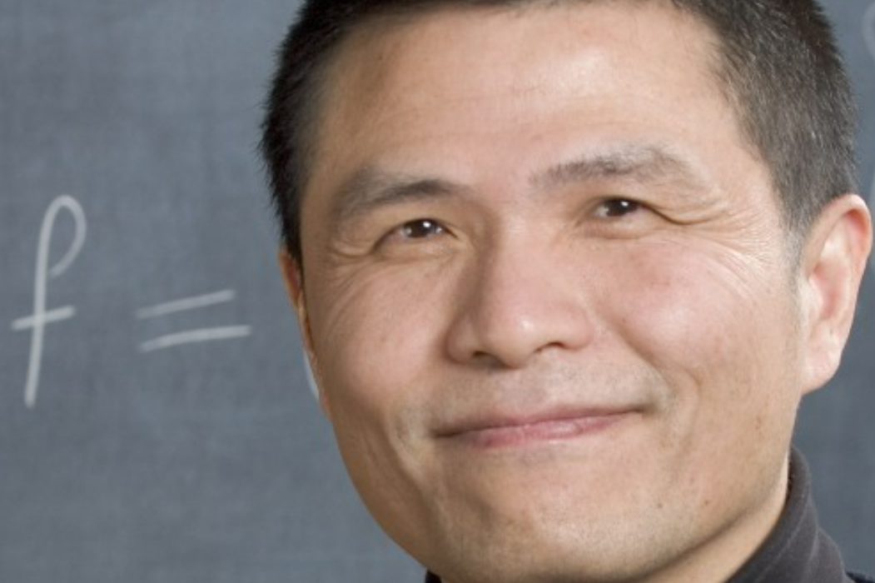
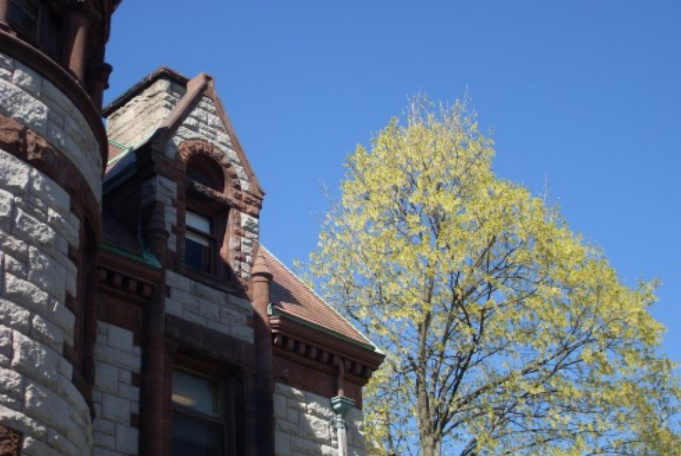
Thanks to Chi-Wang for inviting me
to
May 5, 2023

Slide 3
Kirchhoff’s Law is about Current
Physical Statement
The current that flows into a node flows out.
The current that flows in a wire is equal everywhere.
The current that flows in a series of components is equal everywhere.
NOTE Kirchhoff’s law is true at all times and in all conditions
as we shall prove

Slide 4
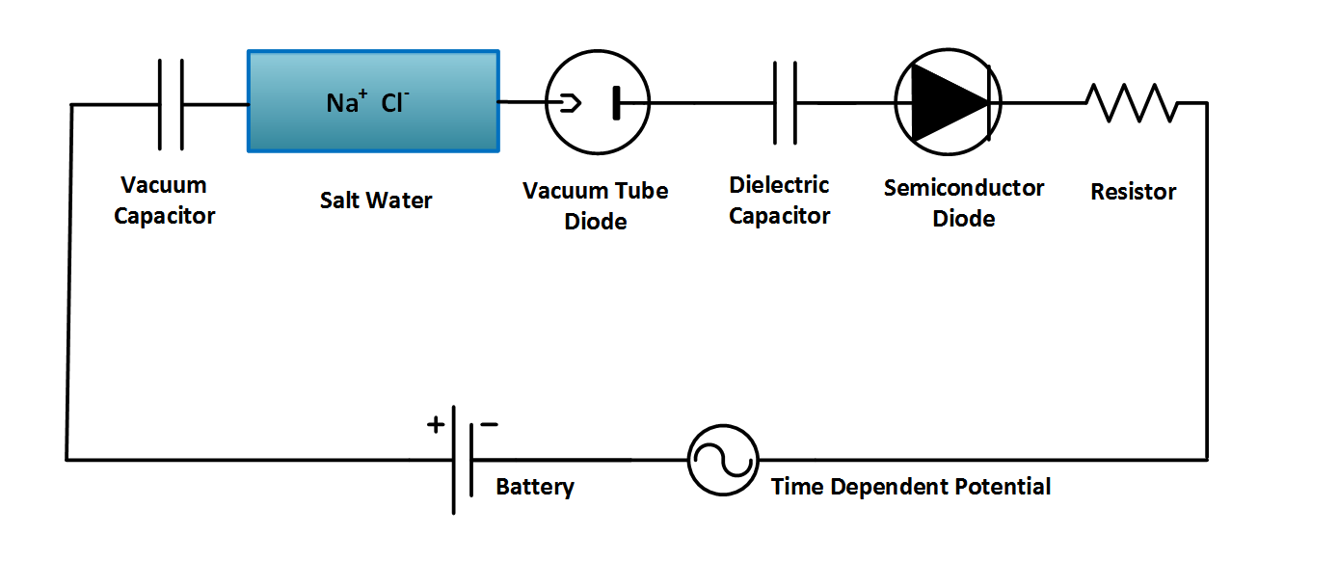
Kirchhoff Coupling: Total Current is the Same in Series Systems
Independent of Mechanism of Charge Movement
Ag AgCl
Ag AgCl
D = permittivity × E
TRIVIAL and PROFOUND
Eisenberg (2016) Mass Action and Conservation of Current. Hungarian Journal of Industry and Chemistry 2016 44:1-28
also arXiv:1502.07251 44:1-28.

Slide 5
Kirchhoff’s Law is about Current
Engineering Statement Stochastic Signal Processing
Currents in a Classical Circuit
are perfectly correlated
with Coherence Function of 1.0
Another Talk
Another Time
Nicholson, Minh , Eisenberg Coherence in an α-helix. ACS Omega 2023 8:13920
$$X(f)$$
$$H(f)$$
$$Y(f)$$
$C_{xy}\left(f\right)=\frac{{\left|H\left(f\right)G_{xx}\right|}^{2}}{G_{xx}\left(f\right){\left|H\left(f\right)\right|}^{2}G_{xx}} =1$ when$H\left(f\right)= \frac{Y\left(f\right)}{X\left(f\right)}$
NOTE Kirchhoff’s law is true at all times and in all conditions
as we shall prove

Slide 6
Kirchhoff’s Law is about Current
Chemists find this problematic
Currents in a series system are COUPLED
by Kirchhoff’s law,
TRIVIAL and PROFOUND No matter what the local mechanism of charge movement
No matter what ions are carrying the current
NOTE Kirchhoff’s law is true at all times and in all conditions
as we shall prove

Slide 7
Kirchhoff’s Law is about Current
Biological Statement
A graph of one current vs another is a straight line
Currents in a series system are COUPLED
by Kirchhoff’s law,
TRIVIAL and PROFOUND No matter what the local mechanism of charge movement
NOTE Kirchhoff’s law is true at all times and in all conditions
as we shall prove

Slide 8
What is Current?

Slide 9
This is a math department
So first
DEFINE CURRENT WITH EQUATIONS

Slide 10
Derivation
$$\frac{1}{μ_{0}} curl B=J+ε_{0} ∂E/∂t$$
Maxwell-Ampere
Physical Fact:
$J$ is the flux of charge with mass, however brief, small, or transient
$J$ includes the polarization charge of dielectrics
Math Identity:
$$div curl anything=0$$
Result:
Kirchhoff Current Law
$$div \left(J+ε_{0}\frac{∂E}{∂t}\right)=div curl B=0$$

Slide 11
What is Current?
$$\frac{1}{μ_{0}} curl B=J+ε_{0}∂E/∂t$$
Maxwell-Ampere
Physical Fact:
$J$ is the flux of charge with mass, however brief, small, or transient.
$J$ includes the polarization charge of dielectrics.
$$\boxed{ {J_{total}=J+ε_{0} ∂E/∂t}^{}}$$
Natural Definition of Total Current:
Result:
Kirchhoff Current Law
$$div{ J}_{total}=0 \begin{matrix} \\ \end{matrix}$$

Slide 12
For non-mathematicians
Div is Divergence
Divergence is an exact measure of what flows out of a region.
When div equals zero, nothing flows in or out $div=0$.
When $div J_{total} =0$,
$J_{total}$ is exactly CONSERVED.
All that flows in, flows out.

Slide 13
For non-mathematicians
Div curl “Anything” $= 0$
NOT fancy math
Easy to prove, in every Graduate Physics Course
$$Div curl B = 0$$
Is also a testable experimental fact

Slide 14
Key Result Conservation of TOTAL Current $${ J}_{total}$$
$${J_{total}=J+ε_{0} ∂E/∂t}^{}$$
Natural Definition of Total Current:
Result:
Kirchhoff Current Law
$$div{ J}_{total}=0 \begin{matrix} \\ \end{matrix}$$

Slide 15
The previous slides were mathematically sufficient
But mathematicians are people
So we move on
to motivate the equations with the underlying physics

Slide 16
What is Current?
Current is Defined in Physics
as that which makes a magnetic field

Slide 17
Current is NOT the Flow of Charge
How do we know that?
Magnetic Fields Exist in Vacuum
Charge and Current density are ZERO in a vacuum
Magnetic Fields in Vacuum Create Electromagnetic Waves LIGHT
$$μ_{0}ε_{0}\frac{∂^{2}E}{∂t^{2}}−∇^{2}E=0$$
$$μ_{0}ε_{0}\frac{∂^{2}B}{∂t^{2}}−∇^{2}B=0$$
${c=1}/{\sqrt{ε_{0}μ_{0}}}$ = velocity of light

Slide 18
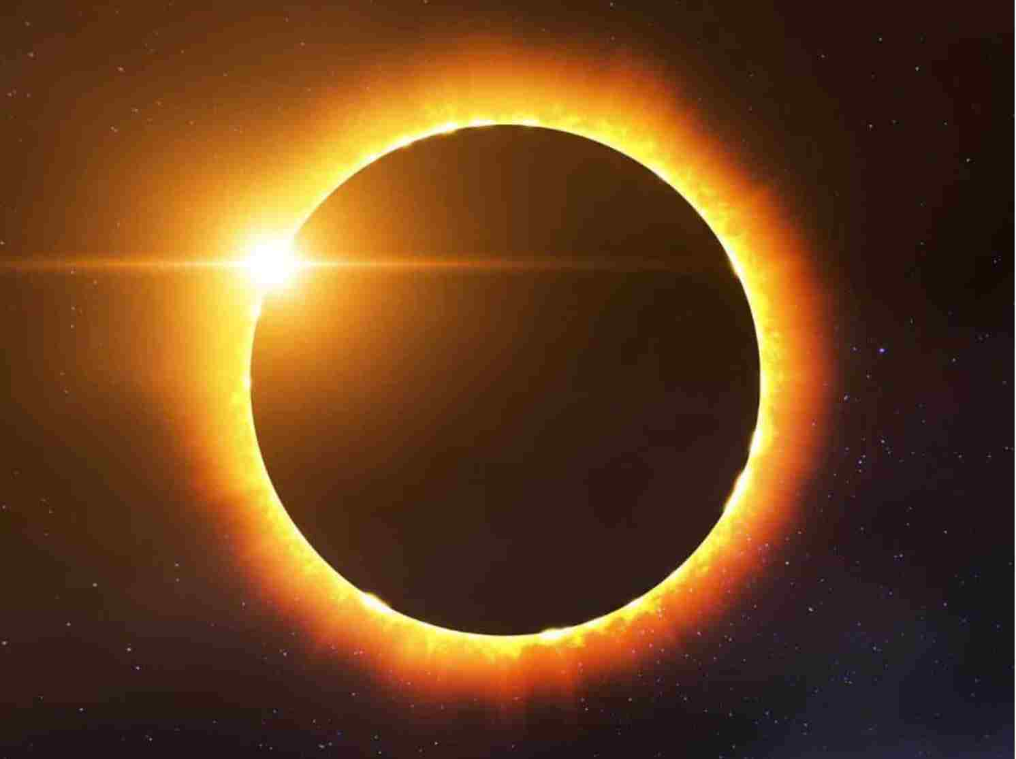
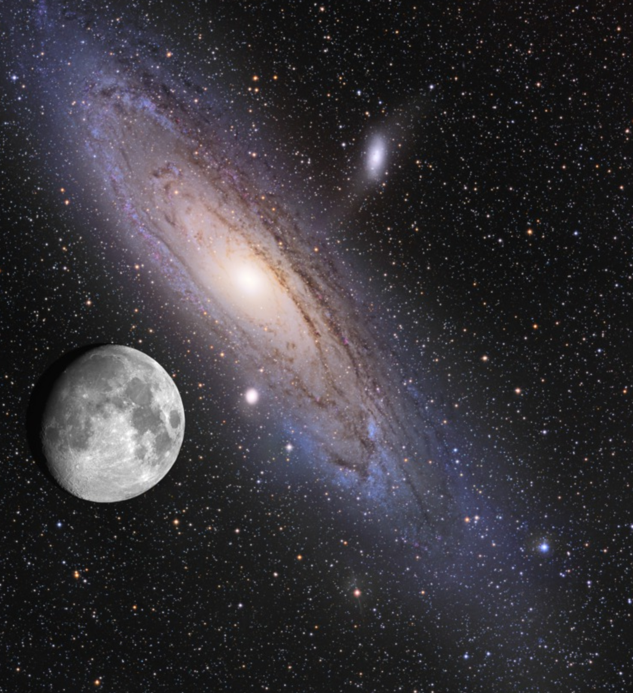
Light travels through the Vacuum of Space
ethereal current ${ε_{0}∂E}/{∂t}$ flows in vacuum of space,
once thought to be filled with an ‘aether’
Jeans 1908. The mathematical theory of electricity and magnetism.
Whittaker 1951. A History of the Theories of Aether & Electricity.
Simpson 1998. Maxwell on the Electromagnetic Field: A Guided Study.
$$μ_{0}ε_{0}\frac{∂^{2}E}{∂t^{2}}−∇^{2}E=0$$
Wave Equation Corollary of Maxwell Equations
${c=1}/{\sqrt{ε_{0}μ_{0}}}$ = velocity of light
$$μ_{0}ε_{0}\frac{∂^{2}B}{∂t^{2}}−∇^{2}B=0$$

Slide 19
Well known Example
taught,
or should be taught,
In First Year of Physics
Vacuum
Vacuum Current
Current
Current
$${=ε}_{0}\frac{∂E}{∂t}$$
Vacuum current = Ethereal current = Displacement Current
All are names for the same thing $ε_{0}{∂E}/{∂t}$

Slide 20
Maxwell Ampere Law in a Vacuum
No known error between stars, inside atoms
Magnetism
↓
$\frac{1}{μ_{0}} curl B=$ $ε_{0}$
$$\frac{∂E}{∂t}$$
CURRENT
Vacuum contains no charge and thus flow of charge $J=0$

Slide 21
Fundamental Result of Physics
$ε_{0}\frac{∂E}{∂t }$is everywhere

Slide 22
Displacement Current $ε_{0} ∂E/∂t$ is a Property of Space
according to Theory of Relativity
Maxwell Equations and Relativity are almost the same thing
"The special theory of relativity ... was simply a systematic development of the electrodynamics of Clerk Maxwell and Lorentz".
p. 57 of Einstein, A. 1934. Essays in science,
originally published as Mein Weltbild 1933,
translated from the German by Alan Harris. Open Road Media.

Slide 23
Electrodynamics and Relativity
Charge has a Special Place in physics
Charge on a particle (coulombs) does not vary as it moves at velocity $v,$
even near the velocity of light $c$
Charge (coulombs) is “Lorentz Invariant”
Distance, time, and relativistic mass Change Dramatically
near the velocity of light as $\sqrt{1−{v^{2}}/{c^{2}}}$

Slide 24
Electrodynamics and Relativity
Charge has a Special Place in Physics
Displacement Current $ε_{0} ∂E/∂t$makes charge Lorentz Invariant
$ε_{0} ∂E/∂t$ has a Special Place in Physics

Slide 25
Maxwell Ampere Law Everywhere
No known error, inside atoms or between stars
Universal Displacement Current
Magnetism
↓
$\frac{1}{μ_{0}} curl B$ ${=J+ε}_{0}$
$$\frac{∂E}{∂t}{ =J}_{total}$$
Fundamental Experimental Result in Physics
$ε_{0}∂E/∂t$ exists everywhere, e.g., inside atoms
$J$is the flow of all charge, however brief, small or transient. $J$ includes polarization charge of dielectrics

Slide 26
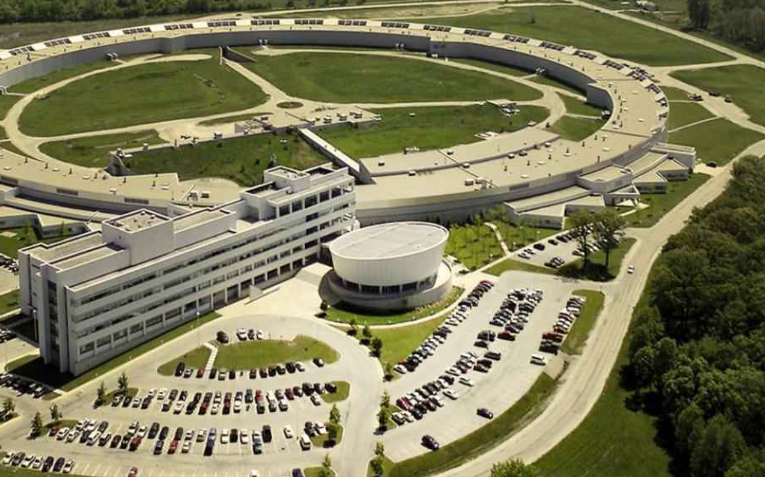
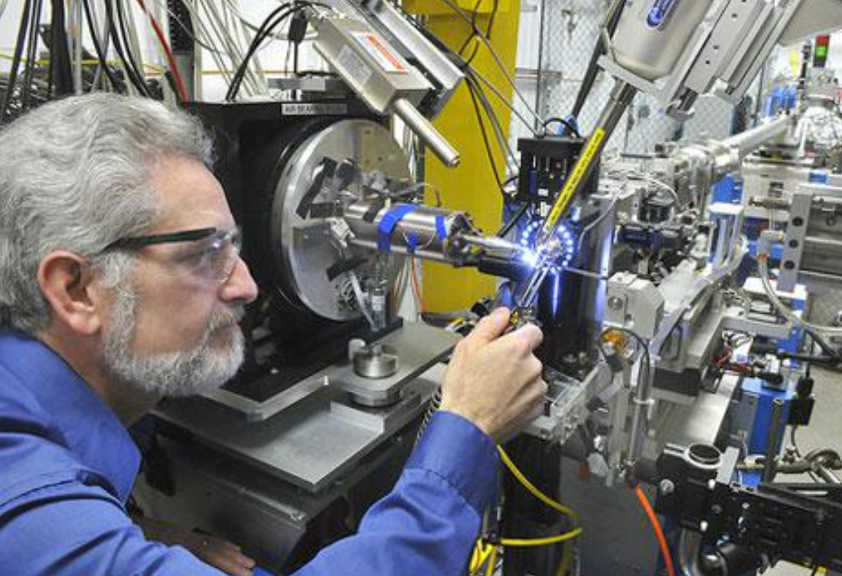
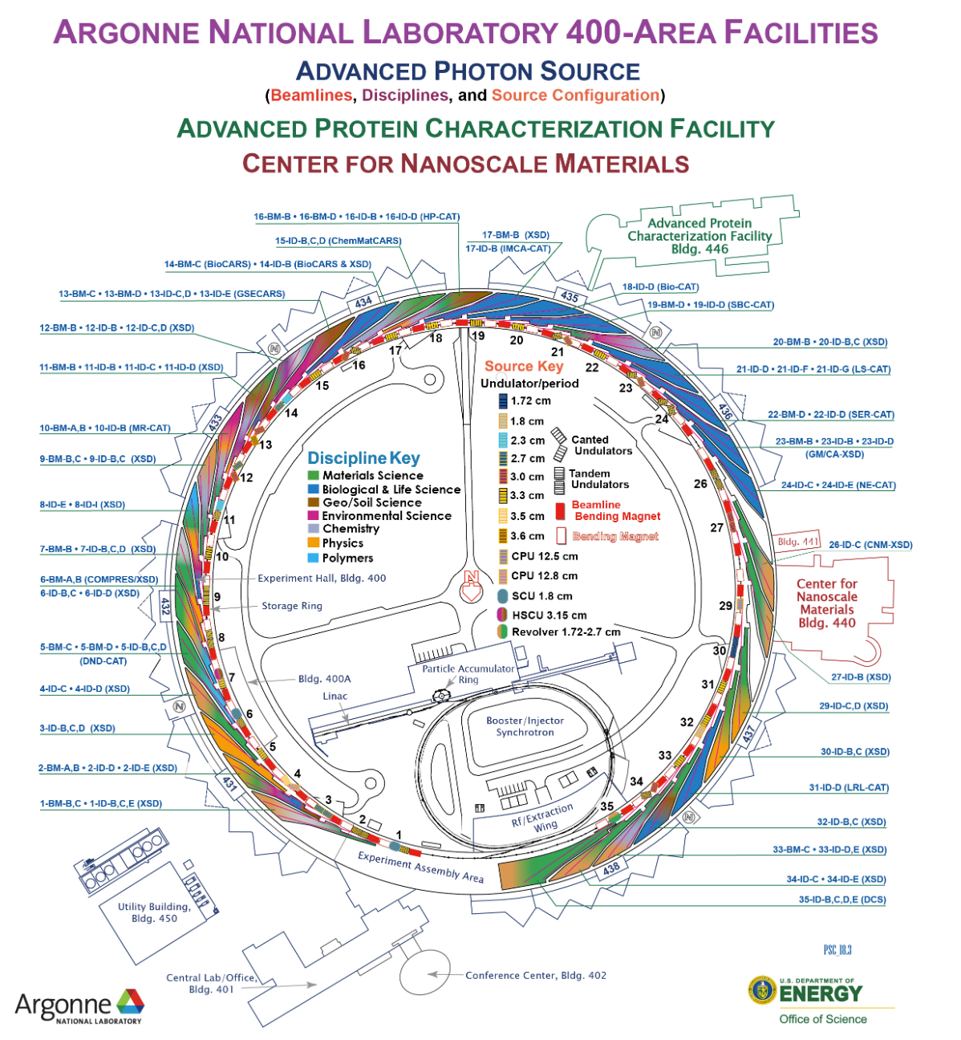
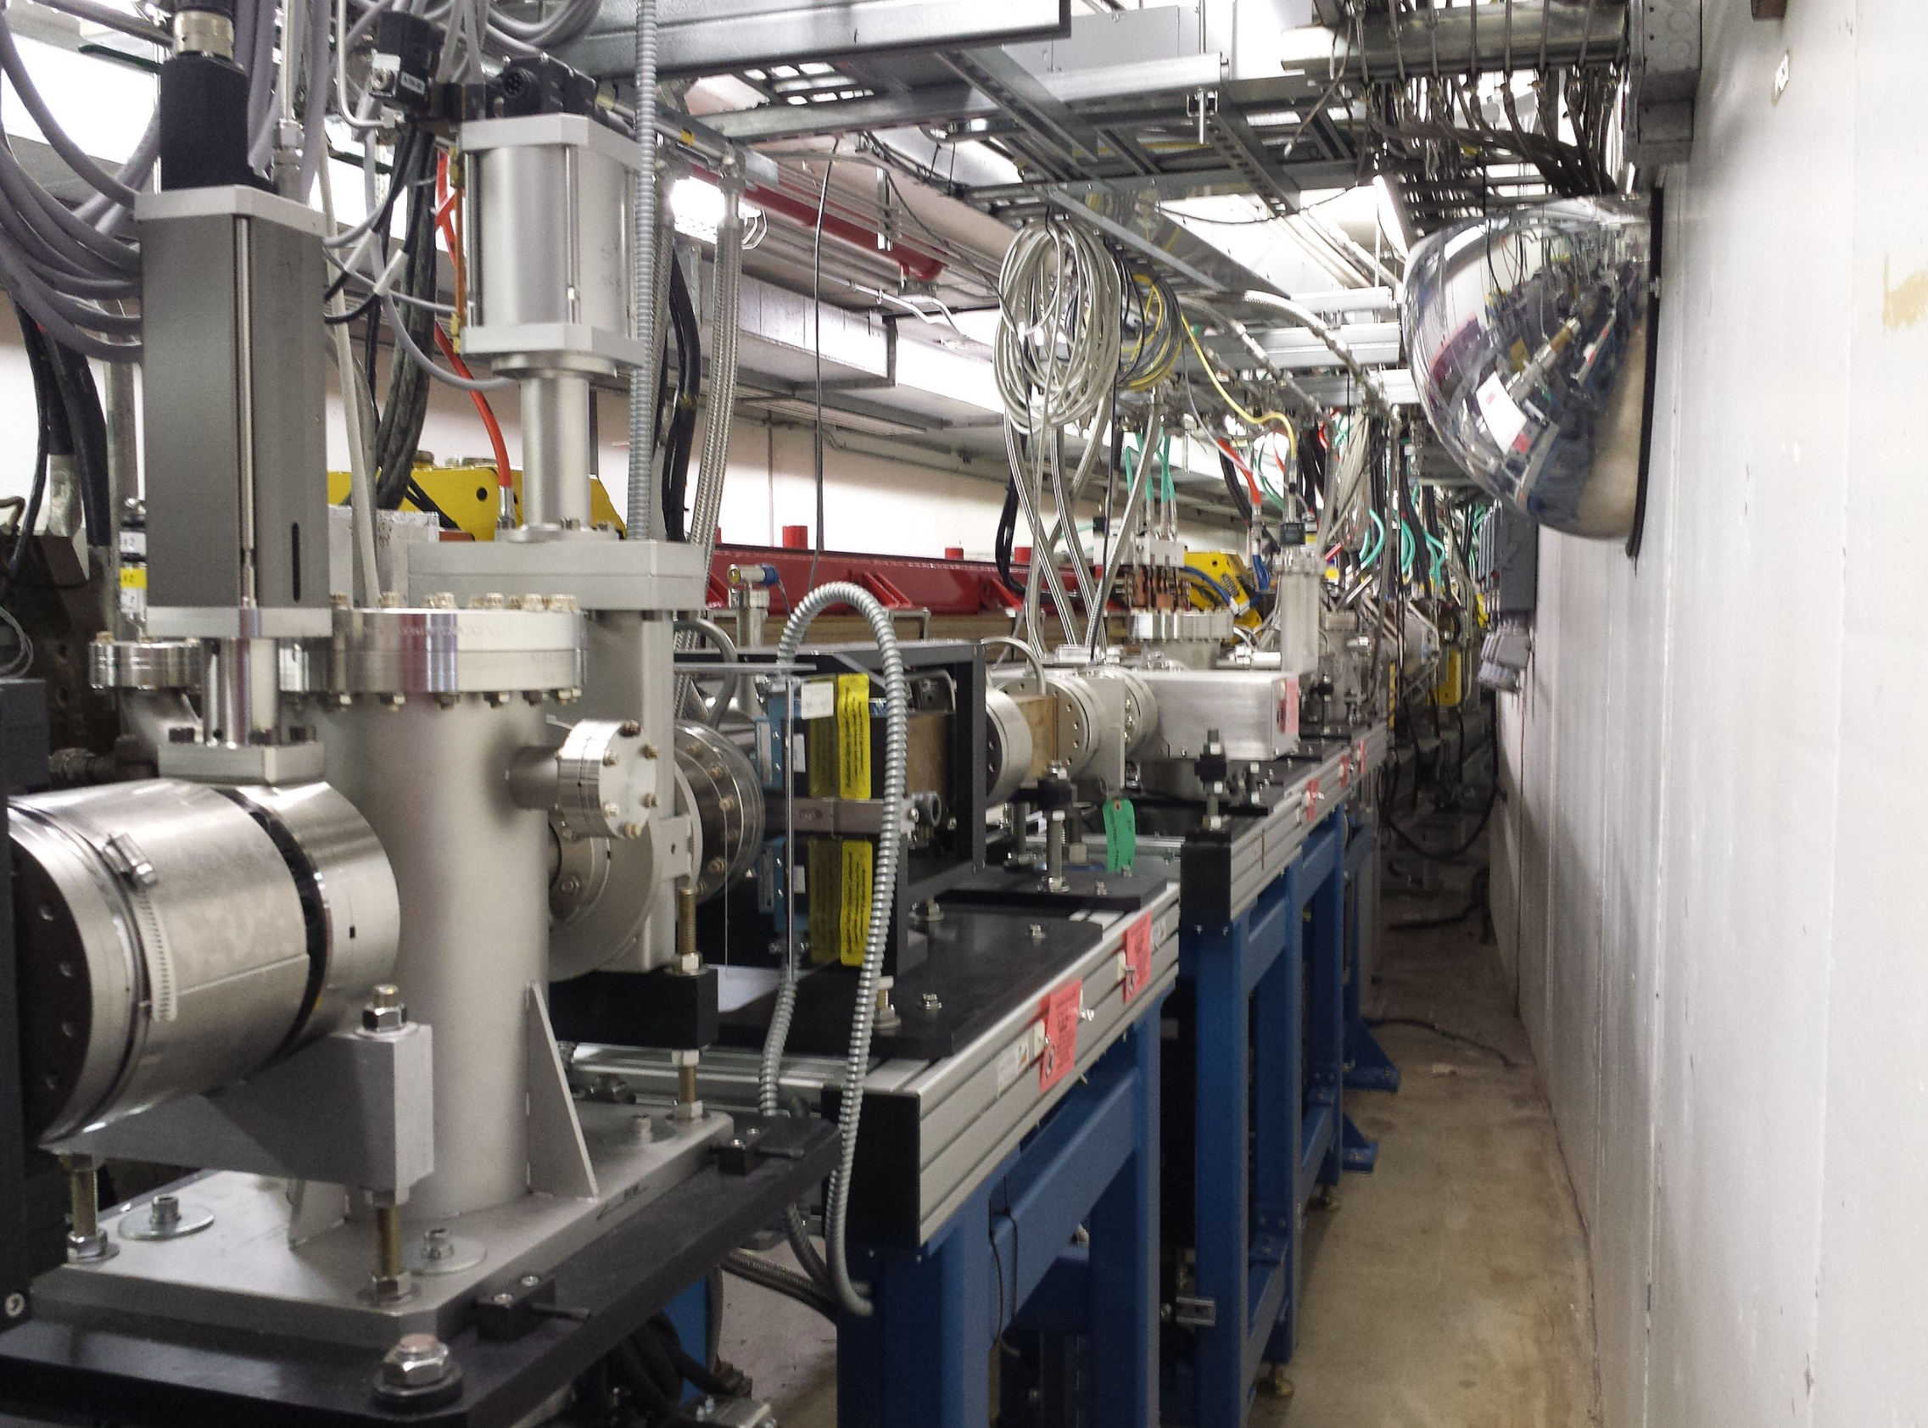
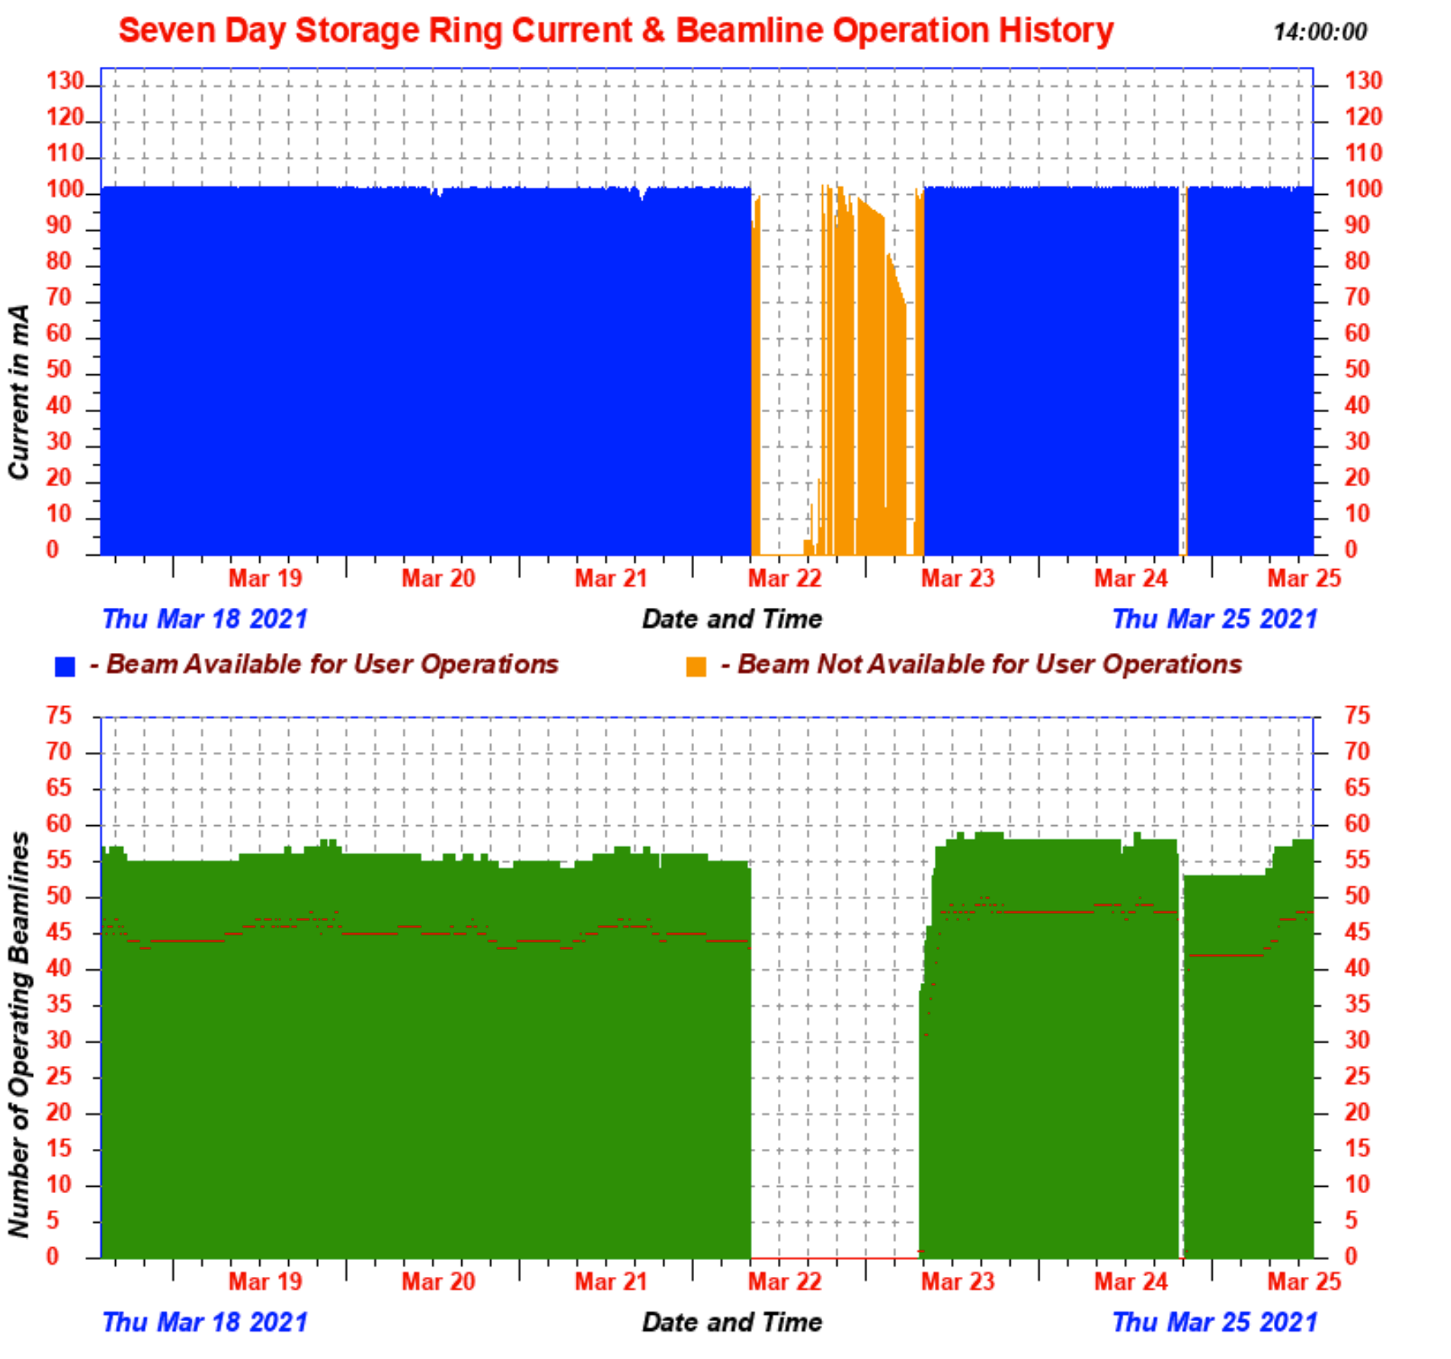
Error in Theory $<{10}^{−10}$
Beam${ \sim 10}^{10}$ eV
Beam length ${10}^{3}$ m Tolerance $<{10}^{−7 }$m
Beam Current $100$ mA Beam Power${10}^{9} watts$
Advanced Photon Source Argonne National Laboratory
Source Internet

Slide 27
Maxwell-Ampere Equation Implies Conservation of Total Current
$$\frac{1}{μ_{0}} curl B=J_{total}$$
$J_{total} includes$ the flux of charge with mass, however brief, small, or transient.
$J_{total}$includes the polarization charge of dielectrics.
Identity
$$div curl anything=0$$
Kirchhoff Current Law for Fields
$$div J_{total}=div curl B=0$$

Slide 28
Paradigm Change
Usual derivation of Circuit Kirchhoff Discusses only flux $J$of charges
Derivation should discuss $J_{total}$ $$J_{total}=J+ε_{0}{∂E}/{∂t}$$
Maxwell div $J_{total}=0$ and
Classical Kirchhoff div $J=0$
DISAGREE

Slide 29
If $J_{total} is conserved, J$ 𝐢𝐬 𝐧𝐨𝐭 𝐜𝐨𝐧𝐬𝐞𝐫𝐯𝐞𝐝
If$div \left(J+ε_{0}{∂E}/{∂t}\right)=0, div J≠0$
The flux of charges is not conserved.
The current of charges accumulates as ‘free’ charge $ρ$ by Continuity Equation${{div J=−ε}_{0} ∂ρ}/{∂t ⇒} div J≠0$
Obvious,
But Widely Misunderstood

Slide 30
Physical Note about Steady State $∂E/∂t=0$
Underlying physics is hidden by the special case $ε_{0} ∂E/∂t=0$
The steady state ignores the charge that invariably* accompanies an E field,
usually at its boundaries
Physics prohibits general steady state
$ε_{0} ∂E/∂t≠0$ in general because fields change in applications
*Gauss’ law, the first Maxwell Eqution

Slide 31
Mathematical Note about Steady State $∂E/∂t=0$
Studying electrodynamics always involves initial and boundary Conditions
Careful Treatment of Initial and Boundary Conditions shows that Charge $ρ\left(x,y,z;t\right)$ ALWAYS accompanies an Electric field
Charge may be on boundaries or in the initial state, of course.

Slide 32
We have shown that Kirchhoff’s law for fields must include Displacement Current $ε_{0}{∂E}/{∂t}$
Versions of Kirchhoff’s law that do not include
Displacement Current $ε_{0}{∂E}/{∂t}$ are incompatible with the Maxwell equations

Slide 33
MATHEMATICIANS NEED NOT WORRY
When Kirchhoff’s law is corrected, classical applications are well defined approximations
provided a single dielectric constant is a good approximation
not bad in silicon,
bad in ionic solutions,
horrible in proteins

Slide 34
OTHER APPLICATIONS HAVE PROBLEMS
The fundamental understanding of atomic motion is changed when Kirchhoff's law is corrected
‘Everything’ is Coupled to ‘Everything Else’
as we shall see.
Atomic motion is then viewed as the motion of charges necessary to maintain conservation of total current,
which is as universal and exact as the Maxwell equations themselves)
This revision changes the interpretation of how molecular machines work,
e.g., the transporters of protons and electrons that creat the 'storehouse of nearly all chemical energy in living systems' ATP

Slide 35
So far we have talked about
Conservation of Total Currentin general Fields
But not in circuits
What about Kirchhoff’s Current Law in Circuits?

Slide 36
We have shown that Kirchhoff’s law for fields must include Displacement Current $ε_{0}{∂E}/{∂t}$
Versions of Kirchhoff’s Circuit law that do not include
Displacement Current $ε_{0}{∂E}/{∂t}$ are incompatible with the Maxwell equations

Slide 37
Kirchhoff’s Law of Circuits must include the Displacement Current
But including displacement current is not enough
To validate Kirchhoff’s Law in Circuits
All the total current must flow in branched networks
Circuit components must be ideal, including wires

Slide 38
All the total current must flow in branched networks
Circuit components must be ideal, including wires
Difficult to Specify in Theory
But
EASY TO CHECK IN EXPERIMENTS

Slide 39
EASY IN IDEALIZED CIRCUITS
Just include stray capacitances
But Difficult to Specify a priori in Realistic Models

Slide 40
Difficult to Specify in Realistic Models
But
EASY TO CHECK IN EXPERIMENTS
MEASURE THE CURRENTS
See if they add up
CHECK THE THEORY

Slide 41
Textbooks do not
include displacement current in Kirchhoff’s Circuit Law
as far as my collaborators and I can determine
How can circuits work if they are designed with the wrong version of Kirchhoff’s Law?

Slide 42
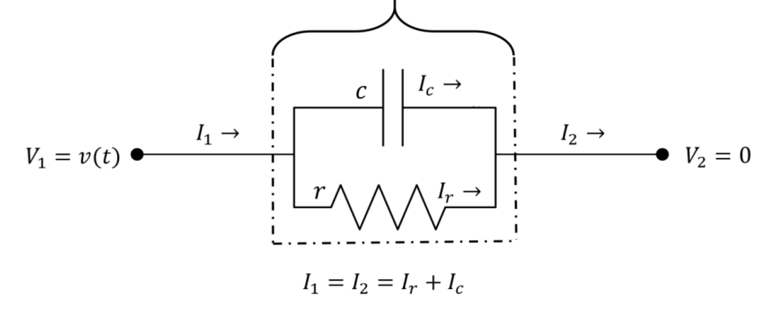
How can circuits work if they are designed with the wrong version of Kirchhoff’s Law?
Answer:
Circuits are Expanded to include ‘Stray’ Capacitances
And those include the universal displacement current
Realistic Resistor
Stray Capacitance

Slide 43
Numerical treatments of Electrodynamics
must include the Displacement Current $ε_{0}{∂E}/{∂t}$
Numerical Treatments with dielectric constant
${ε_{r}ε}_{0}{∂E}/{∂t}$ include Displacement Current
because $ε_{r}≥1$

Slide 44
Optimal Numerical Treatment of Total Current
is put forward in the following references
Ji, Lijie, Pei Liu, Zhenli Xu, and Shenggao Zhou. "Asymptotic Analysis on Dielectric Boundary Effects of Modified Poisson--Nernst--Planck Equations." SIAM Journal on Applied Mathematics 78, no. 3 (2018): 1802-22.
Qiao, Zhonghua, Zhenli Xu, Qian Yin, and Shenggao Zhou. "Structure-Preserving Numerical Method for Maxwell-Ampère Nernst-Planck Model." Journal of Computational Physics 475 (2023/02/15/ 2023): 111845.
Qiao, Z., Z. Xu, Q. Yin and S. Zhou (2023). "A Maxwell–Ampère Nernst–Planck Framework for Modeling Charge Dynamics." SIAM Journal on Applied Mathematics 83(2): 374-393.

Slide 45
Surprising PHYSICAL and Biophysical
Consequences of Kirchhoff Field Law

Slide 46
OTHER IMPLICATIONS ARE SIGNIFICANT
The fundamental understanding of atomic motion is changed when Kirchhoff's law is corrected
‘Everything’ is Coupled to ‘Everything Else’
as we shall see.
Atomic motion is then viewed as the motion of charges necessary to maintain conservation of total current
which is as universal and exact as the Maxwell equations themselves)
This revision changes the interpretation of how molecular machines work,
e.g., the transporters of protons and electrons that creat the 'storehouse of nearly all chemical energy in living systems' ATP

Slide 47
Conservation of Current is Exact and Universal
So what?
(1) Current must always be described by Continuum Equations
Because of $ε_{0}{∂E}/{∂t}$
(2) Particle motion does NOT define Current
Contradicts Intuition
Current ≠ Flux of charge

Slide 48
Contradicts Intuition Small Systems REQUIRE Continuum Description
of Electric Current
Because of $ε_{0}{∂E}/{∂t}$
Current does NOT flow by hopping Current is independent of location in series systems Particles can hop, total current cannot

Slide 49
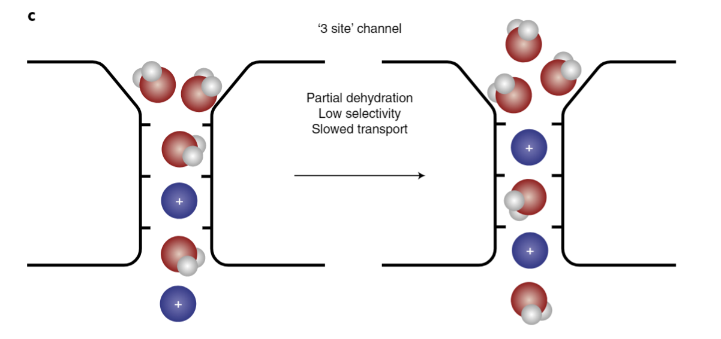
What does this mean for Ion Channels?
Knock On and Knock Off of Ions is IRRELEVANT for the Total Current $J_{total }$ Through the Channel
Paradigm Change
Eisenberg (2020) ‘Electrodynamics Correlates Knock-on and Knock-off: Current is Spatially Uniform in Ion Channels.’ Preprint on arXiv at 2002.09012
Corry (2018) ‘The naked truth about K⁺ selectivity’. Nature Chemistry 10:799-800.

Slide 50
View of Channels has been focused on movements of individual ions in channels,
But
Total Current $J_{total }$ is equal everywhere in a one dimensional channel
Position does not appear in equations for total current $J_{total }$in a one dimensional channel
Paradigm Change
References and Proofs in Eisenberg (2019) Kirchhoff's Law can be Exact. arXiv: 1905.13574
Eisenberg, Gold, Song, and Huang (2018) What Current Flows Through a Resistor? arXiv:1805.04814

Slide 51
Revolution in Biophysics Total Current flow $J_{total }$is equal everywhere in a one dimensional system
Thermal Motion in Space does not appear in equations for flow of total current $J_{total }$in a one dimensional system
Thermal motion appears ONLY in time
Eisenberg (2020) Electrodynamics Correlates Knock-on and Knock-off: Current is Spatially Uniform in Ion Channels. Preprint on arXiv at https://arxiv.org/abs/2002.09012.

Slide 52
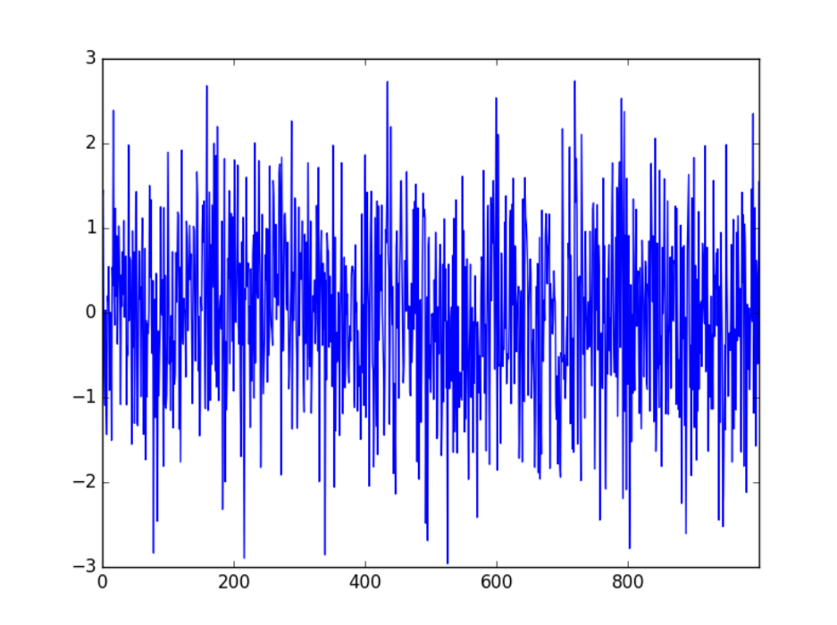
Current Noise ${ J}_{total}$ is Zero in Space
Time
vs
Space
$$t=400$$
Current Noise ${ J}_{total}$ is HUGE in time
$$Current$$
$$Current$$
$$t=0$$
$$t=800$$
t
x
One Dimensional Systems like Channels or Circuit Components

Slide 53
EQUALITY of Total Current $J_{total }$ is an Enormous Simplification
It can create a Perfect Low Pass Filter
It can Convert Chaos of Brownian Motion
into a Constant

Slide 54
What does this mean for Mathematical Models?
The image of total current flow $J_{total }$is very different VERY SMOOTH in space
Total Current $J_{total }$does not vary in space so
Spatial Derivatives are not needed to describe total current
But they are needed to describe everything else.

Slide 55
This is not magic
Conservation of Total Current
Says the fields of the Maxwell Equations
Are exactly what are needed to conserve current

Slide 56
Maxwell Equations Guarantee that
Atoms in Series System Move so
Total Current is Equal
Magnetic and Electric Fields Move Atoms
EXACTLY THE RIGHT AMOUNT
so total current is conserved

Slide 57
Maxwell Equations Guarantee that
Atomic Motions we see in Simulations
Are those needed to Conserve Total Current
In my view, this is the best way
to understand atomic motion.
Thinking of charges in circuits is a fool’s errand
Circuits contain ${ \sim 10}^{23}$charges
with ${≫10}^{23}!$𝐢𝐧𝐭𝐞𝐫𝐚𝐜𝐭𝐢𝐨𝐧𝐬
Thinking of Total Current is MUCH Easier

Slide 58
In my view, this is the best way
to understand atomic motion.
Thinking of charges is a fool’s errand
When there are ${10}^{23}$ charges
Thinking of Total Current is MUCH Easier
Atomic Motions we see in Simulations
Are those needed to Conserve Total Current

Slide 59
Current flow is very smooth in spatial coordinate
Differential equation in $x$ is not needed for $J_{total }$
$$J_{total }=J+ε_{0}{∂E}/{∂t}$$
What does this mean for theory and simulations?
Opportunity to Simplify Algorithms and Codes
perhaps dramatically
Spatial Dependence is Already Known
Only have to average the time dependence
Ma, Li and Liu (2016). arXiv:1605.04886; Ma, Li and Liu (2016). arXiv:1606.03625.

Slide 60
Spatial Variable does NOT appear in description of current in a one dimensional channel
How take advantage of this enormous simplication?

Slide 61
Current flow is very smooth in spatial coordinate
Differential equation in $x$ is not needed for $J+ε_{0}{∂E}/{∂t}$
What does this mean for theory and simulations?
YOU tell me!
Opportunity to Simplify Algorithms and Codes
perhaps dramatically
Spatial Dependence is Already Known
Only have to average the time dependence of particle motion
Ma, Li and Liu (2016). arXiv:1605.04886; Ma, Li and Liu (2016). arXiv:1606.03625.

Slide 62
Biophysical Consequences
Of
Perfect Conservation of Total Current
Total Current does not hop in Channels
Kirchhoff Coupling in Nerve Signal
Kirchhoff Coupling in Mitochondria and Transporters
Kirchhoff Coupling is different in vesicles/mitochondria, and in voltage clamped bilayers.

Slide 63
Some Biologists Know How to Use the Maxwell Equations

Slide 64
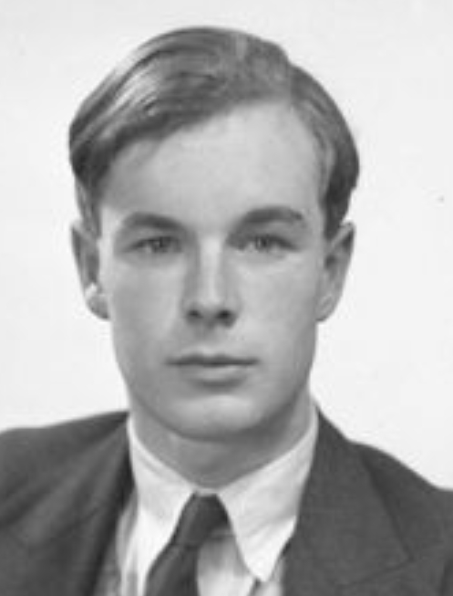
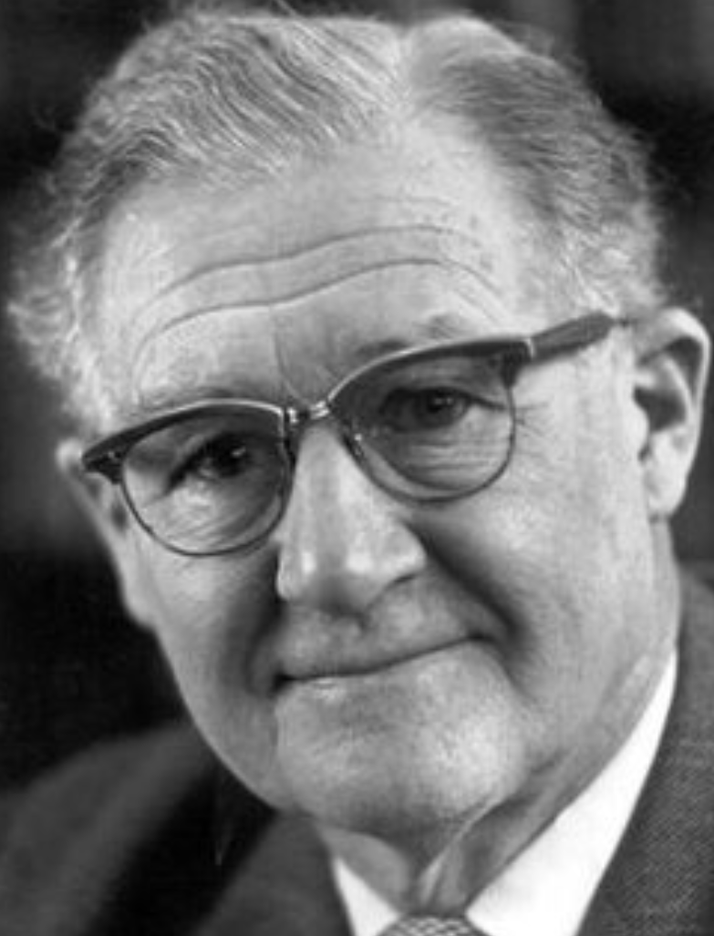
Some biologists have been Applying Maxwell to the Nerve Signal for a long time
Alan Hodgkin William Rushton Proc Roy Soc (London) Ser B. 1946;133:444-79.

Slide 65
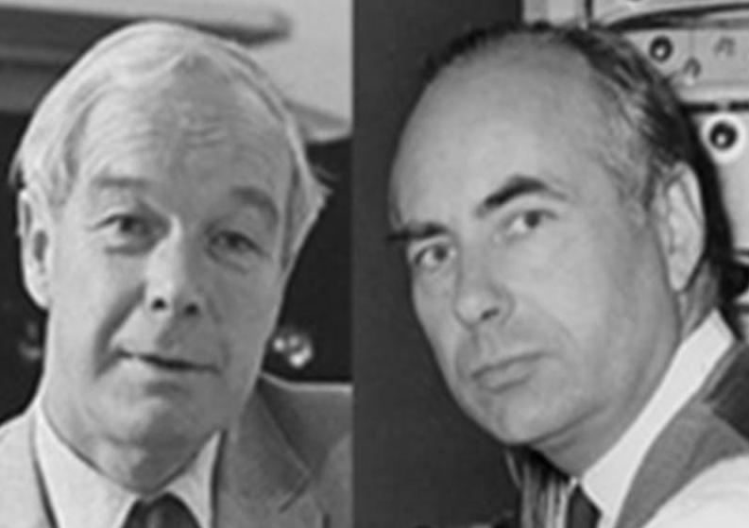
Channels are Chemically and Structurally INDEPENDENT
Electric Field Couples Channels so they can make a Useful Electrical Signal,
the Action Potential

Slide 66
Channels are Chemically and Structurally INDEPENDENT
Natural Function of Channels
Requires
Coupling by the Electric Field
Electric Field Couples Channels so they can make a Useful Electrical Signal
the Action Potential

Slide 67
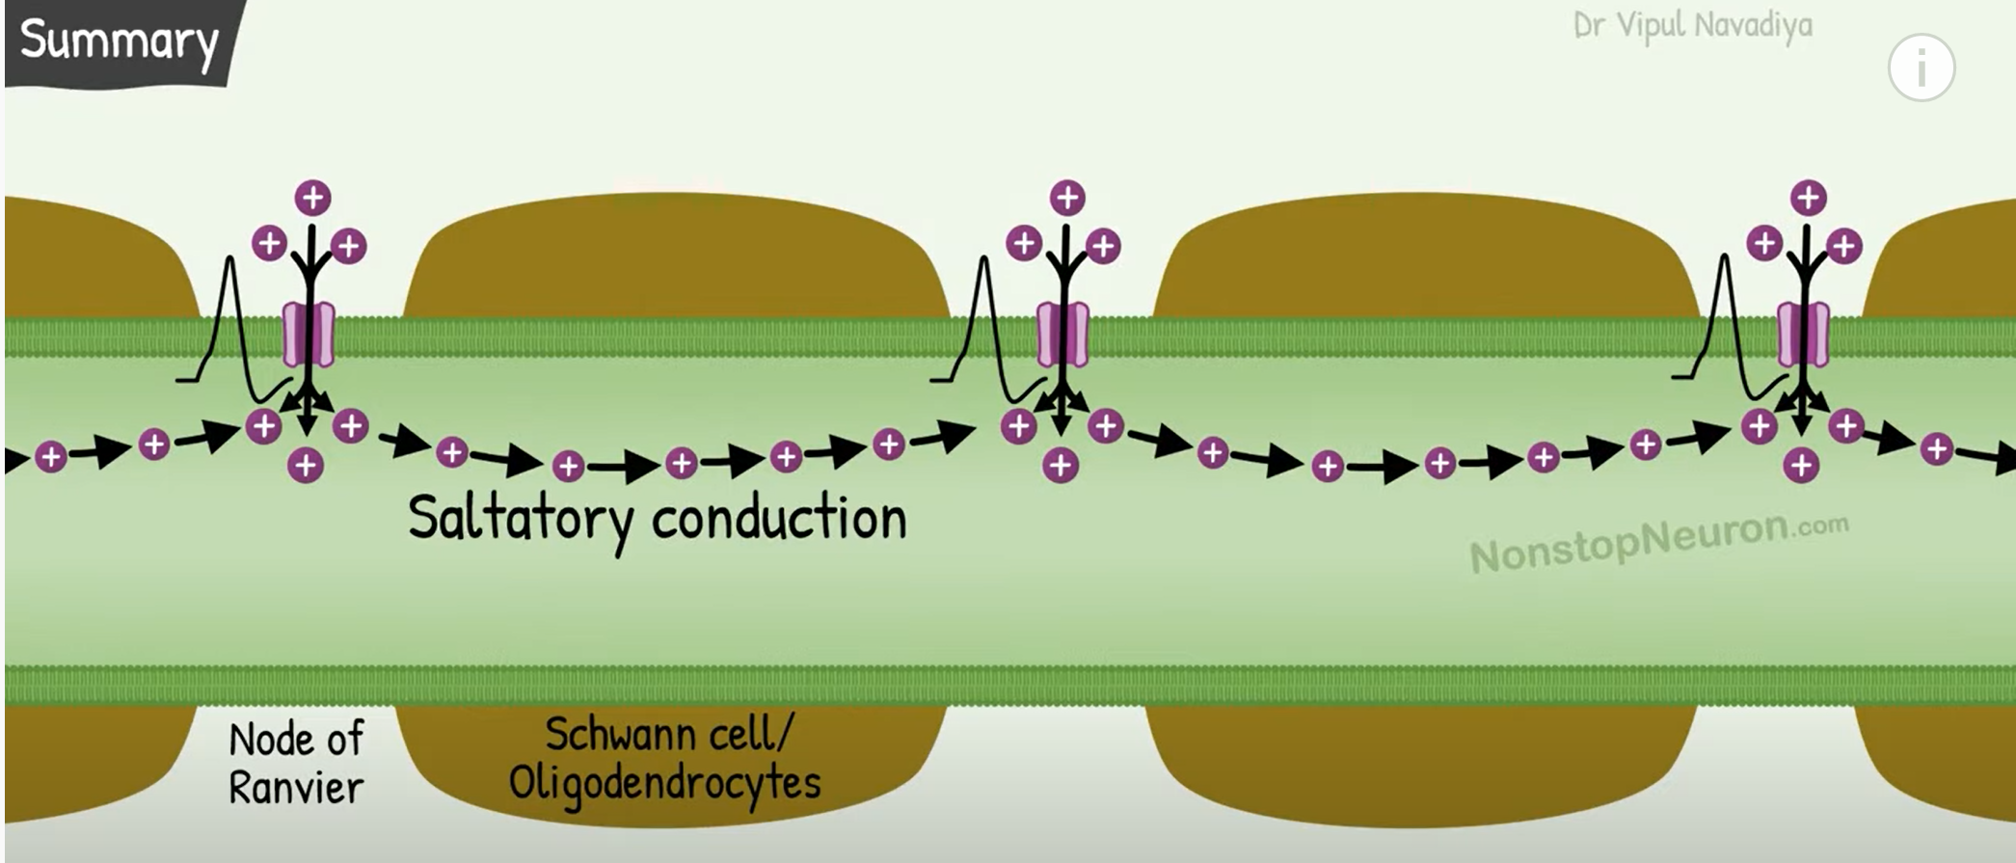
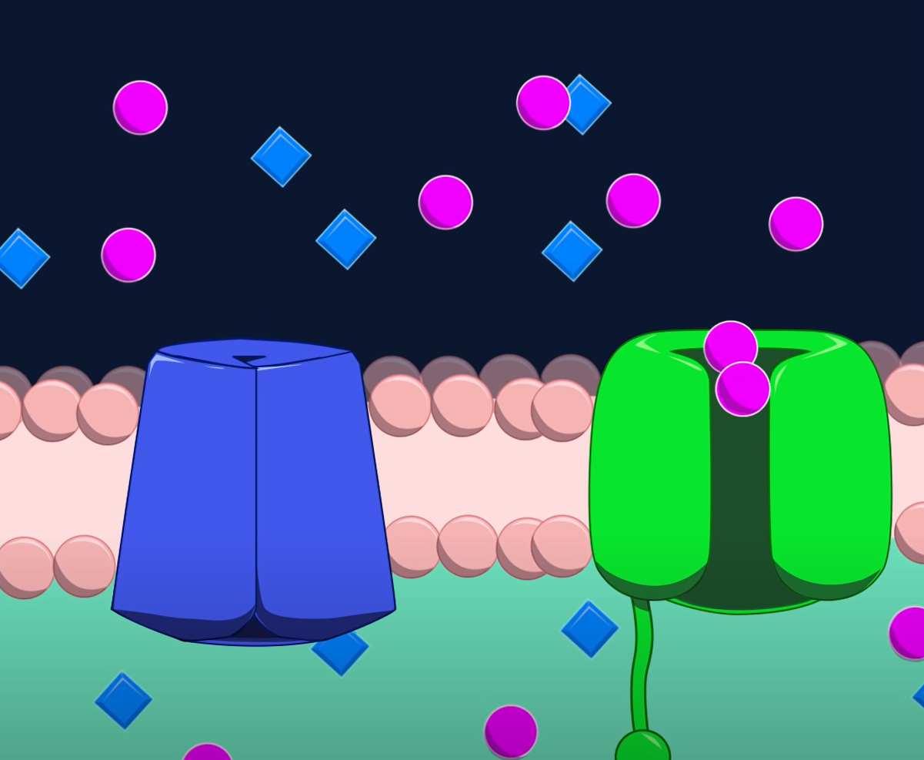
Coupling in Natural Function is by Electric Field, i.e., VOLTAGE SPREAD
Channels
Nerve Fiber with Myelin
Na K
https://www.youtube.com/watch?v=tOTYO5WrXFU
https://www.youtube.com/watch?v=oa6rvUJlg7o

Slide 68
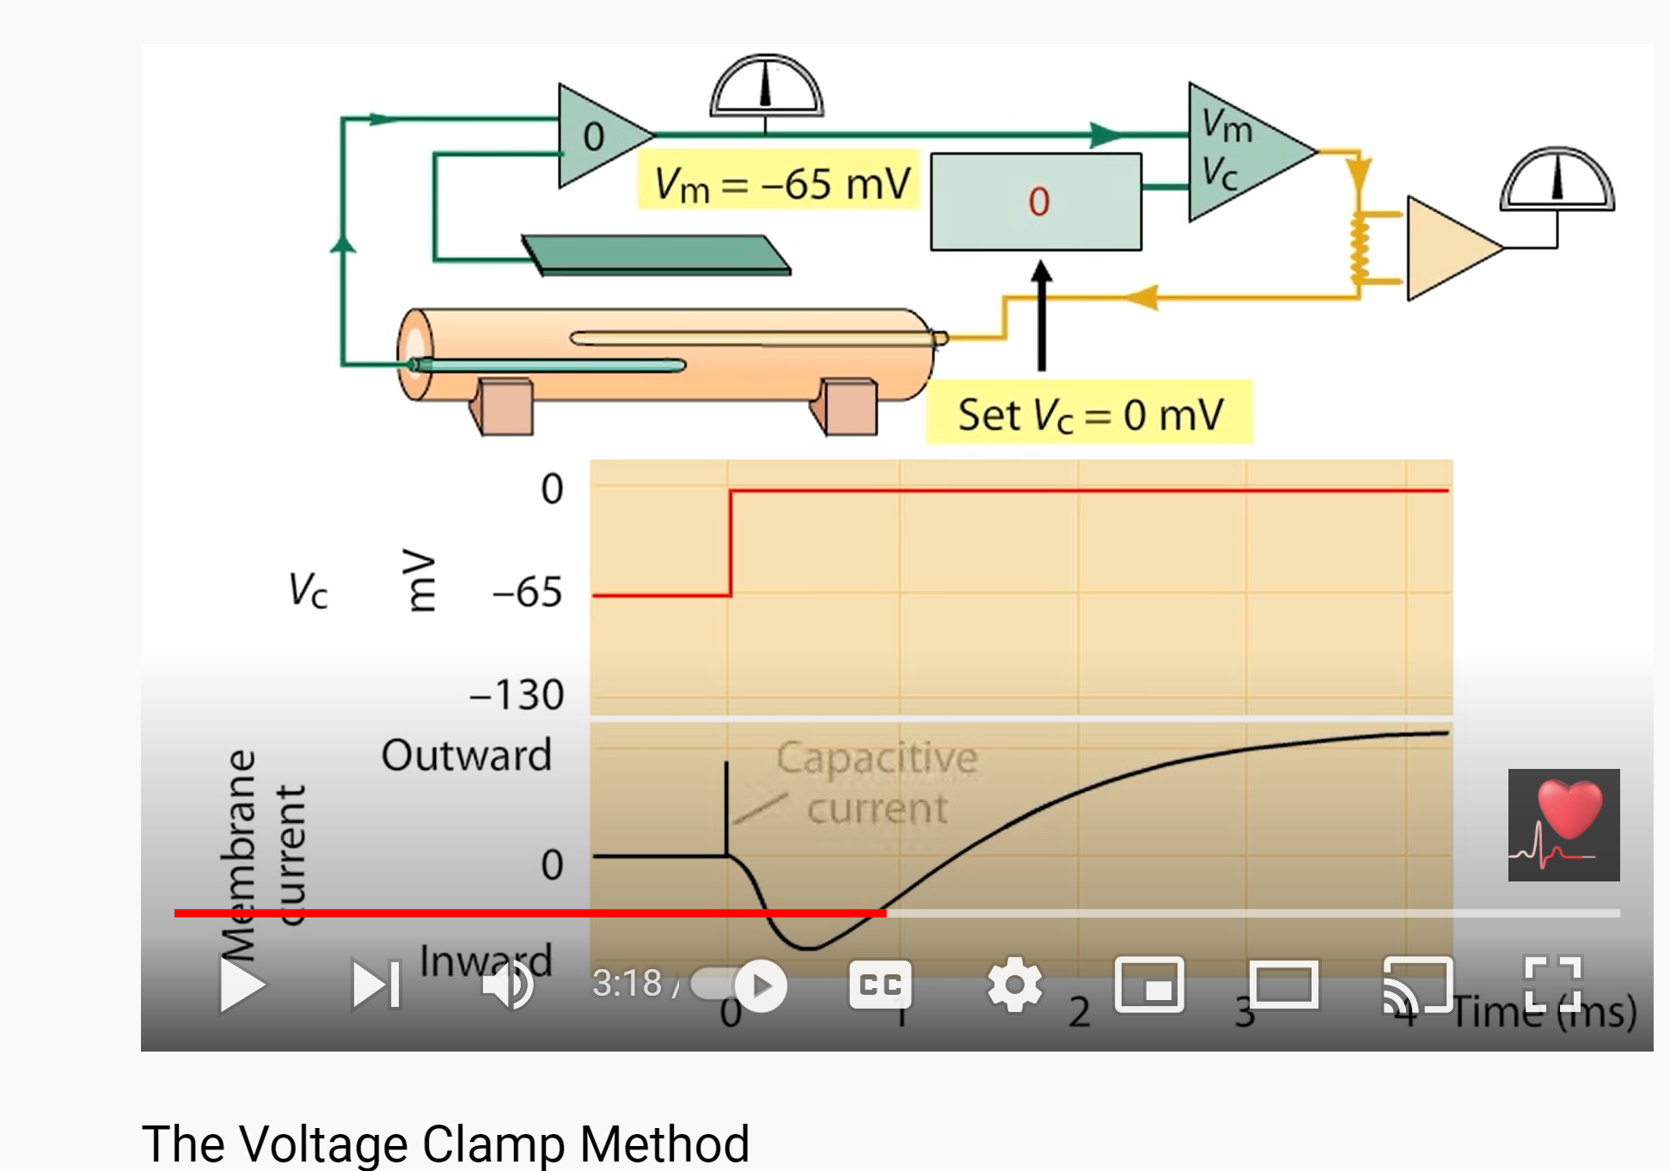
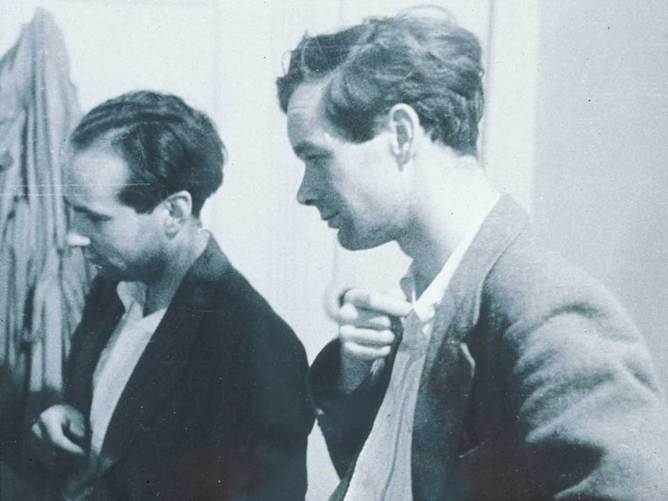
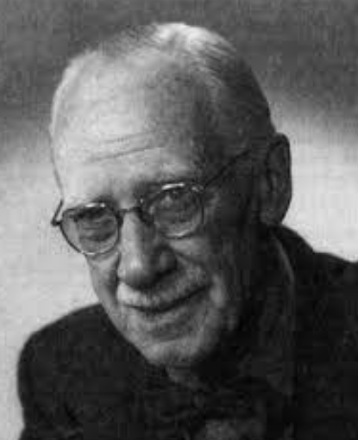
ONLY in the Unnatural Voltage Clamp are Channels Independent
Huxley Hodgkin
KS Cole
https://www.youtube.com/watch?v=3F-Uw1RZqAQ

Slide 69
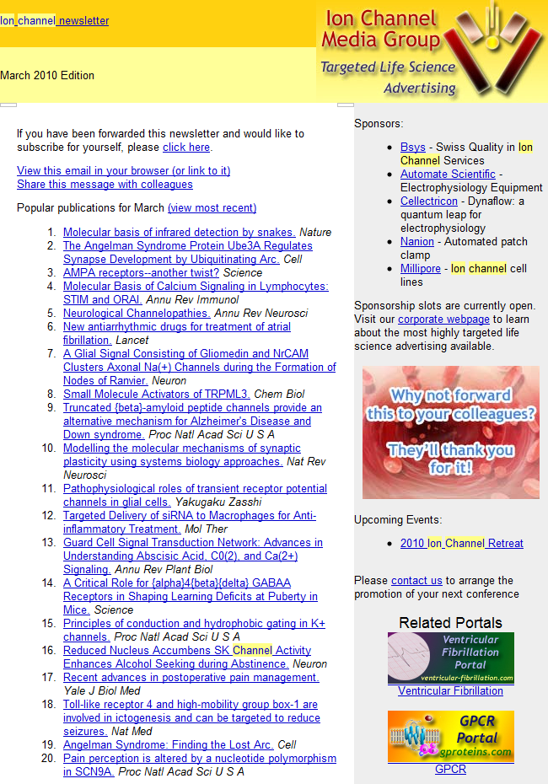
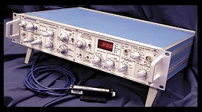
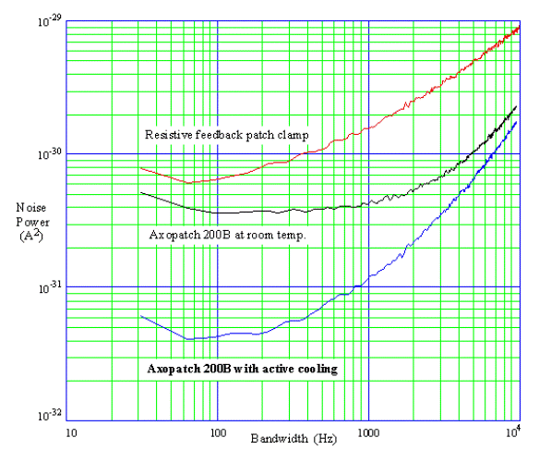
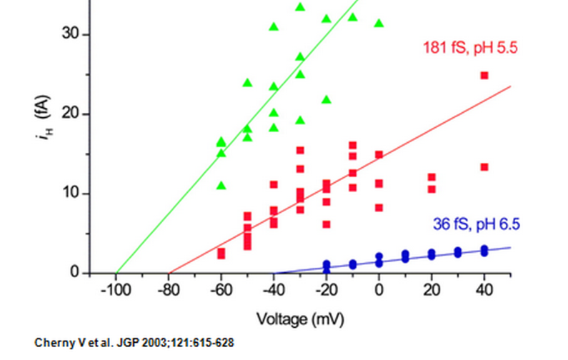
Our Axopatch makes Voltage Clamp seem natural
It is not. UNclamp is Natural!
Ion Channel Monthly
AxoPatch 200B

Slide 70
Important Applications in Biology and Technology

Slide 71
What are the PHYSICAL problems with traditional Maxwell Equations?
Classical Maxwell’s equations do not deal with Diffusion Convection Complex materials
Complicated dielectric properties
Indeed, Maxwell’s original equations do not include ions or electrons or their movement! Textbook treatments do not deal with other forces like diffusion or convection at all.
Eisenberg, 2019. Dielectric Dilemma. arXxiv: 1901.10805.

Slide 72
Traditional Form of Maxwell Equations Cannot be Used
Maxwell’s equations do not deal with Diffusion Convection Complex materials
Complex dielectric properties* present in almost all materials
*Eisenberg, 2019. Dielectric Dilemma. arXiv: 1901.10805.

Slide 73
It is necessary to update Maxwell’s Equations https://arxiv.org/abs/1904.09695 Not just my opinion
This is the opinion* of Nobel Prize winners in Physics,
Richard Feynman (quantum electrodynamics) and Edward Purcell (nuclear magnetic resonance)
*p. 10-7 of Feynman, Leighton, and Sands. 1963. Mainly Electromagnetism and Matter *p. 506 of Purcell and Morin. 2013. Electricity and Magnetism

Slide 74
It is necessary (and feasible) to update Maxwell’s Equations https://arxiv.org/abs/1904.09695
Work in Progress!!!
Eisenberg, B., C. Liu and Y. Wang (2022). "On Variational Principles for Polarization Responses in Electromechanical Systems." Communications in Mathematical Sciences 20(6): 1541-1550.
Wang, Y., C. Liu, P. Liu and B. Eisenberg (2020). "Field theory of reaction-diffusion: Law of mass action with an energetic variational approach." Physical Review E 102(6): 062147 Preprint available on the physics arXiv at https://arxiv.org/abs/062001.010149.
Xu, S., R. Eisenberg, Z. Song and H. Huang (2022). "Mathematical Model for Chemical Reactions in Electrolyte Applied to Cytochrome $ c $ Oxidase: an Electro-osmotic Approach." arXiv preprint arXiv:2207.02215.

Slide 75
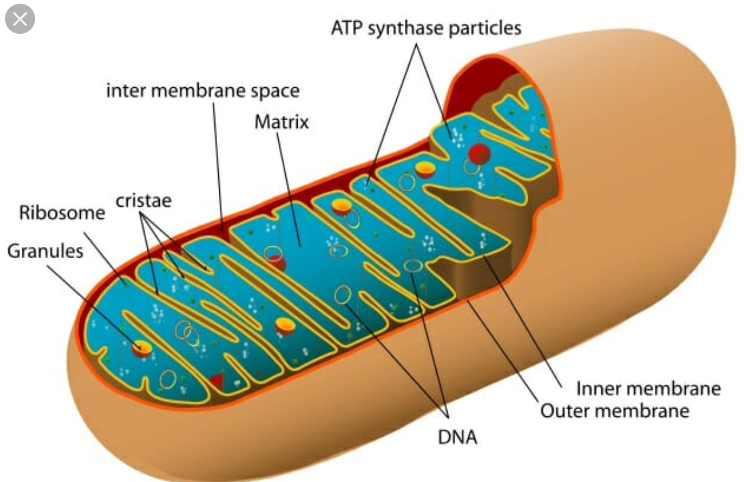
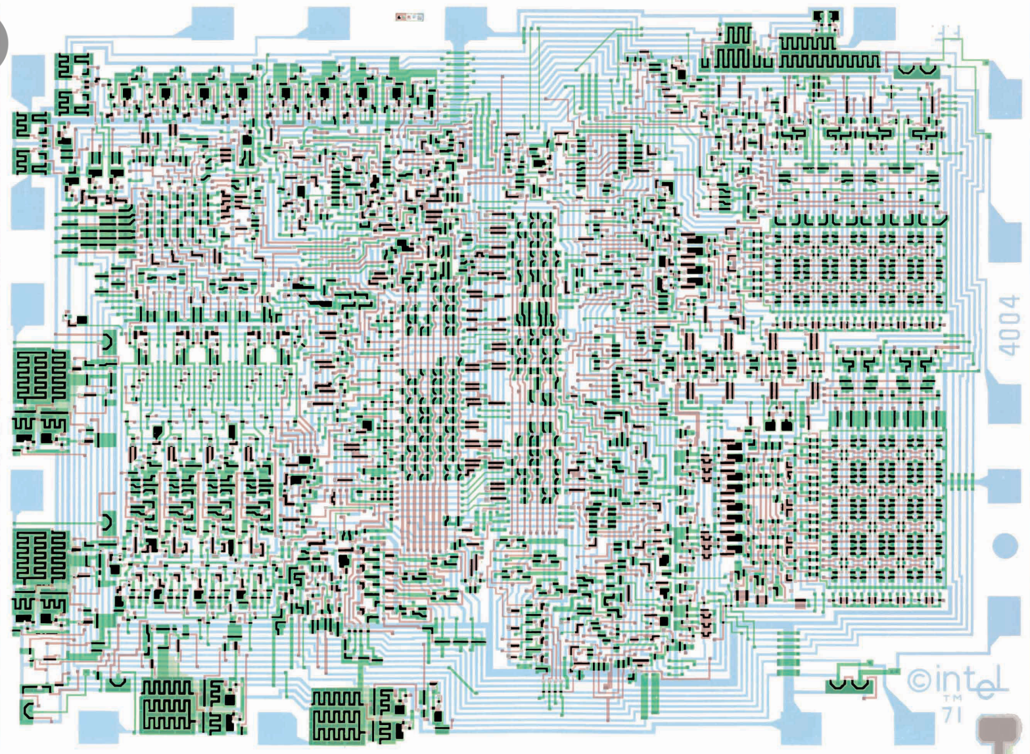
Kirchhoff’s Current Law is the key that allows predictions in Biophysics and Engineering
Equivalent to the Maxwell Equations themselves
Valid at ${10}^{−10}$ sec and ${10}^{−8}$ cm

Slide 76
From Maxwell to Mitochondria
Seems Hopeless
${10}^{17}$ charges
${10}^{17}$factorial pairwise interactions $≅{\left({10}^{17}\right)}^{{10}^{17}}×\left(\sqrt{{2π{10}^{17}}/{e^{{10}^{17}} }}\right)$

Slide 77
From Maxwell to Integrated Circuits
is obvious
to Engineers
${10}^{17}$ charges
${10}^{17}$factorial pairwise interactions

Slide 78
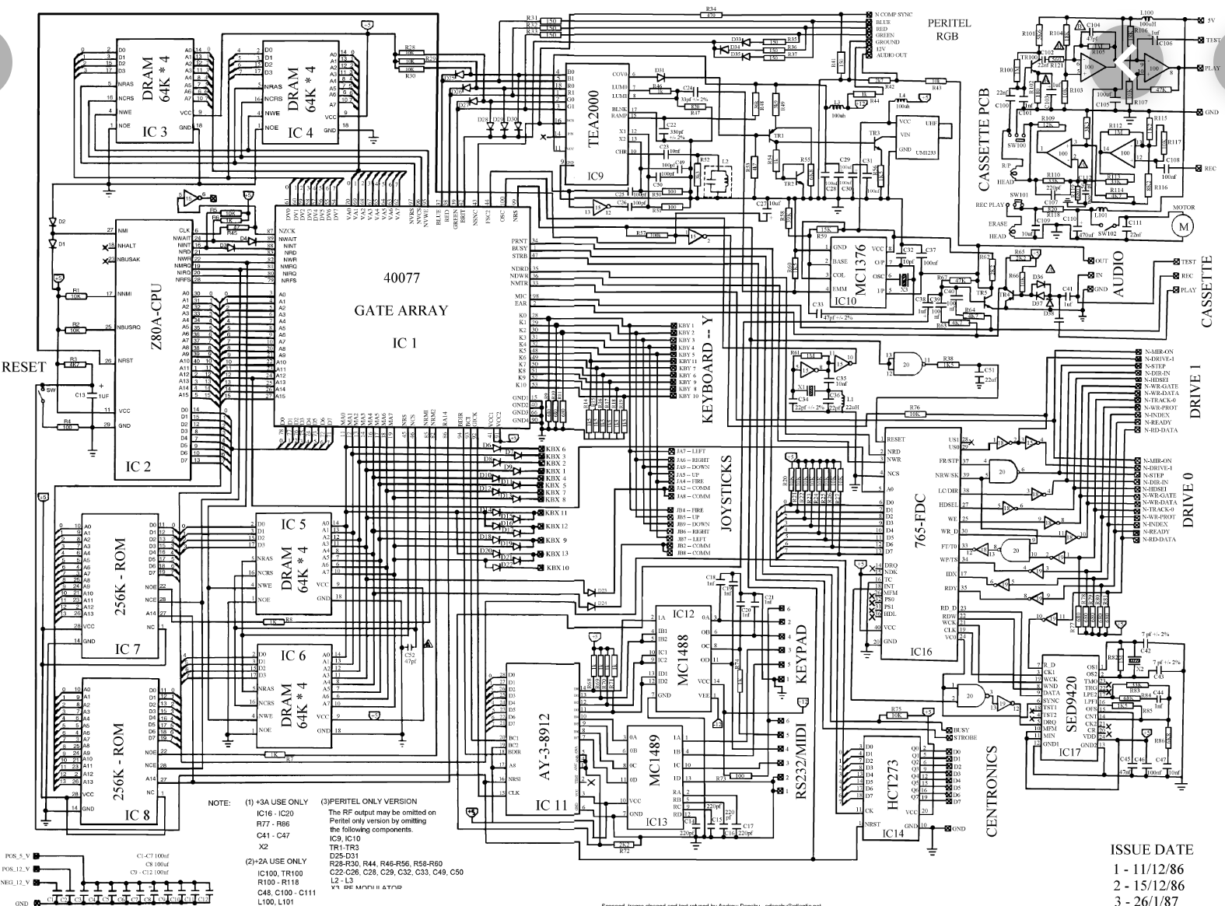
Is it Hopeless to know all charges and how they move in an IC? integrated circuit
${10}^{17}$ charges
${10}^{17}$factorial pairwise interactions

Slide 79
Fortunately, It is NOT necessary in our computers to know all the charges!
Kirchhoff’s law is (almost) enough

Slide 80
Conservation of Current makes
Analysis Possible
In Complex Biological Systems
and Complex Engineering Systems
we do NOT have to know all ~10¹⁷ charges and how they interact or move

Slide 81
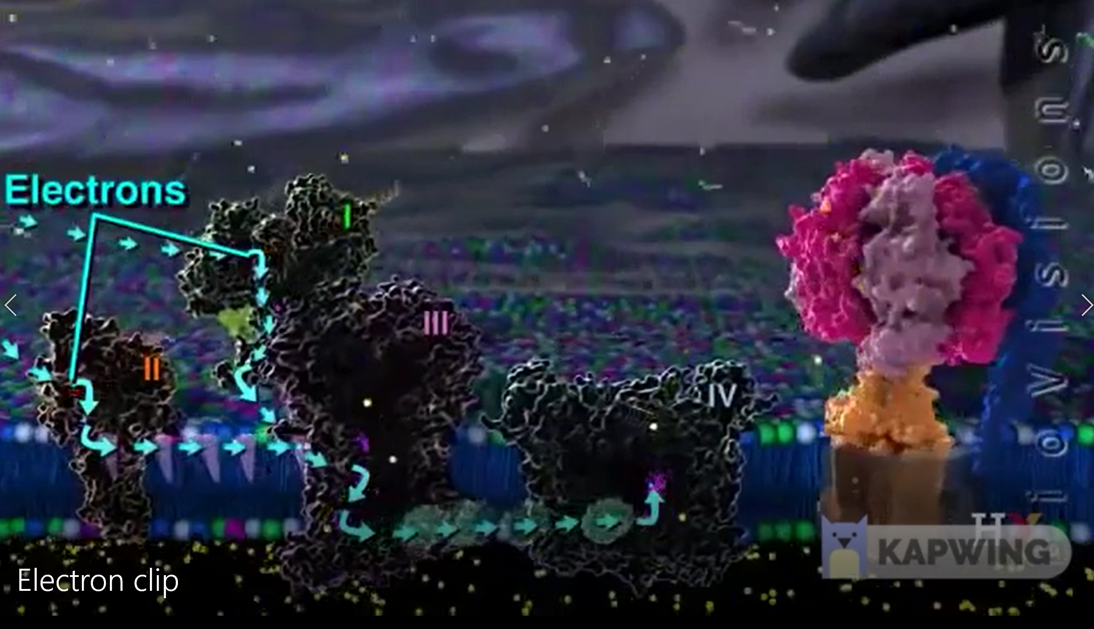
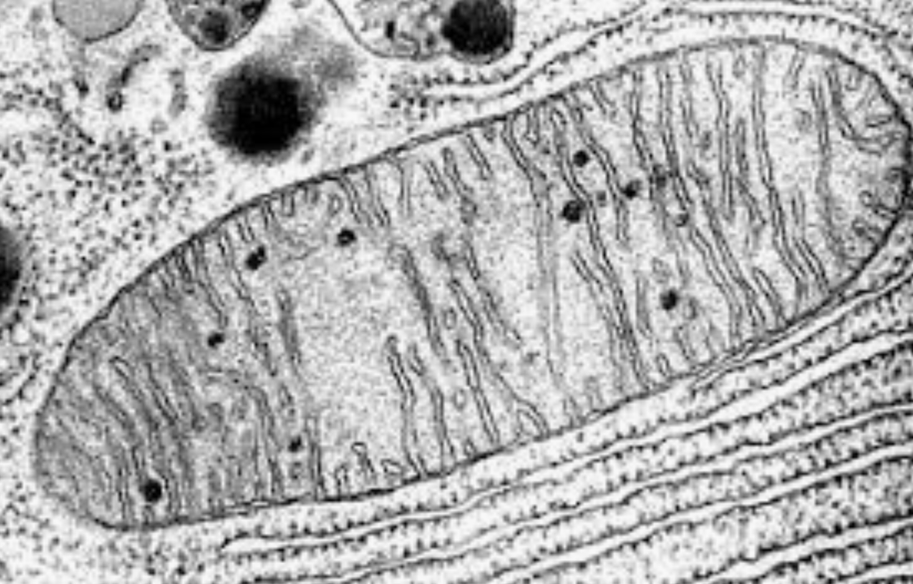
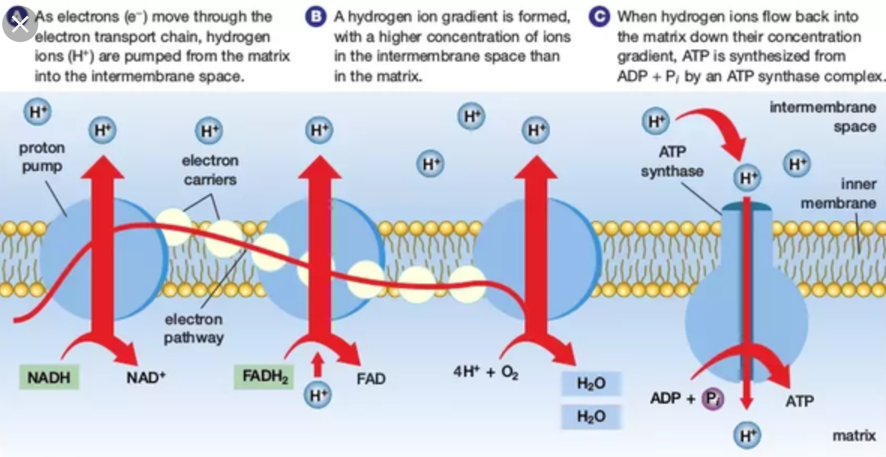
Mitochondrion
Applying Maxwell To Mitochondrion Depends on Conservation of Current

Slide 83
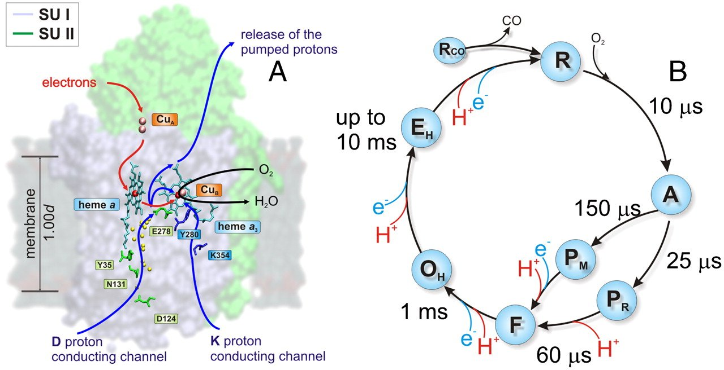
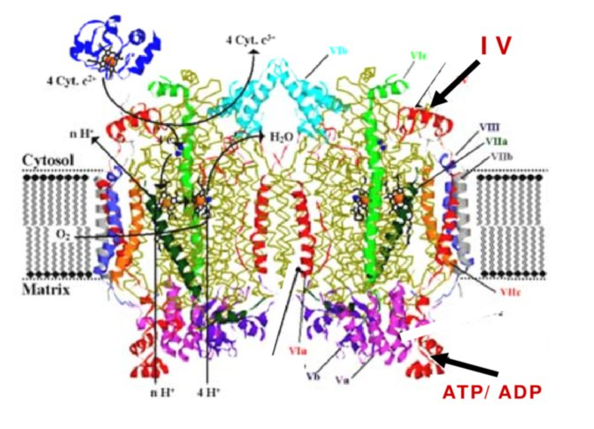
Cytochrome c oxidase
Complex IV
Belevich et al, PNAS 2010;107:18469-74.
Magdalena Misiak National Institute on Aging

Slide 84
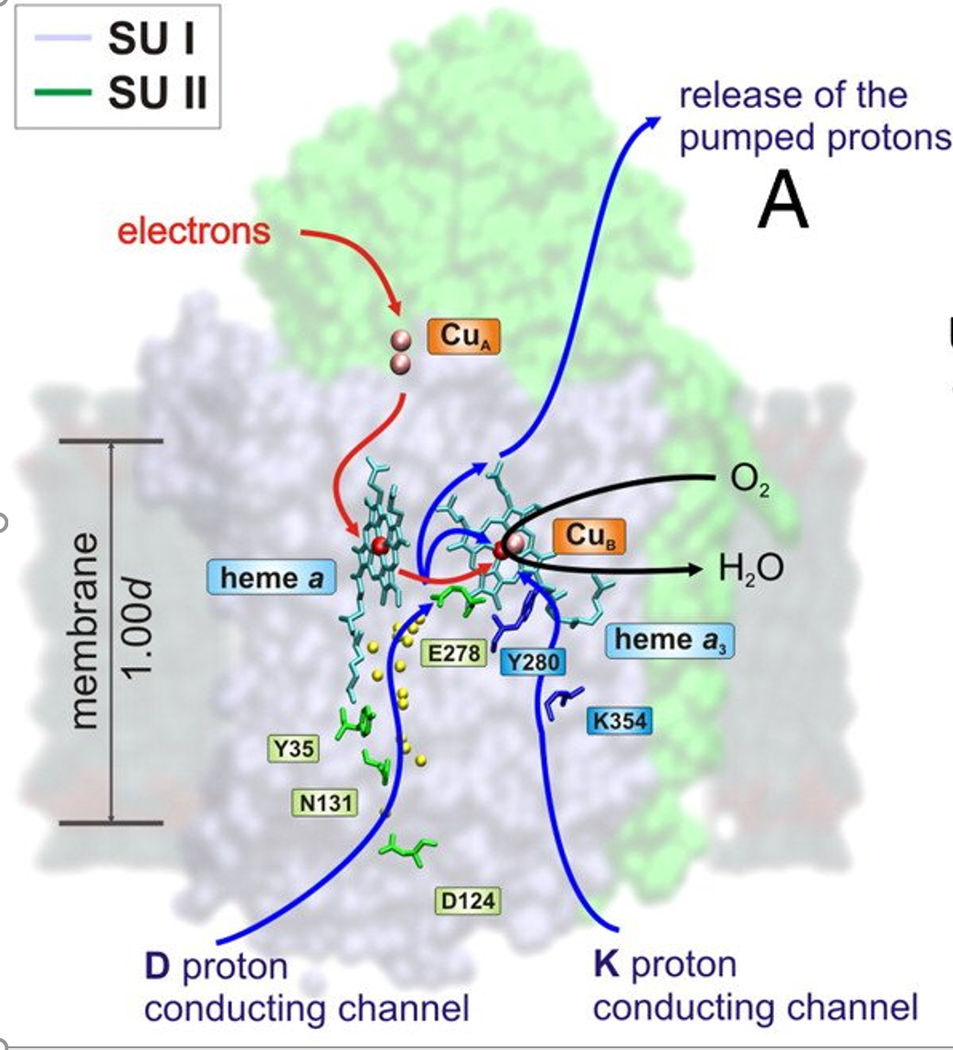
INPUT
Belevich et al, PNAS 2010;107:18469
OUTPUT
POWER SUPPLY
POWER SUPPLY

Slide 85
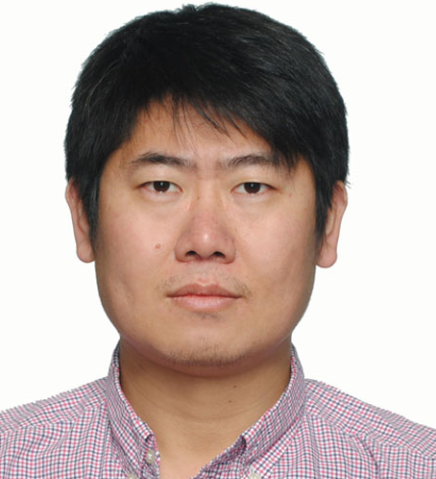
Circuit Model of Cytochrome Oxidase C
Project Leader
Shixin Xu
Huaxiong Huang
Zilong Song
士鑫 徐
华雄 黄
宋子龙

Slide 86
Circuit Model of Cytochrome Oxidase C
OUTSIDE
the mitochondrion
$$H^{+}$$
$$H^{+}$$
$$H^{+}$$
$$H^{+}$$
OUTSIDE
the mitochondrion
Intermembrane Space
$$P$$
Output
$$H^{+}$$
$$I_{X→P}$$
Input
$$I_{leak}$$
$$X$$
$$Energy$$
$$J_{e}$$
Our Representation
Without detailed reaction timings
$$I_{xleak}$$
$$I_{pump}$$
$$J_{o_{2}}$$
$$E$$
$$B$$
$$I_{E→B}$$
$$I_{D→E}$$
$$I_{K→B}$$
$$H^{+}$$
$$H^{+}$$
$$N$$
$$D$$
$$K$$
INSIDE
the mitochondrion
INSIDE
the mitochondrion
Mitochondrial Matrix
$$H^{+}$$
$$H^{+}$$
$$H^{+}$$

Slide 87
Chemical Reaction
Chemical Reaction
Chemical Reaction

Slide 88
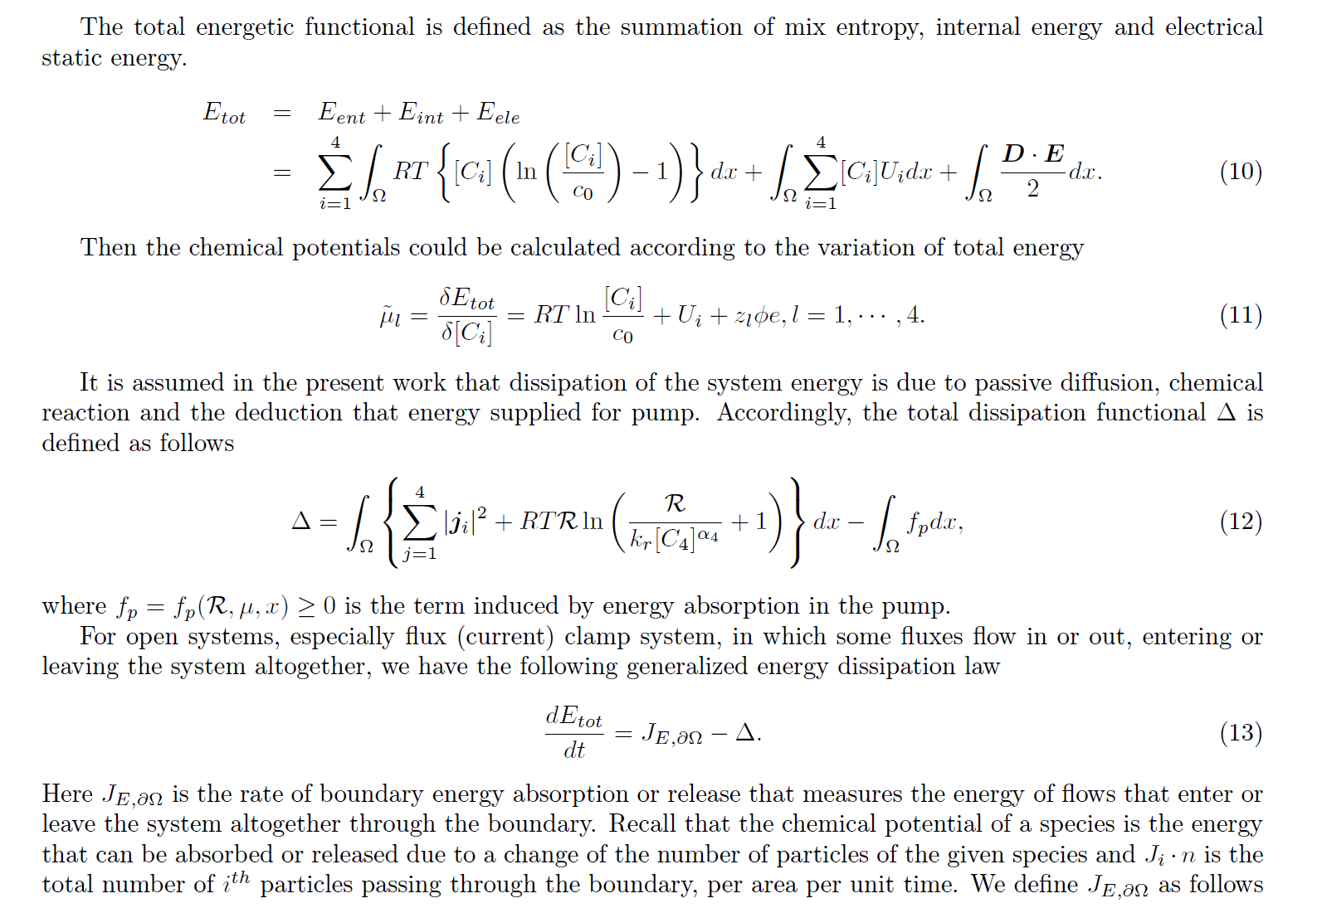
Field Equations Diffusion, Convection, Migration
Energy Functional
Dissipation Functional
Dissipation Principle

Slide 89
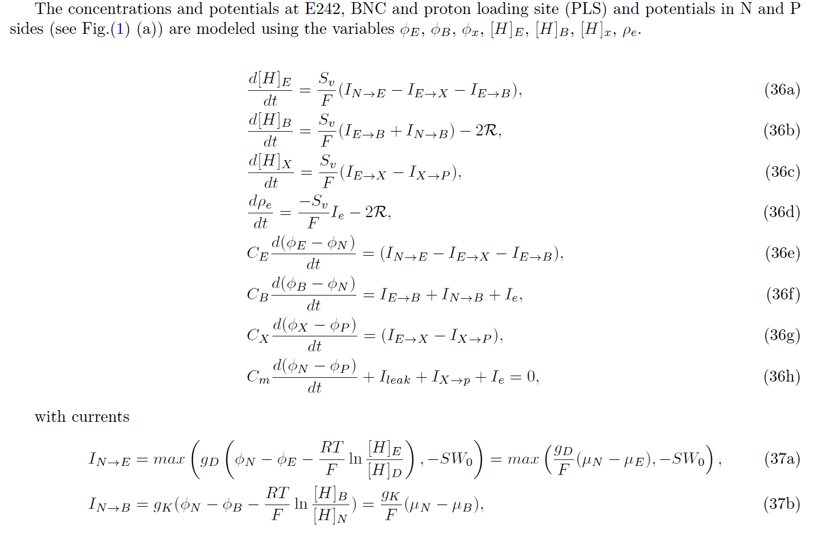
An Electro-osmotic Model of cytochrome c oxidase
Field
Equations
Structure and Boundary Conditions

Slide 90
More Structure and Boundary Conditions

Slide 91
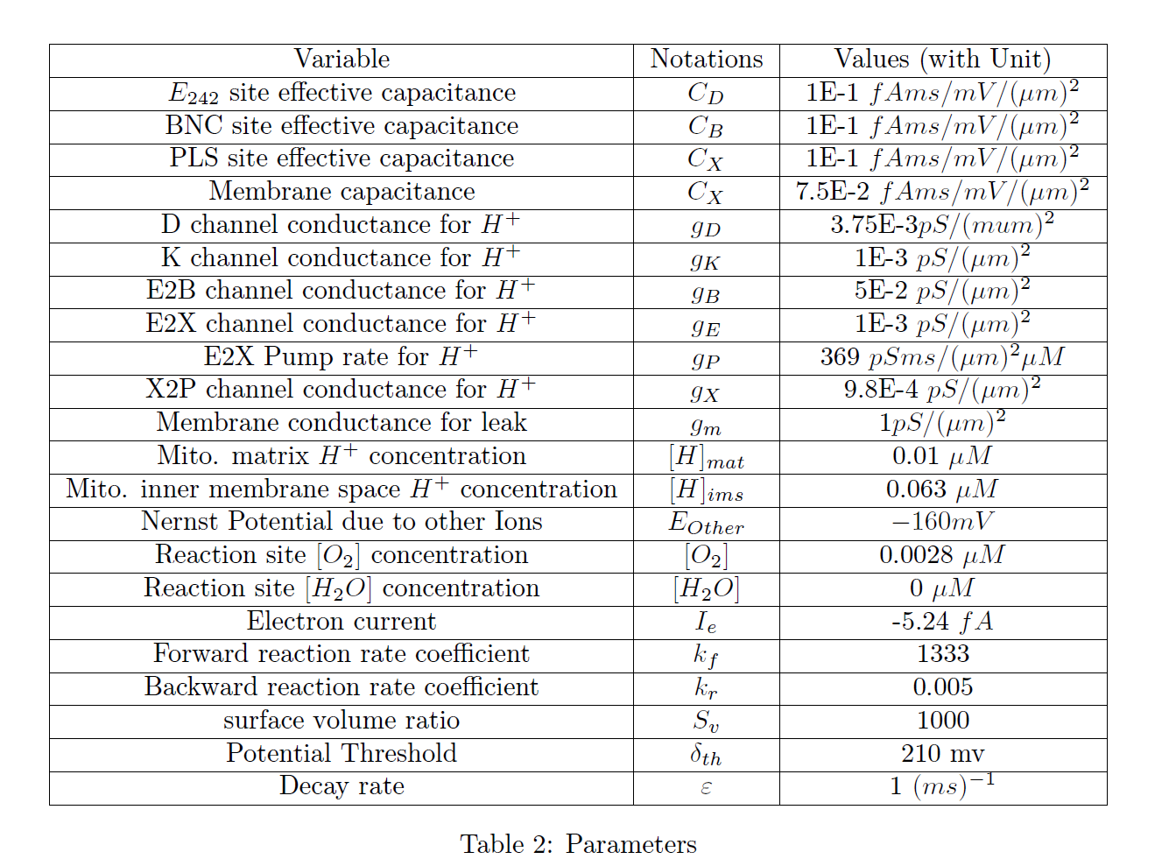
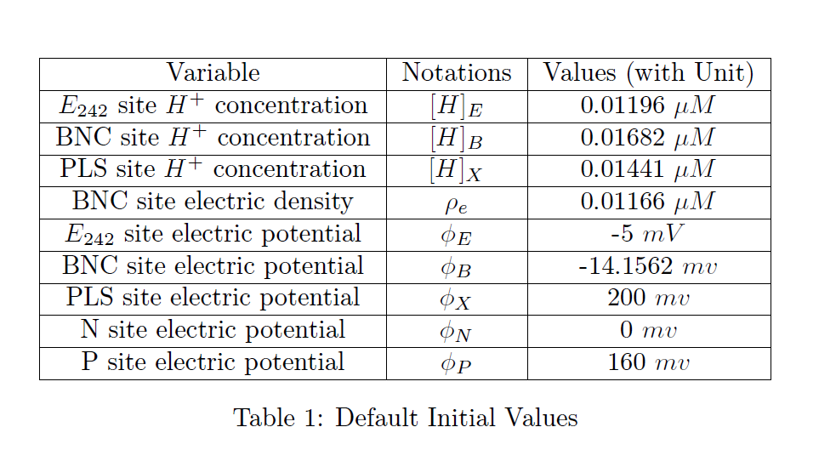
Preliminary Parameter Values

Slide 92
Early Results
Everything can be Computed.
Model can be modified to deal
with other information
and predict experiments
Not yet digested!

Slide 93
Clamping the Voltage Makes a Difference!
Voltage is on atomic and biological length and time scale so clamping the voltage changes NATURAL FUNCTION in mitochondria
Just as it does in Nerve Fibers.
Fluxes in Channels interact by CHANGING
(i.e., Unnclamping) the voltage.
Fluxes in mitochondria interact by CHANGING
(i.e., Unnclamping) the voltage.

Slide 94
Clamping Voltage Changes Things!
Fluxes in Nerve Channels interact by CHANGING
(i.e., Unnclamping) the voltage.
Fluxes in mitochondria interact CHANGING
(i.e., Unnclamping) the voltage.
Flux ratios depend on MACROSCOPIC as well as ATOMIC Interactions
Flux Ratios do NOT estimate atomic scale reaction constants
Classically DEFINED rates are different in Voltage Clamped and Unclamped Conditions

Slide 95
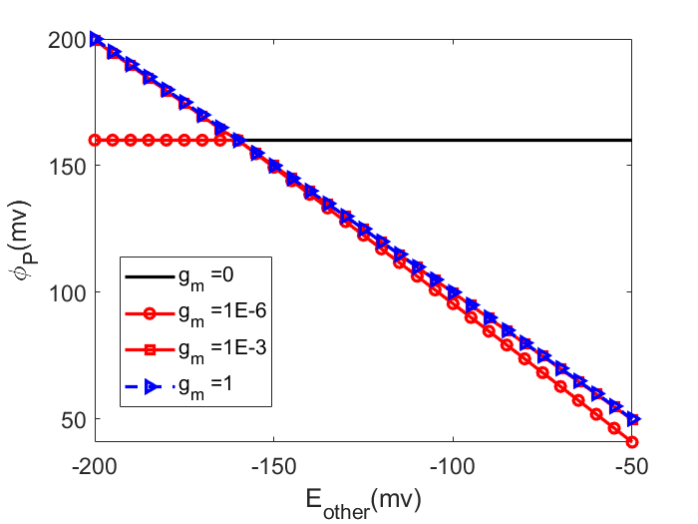
BLUE is Clamped by $E_{other}$= V_{clamp}
Red is UNclamped
Control by Transporter
${  E}_{other}$control
$$δ_{th}=210mv$$

Slide 96
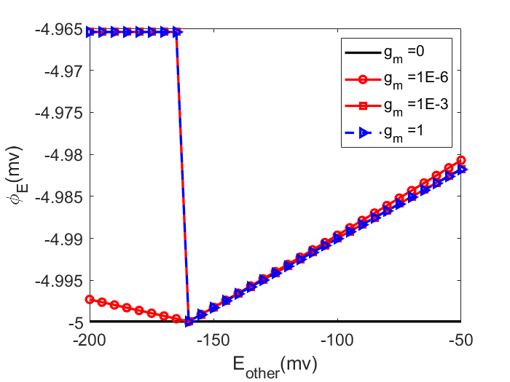
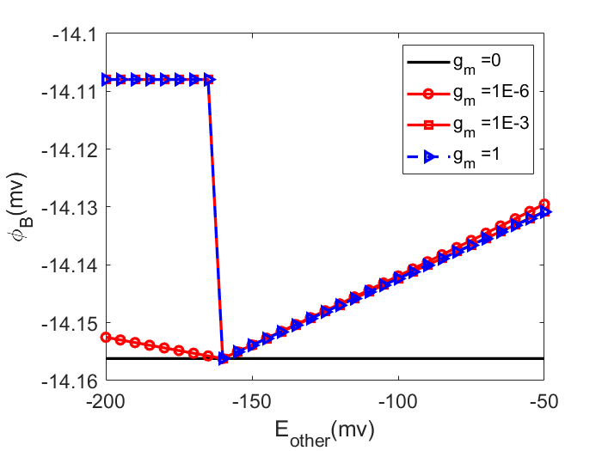
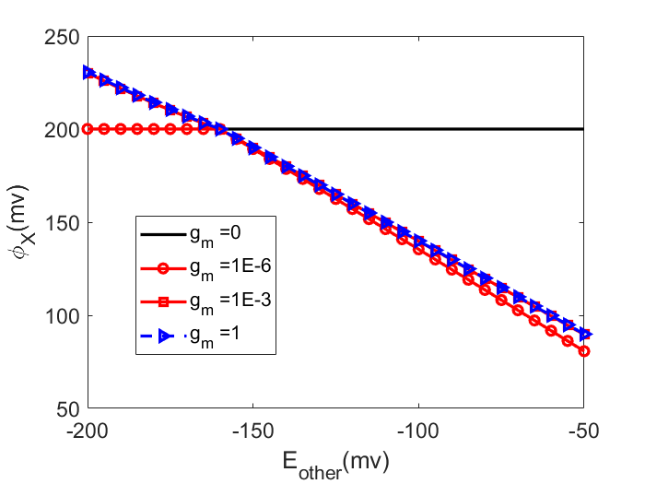
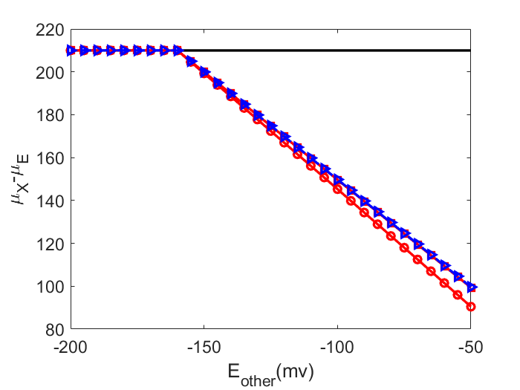
Effects of${ E}_{other}$= V_{clamp} under different $(g_{m}, δ_{th})$
$$δ_{th}=210mv$$

Slide 97
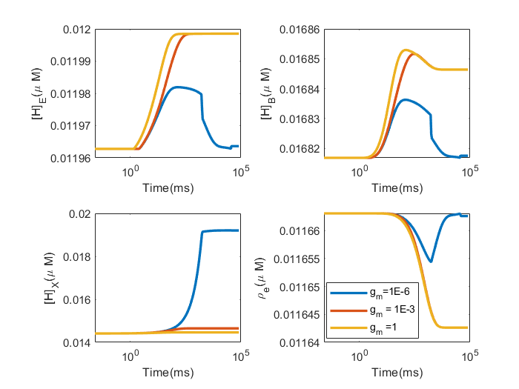
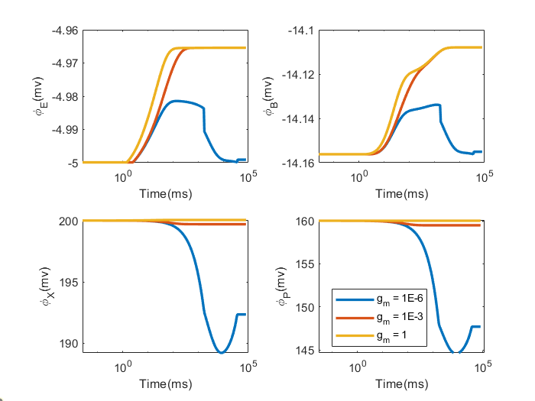
High ${\left[H^{+}\right]}_{P}$
BLUE is Unclamped
Brown is clamped by ${ E}_{other}$= V_{clamp}

Slide 98
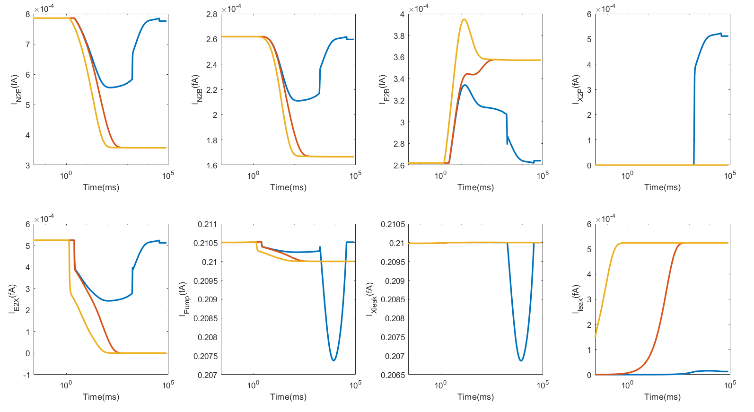
High ${\left[H^{+}\right]}_{P}$
BLUE is Unclamped
Brown is clamped by ${ E}_{other}$= V_{clamp}

Slide 99
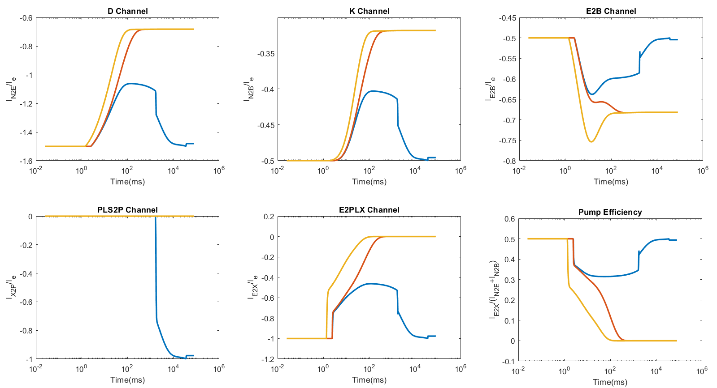
High ${\left[H^{+}\right]}_{P}$
BLUE is Unclamped
Brown is clamped by${ E}_{other}$= V_{clamp}

Slide 100
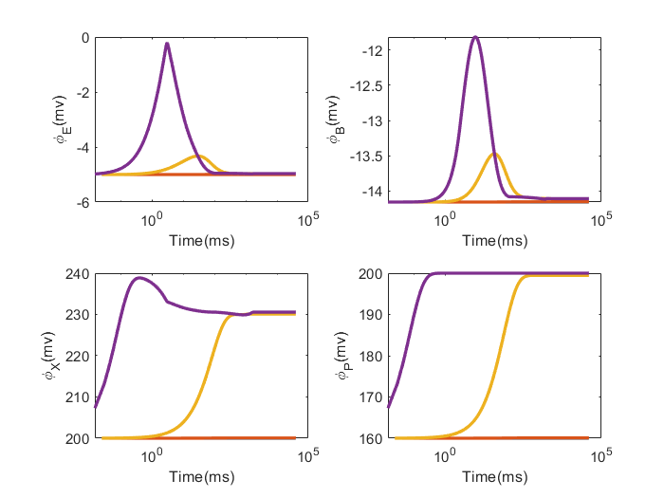
High $E_{other}$
BLUE is Unclamped
Brown is clamped by${ E}_{other}$= V_{clamp}

Slide 101
High $E_{other}$
BLUE is Unclamped
Brown is clamped by${ E}_{other}$= V_{clamp}

Slide 102
High $E_{other}$
BLUE is Unclamped
Brown is clamped by${ E}_{other}$= V_{clamp}

Slide 103
Any Questions?

