Slide 1
Thanks!
to
Lucie, Enzo, and Jackie,
and to Mike for making this visit possible, and so much else

Slide 2
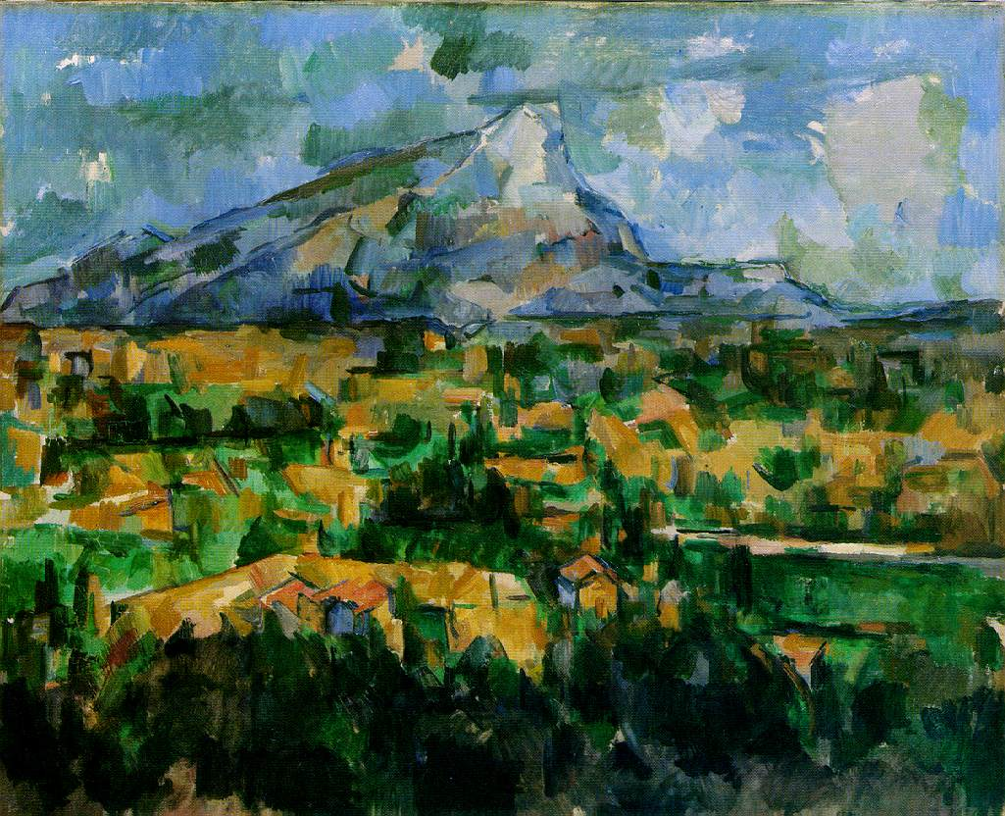

Slide 3

For me (and maybe few others)
Cezanne’s
Mont Sainte-Victoire*
vu des Lauves
is a
Miracle
*one of two at Philadelphia Museum of Art

Slide 4
And its fraternal twin
(i.e., not identical)
in the
Philadelphia Museum of Art
it is worth a visit,
and see the Barnes as well

Slide 5
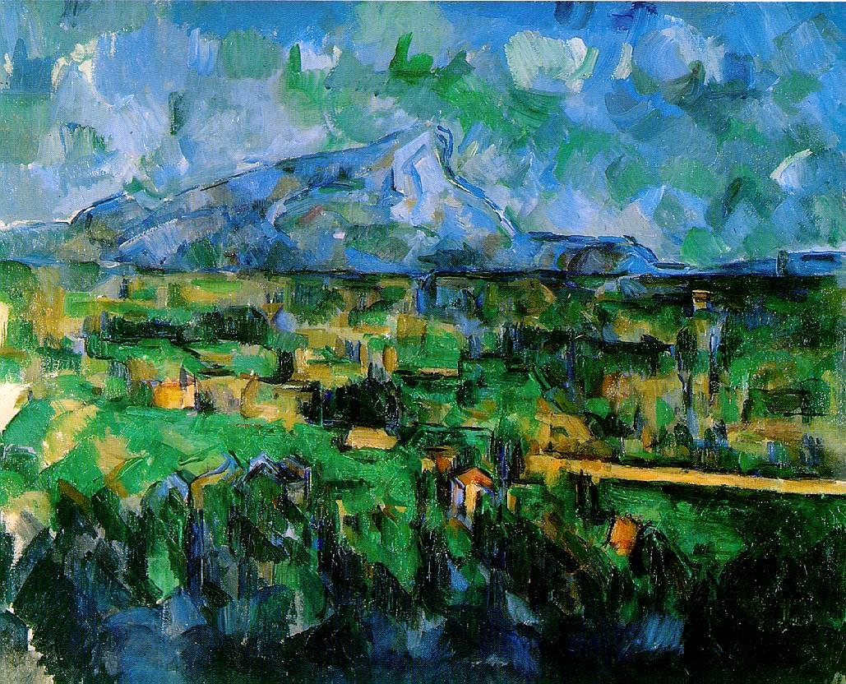

Slide 6
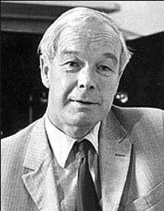
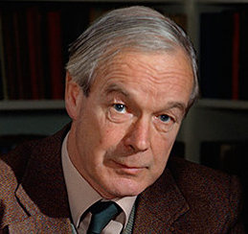
Device Approach
to Biology
is also a
Miracle
Alan Hodgkin
friendly
Alan Hodgkin:
“Bob, I would not put it that way”

Slide 7
Take Home Lesson
Biology
is all about
Dimensional Reduction
to a
Reduced Model
of a
Device

Slide 8
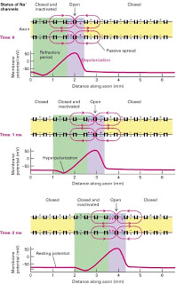
Biology is made of
Devices
and they are Multiscale
Hodgkin’s Action Potential
is the
Ultimate Biological Device
from
Input from Synapse
Output to Spinal Cord
Ultimate
Multiscale
Device
from
Atoms to Axons
Ångstroms to Meters

Slide 9
Device
Amplifier
Converts an Input to an Output
by a simple ‘law’
an algebraic equation
V_{in}
Gain
V_{out}
Power Supply
110 v

Slide 10
Device
converts an
Input to an Output
by a simple ‘law’
DEVICE IS USEFUL
because it is
ROBUST and TRANSFERRABLE
g_{gain} is Constant !!

Slide 11
Device
Amplifier
Converts an Input to an Output
V_{in}
Gain
V_{out}
Power Supply
110 v
Power is needed
Non-equilibrium, with flow
Displaced Maxwellian
of velocities
Provides Flow
Input, Output, Power Supply
are at
Different Locations
Spatially non-uniform boundary conditions

Slide 12
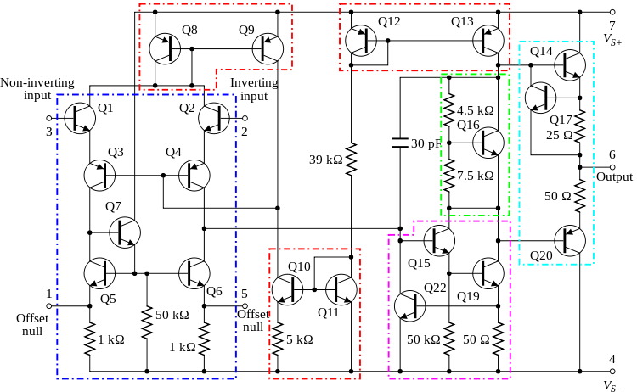
Device converts Input to Output by a simple ‘law’
Device is ROBUST and TRANSFERRABLE
because it uses POWER and has complexity!
Circuit Diagram of common 741 op-amp: Twenty transistors needed to make linear robust device
Power Supply
Dirichlet Boundary Condition
independent of time
and everything else
INPUT
V_{in} (t)
OUTPUT
V_{out} (t)
Power Supply
Dirichlet Boundary Condition
independent of time
and everything else
Dotted lines outline: current mirrors (red); differential amplifiers (blue);
class A gain stage (magenta); voltage level shifter (green); output stage (cyan).

Slide 13
How Describe a Device?
Not by its circuit diagram
Not by its atomic structure
but by its
Device Equation !!

Slide 14
Engineering is about Device Equations
How Describe Biological Devices?
P.S. I do not know the answer. But I know how to begin, …. I think.

Slide 15
Biological Question
How do a few atoms control (macroscopic)
Device Function ?
Mathematics of Molecular Biology
is about
How the device works
In mathspeak:
Solving Inverse Problems

Slide 16
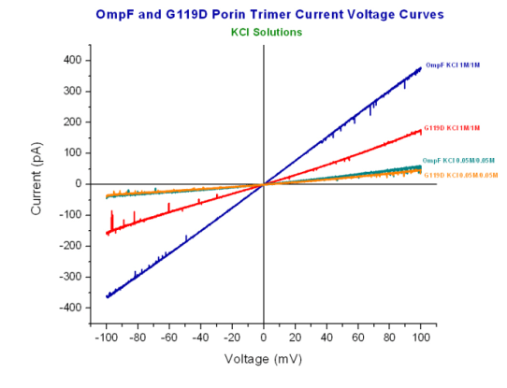
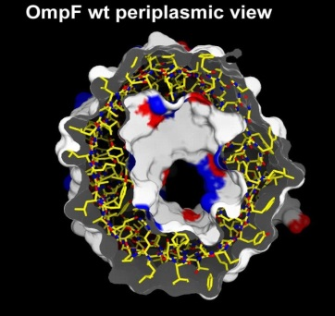
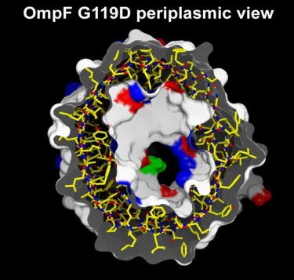
A few atoms make a
BIG Difference
Glycine G
replaced by
Aspartate D
Ompf
OmpF 1M/1M
G119D
1M/1M
OmpF
0.05M/0.05M
G119D
0.05M/0.05M
G119D
Current Voltage relation determined by John Tang
in Bob Eisenberg’s Lab
Structure determined by
Raimund Dutzler
in Tilman Schirmer’s lab

Slide 17
Device Approach
enables
Dimensional Reduction
to a
Device Equation
which tells
How it Works

Slide 18
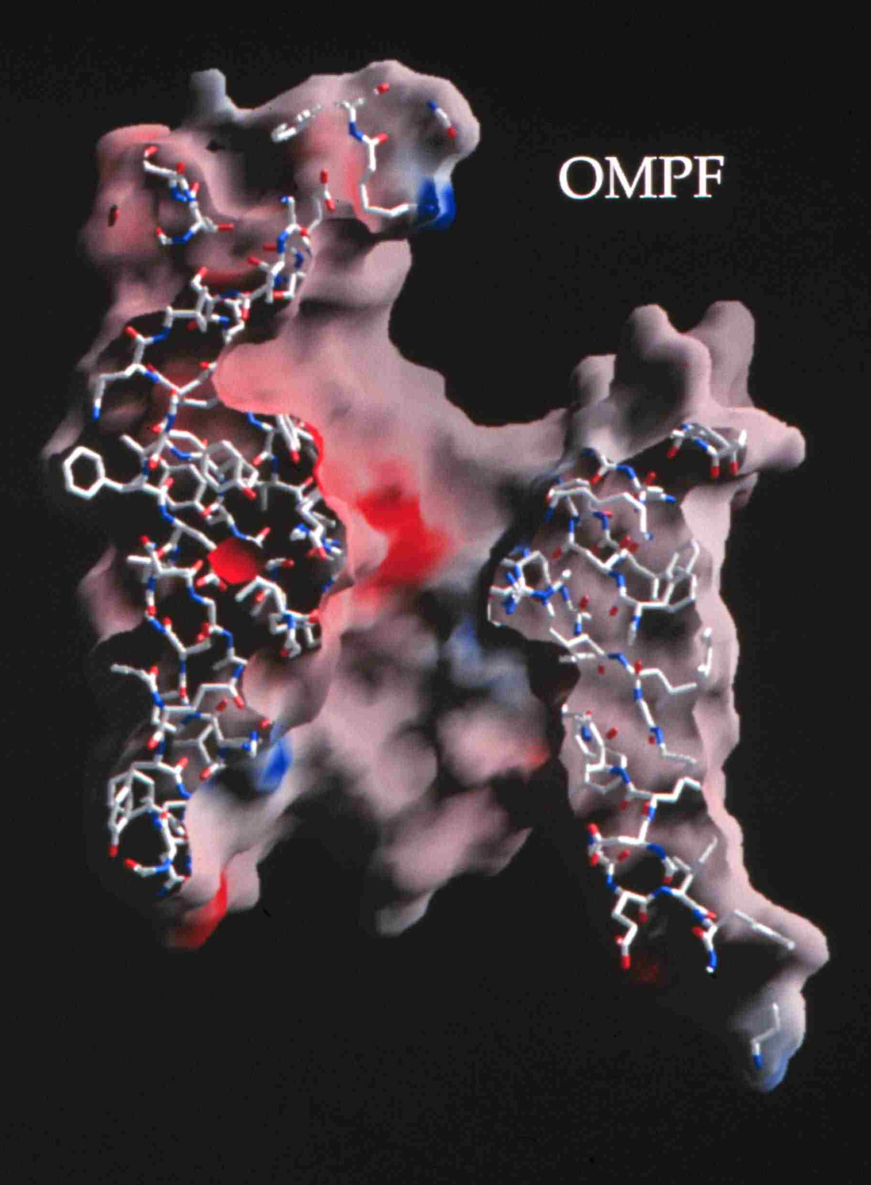
Natural nano-valves** for atomic control of biological function
Ions in Channels: Biological Devices, Diodes*
Ions channels coordinate contraction of cardiac muscle, allowing the heart to function as a pump
Coordinate contraction in skeletal muscle
Control all electrical activity in cells
Produce signals of the nervous system
Are involved in secretion and absorption in all cells:
kidney, intestine, liver, adrenal glands, etc.
Are involved in thousands of diseases and many
drugs act on channels
Are proteins whose genes (blueprints) can be
manipulated by molecular genetics
Have structures shown by x-ray crystallography in
favorable cases
Can be described by mathematics in some cases
K⁺
~30 x 10⁻⁹ meter
*Device is a Specific Word,
that exploits
specific mathematics & science
*nearly pico-valves: diameter is 400 – 900 x 10⁻¹² meter; diameter of atom is ~200 x 10⁻¹² meter
Notes:
Ion channels are a class of Proteins that reside in the cell membrane of all biological cells. Each channel protein consists of a chain of amino acids folded in such a way that it forms a nanoscopic water-filled tunnel through which ions can flow to cross the otherwise impermeable membrane.
Every ion channel carries a strong and steeply varying distribution of permanent charge, which depends on the particular combination of channel and prevalent physiological conditions. This permanent charge has an important role in determining the current-voltage characteristics of the open channel.
Many channels are designed by nature to selectively transmit or block a particular ion species. This allows only one type of ion to cross the membrane even though other ions may be present in much higher concentrations. Many channels can also open and close by mechanical or other means, switching on and off like electronic devices.
From a physiological point of view ion channels are essential for maintaining the correct internal ion composition necessary for cell survival and function. They directly control electrical signaling in the nervous system, muscle contraction, and the delivery of many clinical drugs. Malfunctioning channels cause or are associated with many diseases.
From a device point of view, ion channels can be thought of as elements in an electrical circuit, behaving like resistors, diodes or batteries depending on the specific channel and environmental factors. By replacing or deleting one or more of the amino acids many channels can be mutated, altering the charge distribution along the channel. Designing and engineering channels with specific conductances and selectivities, and incorporating them into bio-devices, is a real possibility.

Slide 19
Mathematics of Molecular Biology
Must be Multiscale
because a few atoms
control
Macroscopic Function

Slide 20

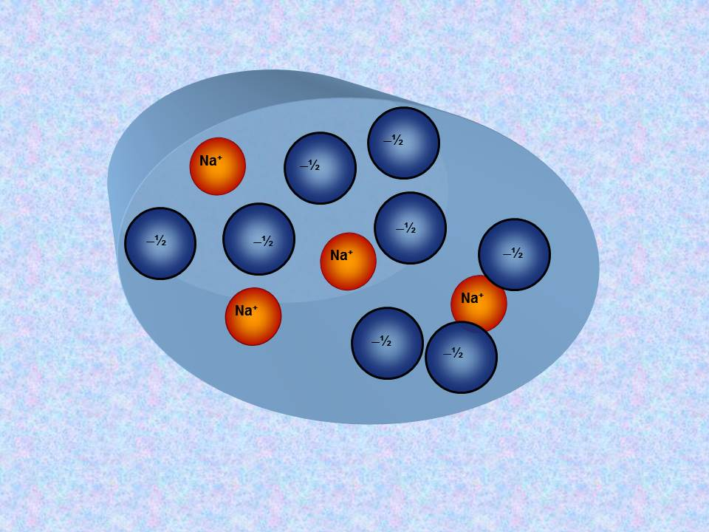
‘All Spheres’ Model
Side Chains are Spheres
Channel is a Cylinder
Side Chains are free to move within Cylinder
Ions and Side Chains are at free energy minimum
i.e., ions and side chains are ‘self organized’,
‘Binding Site” is induced by substrate ions
Nonner & Eisenberg

Slide 21
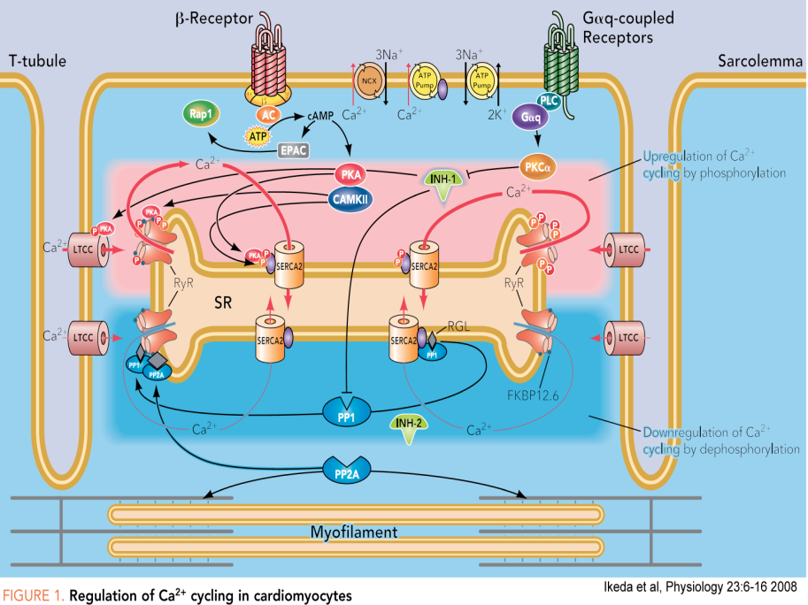
All Spheres Models
work well for
Calcium and Sodium Channels
Nerve
Skeletal muscle
Heart Muscle Cell

Slide 22
Ions in Channels
and
Ions in Bulk Solutions
are
Complex Fluids
like liquid crystals of LCD displays
All atom simulations of complex fluid are particularly challenging because
‘Everything’ interacts with ‘everything’ else
on atomic & macroscopic scales

Slide 24
Energetic Variational Approach
EnVarA
Chun Liu, Rolf Ryham, and Yunkyong Hyon
Mathematicians and Modelers: two different ‘partial’ variations
written in one framework, using a ‘pullback’ of the action integral
Shorthand for Euler Lagrange process
with respect to
Shorthand for Euler Lagrange process
with respect to
Action Integral, after pullback
Rayleigh Dissipation Function
Composite
Variational Principle
Euler Lagrange Equations
Field Theory of Ionic Solutions: Liu, Ryham, Hyon, Eisenberg
Allows boundary conditions and flow
Deals Consistently with Interactions of Components

Slide 25
Dissipation Principle
Conservative Energy dissipates into Friction
Number Density
time
Permanent Charge of protein
Hard Sphere Terms
Thermal Energy
valence
proton charge
c_{i} number density; thermal energy; D_{i} diffusion coefficient; n negative; p positive; z_{i} valence; ε dielectric constant
Note that
with suitable boundary conditions

Slide 26
Energetic Variational Approach
EnVarA
is defined by the Euler Lagrange Process,
as I understand the pure math from Craig Evans
which gives
Equations like PNP
BUT
I leave it to you (all)
to argue/discuss with Craig
about the purity of the process
when two variations are involved

Slide 27
PNP (Poisson Nernst Planck) for Spheres
Non-equilibrium variational field theory EnVarA
Nernst Planck Diffusion Equation
for number density c_{n} of negative n ions; positive ions are analogous
Diffusion Coefficient
Thermal Energy
Coupling Parameters
Ion Radii
Number Densities
Poisson Equation
Dielectric Coefficient
valence
proton charge
Eisenberg, Hyon, and Liu
Permanent Charge of Protein

Slide 28
All we have to do is
Solve it / them! with boundary conditions defining
Charge Carriers ions, holes, quasi-electrons
Geometry

Slide 29
Evidence
(start)

Slide 30
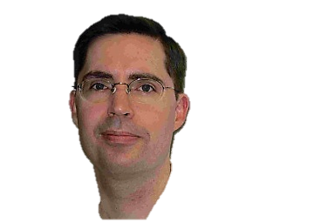
Best Evidence is from the
RyR Receptor
Dirk Gillespie
Dirk_Gillespie@rush.edu
Gerhard Meissner, Le Xu, et al,
not Bob Eisenberg
● More than 120 combinations of solutions & mutants
● 7 mutants with significant effects fit successfully

Slide 31
1. Gillespie, D., Energetics of divalent selectivity in a calcium channel: the ryanodine receptor case study. Biophys J, 2008. 94(4): p. 1169-1184.
2. Gillespie, D. and D. Boda, Anomalous Mole Fraction Effect in Calcium Channels: A Measure of Preferential Selectivity. Biophys. J., 2008. 95(6): p. 2658-2672.
3. Gillespie, D. and M. Fill, Intracellular Calcium Release Channels Mediate Their Own Countercurrent: Ryanodine Receptor. Biophys. J., 2008. 95(8): p. 3706-3714.
4. Gillespie, D., W. Nonner, and R.S. Eisenberg, Coupling Poisson-Nernst-Planck and Density Functional Theory to Calculate Ion Flux. Journal of Physics (Condensed Matter), 2002. 14: p. 12129-12145.
5. Gillespie, D., W. Nonner, and R.S. Eisenberg, Density functional theory of charged, hard-sphere fluids. Physical Review E, 2003. 68: p. 0313503.
6. Gillespie, D., Valisko, and Boda, Density functional theory of electrical double layer: the RFD functional. Journal of Physics: Condensed Matter, 2005. 17: p. 6609-6626.
7. Gillespie, D., J. Giri, and M. Fill, Reinterpreting the Anomalous Mole Fraction Effect. The ryanodine receptor case study. Biophysical Journal, 2009. 97: p. pp. 2212 - 2221
8. Gillespie, D., L. Xu, Y. Wang, and G. Meissner, (De)constructing the Ryanodine Receptor: modeling ion permeation and selectivity of the calcium release channel. Journal of Physical Chemistry, 2005. 109: p. 15598-15610.
9. Gillespie, D., D. Boda, Y. He, P. Apel, and Z.S. Siwy, Synthetic Nanopores as a Test Case for Ion Channel Theories: The Anomalous Mole Fraction Effect without Single Filing. Biophys. J., 2008. 95(2): p. 609-619.
10. Malasics, A., D. Boda, M. Valisko, D. Henderson, and D. Gillespie, Simulations of calcium channel block by trivalent cations: Gd(3+) competes with permeant ions for the selectivity filter. Biochim Biophys Acta, 2010. 1798(11): p. 2013-2021.
11. Roth, R. and D. Gillespie, Physics of Size Selectivity. Physical Review Letters, 2005. 95: p. 247801.
12. Valisko, M., D. Boda, and D. Gillespie, Selective Adsorption of Ions with Different Diameter and Valence at Highly Charged Interfaces. Journal of Physical Chemistry C, 2007. 111: p. 15575-15585.
13. Wang, Y., L. Xu, D. Pasek, D. Gillespie, and G. Meissner, Probing the Role of Negatively Charged Amino Acid Residues in Ion Permeation of Skeletal Muscle Ryanodine Receptor. Biophysical Journal, 2005. 89: p. 256-265.
14. Xu, L., Y. Wang, D. Gillespie, and G. Meissner, Two Rings of Negative Charges in the Cytosolic Vestibule of T Ryanodine Receptor Modulate Ion Fluxes. Biophysical Journal, 2006. 90: p. 443-453.

Slide 32
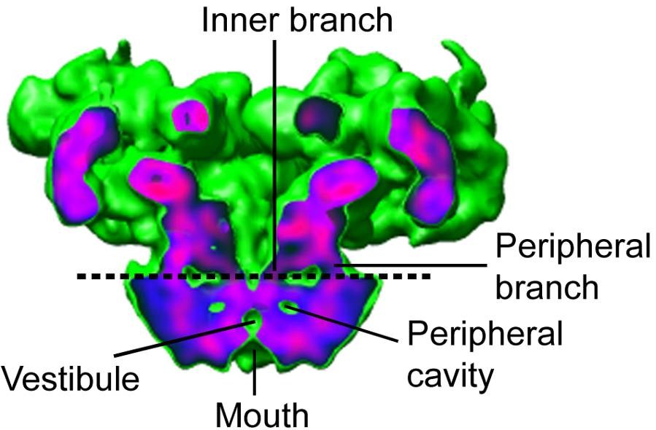
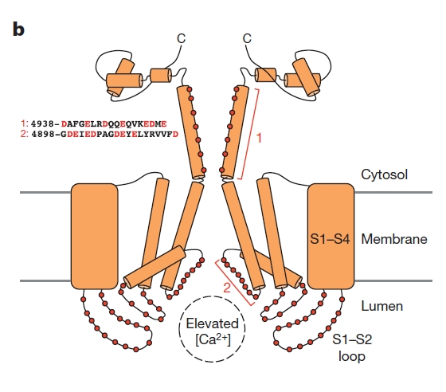
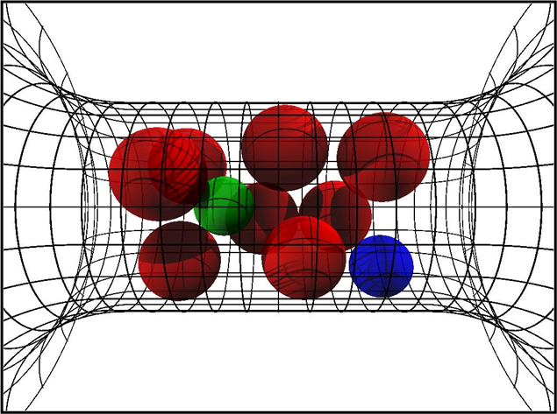
RyR
Ryanodine Receptor redrawn in part from Dirk Gillespie, with thanks!
Samsó et al, 2005, Nature Struct Biol 12: 539
Zalk, et al 2015 Nature 517: 44-49.
All Spheres Representation
4 negative charges D4899
Cylinder 10 Å long, 8 Å diameter
13 M of charge!
18% of available volume
Very Crowded!
Four lumenal E4900 positive
amino acids overlapping D4899.
Cytosolic background charge

Slide 33
Solved by DFT-PNP (Poisson Nernst Planck)
DFT-PNP
gives location
of Ions and ‘Side Chains’
as OUTPUT
Other methods
give nearly identical results
DFT (Density Functional Theory of fluids, not electrons)
MMC (Metropolis Monte Carlo))
SPM (Primitive Solvent Model)
EnVarA (Energy Variational Approach)
Non-equil MMC (Boda, Gillespie) several forms
Steric PNP (simplified EnVarA)
Poisson Fermi (replacing Boltzmann distribution)

Slide 34
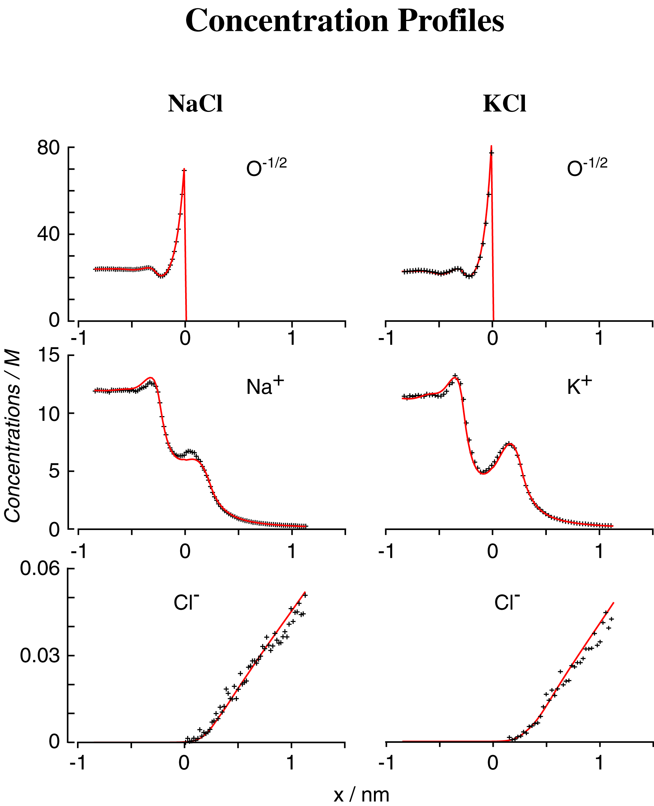
DFT/PNP vs Monte Carlo Simulations
Concentration Profiles
Different Methods give Same Results
NO adjustable parameters
Misfit
Nonner, Gillespie, Eisenberg

Slide 35
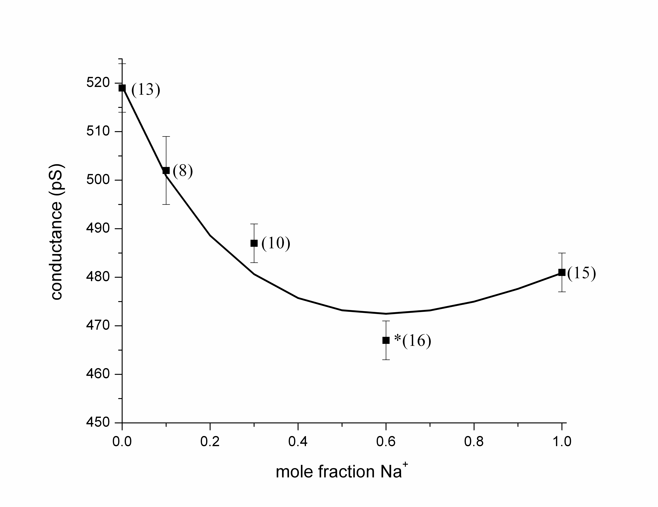
The model predicted an AMFE for Na⁺/Cs⁺ mixtures
before it had been measured
62 measurements
Thanks to Le Xu!
Mean
±
Standard Error of Mean
Note the Scale
2% error
Note the Scale
Gillespie, Meissner, Le Xu, et al

Slide 36
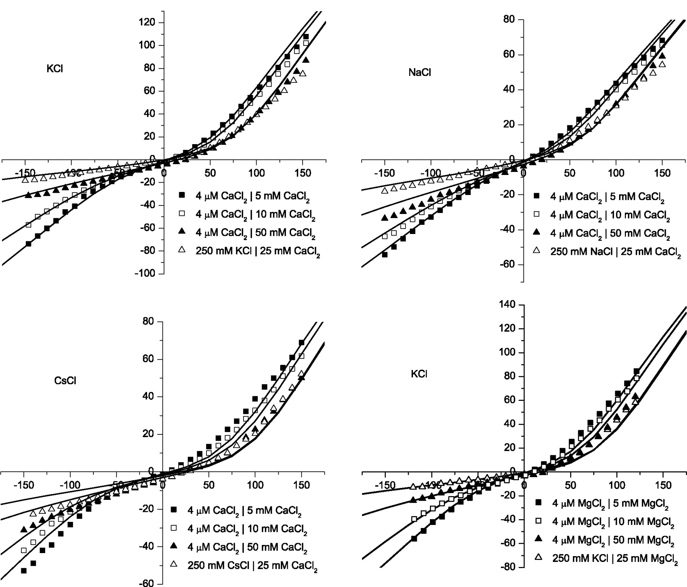
Divalents
KCl
CaCl₂
NaCl
CaCl₂
Misfit
CsCl
CaCl₂
KCl
MgCl₂
Misfit

Slide 37
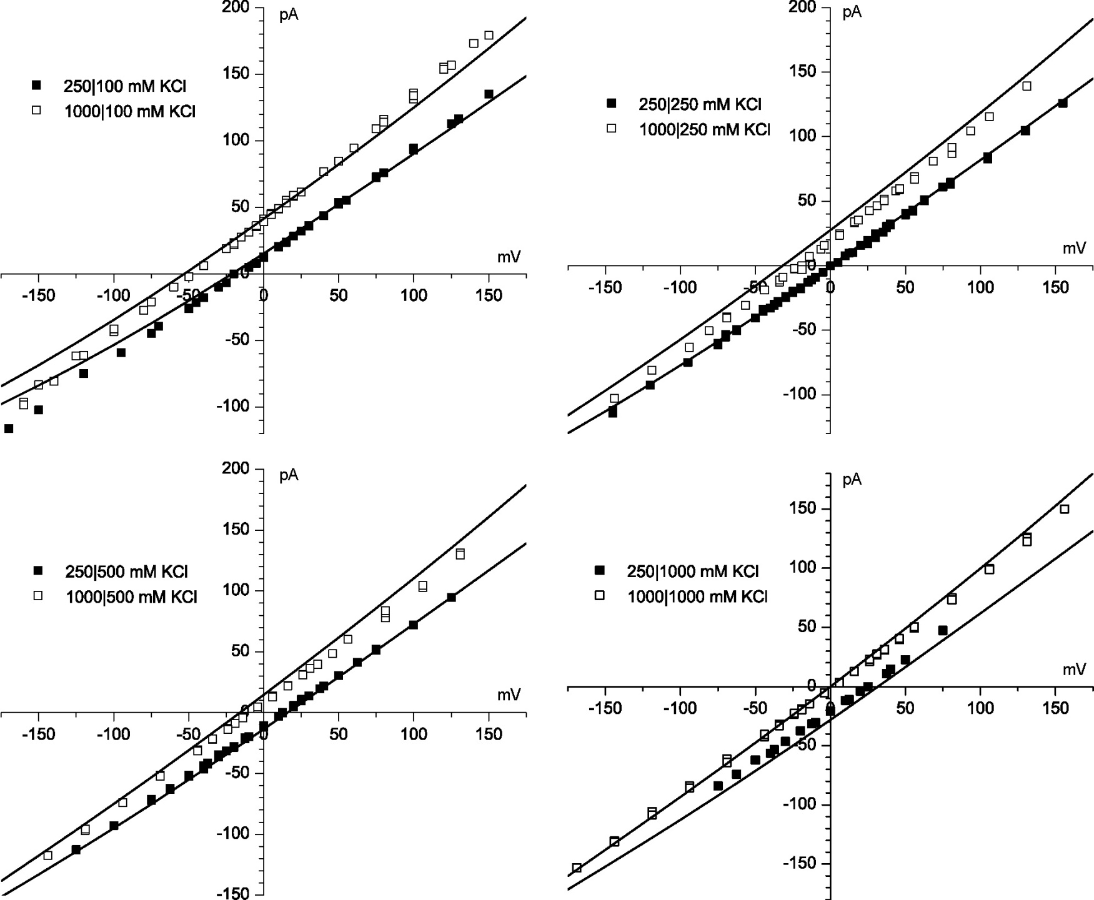
KCl
Gillespie, Meissner, Le Xu, et al
4 kT/e
Error < 0.1 kT/e
Misfit

Slide 38
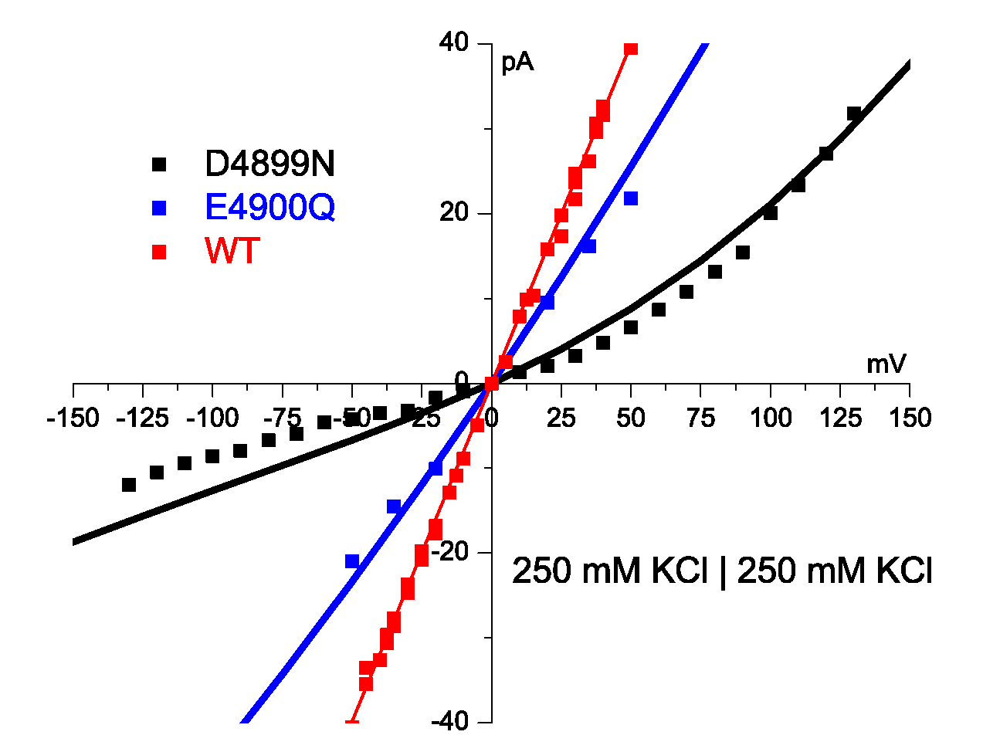
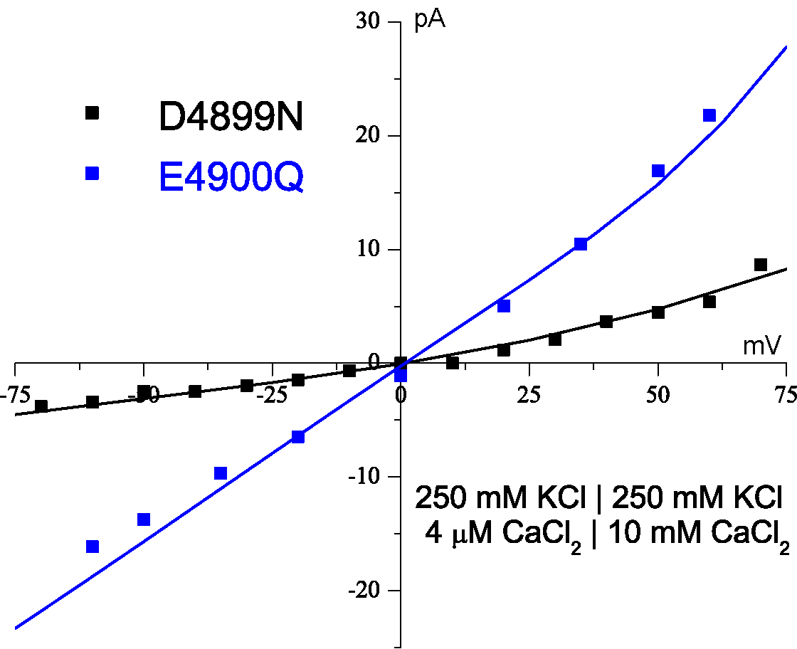
Theory fits Mutation with Zero Charge
Theory Fits Mutant in K
Theory Fits Mutant
in K + Ca
Error < 0.1 kT/e
1 kT/e
Protein charge density
wild type* 13 M
Solid Na⁺Cl⁻ is 37 M
*some wild type curves not shown, ‘off the graph’
⇨
0 M in D4899
1 kT/e
Gillespie et al
J Phys Chem 109 15598 (2005)

Slide 39
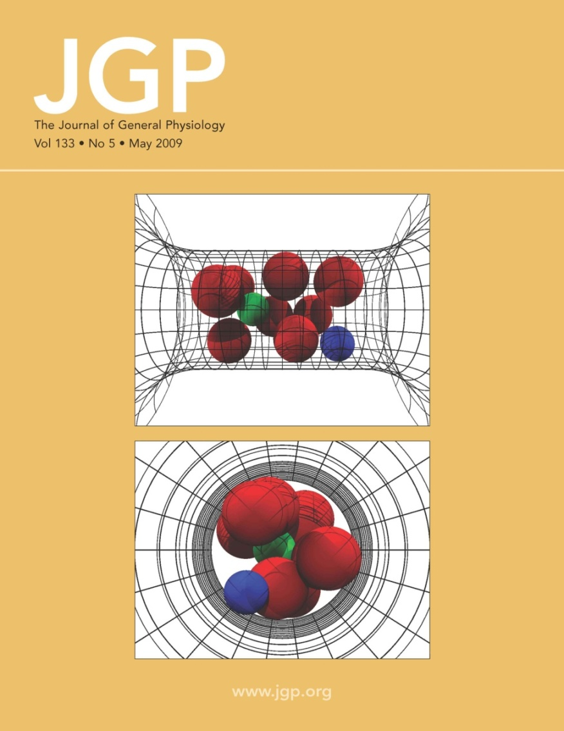
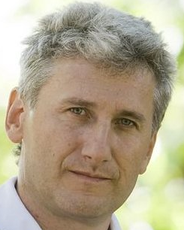
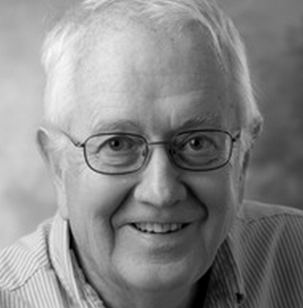
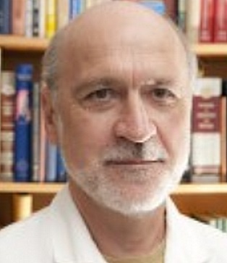
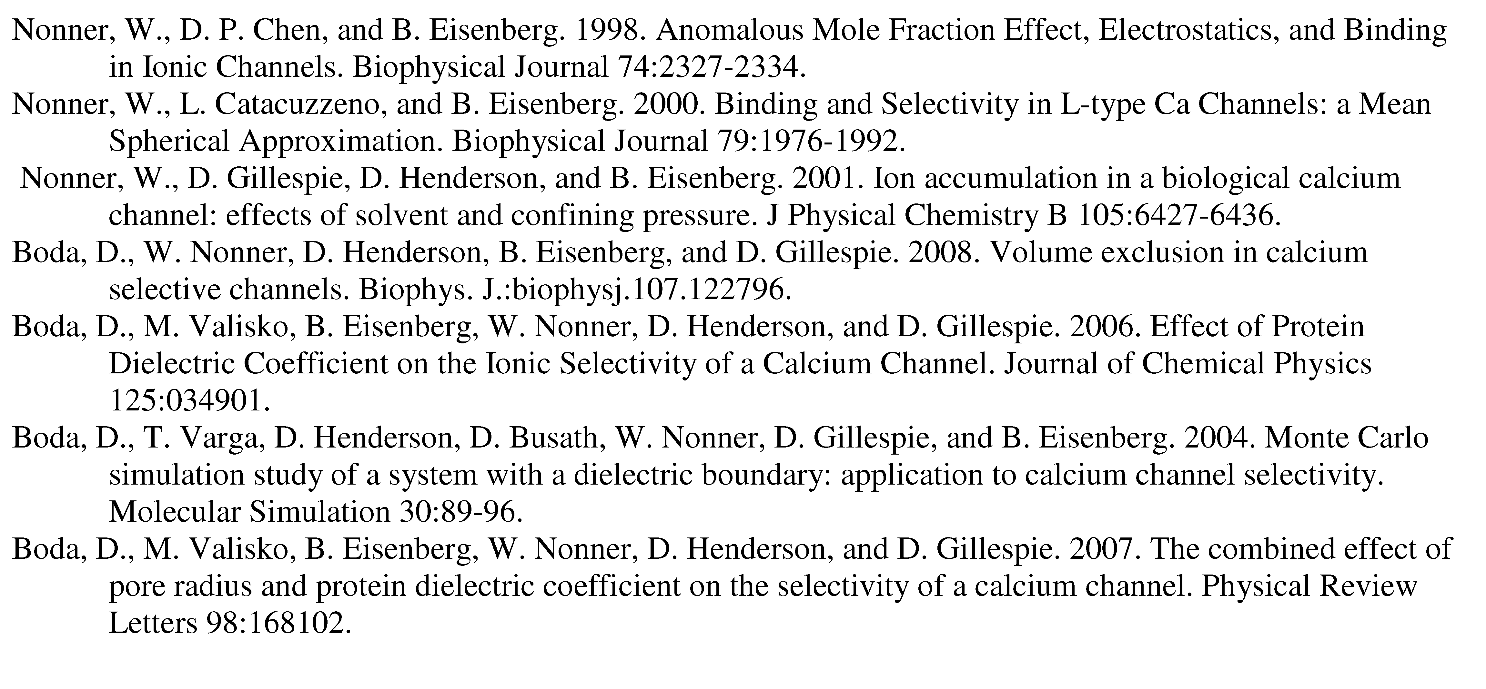
Calcium Channel of the Heart
Dezső Boda
Doug Henderson
Wolfgang Nonner
More than 35 papers are available at
ftp://ftp.rush.edu/users/molebio/Bob_Eisenberg/reprints

Slide 40
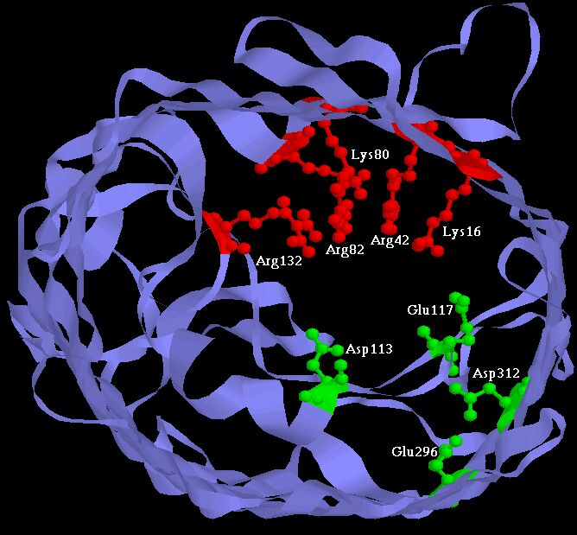
Experiments have ‘engineered’ channels (5 papers) including
Two Synthetic Calcium Channels
Atomic Scale
Mutants of ompF Porin
Designed by Theory
Glutathione derivatives
MUTANT ─ Compound
Calcium selective
Unselective
Natural ‘wild’ Type
As density of permanent charge increases, channel becomes calcium selective
E_{rev} → E_{Ca} in 0.1M 1.0 M CaCl₂ ; pH 8.0
Macro Scale
||
built by Henk Miedema, Wim Meijberg of BioMade Corp. Groningen, Netherlands
Miedema et al, Biophys J 87: 3137–3147 (2004); 90:1202-1211 (2006); 91:4392-4400 (2006)

Slide 41
‘All Spheres’ Model
Side Chains are Spheres
Channel is a Cylinder
Side Chains are free to move within Cylinder
Ions and Side Chains are at free energy minimum
i.e., ions and side chains are ‘self organized’,
‘Binding Site” is induced by substrate ions
Nonner & Eisenberg

Slide 42
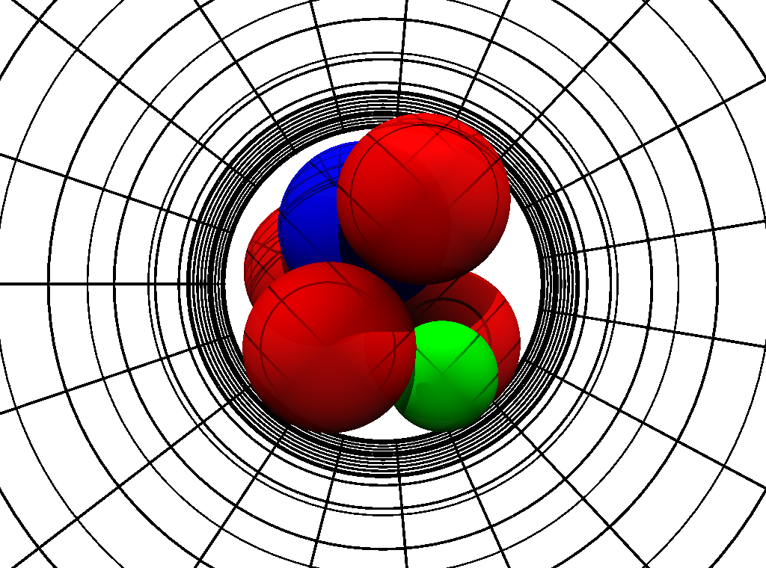
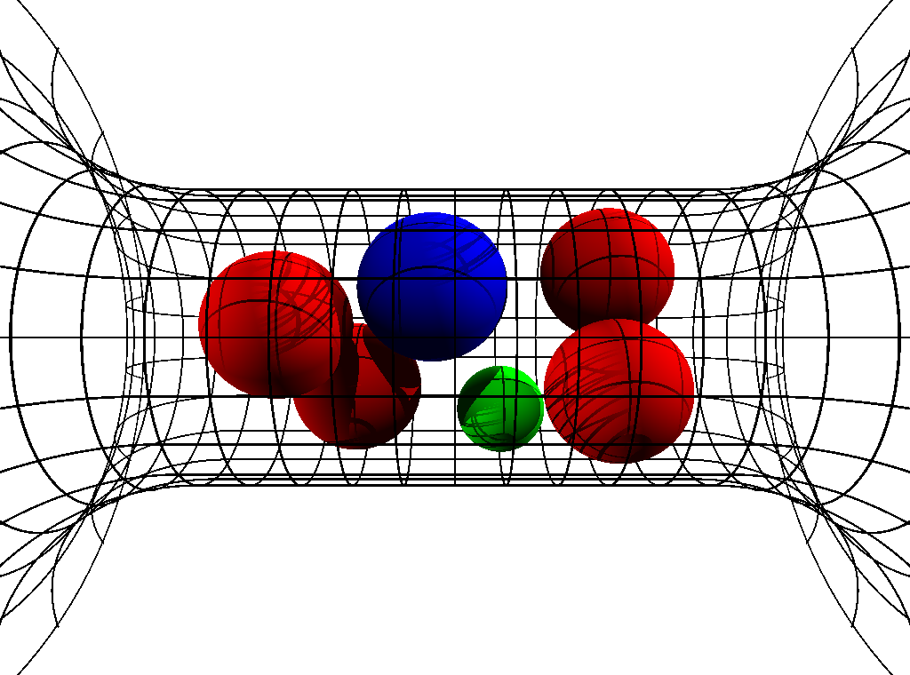
Crowded Ions
Radial Crowding is Severe
Ion Diameters ‘Pauling’ Diameters
Ca⁺⁺ | 1.98 Å
Na⁺ | 2.00 Å
K⁺ | 2.66 Å
‘Side Chain’ Diameter
Lysine K | 3.00 Å
D or E | 2.80 Å
Channel Diameter 6 Å
6Å
Snap Shots of Contents
Parameters are Fixed in all calculations
in all solutions for all mutants
‘Side Chains’ are Spheres
Free to move inside channel
Experiments and Calculations done at pH 8
Boda, Nonner, Valisko, Henderson, Eisenberg & Gillespie

Slide 43
large mechanical forces

Slide 44
Solved with Metropolis Monte Carlo
MMC Simulates Location of Ions
both the mean and the variance
Produces Equilibrium Distribution
of location
of Ions and ‘Side Chains’
MMC yields Boltzmann Distribution with correct Energy, Entropy and Free Energy
Other methods
give nearly identical results
DFT (Density Functional Theory of fluids, not electrons)
DFT-PNP (Poisson Nernst Planck)
MSA (Mean Spherical Approximation)
SPM (Primitive Solvent Model)
EnVarA (Energy Variational Approach)
Non-equil MMC (Boda, Gillespie) several forms
Steric PNP (simplified EnVarA)
Poisson Fermi

Slide 45
Metropolis Monte Carlo
Simulates Location of Ions
both the mean and the variance
MMC details
Start with Configuration A, with computed energy E_{A}
Move an ion to location B, with computed energy E_{B}
If spheres overlap, E_{B} → ∞ and configuration is rejected
If spheres do not overlap, E_{B} ≠ 0 and configuration may be accepted
(4.1) If E_{B} < E_{A} : accept new configuration.
(4.2) If E_{B} > E_{A} : accept new configuration with Boltzmann probability
Key Idea
produces enormous improvement in efficiency
MMC chooses configurations with Boltzmann probability and weights them evenly, instead of choosing from uniform distribution and weighting them with Boltzmann probability.

Slide 46
Mutation
  Na Channel
  Ca Channel
Same Parameters
  E
  E
  E
  A
  D
  E
  K
  A
Charge -3e
Charge -1e
1
0.004
Na⁺
Ca²⁺
Na⁺
Occupancy (number)
0.002
0.5
Ca²⁺
0
0
-6
-4
-2
0
0.05
0.1
log (Concentration/M)
Concentration/M
EEEE has full biological selectivity
^{in similar simulations}
Boda, et al

Slide 47
Selectivity
comes from
Electrostatic Interaction
and
Steric Competition for Space
Repulsion
Location and Strength of Binding Sites Depend on Ionic Concentration and Temperature, etc
Rate Constants are Variables

Slide 48
Sodium Channel
Voltage controlled channel responsible for signaling in nerve and coordination of muscle contraction

Slide 49
Challenge
from channologists
Walter Stühmer and Stefan Heinemann
Göttingen Leipzig
Max Planck Institutes
Can THEORY explain the MUTATION
Calcium Channel into Sodium Channel?
DEEA DEKA
Calcium Channel
Sodium Channel

Slide 50
Mutation
  Na Channel
  Ca Channel
Same Parameters
  E
  E
  E
  A
  D
  E
  K
  A
Charge -3e
Charge -1e
1
0.004
Na⁺
Ca²⁺
Mutation
Na⁺
Occupancy (number)
0.002
0.5
Same Parameters
pH 8
Ca²⁺
0
0
-6
-4
-2
0
0.05
0.1
log (Concentration/M)
Concentration/M
pH =8
EEEE has full biological selectivity
^{in similar simulations}
Monte Carlo simulations of Boda, et al

Slide 51
Nothing was Changed from the
EEEA Ca channel except the amino acids
Calculated DEKA Na Channel
Selects
Ca ²⁺ vs. Na ⁺ and also K⁺ vs. Na⁺
Calculations and experiments done at pH 8

Slide 52

Size Selectivity is in the Depletion Zone
Na⁺ vs. K⁺ Occupancy
Binding Sites
NOT SELECTIVE
Channel Protein
Na⁺
[NaCl] = 50 mM
[KCl] = 50 mM
pH 8
K⁺
Concentration [Molar]
Selectivity Filter
K⁺
Na⁺
Na Selectivity
because 0 K⁺
in Depletion Zone
Depletion Zone
of the DEKA Na Channel, 6 Å
Boda, et al

Slide 53
How?
Usually Complex Unsatisfying Answers*
How does a Channel Select Na⁺ vs. K⁺ ?
* Gillespie, D., Energetics of divalent selectivity in the ryanodine receptor.
Biophys J (2008). 94: p. 1169-1184
* Boda, et al, Analyzing free-energy by Widom's particle insertion method.
J Chem Phys (2011) 134: p. 055102-14
Calculations and experiments done at pH 8

Slide 54
Simple
Independent§ Control Variables*
DEKA Na⁺ channel
Amazingly simple, not complex
for the most important selectivity property
of DEKA Na⁺ channels
*Control variable = position of gas pedal or dimmer on light switch
§ Gas pedal and brake pedal are (hopefully) independent control variables
Boda, et al

Slide 55
(1) Structure and
(2) Dehydration/Re-solvation emerge from calculations
Structure (diameter) controls Selectivity
Solvation (dielectric) controls Contents
*Control variables emerge as outputs
Control variables are not inputs
Independent Control Variables*
Dielectric constants
Diameter

Slide 56
Structure (diameter) controls Selectivity
Solvation (dielectric) controls Contents
Control Variables emerge as outputs
Control Variables are not inputs
Monte Carlo calculations of the DEKA Na channel

Slide 57
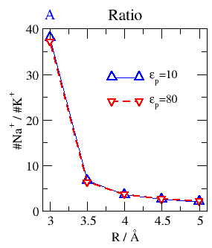
Na⁺ vs K⁺ (size) Selectivity (ratio)
Depends on Channel Size, not dehydration (not on Protein Dielectric Coefficient)*
Selectivity
for small ion
Na⁺
2.00 Å
K⁺
Na⁺
K⁺
2.66 Å
6 8 10
Small Channel Diameter Large
in Å
Boda, et al
*in DEKA Na channel

Slide 58
Evidence
(end)

Slide 59
Biology and
Semiconductors share a very similar
Reduced Model
PNP of various flavors

Slide 60
Semiconductor Technology
like biology
is all about
Dimensional Reduction
to a
Reduced Model
of a
Device

Slide 61
Semiconductor PNP Equations
For Point Charges
Dielectric Coefficient
Poisson’s Equation
Permanent Charge of Protein
Valence
Proton charge
Cross sectional Area
Drift-diffusion & Continuity Equation
Number Densities
Flux
Diffusion Coefficient
Chemical Potential
Not in Semiconductor
valence
proton charge
Thermal Energy

Slide 62
Boundary conditions:
STRUCTURES of Ion Channels
STRUCTURES of semiconductor devices and integrated circuits
All we have to do is
Solve it / them!

Slide 63
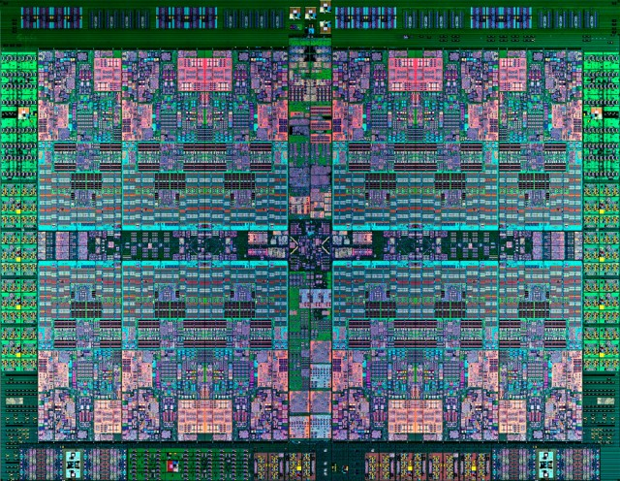
Integrated Circuit
Technology as of ~2014
IBM Power8
Too small to see!

Slide 64
Semiconductor Devices
PNP equations describe many robust input output relations
Amplifier
Limiter
Switch
Multiplier
Logarithmic convertor
Exponential convertor
These are SOLUTIONS of PNP for different boundary conditions
with ONE SET of CONSTITUTIVE PARAMETERS
PNP of POINTS is TRANSFERRABLE
Analytical - Numerical Analysis
should be attempted using techniques of
Weishi Liu University of Kansas
Tai-Chia Lin National Taiwan University & Chun Liu PSU

Slide 65
DEVICE APPROACH IS FEASIBLE
Biology Provides the Data
Semiconductor Engineering Provides the Approach
Mathematics Provides the Tools

Slide 66
Learn from
Mathematics of Ion Channels
solving specific
Inverse Problems
How does it work?
How do a few atoms control (macroscopic)
Biological Devices

Slide 67
Biology is Easier than Physics
Reduced Models Exist*
for important biological functions
or the
Animal would not survive
to reproduce
*Evolution provides the existence theorems and uniqueness conditions
so hard to find in theory of inverse problems.
(Some biological systems − the human shoulder − are not robust,
probably because they are incompletely evolved,
i.e they are in a local minimum ‘in fitness landscape’ .
I do not know how to analyze these.
I can only describe them in the classical biological tradition.)

Slide 68
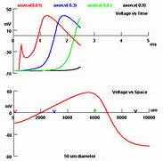
Propagation
of
Action Potential

Slide 69
Reduced models exist
because they are the
Adaptation
created by evolution
to perform a biological function
like selectivity
Reduced Models
and its parameters
are found by
Inverse Methods

Slide 70
The Reduced Equation
is
How it works!
Multiscale Reduced Equation
Shows how a
Few Atoms
Control
Biological Function

Slide 71
This kind of
Dimensional Reduction
is an
Inverse Problem
where the essential issues are Robustness
Sensitivity
Non-uniqueness

Slide 72
Ill posed problems
with too little data
Seem Complex
even if they are not
Some of Biology is Simple

Slide 73
Ill posed problems
with too little data
Seem Complex
even if they are not
Some of biology seems complex
only because data is inadequate
Some* of biology is
amazingly
Simple
ATP as UNIVERSAL energy source
*The question is which ‘some’?
PS: Some of biology IS complex

Slide 74
Bioengineers: this is reverse engineering
Inverse Problems
Find the Model, given the Output
Many answers are possible: ‘ill posed’ *
Central Issue
Which answer is right?
*Ill posed problems with too little data
seem complex, even if they are not.
Some of biology seems complex for that reason.
The question is which ‘some’?

Slide 75
How does the
Channel control Selectivity?
Inverse Problems: many answers possible
Central Issue
Which answer is right?
Key is
ALWAYS
Large Amount of Data
from
Many Different Conditions
Almost too much data was available for reduced model:
Burger, Eisenberg and Engl (2007) SIAM J Applied Math 67:960-989

Slide 76
Inverse Problems: many answers possible
Which answer is right?
Key is
Large Amount of Data from Many Different Conditions
Otherwise problem is ‘ill-posed’ and has no answer or even set of answers
Molecular Dynamics
usually yields
ONE data point
at one concentration
MD is not yet well calibrated
(i.e., for activity = free energy per mole)
for Ca²⁺ or ionic mixtures like seawater or biological solutions

Slide 77
Working Hypothesis:
Crucial Biological Adaptation is
Crowded Ions and Side Chains
Wise to use the Biological Adaptation
to make the reduced model!
Reduced Models allow much easier Atomic Scale Engineering

Slide 78
Working Hypothesis:
Crucial Biological Adaptation is
Crowded Ions and Side Chains
Biological Adaptation
GUARANTEES stable
Robust, Insensitive Reduced Models
Biological Adaptation ‘solves’ the Inverse Problem

Slide 79
Working Hypothesis:
Biological Adaptation
of Crowded Charge
produces stable
Robust, Insensitive, Useful Reduced Models
Biological Adaptation
Solves
the
Inverse Problem
Provides Dimensional Reduction

Slide 80
Working Hypothesis:
Crowded Charge
enables
Dimensional Reduction
to a
Device Equation
which is
How it Works

Slide 81
Physical basis of function
Active Sites of Proteins are Very Charged
7 charges ~ 20 M net charge
= 1.2×10²² cm⁻³
liquid Water is 55 M
solid NaCl is 37 M
OmpF Porin
Ions are Crowded
Hard Spheres
Na⁺
+
+
+
+
+
K⁺
Ca²⁺
Na⁺
-
-
-
K⁺
-
Induced Fit
of
Side Chains
4 Å
Selectivity Filters and Gates of Ion Channels
are
Active Sites
Figure adapted from Tilman Schirmer

Slide 82
Crowded Active Sites in 573 Enzymes
Enzyme Type |  | Catalytic Active Site Density (Molar) |  |  | Protein
 |  | Acid (positive) | Basic (negative) | | Total | | Elsewhere
 | Total (n = 573) | 10.6 | 8.3 | 18.9 | 2.8
EC1 | Oxidoreductases (n = 98) | 7.5 | 4.6 | 12.1 | 2.8
EC2 | Transferases (n = 126) | 9.5 | 7.2 | 16.6 | 3.1
EC3 | Hydrolases (n = 214) | 12.1 | 10.7 | 22.8 | 2.7
EC4 | Lyases (n = 72) | 11.2 | 7.3 | 18.5 | 2.8
EC5 | Isomerases (n = 43) | 12.6 | 9.5 | 22.1 | 2.9
EC6 | Ligases (n = 20) | 9.7 | 8.3 | 18.0 | 3.0
Jimenez-Morales, Liang, Eisenberg

Slide 83
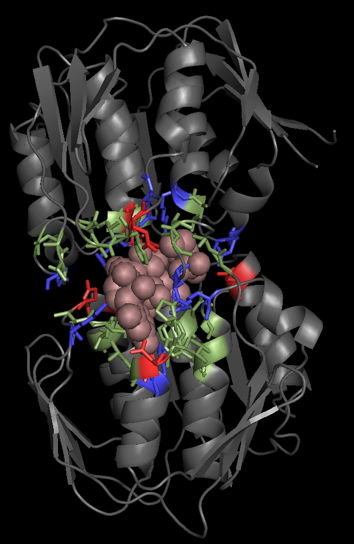
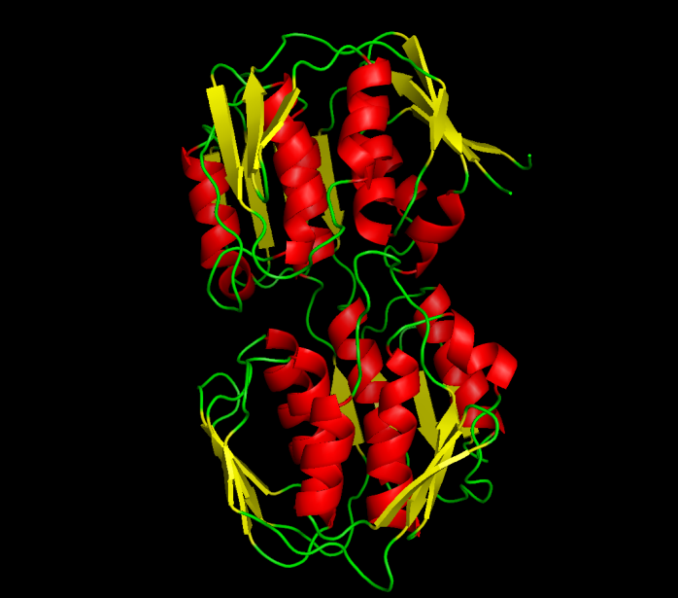
EC2: TRANSFERASES
Average Ionizable Density: 19.8 Molar
Example
UDP-N-ACETYLGLUCOSAMINE ENOLPYRUVYL TRANSFERASE (PDB:1UAE)
Functional Pocket Volume: 1462.40 Å³
Density : 19.3 Molar (11.3 M+. 8 M-)
Crowded
Green: Functional pocket residues
Blue: Basic = Probably Positive = R+K+H
Red: Acid = Probably Negative = E + Q
Brown Uridine-Diphosphate-N-acetylclucosamine
Jimenez-Morales, Liang, Eisenberg

Slide 84
Experiments have ‘engineered’ channels (5 papers) including
Two Synthetic Calcium Channels
Atomic Scale
Mutants of ompF Porin
Designed by Theory
Glutathione derivatives
MUTANT ─ Compound
Calcium selective
Unselective
Natural ‘wild’ Type
As density of permanent charge increases, channel becomes calcium selective
E_{rev} → E_{Ca} in 0.1M 1.0 M CaCl₂ ; pH 8.0
Macro Scale
||
built by Henk Miedema, Wim Meijberg of BioMade Corp. Groningen, Netherlands
Miedema et al, Biophys J 87: 3137–3147 (2004); 90:1202-1211 (2006); 91:4392-4400 (2006)

Slide 85
Take Home Lesson

Slide 86
Biological Adaptation
enables
Dimensional Reduction
to a
Device Equation
which is
How it Works
Guess
Crowded Charge is the crucial biological adaptation in channels and enzymes

Slide 87
The End
Any Questions?

Slide 88
Where to start?
Why not compute all the atoms?

Slide 89
^{Multi-Scale Issues}
Journal of Physical Chemistry C (2010 )114:20719
Computational Scale | Biological Scale | Ratio
Time 10⁻¹⁵ sec | 10⁻⁴ sec | 10¹¹
Length 10⁻¹¹ m | 10⁻⁵ m | 10⁶
DEVICES DEPEND ON FINE TOLERANCES
parts must fit
Atomic and Macro Scales are BOTH used by channels because they are nanovalves
so atomic and macro scales must be
Computed and CALIBRATED Together
This may be impossible in all-atom simulations

Slide 90
^{Multi-Scale Issues}
Journal of Physical Chemistry C (2010 )114:20719
Computational Scale | Biological Scale | Ratio
Spatial Resolution |  | 10¹²
Volume 10⁻³⁰ m³ | (10⁻⁴ m)³ = 10⁻¹² m³ | 10¹⁸
Three Dimensional (10⁴)³
DEVICES DEPEND ON FINE TOLERANCES
parts must fit
Atomic and Macro Scales are BOTH used by channels because they are nanovalves
so atomic and macro scales must be
Computed and CALIBRATED Together
This may be impossible in all-atom simulations

Slide 91
^{Multi-Scale Issues}
Journal of Physical Chemistry C (2010 )114:20719
Computational Scale | Biological Scale | Ratio
Solute Concentration including Ca²⁺mixtures | 10⁻¹¹ to 10¹ M | 10¹²
DEVICES DEPEND ON FINE TOLERANCES
parts must fit
Atomic and Macro Scales are BOTH used by channels because they are nanovalves
so atomic and macro scales must be
Computed and CALIBRATED Together
This may be impossible in all-atom simulations

Slide 92
All Life Occurs in Ionic Mixtures
in which [Ca²⁺] is important* as a control signal
Simulations must deal with
Multiple Components
as well as
Multiple Scales
This may be nearly impossible for ionic mixtures
because
‘everything’ interacts with ‘everything else’
on both atomic and macroscopic scales
particularly when mixtures flow
*[Ca²⁺] ranges from 1×10⁻⁸ M inside cells to 10 M inside channels

Slide 93
^{Multi-Scale Issues}
Journal of Physical Chemistry C (2010 )114:20719
DEVICES DEPEND ON FINE TOLERANCES
parts must fit
Atomic and Macro Scales are BOTH used by channels because they are nanovalves
so atomic and macro scales must be
Computed and CALIBRATED Together
This may be impossible in all-atom simulations

Slide 94
Uncalibrated Simulations
will make devices
that do not work
Details matter in devices

Slide 95
Valves Control Flow
Classical Theory & Simulations
NOT designed for flow
Thermodynamics, Statistical Mechanics do not allow flow
Rate Models are inconsistent with Maxwell’s Eqn (Kirchoff Law)
(if rate constants are independent of potential)

