Slide 1
Flushing Waste in the Central Nervous System in Sleep A Glymphatic Hypothesis K⁺ in Optic Neve of Necturus
Bob Eisenberg October 21, 2021
University of Illinois Chicago
Biomedical Engineering Seminar October 22, 2021
DOI: 10.13140/RG.2.2.24580.04481

Slide 2
Thanks to James Patton, Jie Liang, and Tom Royston for the kind invitation
Thanks to Tina Moore for all the support
and
Thanks to Rich Magin for many fine interactions through the years

Slide 3
DOI: 10.13140/RG.2.2.24580.04481
Flushing Waste in the Central Nervous System in Sleep
A Glymphatic Hypothesis
Bob Eisenberg
The central nervous system has a tiny extracellular space that can be filled with flows from nerve and glia. Potassium ions in that space can easily block signaling in nerve fibers and thus become a toxic waste. Sleep is said to flush toxic wastes from the brain, in the glymphatic hypothesis, proposed by others. Qualitative hypotheses like this are difficult to test and can lead to more discussion than knowledge. Numbers are needed because flows in complex structures are complex. We show how to construct models that are field theories built on conservation laws written as partial differential equations in three dimensions and time. These differential equations of nerve, glia and extracellular space fit experimental data in some detail, as do equations of the lens of the eye. Computation shows that extracellular potassium in optic nerve is maintained by bulk flow, mostly in the glia. The glia acts as a pipe that moves potassium by convection away from the nerve membrane, presumably into blood vessels, as proposed by the glymphatic hypothesis.

Slide 4
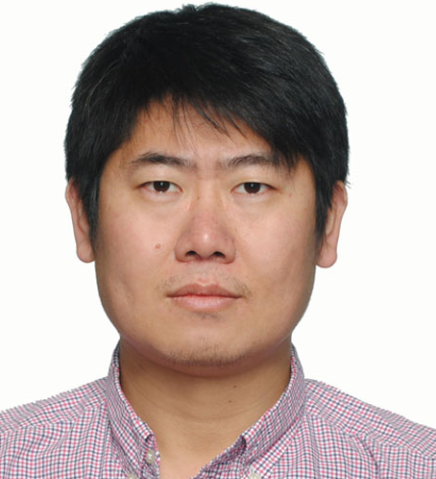
Collaborators
Project Leader
Yi Zhu
Huaxiong Huang
Shixin Xu
毅 朱
华雄 黄
士鑫 徐
1) arXiv:2105.14411. (2021) Derivation: Membranes in Optic Nerve Models
2) Biophysical Journal (2019) 116: p. 1171-1184 Lens of the Eye
3) Physics of Fluids (2021) 33(4): 041906. Physics of Model
4) Biophysical journal 120(15): 3008-3027. Biological Implications

Slide 5
Details are in Publications
Zhu, Y., S. Xu, R. S. Eisenberg and H. Huang (2021). Optic nerve microcirculation: Fluid flow and electrodiffusion. Physics of Fluids 33(4): 041906.
Zhu, Y., S. Xu, R. S. Eisenberg and H. Huang (2021). A tridomain model for potassium clearance in optic nerve of Necturus. Biophysical journal 120(15): 3008-3027.
Xu, S., B. Eisenberg, Z. Song and H. Huang (2018). Osmosis through a Semi-permeable Membrane: a Consistent Approach to Interactions. arXiv preprint arXiv:1806.00646.
Zhu, Y., S. Xu, R. S. Eisenberg and H. Huang (2019). A Bidomain Model for Lens Microcirculation
Biophysical Journal 116(6): 1171-1184 Preprint available on arXiv:1810.04162
Zhu, Y., S. Xu, R. S. Eisenberg and H. Huang (2021).
Membranes in Optic Nerve Models. arXiv preprint arXiv:2105.14411.
Supporting Publications

Slide 6
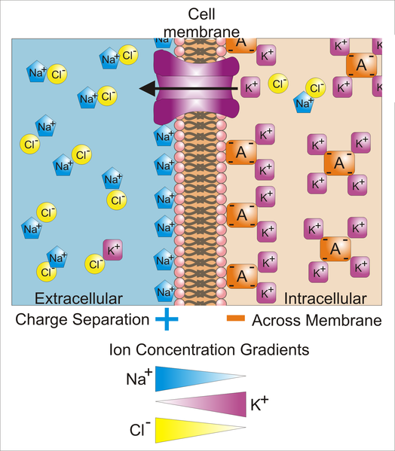
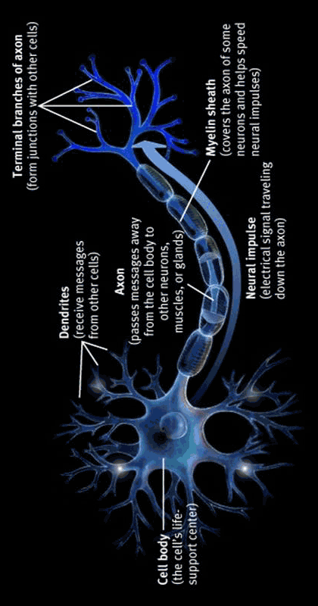
Nerve Signals
Move Potassium K⁺ Out of Nerve Cells
http://www.stat.ucla.edu/~ywu/neuron.html
https://teachmephysiology.com/nervous-system/synapses/action-potential/

Slide 7
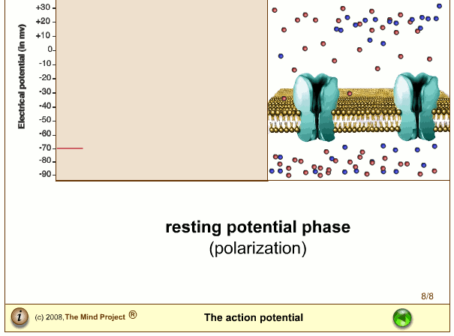
Nerve Signals
Move Potassium K⁺ out of Nerve Cells
Action Potentials
Na⁺
K⁺
Outside
Na⁺
K⁺
Inside
K⁺
https://teachmephysiology.com/nervous-system/synapses/action-potential/
http://www.stat.ucla.edu/~ywu/neuron.html

Slide 8
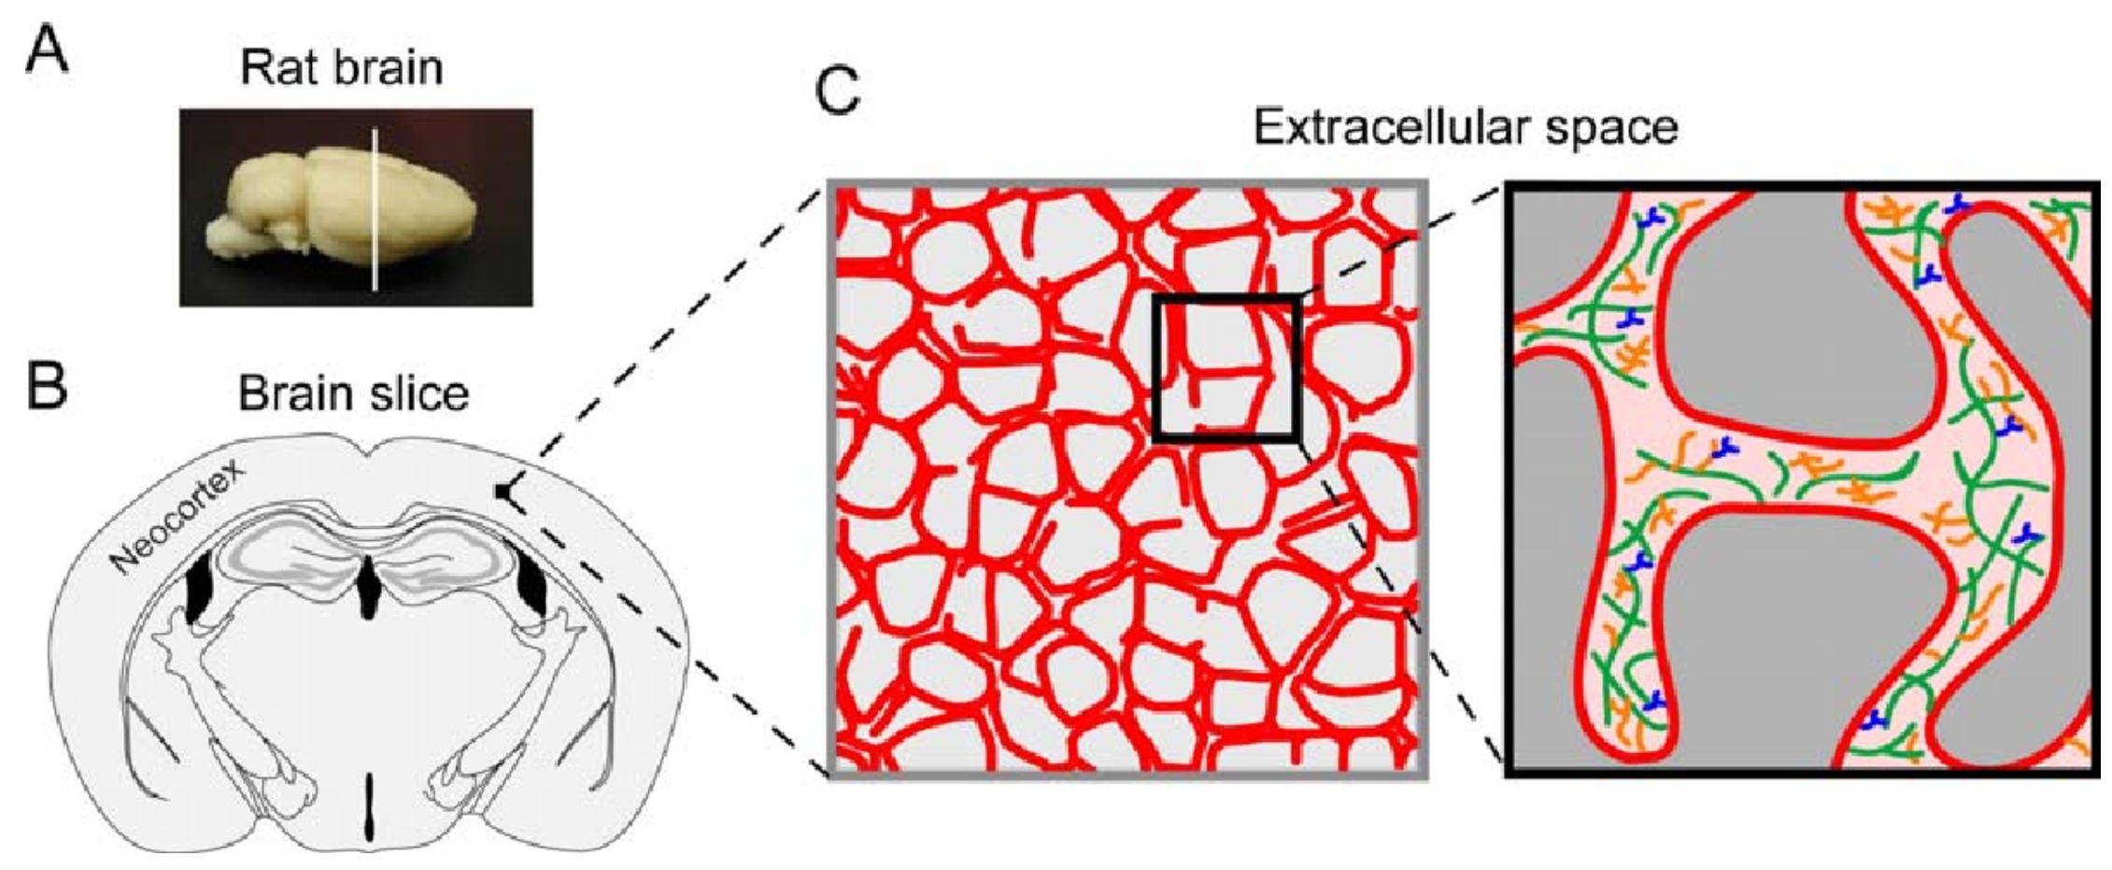
Potassium Moves Out of Nerve Cells
Into Extracellular Space
NARROW (10 nm) extracellular spaces
Sherpa, A. D. and S. Hrabetova (2016). "Astrocytes and diffusive spread of substances in brain extracellular space.“
Diffusion fundamentals 25 4, S. 1-17

Slide 9
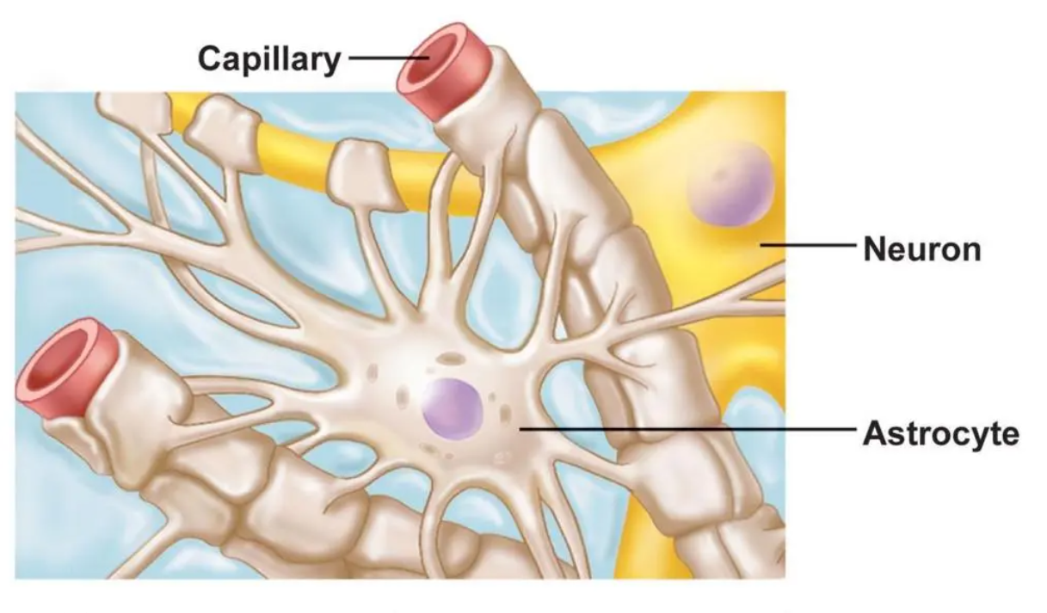
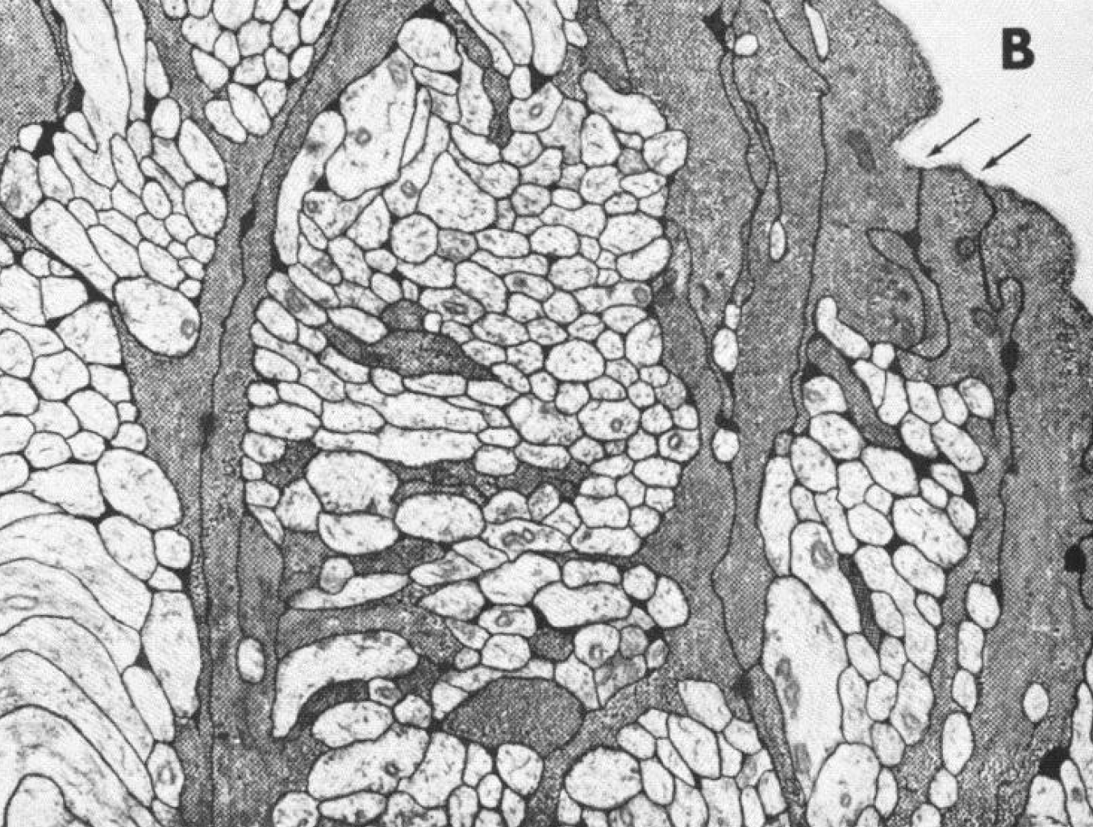
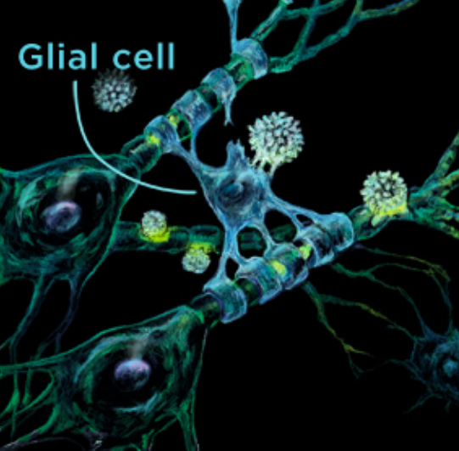
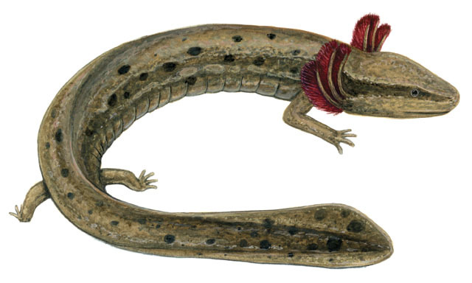
Nerve Fiber: GLIA, Extracellular Space and Nerve Axons
Glia
Glia
Nerve Axons
Nerve Axons
Glia
Kuffler, Nicholls and Orkand (1966). J Neurophysiol 29: 768
= Necturus, mud puppy, salamander, amphibian
Nerve
Nerve

Slide 10
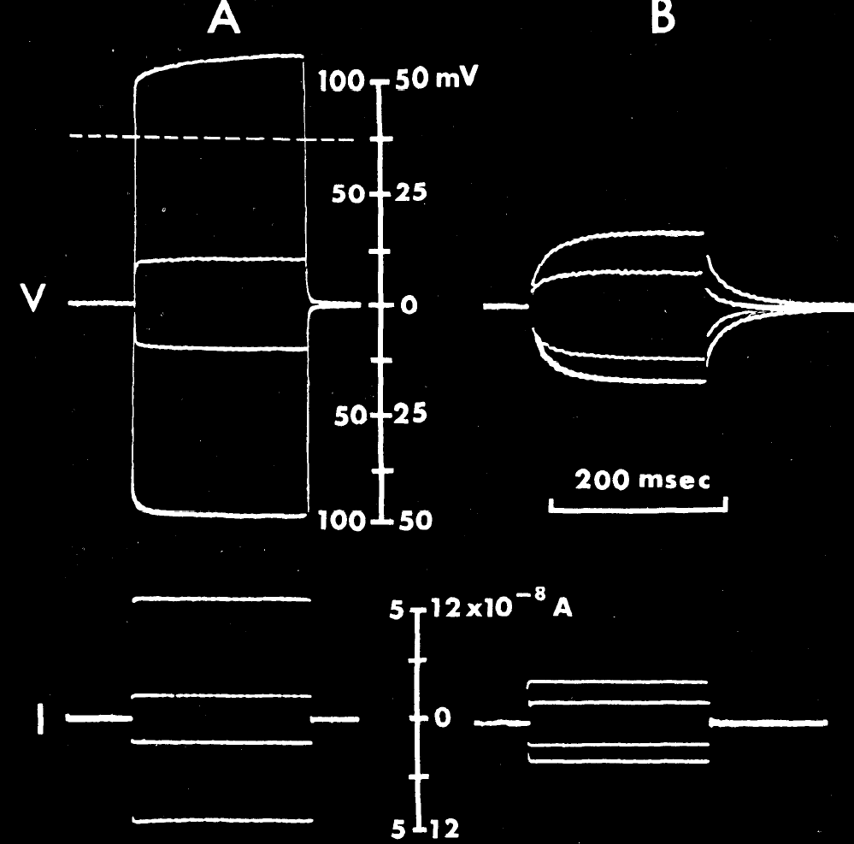
I
V
V
Glia is a Syncytium
Kuffler, Nicholls and Orkand (1966) J Neurophysiol 29: 768-787
Microelectrodes
Close Together
Microelectrodes
Far Apart
‘Jump’ in potential when microelectrodes are close together is effect of three dimensional spread of current
1} Eisenberg & Engel (1970) J Gen Physiol 55: 736
2) Barcilon, Cole, Eisenberg (1971)
SIAM J. Appl. Math. 21: 339
3) Eisenberg & Rae (1976)
J Physiol 262(2): 285
Volage V Recording Microelectrode
V
I
Current I Passing Microelectrode

Slide 11
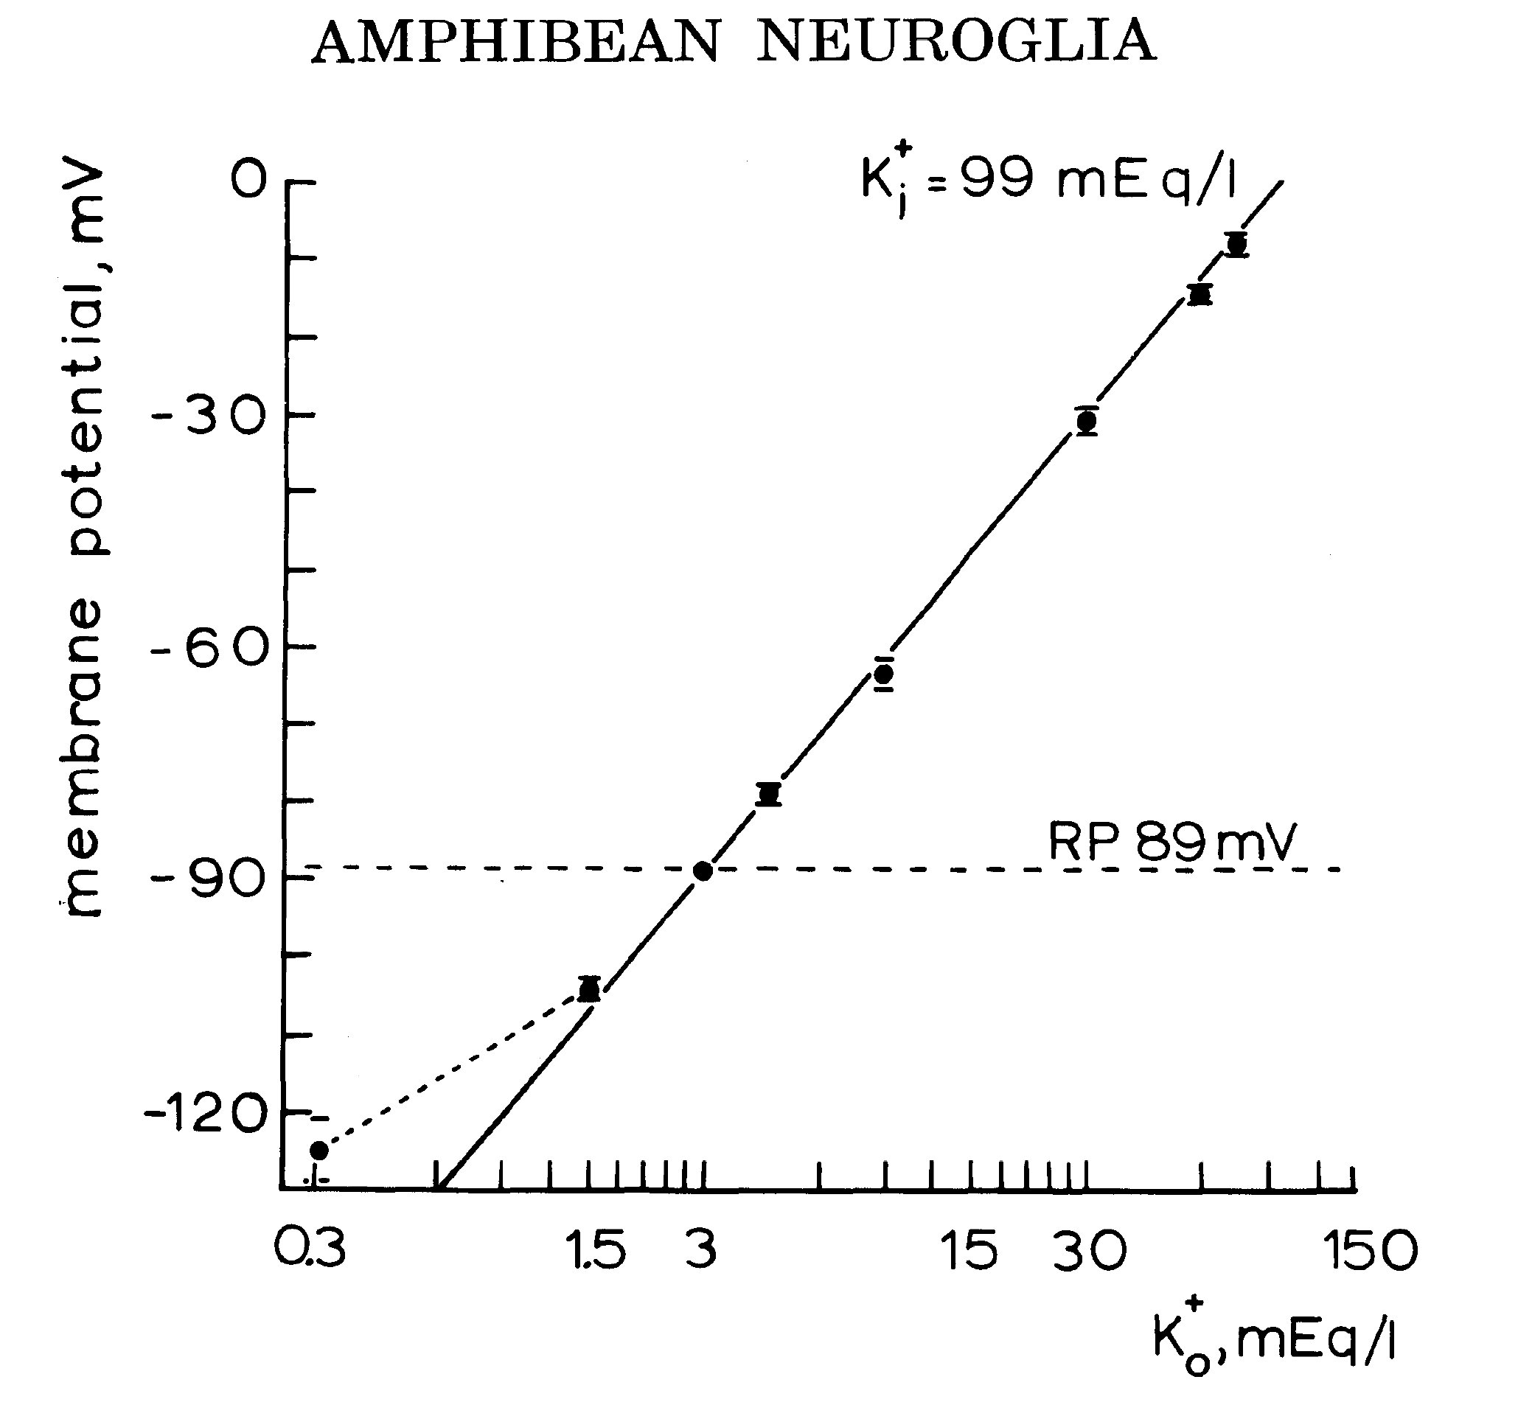
Glia Membrane Potential Measures
Extracellular Potassium
Kuffler, Nicholls Orkand (1966) J Neurophysiol 29(4): 768-787

Slide 12
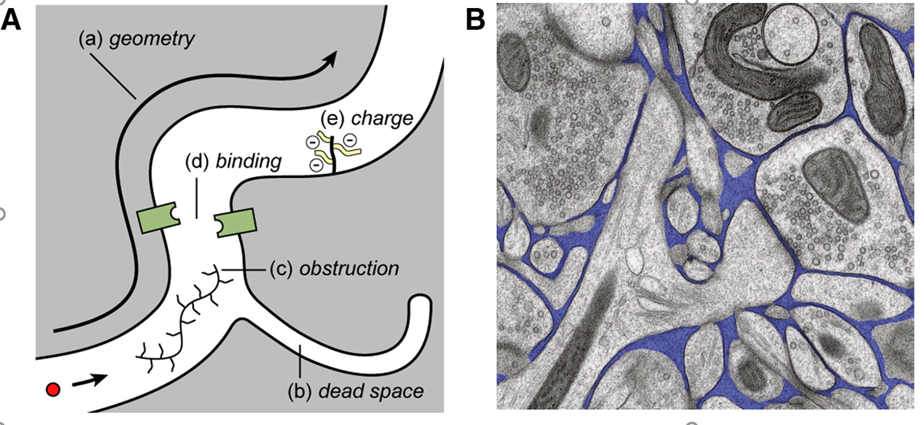
“Brain Extracellular Space: The Final Frontier”
Nicholson and Hrabětová, Biophysical Journal, 2017. 113: p. 2133-2142.
Stirred by Convection at work and in sleep
Driven by Electrochemical Potential for Water,
i.e., an Osmotic Pump

Slide 13
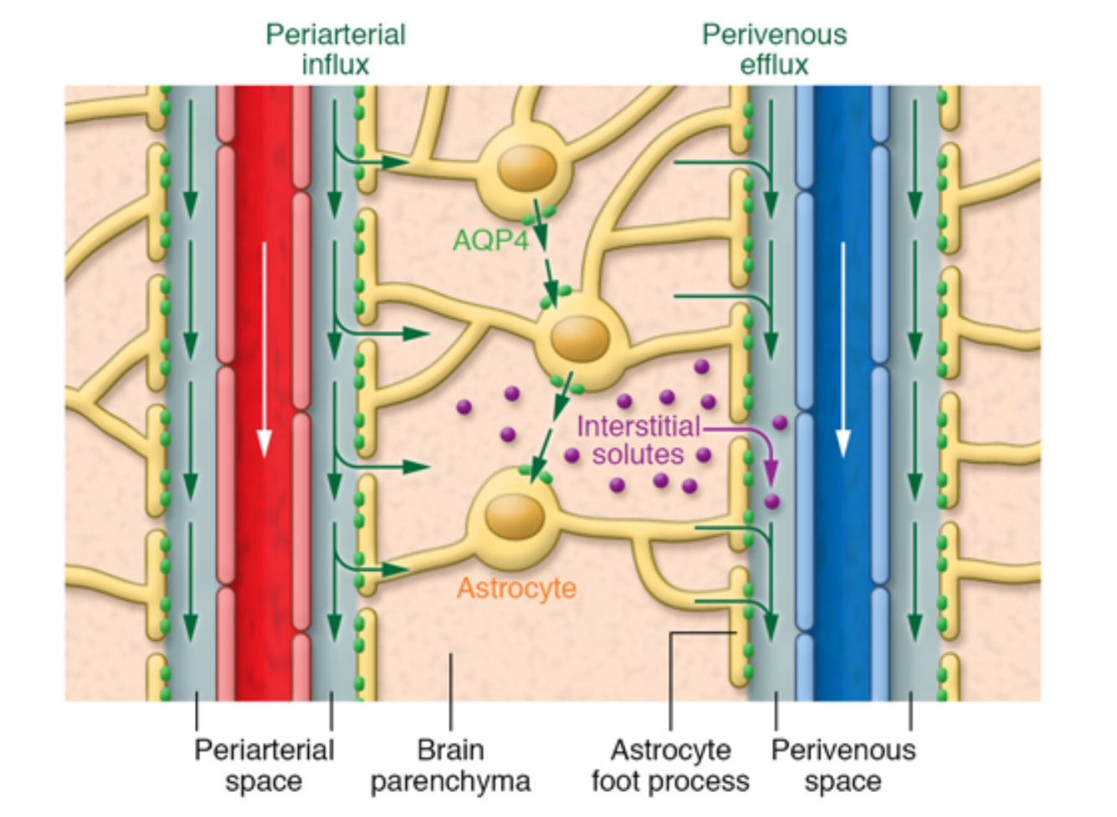
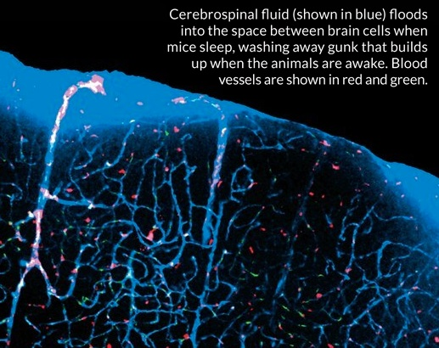
Glymphatic Hypothesis
Kaur, Davoodi-Bojd, Fahmy, Zhang, Ding, Hu, Zhang, Chopp and Jiang (2020). "Magnetic Resonance Imaging and Modeling of the Glymphatic System." Diagnostics 10(6): 344.
Tina Saey Science news, November 16 2013

Slide 14
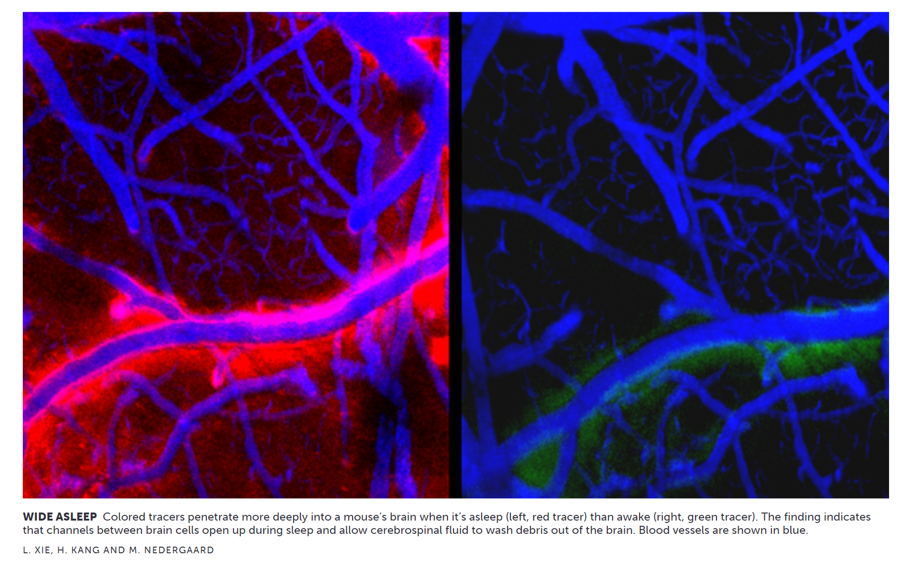
Asleep
Awake
Extracellular Tracer

Slide 15
(part of) Glymphatic Hypothesis
Sleep Cleanses Waste from the Brain
Leading worker
“We need sleep. It cleans up the brain.”
Dr. Maiken Nedergaard (Univ of Rochester)
https://www.upi.com/Health_News/2013/10/17/Brain-may-flush-toxins-out-during-sleep/20861382065779/
Mestre, H., Y. Mori and M. Nedergaard The Brain's Glymphatic System: Current Controversies. Trends in Neurosciences.
Nedergaard, M. (2013). Garbage Truck of the Brain. Science 340(6140): 1529-1530.
Xie, Kang, Xu, Chen, Liao, Thiyagarajan, O’Donnell, Christensen, Nicholson, Iliff, Takano, Deane and Nedergaard (2013). Sleep Drives Metabolite Clearance from the Adult Brain. Science 342(6156): 373-377.

Slide 16
Sleep Cleanses Waste from the Brain
“Sleep knits up the raveled sleeve of care” William Shakespeare: Macbeth Act 2, Scene 2
Translation into modern American
Sleep soothes away all our worries. Sleep re-knits and repairs the sweater damaged by life’s worries

Slide 17
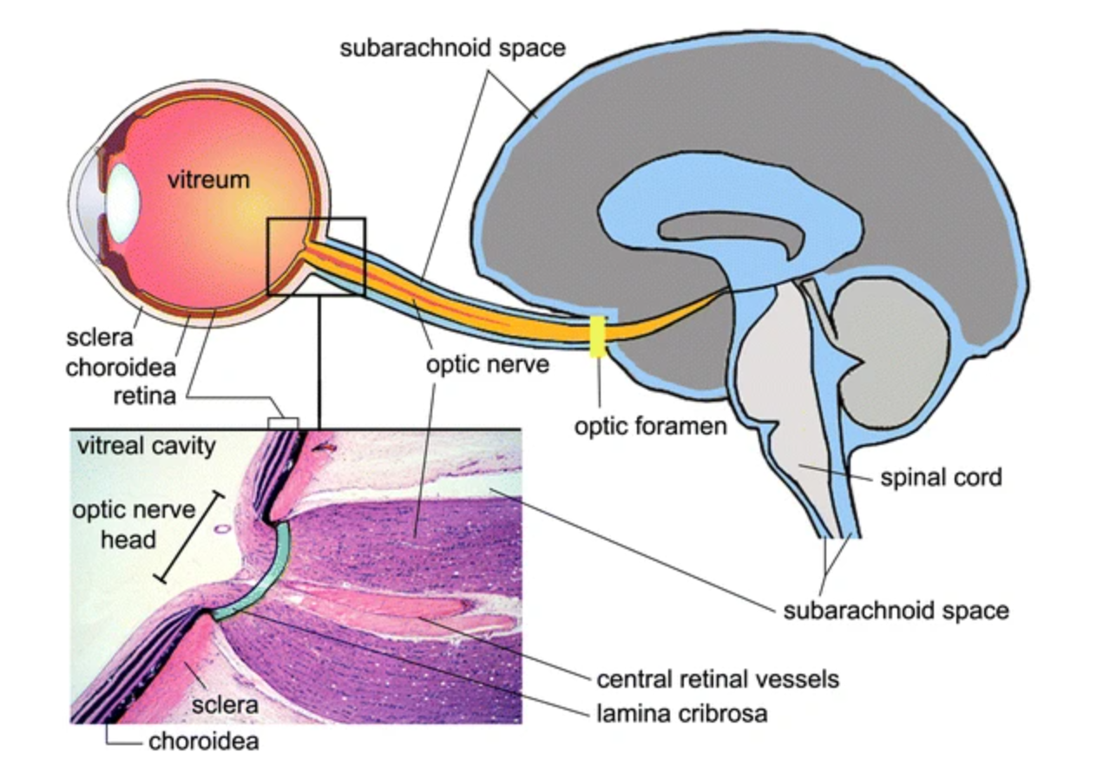
Wostyn, Van Dam, Audenaert, Killer, Paul and Groot (2015) A new glaucoma hypothesis: A role of glymphatic system dysfunction Fluids and barriers of the CNS 12: 16

Slide 18
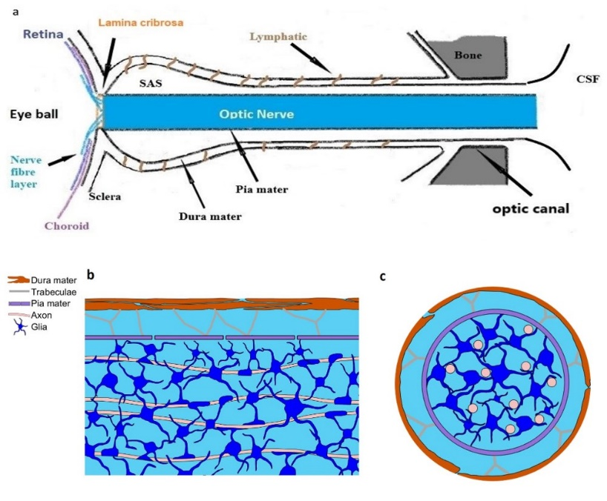
Optic Nerve of Necturus

Slide 19
Plan of Action
Field Equations are Needed of the Whole Optic Nerve
EVERYTHING INTERACTS WITH EVERYTHING ELSE
Partial differential equations are needed, in time and space,
in neuron, glia, and extracellular space and across membranes
involving diffusion, migration, and convection of ions and water
In our work,
Compartment Models are derived from Field Equations
by mathematics: perturbation theory
Compartments are NOT assumed.

Slide 20
Plan of Action
Field Equations are Needed even though they involve Coupled Partial Differential Equations
Systems that use Complex Structures
must have theories that involve structure
Structure is in Three Dimensions
So Partial Differential Equations Appear Naturally

Slide 21
Plan of Action
Field Equations are Needed of the Whole Optic Nerve
EVERYTHING INTERACTS WITH EVERYTHING ELSE
Compartment Models can be derived from Field Equations
by mathematics: perturbation theory
compared to numerical solution
Combining perturbation theory and numerical analysis
Is very powerful
Retains General Insight of Leading Simple Terms of Perturbation
Accuracy determined by numerics in a range of conditions
Without a difficult error analysis.

Slide 22
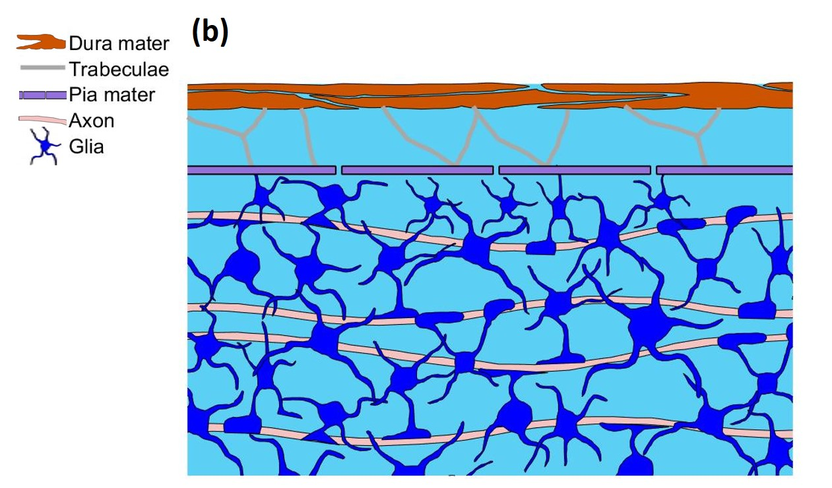
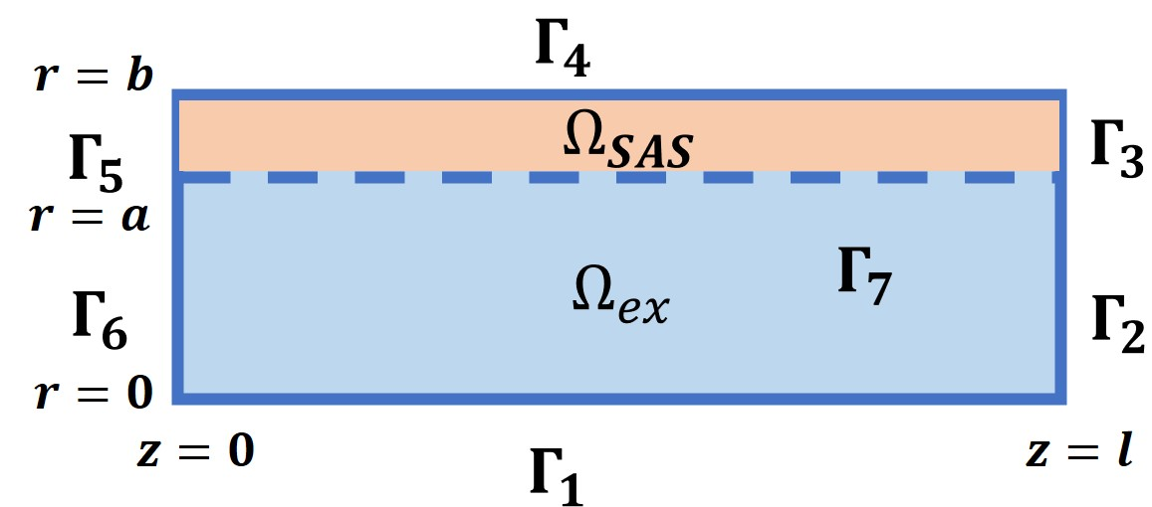
Mathematical Model
Necturus, mud puppy, salamander, amphibian
Tridomain Model:
Each point is a mixture of optic nerve axons, glial cells and extracellular space with fraction $η_{ax}, η_{gl}, η_{ex}$.
Pumps and passive channels in cell membranes serve as source or sink for changing of concentrations and fluid.
$$\frac{∂(η_{l}f_{l})}{∂t}+∇⋅\left({η_{l}J}_{l}\right)+ℳ_{l}\left(a_{l}+b_{l}\right)=0$$

Slide 23
Mathematical Model is Needed
to deal with
Structural Complexity that is ESSENTIAL in biology, as it is in engineering. Structural Complexity is in Boundary Conditions and parameters
Nerve, Glia, Extracellular Space
Flows of Ions and Water driven by
Diffusion Gradients, Osmotic Gradients, Migration of Charges
We use Coupled Partial Differential Equations with structural boundary conditions

Slide 24
Mathematical Model: Assumptions
Structure:
We mainly focus on the intraorbital region, which is formed by axons, glial cells and extracellular space. Model will need to be extended to deal with glaucoma
Glial compartment and extracellular space are isotropic
Axon compartment is anisotropic
Subarachnoid space (SAS) is modeled as porous media
Ions:
Only the $Na^{+}, K^{+},Cl^{−}$ and negative proteins are considered
Local ‘electroneutrality’ is used to couple PNP and cable models
Water:
The loss of water in axons and glial cells is only through membranes flowing into or out of the extracellular space.
The trans-membrane water flux is proportional to the intra/extra-cellular hydrostatic pressure and osmotic pressure differences.
The glial cell and axons swell and shrink due to the water inflows and outflows. Axon is stiffer than glia compartment, so the volume change is smaller.

Slide 25
Mathematical Model: Water Flow
Darcy’s law: fluid is mainly driven by hydrostatic pressure and osmotic pressure
Mass conservation: deformation of each compartment is induced by the water flow
$$\frac{∂η_{gl}}{∂t}+ℳ_{gl}L_{gl}^{m}\left(P_{gl}−P_{ex}−γ_{gl}k_{B}T\left(O_{gl}−O_{ex}\right)\right)+▽⋅\left(η_{gl}{\vec{u}}_{gl}\right)=0$$
$$\frac{∂η_{ax}}{∂t}+ℳ_{ax}L_{ax}^{m}\left(P_{ax}−P_{ex}−γ_{ax}k_{B}T\left(O_{ax}−O_{ex}\right)\right)+\frac{∂}{∂z}\left(η_{ax}u_{ax}^{z}\right)=0$$
$$η_{ex}+η_{gl}+η_{ax}=1$$
$$∇⋅\left(η_{gl}u_{gl}\right)+∇⋅\left(η_{ex}u_{ex}\right)+∇⋅\left(η_{ax}u_{ax}\right)=0$$
$K_{gl}\left(η_{gl}−η_{gl}^{re}\right) =P_{gl}−P_{ex}−(P_{gl}^{re}−P_{ex}^{re})$
$$K_{ax}\left(η_{ax}−η_{ax}^{re}\right)=P_{ax}−P_{ex}−(P_{ax}^{re}−P_{ex}^{re})$$

Slide 26
Fundamental Flow Equation was Derived Generalization of Starlings Capillary Law
Osmosis through a Semi-permeable Membrane: a Consistent Approach to Interactions arXiv:1806.00646
Project Leader
Shixin Xu
Huaxiong Huang
Zilong Song
士鑫 徐
华雄 黄
宋子龙
Excess potentials that characterize real, nonideal solutions have not yet been dealt with here, or elsewhere, as far as I know
Eisenberg (2013) "Interacting ions in Biophysics: Real is not ideal" Biophysical Journal 104: 1849-1866.

Slide 27
Numerical Method Challenges Overcome
Shixin Xu
Huaxiong Huang
士鑫 徐
华雄 黄
The whole model consist of 21 PDEs and 3 ODEs
Model evolves different time scales from $1 ms$to $10 s$
Domain decomposition: optical nerve region and outer region
Domain decomposition: stimulated and unstimulated ergions
Finite Volume Method is used to solve the whole system in order to ensure the conservation of mass and the continuity of flux across the all boundaries
MATLAB is an enormous help, supplemented of course by custom code.

Slide 28
Validation
Model and Equations Validated by Analysis
and fitting of DETAILED experimental data
from the LENS of the EYE
and
Optic Nerve of Necturus (mud puppy, salamander an amphibian)

Slide 29
“Osmotic Pump” is fancy language
Osmosis is Diffusion of Water driven by the Chemical Potential of Water,
Precisely: Osmotic flow is driven by gradient of Chemical Potential of water

Slide 30
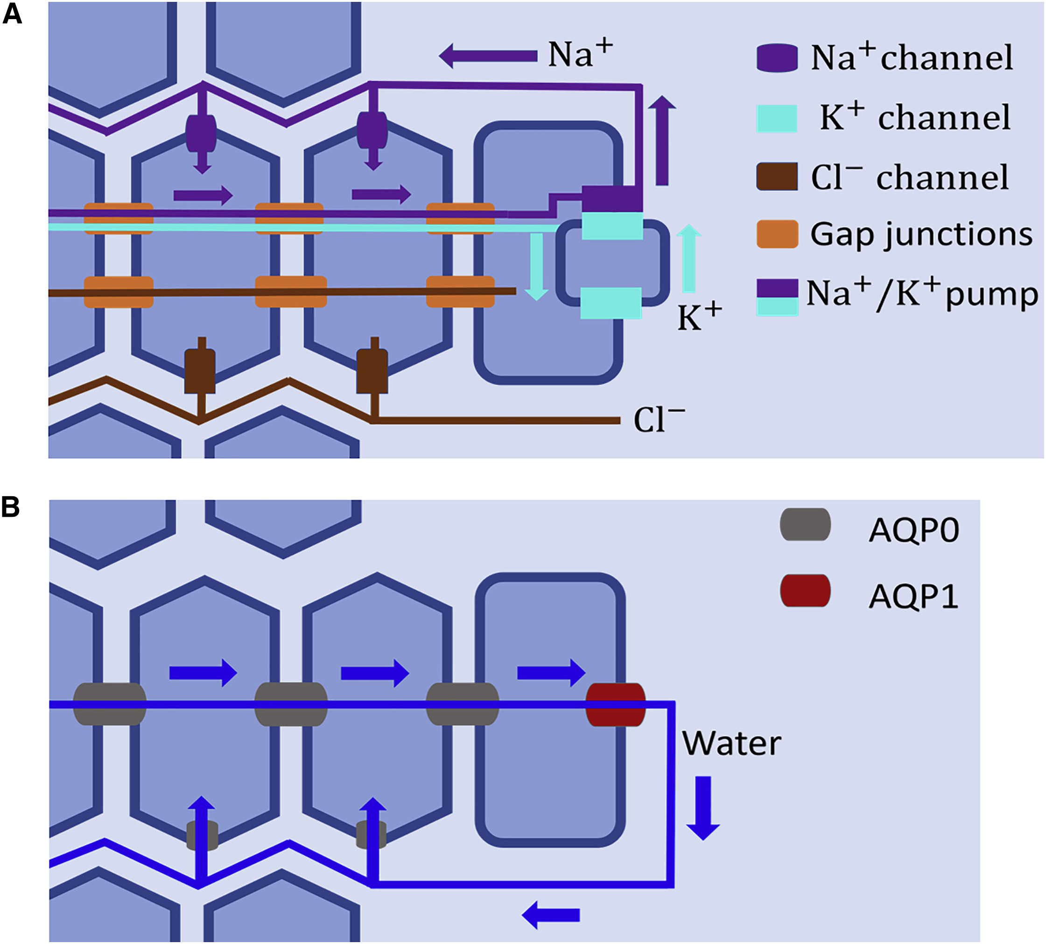
Microcirculation in Lens
Zhu, Xu, Eisenberg & Huang, H. (2019). A bidomain model for lens microcirculation. Biophysical journal, 116, 1171-1184.

Slide 31
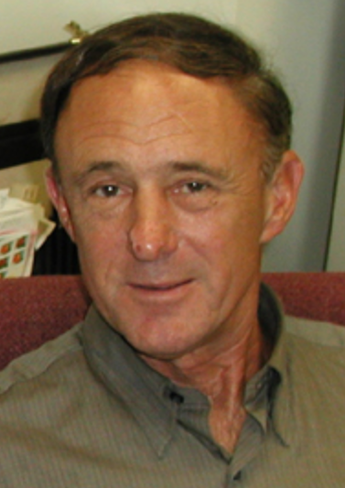
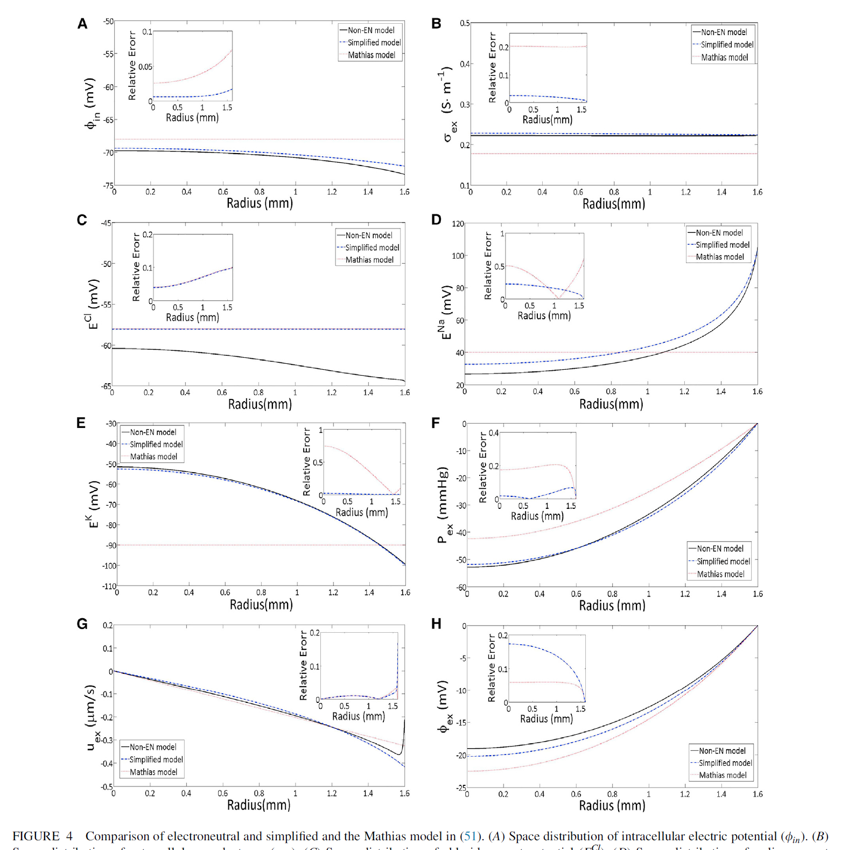
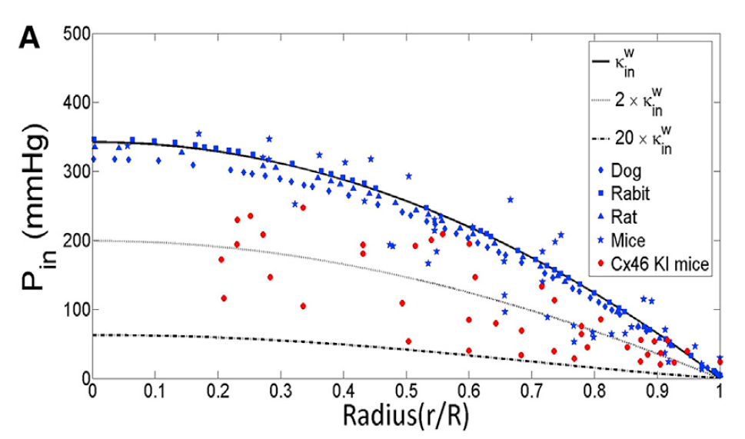
Comparison with Experimental Results
Lens of the Eye is an Osmotic Pump
Life work: Richard (Rick) Mathias
CREATED and VALIDATED an
Engineering Model of the Lens: an Osmotic Pump
Non-Electroneutral Model vs. Simplified, and Mathias Models
Inside Electrical Potential
Conductivity
${Cl}^{−}$ Chemical Potential
${Na}^{+}$ Chemical Potential
Pressure
$K^{+}$ Chemical Potential
Velocity
Extracellular Electrical Potential
We think we have proven that the lens is an Osmotic Pump
Zhu, Xu, Eisenberg and Huang (2019). "A Bidomain Model for Lens Microcirculation Biophysical Journal 116(6): 1171-1184 and arXiv 1810.04162.

Slide 32
Field Theories form a FRAMEWORK
that can easily accommodate
Specialized Structure
Specialized Channels
Specialized Transporters
Structural Parameters determined by Structural Measurements
From which Engineering Models can be Derived

Slide 33
What experiments do we fit for nerve fibers? Harvard Group at birth of Neurobiology Studied Glia in Optic Nerve Preparation of Necturus, mud puppy
Importance of Choice of Preparation
Orkand, Nicholls, KUFFLER J. Neurophysiology (1966) 29:788

Slide 34
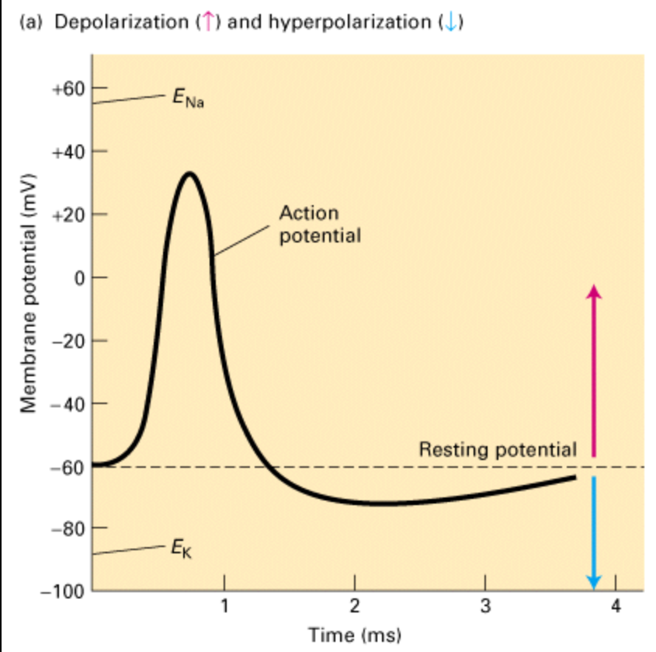
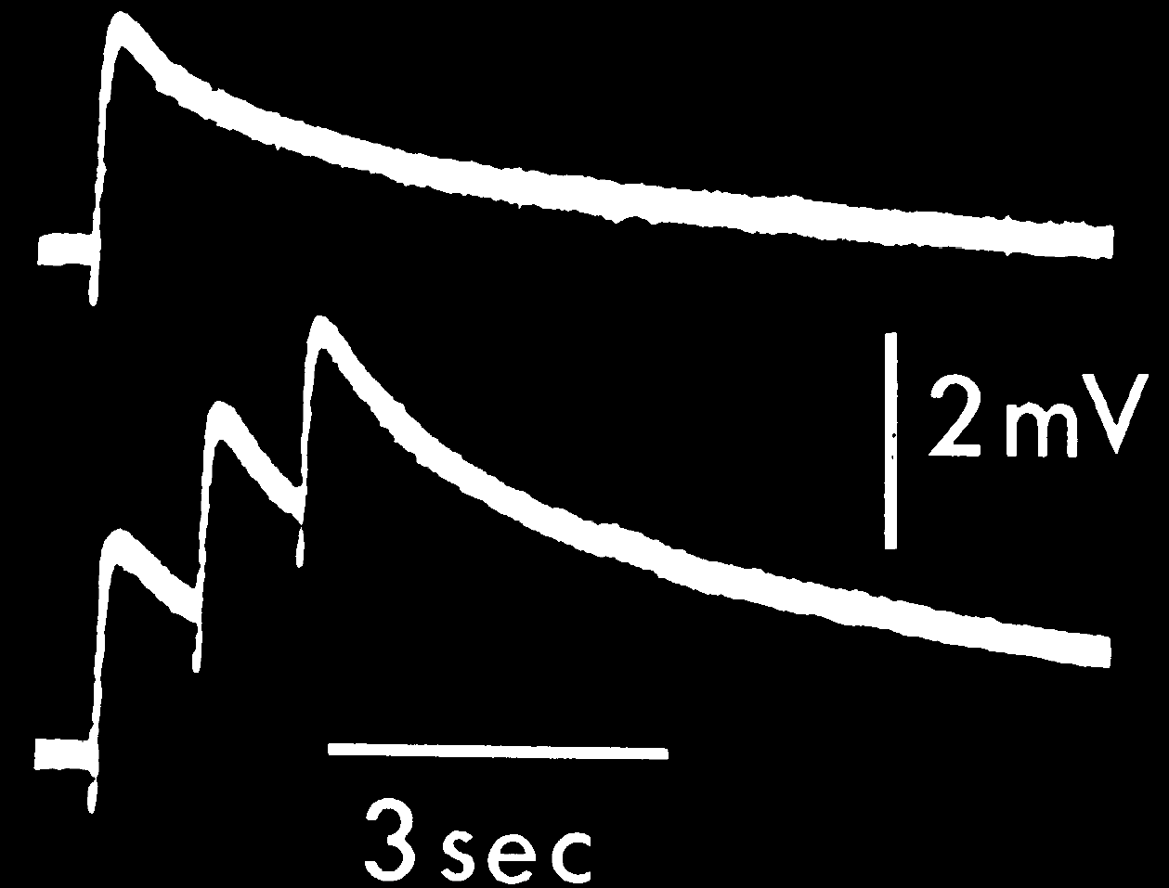
Action Potential in Nerve and Glia
Nerve
Glia
50 mV
2 mV
Orkand, Nicholls, Kuffler. J. Neurophysiology (1966) 29:788
One ‘Action Potential’ in Glia
Three ‘Action Potentials’ in Glia
Time in MILLIseconds
Time in SECONDS

Slide 35
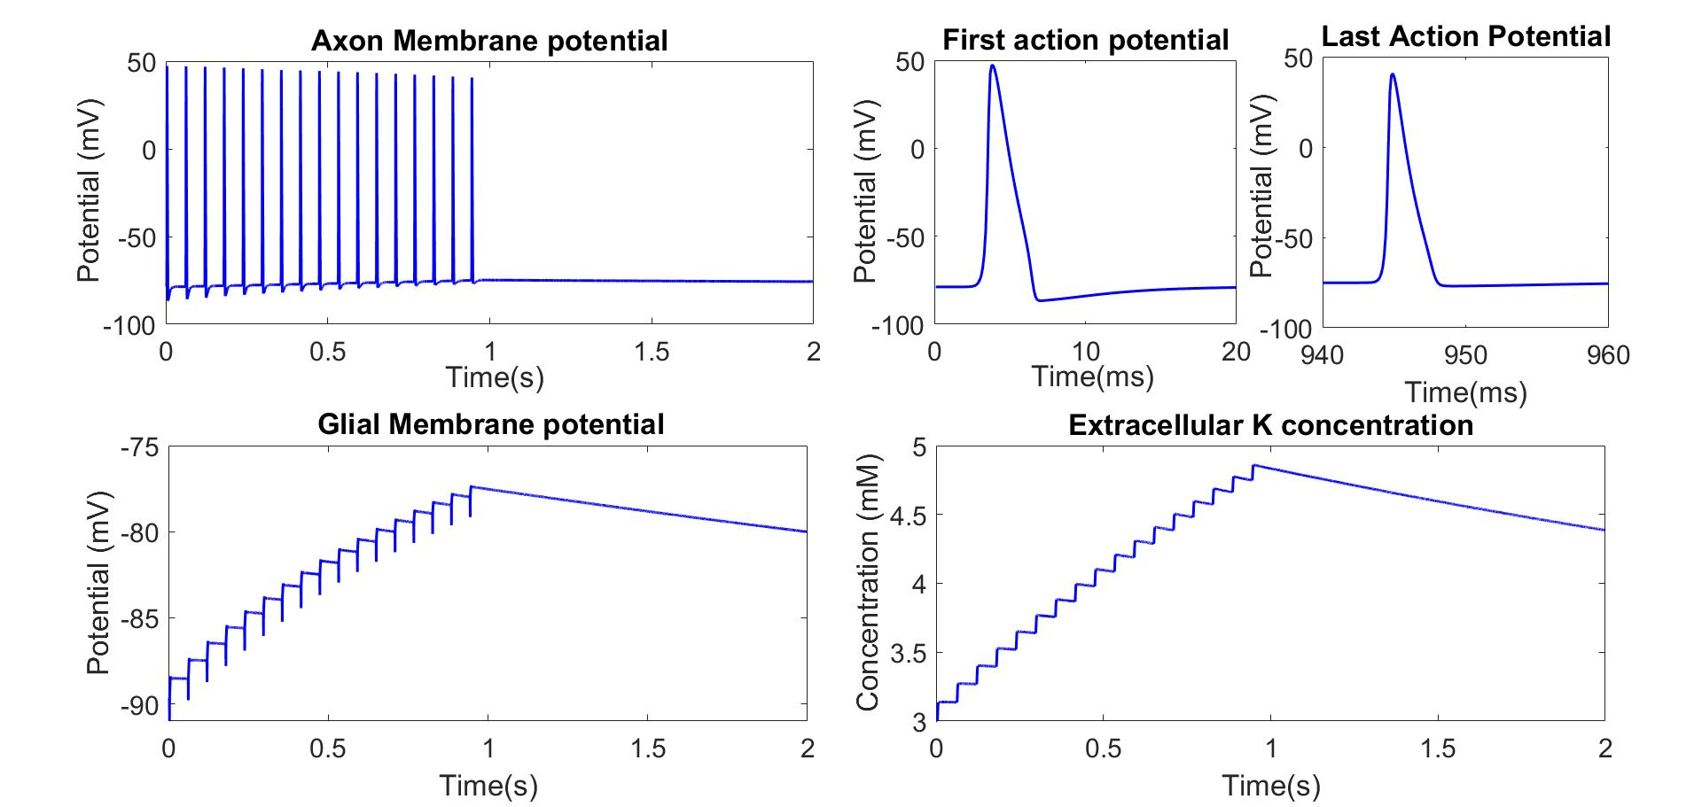
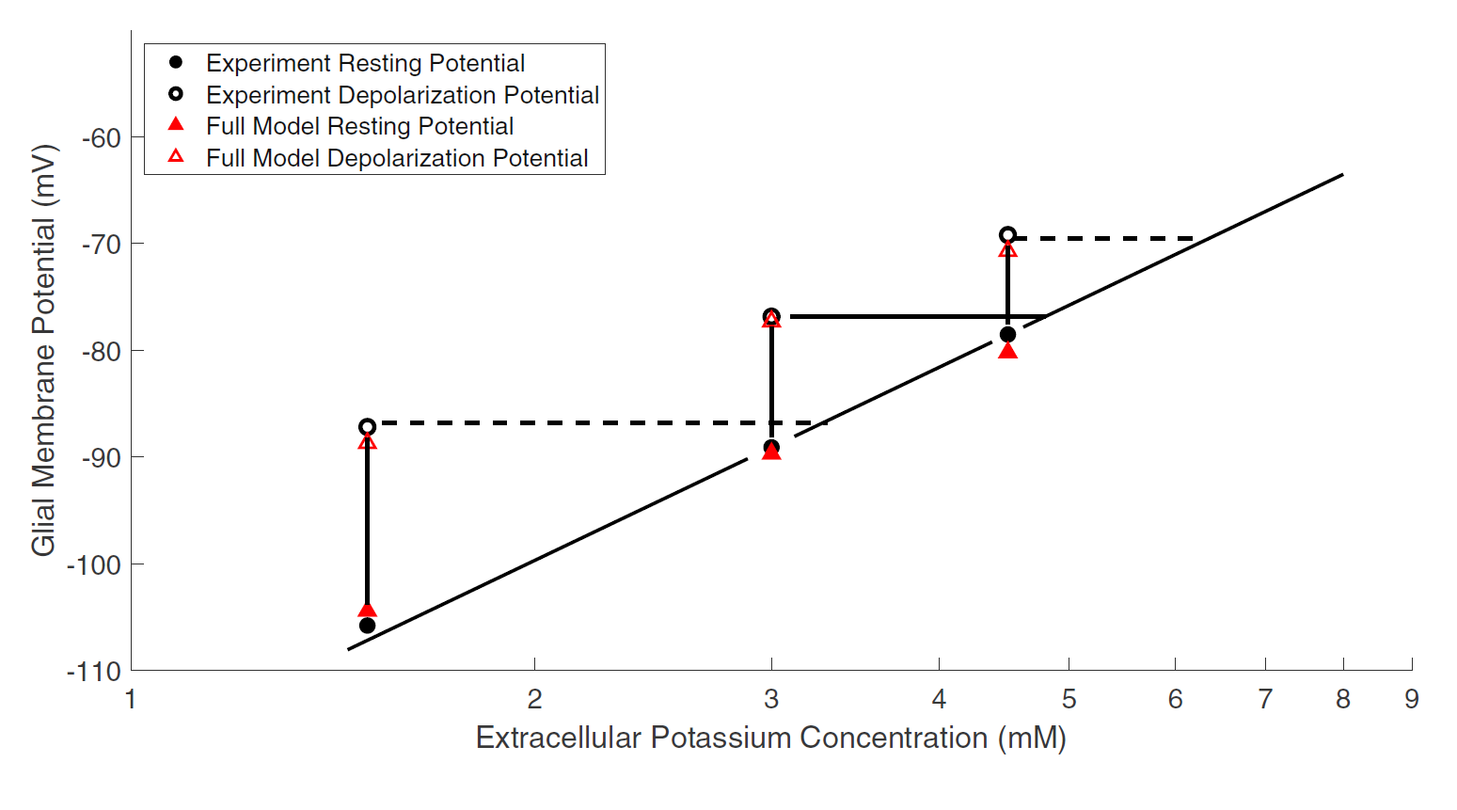
Model Results: Calibration

Slide 36
Model Results: Calibration

Slide 37
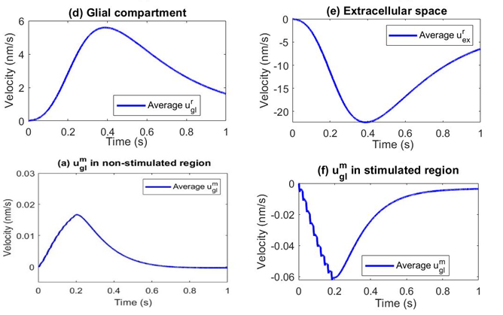
Microcirculation: Water Circulation
Stimulus region: water flows into glial compartment from extracellular space due the decrease of osmotic pressure $δO_{ex}<0$
Inside the glial compartment, water flows from stimulus region to non-stimulus region due to the increase of hydrostatic pressure
In the non-stimulus region, the water flows out of glial into the extracellular space
In the extracellular space, water flows back to stimulus region due to the incompressibility of fluid.
Compartments are Computed by Perturbation Theory, and evaluated by numerics.
They are NOT assumed.

Slide 38
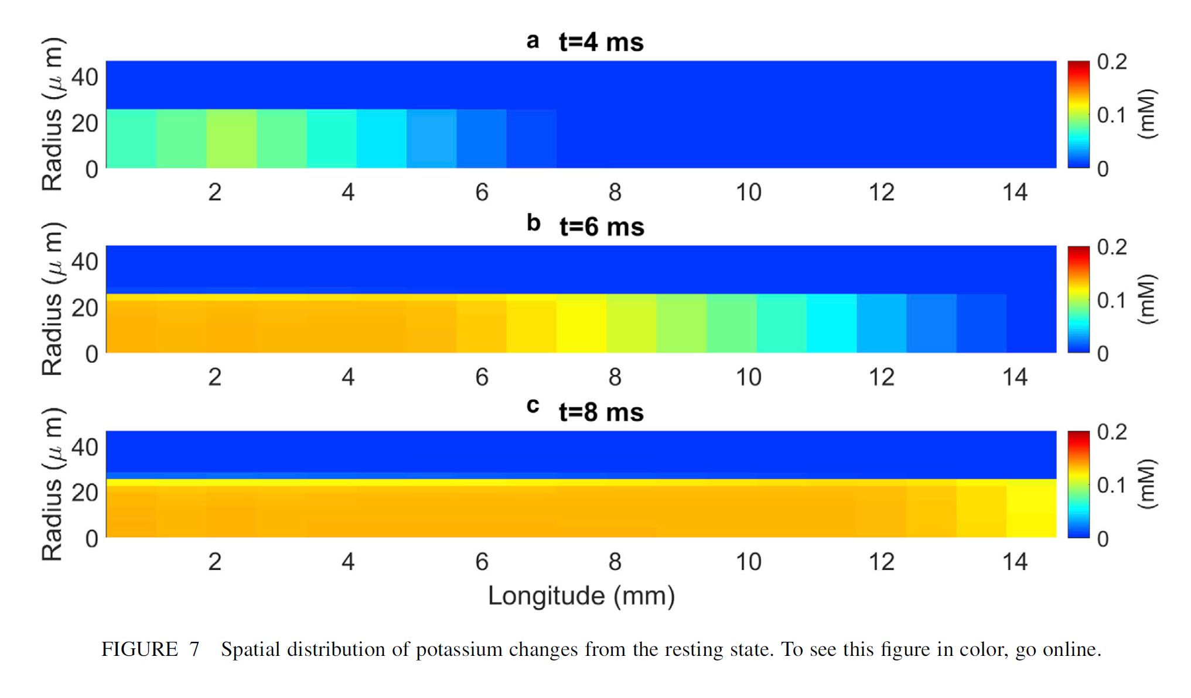
Clearance of Potassium

Slide 39
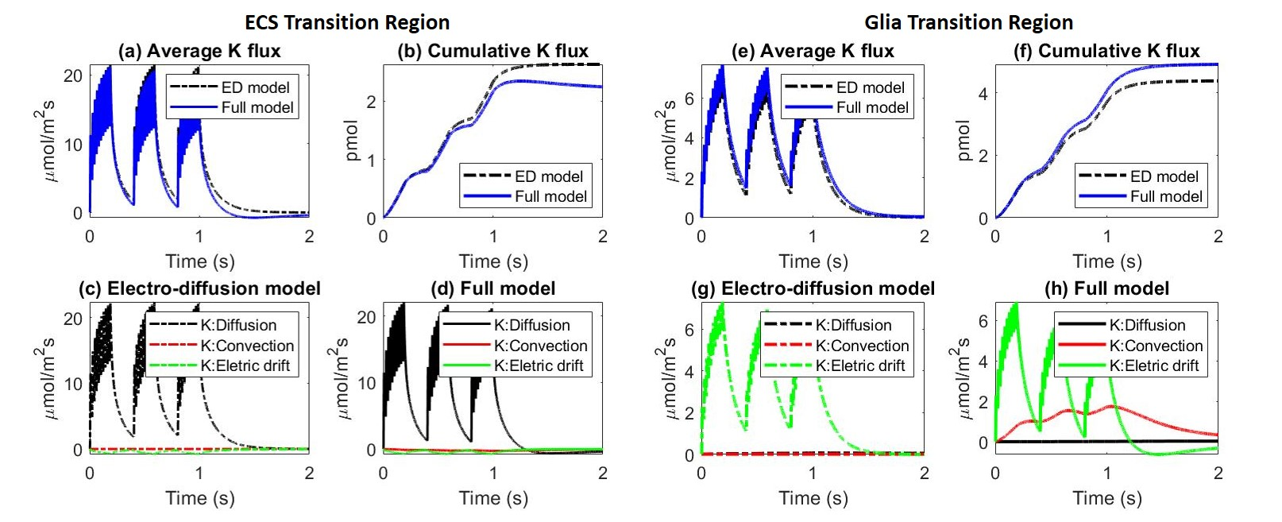
Water Flow Enhances Glial Space Buffering
Field Theory gives so much detail, it is easy to overlook what is happening!!!

Slide 40
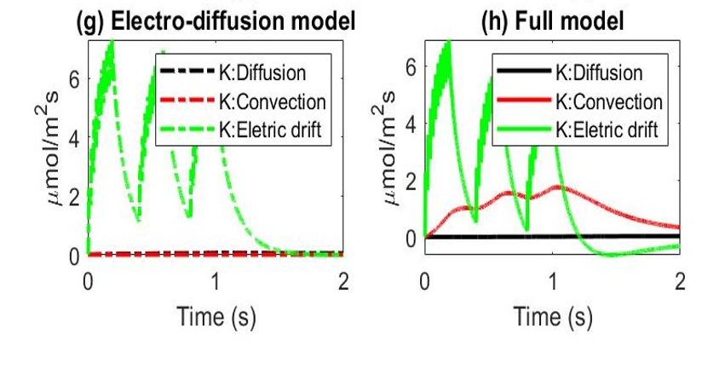
Water Flow Enhances Glial Space Buffering

Slide 41
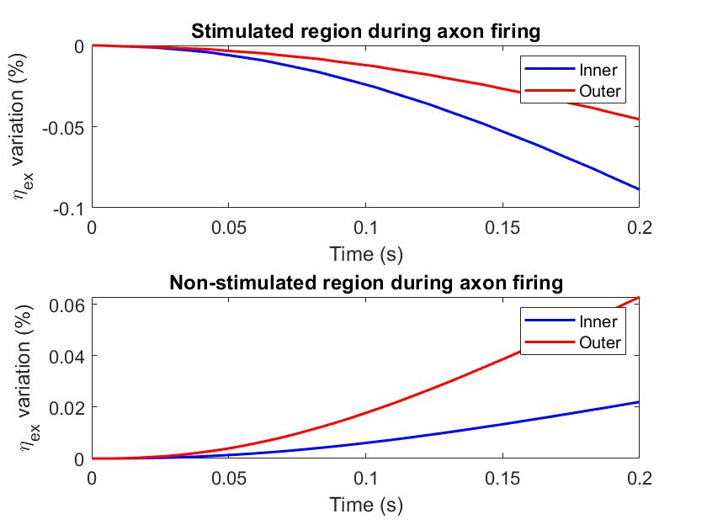
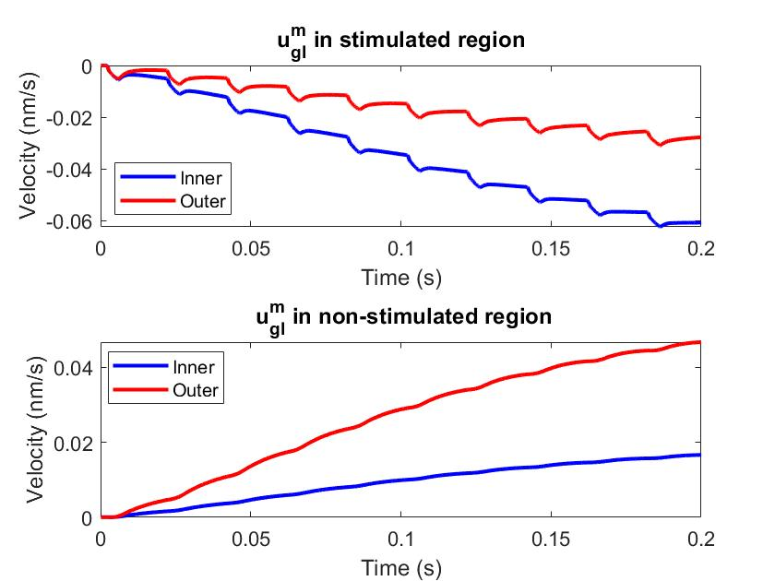
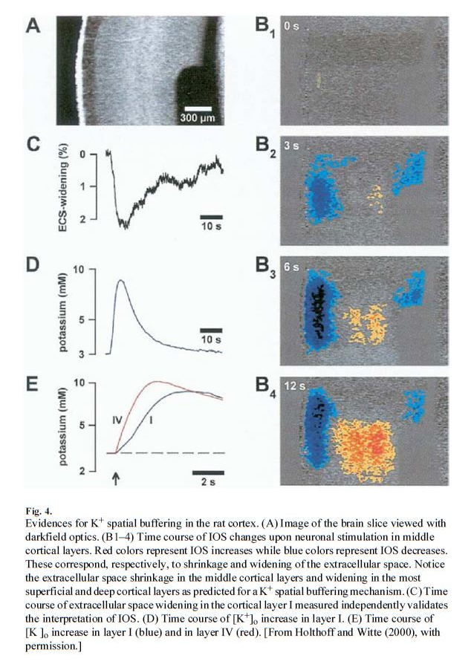
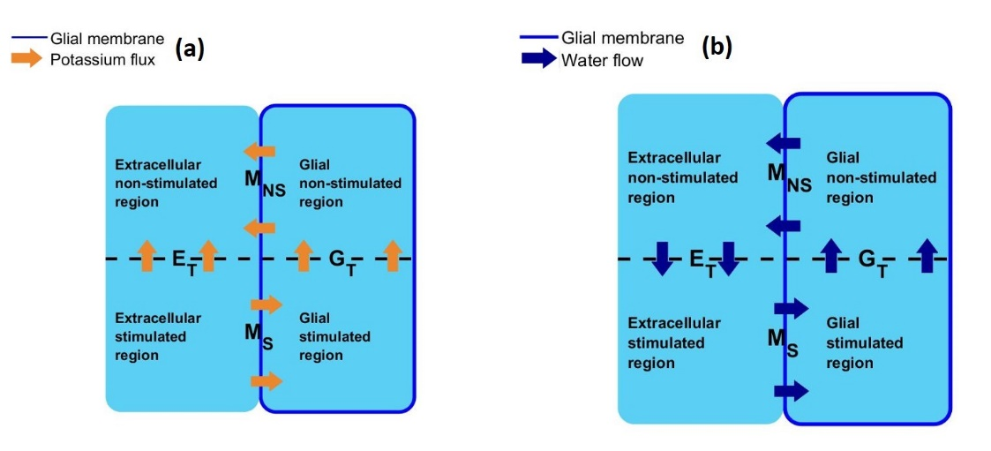
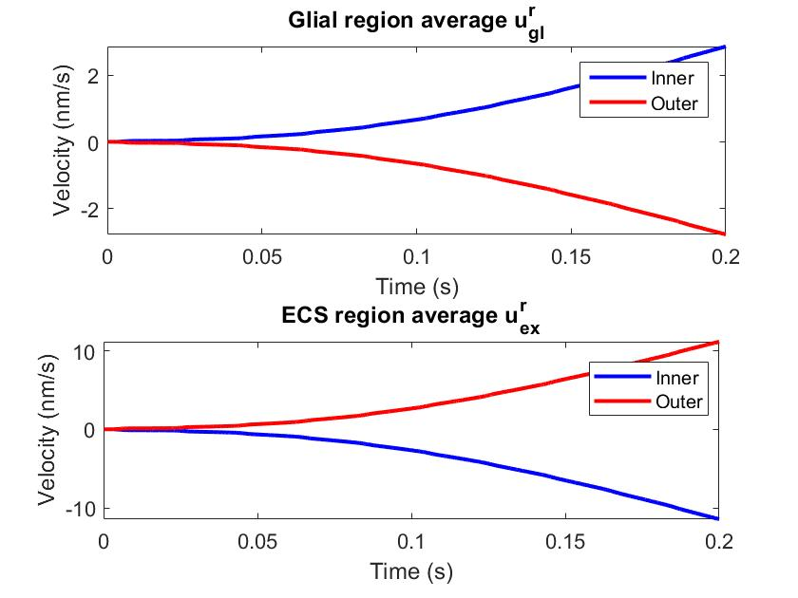
Potassium Clearance
POTASSIUM BUFFERING CENTRAL NERVOUS SYSTEM
Holthoff &Witte. Glia 2000;29:288–292
Brightening reports Shrinkage of the extracellular space
Darkening reports Swelling of the extracellular space (Fig. 1C)
Compartments are Derived

Slide 42
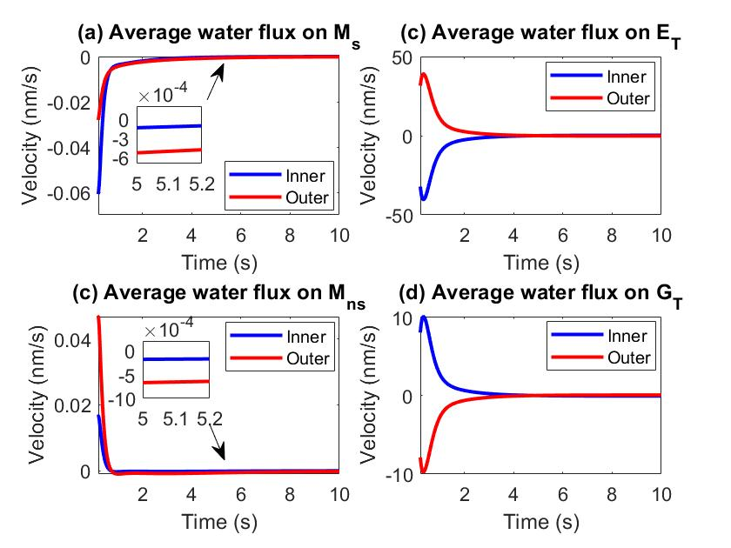
Potassium Clearance
Field Theory gives so much more detail, than you want to understand
Compartments are Derived
By Singular Perturbation Analysis
They are NOT assumed

Slide 43
Microcirculation: Potassium
Axon Stimulation moves extra potassium into the extracellular space
Nernst potential of $K^{+}$ in the stimulus region increases ($E_{k}>{\left[φ\right]}_{gl}$)
$K^{+}$ flows into glial compartments from extracellular space
Whole Glial compartment electric potential becomes more positive
In the non-stimulus region, $E_{k}<{\left[φ\right]}_{gl}$, $K^{+}$ flows out from glial compartment to extracellular space
Also in the extracellular space, $K^{+}$ flows from stimulus region to the non-stimulus region due to the diffusion
Compartments are Computed by PerturbationTheory, NOT assumed

Slide 44
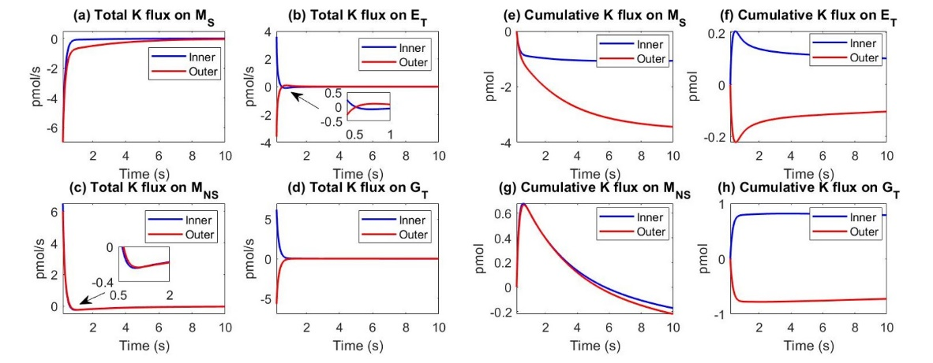
Potassium Clearance: Stimulus Region Effect
After axon firing period $\left[T_{sti}, T_{all}\right]$
Compartments are Derived
The main potassium clearance mechanism is the leakage from extracellular space to glial compartment through the glial membrane;
The potassium flux in extracellular region and glial compartment is negligible, i.e. both of them could be treated as a homogenous compartment;

Slide 45
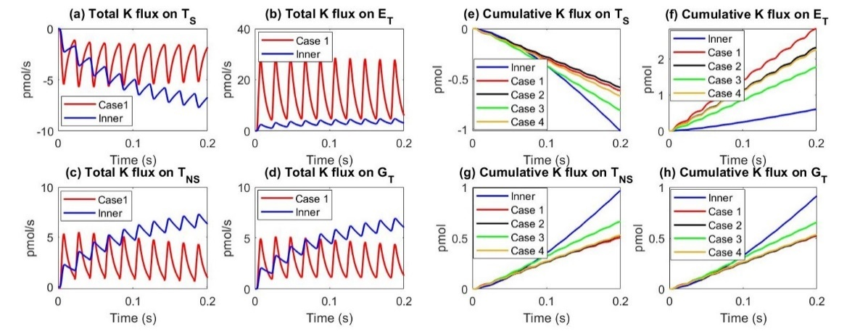
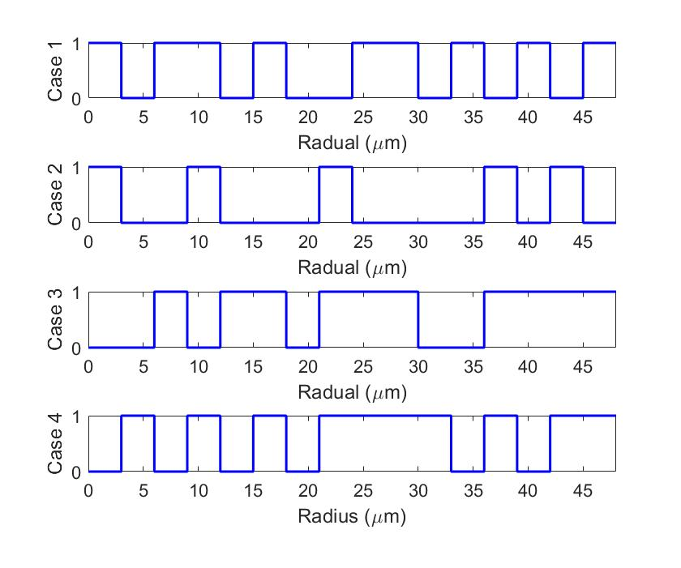
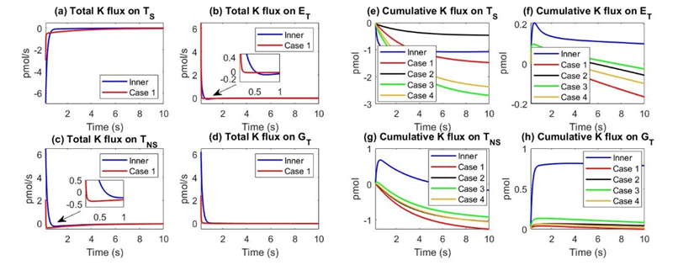
Potassium Clearance: Random (in space)
Sensitivity to Spatial Distribution
Model is a Framework that needs More Experimental data
Sometimes Detail is Surprising
Must be actually computed
for that reason. This detail is hard to capture robustly in compartment and engineering models.

Slide 46
Results Depend on Types and Locations of Channels and Transporters
Model can easily accommodate channel or transporters
in the detail established in future experiments
because
Model is a field theory with defined structure, Allowing any property or location of channels or transporters
Model is a Framework

Slide 47
Model is a FRAMEWORK
that can easily accommodate
Specialized Structure
Specialized Channels
Specialized Transporters
Structural Parameters Determined by Sructural Measurements

Slide 48
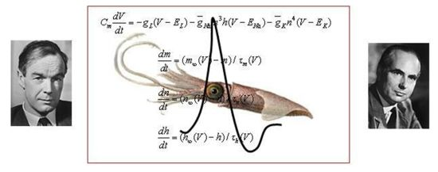
Mathematical Model of Action Potential
Ion concentration and electric potential
Mass conservation law
Local electroneutrality
Passive channel:
Potential dependent conductance on the axon membrane: Hodgkin-Huxley Model
Constant conductance on the glial cells' membrane: Ohm’s Law $\frac{g_{gl}^{i}}{z^{i}e}\left(φ_{gl}−φ_{ex}−E_{gl}^{i}\right)$
Nernst Potential $E_{gl}^{i}=\ln{\frac{C_{ex}^{i}}{C_{gl}^{i}}}$
$$\frac{∂(η_{gl}C_{gl}^{i})}{∂t}+ℳ_{gl}\left(a_{gl}^{i}+b_{gl}^{i}\right)+▽⋅\left(η_{gl}J_{gl}^{i}\right)=0$$
$\frac{∂(η_{ax}C_{ax}^{i})}{∂t}+ℳ_{ax}\left(a_{ax}^{i}+b_{ax}^{i}\right)+\frac{∂}{∂z}\left(η_{ax}J_{ax,z}^{i}\right)=0$
$$\frac{∂(η_{ex}C_{ex}^{i})}{∂t}−ℳ_{ax}\left(a_{ax}^{i}+b_{ax}^{i}\right)−ℳ_{gl}\left(a_{gl}^{i}+b_{gl}^{i}\right)+▽⋅\left(η_{ex}J_{ex}^{i}\right)=0$$
$η_{gl}\sum_{i}{‍}z^{i}C_{gl}^{i}+z^{gl}A_{gl}η_{gl}^{re}=0,$ $η_{ax}\sum_{i}{‍}z^{i}C_{ax}^{i}+z^{ax}A_{ax}η_{ax}^{re}=0,$ $\sum_{i}{‍}z^{i}C_{ex}^{i}=0,$

Slide 49
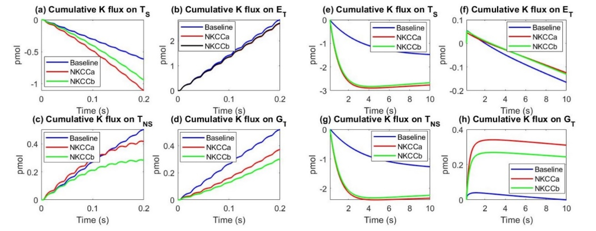
$Na^{+}$/$K^{+}$/$Cl^{−}$ NKCC transporter Potassium Clearance
$J_{NKCC}^{K}=−\frac{I_{max}^{NKCC}}{ez^{K}}\log\left(\frac{C_{ex}^{K}}{C_{gl}^{K}}\frac{C_{ex}^{Na}}{C_{gl}^{Na}}{\left(\frac{C_{ex}^{Cl}}{C_{gl}^{Cl}}\right)}^{2}\right)$ ,
$J_{NKCC}^{Na}=−\frac{I_{max}^{NKCC}}{ez^{Na}}\log\left(\frac{C_{ex}^{K}}{C_{gl}^{K}}\frac{C_{ex}^{Na}}{C_{gl}^{Na}}{\left(\frac{C_{ex}^{Cl}}{C_{gl}^{Cl}}\right)}^{2}\right)$,
$J_{NKCC}^{Cl}=2\frac{I_{max}^{NKCC}}{ez^{Cl}}\log\left(\frac{C_{ex}^{K}}{C_{gl}^{K}}\frac{C_{ex}^{Na}}{C_{gl}^{Na}}{\left(\frac{C_{ex}^{Cl}}{C_{gl}^{Cl}}\right)}^{2}\right)$.
With the help of $Na^{+}$/$K^{+}$/$Cl^{−}$ NKCC transporter, more potassium goes through the glial membrane in the simulated region during axon firing.

Slide 50
Potassium Clearance: NKCC transporter
With the NKCC model, the potassium decays at a much faster rate than in the baseline model.
However, the quicker potassium taken into glial compartment by the NKCC leads the slower stimulated axon compartment potassium concentration back to resting state.

Slide 51
More Details: Microcirculation: Ion
The potassium variation ($δC_{ex}^{K}$) in the extracellular
$$\frac{ d{(η}_{ex}δC_{ex}^{K})}{dt}=−\left(λ_{gl}^{m,K}+λ_{ex}^{K}\right) δC_{ex}^{K}$$
$$δC_{ex}^{K}\left(iT\right)=δC_{ex}^{K}\left(iT\right)+δC_{sti}, i=0,1⋯$$
The sodium variation $(δC_{ex}^{Na})$ in the extracellular region
$\frac{ d{(η}_{ex}δC_{ex}^{Na})}{dt}=− λ_{ex}^{Na,1}δC_{ex}^{Na}+λ_{ex}^{Na,2}δC_{ex}^{K}$,
$$δC_{ex}^{Na}\left(iT\right)=δC_{ex}^{Na}\left(iT\right)−δC_{sti}, i=0,1⋯$$
The Chemical Potential of Water (osmotic ‘pressure’) variation $(δO_{ex})$ in the extracellular region
$$δO_{ex}=2(δC_{ex}^{K}+δC_{ex}^{Na})$$
Where $T$ is firing period, $λ_{ex}^{K}$ describes the spatial effect of the extracellular communication between stimulated region and non-stimulated region, $λ_{gl}^{m,K}$ describles the effect of glial transmembrane flux, $λ_{ex}^{Na,1}$ describes the spatial effect of the extracellular communication between stimulated region and non-stimulated region, and$λ_{ex}^{Na,2}$describles the effect of electric drift in the extracellular space

Slide 52
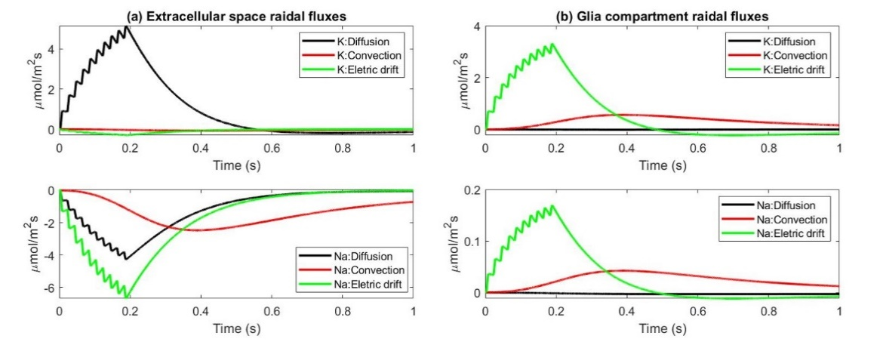
Microcirculation: Convection
Extracellular space:
$K^{+}$: diffusion flux dominates
$Na^{+}$: same order
Qualitative Conclusions are from MATHEMATICAL Perturbation Analysis.
They are NOT verbal vagueries.

Slide 53
Conclusions Field Theory of Glymphatic Flow
A tridomain model is developed to understand the microcirculation in the optic nerve and the potassium clearance mechanism.
Main pathway is Convection Through Glia driven by electrochemical diffusion and migration of ions and water in axon and extracellular space
The electrical syncytium property of the glial cells is critical for clearing potassium during nerve activity.
Spatial distribution of pumps and channels can be included as they are discovered. Likely to have large effects. New Experiments Needed
This is a RESUT derived from a field theory of glymphatic flow without arbitrary compartments or simplifications. It is derived NOT assumed.

Slide 54
Speculations and Future Work
Do Localized Pumps Produce Increased Clearance ?
Can Blood Vessels be included making a Four Domain Model?
Can model account for Sleep Cleansing by up-regulation of localized pumps?
Is the Glymphatic Hypothesis of Sleep Cleansing correct?

Slide 55
Questions ?

Slide 56
Scientists and Poets can Reach
for something
but
Engineers must Grasp and not just reach for it if
Devices are to Work
Uncalibrated Devices do not Work!
Poets
create beauty by mixing dreams and realities
“Ah, … a man's reach should exceed his grasp, Or what's a heaven for?”
Robert Browning
"Andrea del Sarto", line 98

Slide 57
Extra Slides

Slide 58
Inconsistent Models produce confusion even when correct
Mathematics
replaces Inconsistent Models Models with Consistent Partial Differential Equations and boundary conditions

Slide 59
We begin at the beginning:
Ionic Solutions are Complex Fluids
in which ‘everything interacts with everything else’
and
Flows are driven by convection, and diffusion.
Shixin Xu, Eisenberg, Song, and Huang (2018) arXiv:1806.00646, 35 pages.

Slide 60
Our Contributions
are to Derive Consistent Field Equations and Solve Them
Multiple Fields are Hard to Deal with Consistently without Variational Methods
(in engineering models or computations)
A great deal of confusion can result
from nonmathematical reasoning
Including paradoxes

Slide 61
Mathematics Creates our Standard of Living*
Partial Differential Equations are needed to describe Flow driven by multiple fields
*e.g., Electricity, Computers, Fluid Dynamics, Optics, Structural Mechanics, …..

Slide 62
Bulk Solutions and Membranes are described by Consistent Analysis of Coupled Water and Ionic Diffusion and Flow
The Energy Variational Principle and Sharp Boundary Methods have been applied to a variety of membrane models, allowing density of solutions to be a function of concentrations, as is seen every day in chemistry laboratories apparently for the first time
Unfortunately, so far, analysis has only been performed for ideal solutions.
Challenge
No one seems to know how to formulate coupled water and ion flow and diffusion,
in the realistic nonideal case found in biology and electrochemistry
NOT equilibrium, not ideal, must deal with saturation and finite size ions
Shixin Xu, Eisenberg, Song, and Huang (2018) arXiv:1806.00646, 35 pages.

Slide 63
Challenge
No one seems to know how to formulate coupled water and ion flow and diffusion,
in the realistic nonideal case found in biology and electrochemistry
NOT equilibrium, not ideal, must deal with saturation and finite size ions.
Suggestion: Combine EnVarA with Poisson Fermi approach of Jinn Liang Liu, more than anyone else

Slide 64
Field Equations are Needed of the Whole Optic Nerve
EVERYTHING INTERACTS WITH EVERYTHING ELSE
Models of just one part of the system
Ignore membrane flows and interactions
that can dominate properties
Every scientist is sure their ‘one part’ is the right one.
Models with ARBITRARY compartments, that are not derived,
lead to more discussion than insight:
Every scientist is sure their compartments are right,
but none of their compartments are robust.

Slide 65
Single action potential estimation
Axons:
Membrane potential variation is dominant and driven by stimulus
the total axon transmembrane ${Na}^{+}$ and$K^{+}$ flux are same in the leading order
the variation of extra cellular $K^{+}$ concentration is around $0.12 mM$
Glial Cells
On the glial membrane, $K^{+}$current is the dominant one
Stimulus region: $K^{+}$ leaks form extracellular space to glial compartment
Nonstimulus region: $K^{+}$ leaks form glial compartment to extracellular space

Slide 66
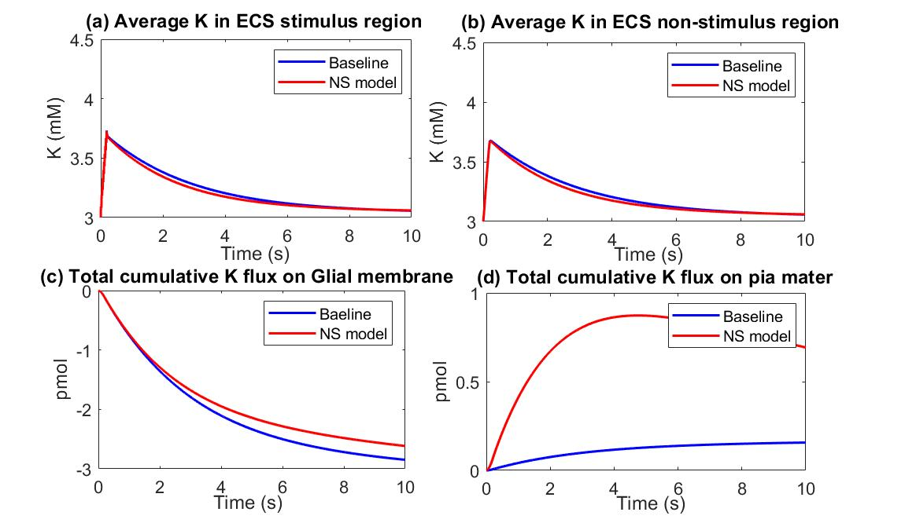
Potassium Clearance in outermost Shell, Pia Mater
Assume the water fluid goes through the non-selective pathway only depends on the hydro pressure difference
$u_{pia}^{m}=$ $L_{pia}^{m}\left(P_{ex}^{OP}−P_{ex}^{sas}−γ_{pia}k_{B}T\left(O_{ex}^{OP}−O_{ex}^{sas}\right)\right), u_{pia}^{ns}=L_{pia}^{ns}{(P}_{ex}^{OP}−P_{ex}^{sas})$.
The non-selective pathway between the cell clefts provides the additional pathway for diffusion, electric drift as well as convection for ions
$$J_{ex}^{i,OP}⋅\hat{r}=J_{ex}^{i,SAS}⋅\hat{r}=\frac{G_{pia}^{i}+G^{ns}}{z^{i}e}\left(φ_{ex}^{OP}−φ_{ex}^{SAS}−E_{pia}^{i}\right)+ C_{ex}^{i}u_{pia}^{ns}, i=Na^{+}, K^{+}$$
The amount of potassium leak out of the optic nerve through the pia boundary has dramatically increased in comparison with the baseline model. However, the dominate pathway of potassium clearance is still through the glial membrane part due to the contact area.

Slide 67
Potassium Clearance: Stimulus Region Effect
Stimulus region
Inner region $\left[0,\frac{r^{∗}}{2}\right]×\left[0,L\right]$
Outer region $\left[\frac{r^{∗}}{2},r^{∗}\right]×\left[0,L\right]$
Transition region $r=\frac{r^{∗}}{2}$
Time period
Axon firing period $\left[0,T_{sti}\right]$
After firing period $[T_{sti},T_{all}]$
$T_{sti}=0.2s$ and $T_{all}=10s$
Outer region
Inner region

Slide 68
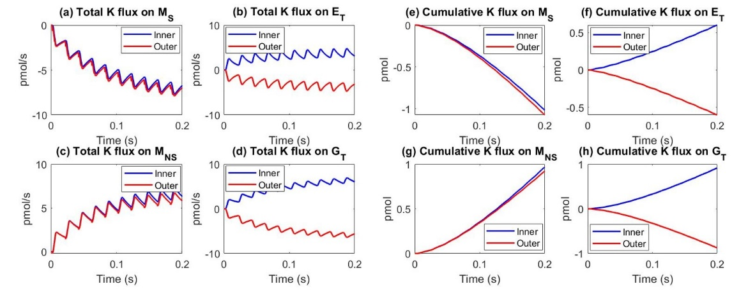
Potassium Clearance: Stimulus Region Effect
During axon firing $[0, T_{sti}]$
Both Glial compartment and ECS help potassium clearance. Glial compartment is more important.

Slide 69
Osmosis through a Semi-permeable Membrane a Consistent Approach to Interactions arXiv:1806.00646
Shixin Xu
Zilong Song
Huaxiong Huang
A Bidomain Model for Lens Microcirculation
Biophysical Journal (2019) 116: p. 1171-1184
Yi Zhu
Shixin Xu
Huaxiong Huang

